Slide 1
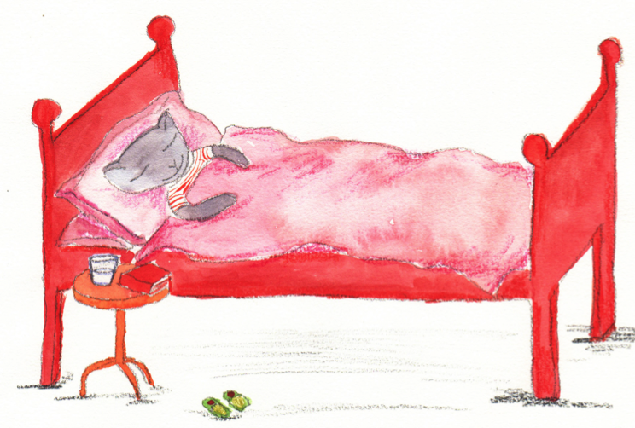
Tense Past and present: simple and progressive
Notes:
All these slides are based on the teaching outlined in the document ‘Teaching_1_Pronouns’ available from Hamilton.
It is essential to read the teaching before using this powerpoint presentation.

Slide 2
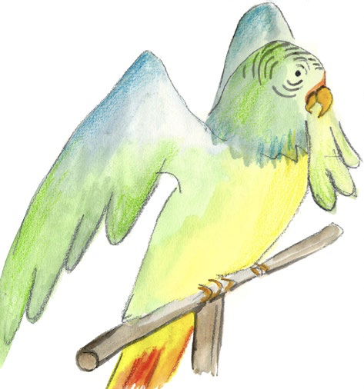
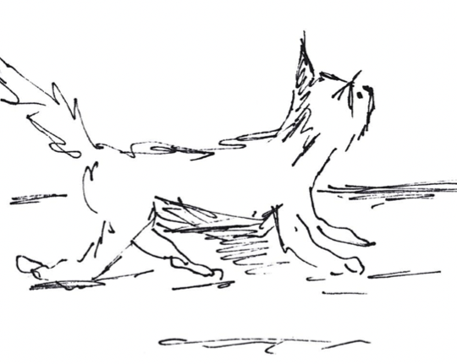
Verbs
Verbs indicate that someone or something is
doing, feeling or being.
The parrot squawked.
The cat stalks the parrot.
A girl shouts a warning.
The parrot escaped!
Usually verbs have the name of a person, thing or a pronoun in front of them.
Revision

Slide 3
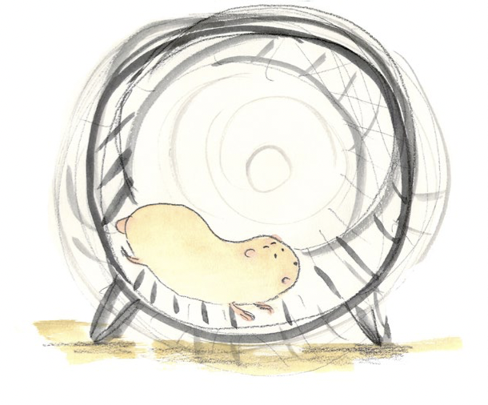
Verbs have a tense.
They tell us when the action happened.
In the past,
In the present,
or, in the future.
The hamster ran in his wheel.
The hamster will run in his wheel.
The hamster runs in his wheel.

Slide 4
Past tense
Stories are mostly told using past tense.
They tell us what happened (in the past).
He got it in the past.
A boy called George had a new bed.
He loved his bed because it took him on trips.
One night, as George lay in his bed…
The story tells us what has already occurred.
All the verbs are past tense

Slide 5
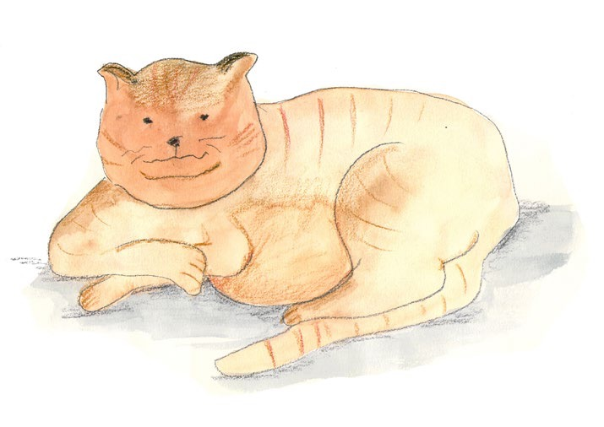
Past tense.
We can spot two forms.
Simple past
Progressive past
George lay in his bed.
George was lying in his bed.
Progressive is very useful when we want to suggest that the action happens over a period of time.
George was lying in his bed when his pet cat jumped up.
We often use the progressive when something happens whilst something else is going on.

Slide 6
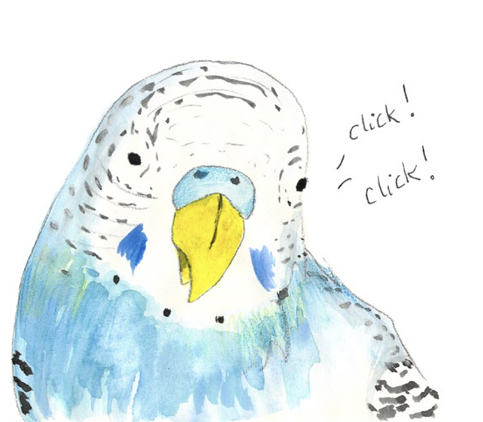
Past Tense
Think of something that happened during this action.
Using the progressive form
My budgie perched on the end of my bed.
was perching
My budgie was perching on the end of my bed.
My budgie was perching on the end of my bed when my mum came in.
The progressive form suggests that something lasts for a while
The budgie looked around.
The budgie was looking around.
The budgie was looking around while my mum talked.

Slide 7
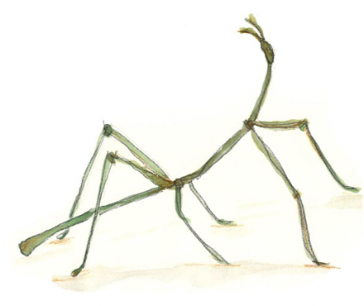
Past Tense
Turn the verbs into the progressive form
Simple past tense | Progressive form
His stick insect stood still.
His stick insect was standing still.
That’s because it’s a quick action! It doesn’t happen over a long time.
It hid itself cleverly.
It was hiding itself cleverly.
She had trouble seeing it.
She was having trouble seeing it.
Then it jumped!
Then it was jumping!
Which one sounds wrong?

Slide 8
Present tense
Book reviews nearly always use the present tense.
They are written about what we feel now.
I really enjoy The Magic Bed.
I am enjoying the book now.
The illustrations make it an attractive read.
I especially like the part where…
The review gives our current opinions – the things we think at the moment.
All the verbs are present tense

Slide 9
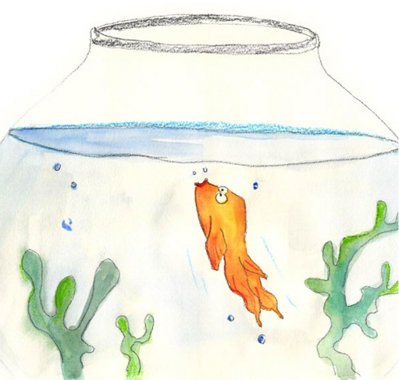
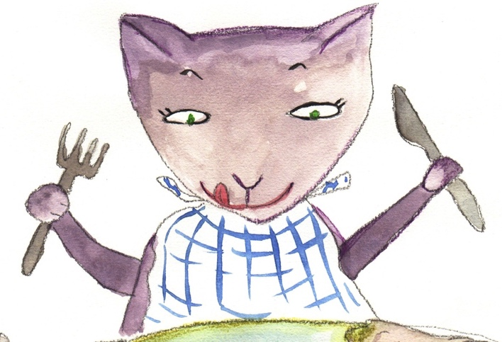
Present tense.
We can spot two forms.
Simple present
Progressive present
The goldfish swims upwards.
The goldfish is swimming upwards.
Remember!
It is swimming at the surface as the cat jumps on the table.
Progressive is very useful when we want to suggest that the action happens over a period of time.
We often use the progressive when something happens whilst something else is going on.

Slide 10
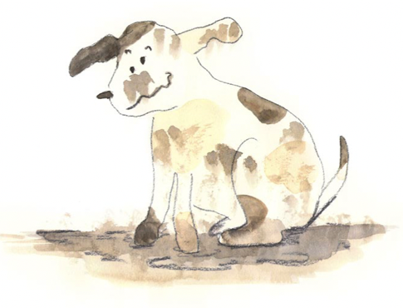
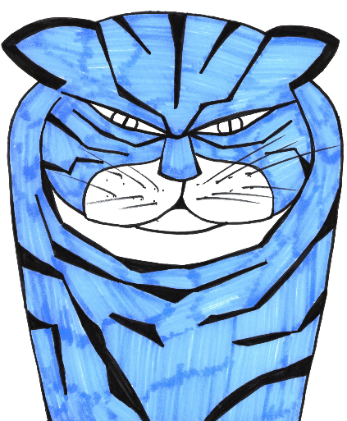
Present tense
Think of something that happened during this action.
Using the progressive form
My puppy plays in the mud.
is playing
My puppy is playing in the mud.
My puppy is playing in the mud when the cat goes past.
The cat stares.
The cat is staring.
The cat is staring as my puppy is playing.
These things last for a while

Slide 11
Present tense
Turn the verbs into the progressive form
Simple past tense | Progressive form
Polly sits on her perch.
Polly is sitting on her perch.
That’s because it’s a quick action! It doesn’t happen over a long time.
She squawks to herself.
She is squawking to herself.
She stretches her wings.
She is stretching her wings.
Then she flies off!
Then she is flying off!
Which one sounds wrong?

Slide 12
Present and past tenses
We can use a simple form or a progressive form
Turn each verb into the progressive form
He was loving his new bed.
He loved his new bed.
Say if it is present or past
I am really enjoying the story.
He lay in the bed.
I really enjoy the story.
He was lying in the bed.
We are listening.
We listen.
The bed was flying off.
The bed flew off.
Now check your answers.
Blue = present
Pink = past
My teacher is reading it really well.
My teacher reads it really well.

Slide 13
End

