Slide 1
Learning Objective
Differentiate the three types of neurones
Categorise voluntary from involuntary actions
Explain the structure and function of a synapse

Slide 2
COORDINATION AND RESPONSE

Slide 3
STIMULUS AND RESPONSE
STIMULUS- change in the organism’s environment
RESPONSE-reaction to the change
e.g. You smell food and your mouth starts to ‘water’ or secrete saliva

Slide 4
Sequence of events
STIMULUS
RECEPTOR
COORDINATION
EFFECTOR
RESPONSE

Slide 5
Central nervous system (CNS)
BRAIN- protected by the skull and has cranial nerves
SPINAL CORD-protected by the spinal column having spinal nerves

Slide 6
PERIPHERAL NERVOUS SYSTEM
NERVES – send information from receptors to effectors
RECEPTORS- often part of a sense organ

Slide 7
REFLEX ACTION
Is a quick, automatic (involuntary) response to a stimulus
The action often protects the body
E.g. Knee jerk reflex or iris reflex

Slide 8
Reflex arc

Slide 9
NEURONES OR NERVE CELL
Sensory neurones- nerves that pass impulses from receptors until they reach the CNS
Relay neurones- pass and relay impulse to other neurones
Motor neurones- transmitting impulses from the CNS to the muscles and glands

Slide 10
MOTOR NEURONE

Slide 13
REFLEX ARC IN YOUR HAND

Slide 14
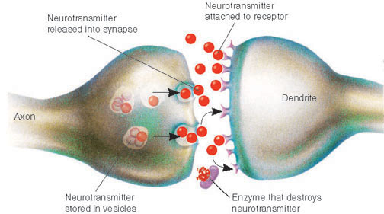
synapses
The ends of the two neurones on either side of the cleft, plus the cleft itself
A gap is called synaptic cleft
Vesicles secrete chemicals called neurotransmitter

Slide 15
Learning Objective
Construct the structure of the eye
Discuss the function of the parts of the eyes

Slide 16
SENSE ORGANS
Group of receptor cells responding to specific stimuli: light, sound, touch, temperature and chemicals
Eye
Ear
Nose
Tongue
Skin

Slide 17
The eye
Sclera- tough outer coat of the eye which is the white part
Cornea- front of the eye the sclera becomes a transparent window that lets light into the eye
Iris- behind the cornea is the coloured ring of tissue
Pupil-middle of the iris which lets the light through; black because there is no light escaping from the inside of the eye

Slide 18
The eye
Orbit- bony socket in the skull that supports the eye
Conjunctiva- a thin, transparent membrane that covers the front of the eye
Tear glands- keeps the eye moist
Lysozyme-enzyme found at the fluid that kills bacteria

Slide 19
Horizontal section of the eye

Slide 20
THE EYE
Choroid- a dark layer underneath the sclera; contains pigment cells as well as blood vessels
Retina- the receptor cell found at the innermost layer of the back of the eye; where light energy is converted into electrical energy of nerve impulses
>Rods- works well in dim light
>Cones-only work in bright light (red, green, blue)
Fovea- at the centre of the retina where cones are concentrated

Slide 21
Blind spot
Area of retina where image cannot be formed
Where the optic nerves leaves the eye
No rod or cones
Both eyes has a blind spot, but the brain puts the images from each eye together, cancelling the blind spots

Slide 22
Learning Objective
Explain how the eye adjusts the focusing of light
State how rod and cones provide night vision and colour vision
Discuss the iris reflex

Slide 23
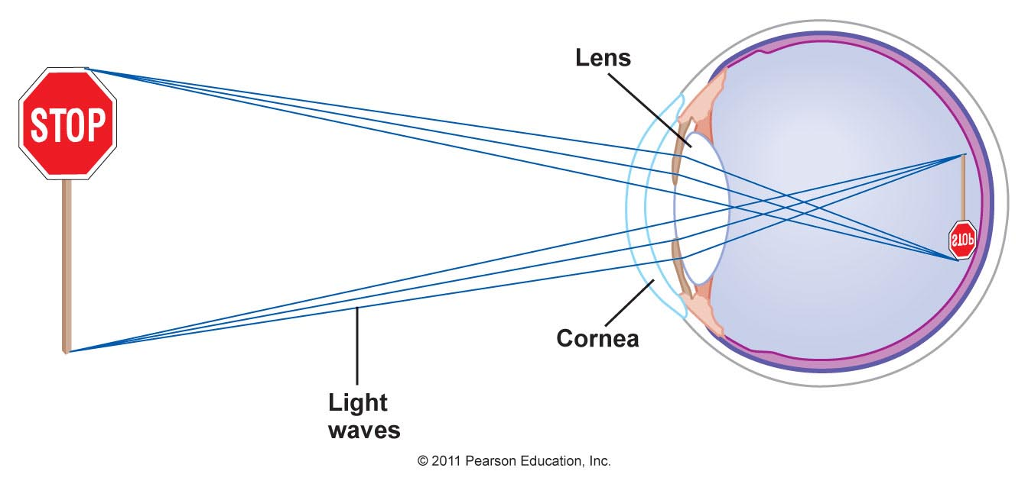
FORMING AN IMAGE
Light is bent or refracted at the cornea and lens, thus the image on the retina is inverted (upside down). The brain interprets the image the right way up.

Slide 24
The iris reflex (IRIS AND PUPIL)

Slide 25
overview
Stimulus (light intensity)
Retina (receptor)
Sensory neurones in optic nerve
Unconscious part of brain
Motor Neurones in nerve to iris
Iris muscles (effector)
Response (change in size of pupil)

Slide 26
accommodation
Changes that take place in the eye which allows us to see objects at different distances
Shape of the lens change
A lens that is fatter in the middle (more convex) will refract more light rays than a thinner lens (less convex)

Slide 27
Accommodation (cornea AND LENS)

Slide 28
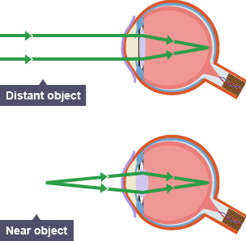
WORKBOOK PAGE 87
Describe how the changes shown are brought about. Use these words in your description:
Ciliary muscles, lens, suspensory ligaments

Slide 29
WORKBOOK PAGE 87
2. Accommodation in the eye is a reflex action. a. Explain what is meant by reflex action.
b. Suggest what could be the stimulus that brings about reflex action.
3. As people get older, their lenses become less able to change shape. Suggest how this may affect their vision.

Slide 30
Sources: Cambridge IGCSE Biology Coursebook
Edexcel IGCSE Biology (Pearson)
Images from Google
https://www.youtube.com/watch?v=U_DGmQq75SA
https://pmgbiology.com/2015/02/18/nerve-cells-and-synapses-a-understanding-for-igcse-biology/
http://slideplayer.com/slide/8543369/
https://www.quora.com/What-is-the-difference-between-sensory-neuron-and-a-motor-neuron
https://socratic.org/questions/explain-the-reflex-arc-with-diagram
https://ehumanbiofield.wikispaces.com/Neurons
http://academia.hixie.ch/bath/eye/home.html
http://mindseyejennifer.blogspot.qa/2015/08/week-3-refraction-of-light.html
https://www.slideshare.net/j3di79/chapter-14-the-human-eye-lesson-3-the-2-mechanisms-of-the-eye-1-accommodation-and-2-pupil-reflex
http://biology-igcse.weebly.com/-accommodation.html
http://studyinggcsebio.blogspot.com/2016/04/288-understand-function-of-eye-in.html

