Slide 1
CHROMOSOMES, GENES AND proteins

Slide 2
Our genetic make-up
BODY
CELL (nucleus)
CHROMOSOME
DNA (deoxyribonucleic acid)

Slide 3
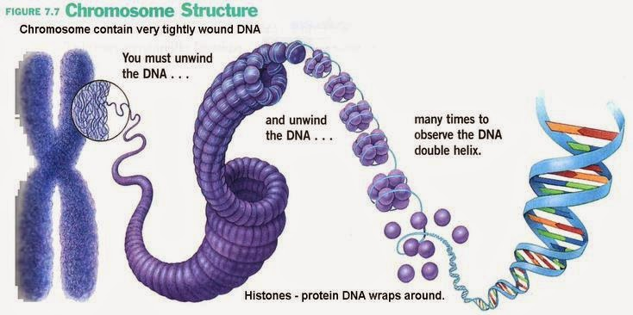
Structure of Chromosomes
http://biology4alevel.blogspot.qa/2014/09/29-dna-structure.html

Slide 4
KEY WORDS
chromosome: a length of DNA, found in the nucleus of a cell; it contains genetic information in the form of many different genes
DNA: a molecule that contains genetic information, in the form of genes, that controls the proteins that are made in the cell
gene: a length of DNA that codes for one protein alleles: alternative forms of a gene

Slide 5
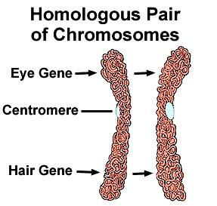
Homologous CHROMOsOMES
Pairs of matching chromosomes
Carry genes for the same features and arranged at the same positions and sequence along the chromosome
https://www.enotes.com/homework-help/what-homologous-pair-467303

Slide 6
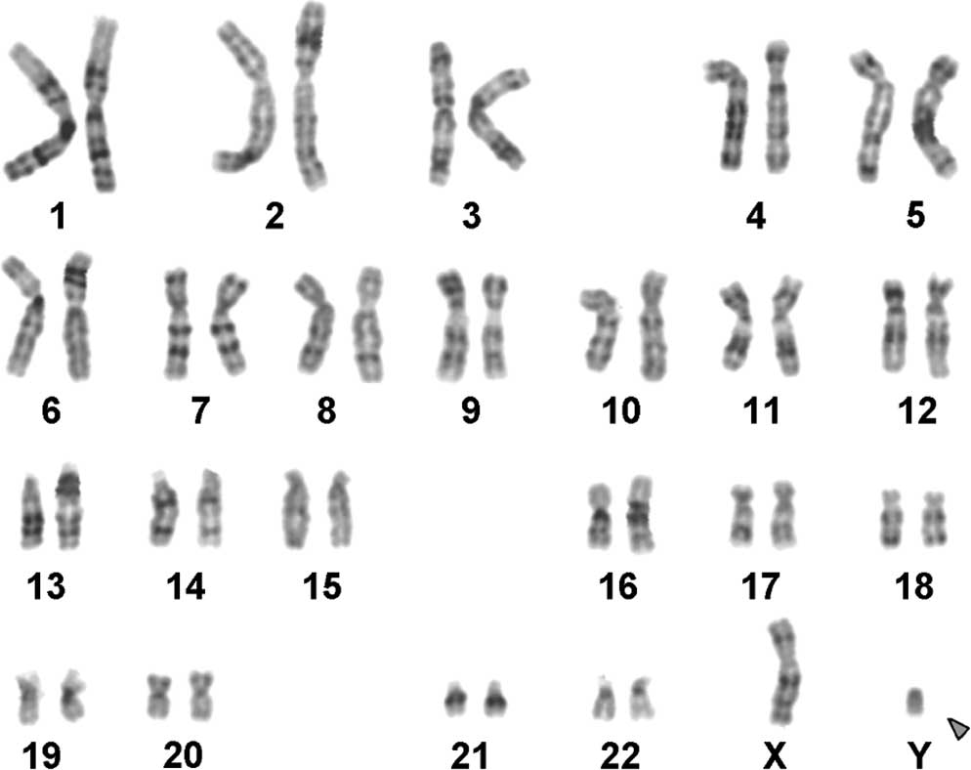
Male karyotype
https://www.spandidos-publications.com/mmr/6/2/293

Slide 7
Diploid Cells –cells with chromosomes in pair
(46 chromosomes)
-Male: 22 pairs and two chromosomes that do not form a pair
-Female: 23 pairs
Haploid Cells- cells with only half the diploid number of chromosomes (23 chromosomes)
- has one chromosome from each homologous pair, and one of the sex hormones
Zygote- a diploid cell formed when two gametes fuse in fertilisation

Slide 8
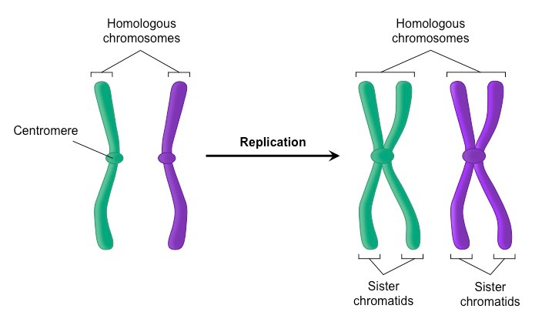
Before mitosis…

Slide 9
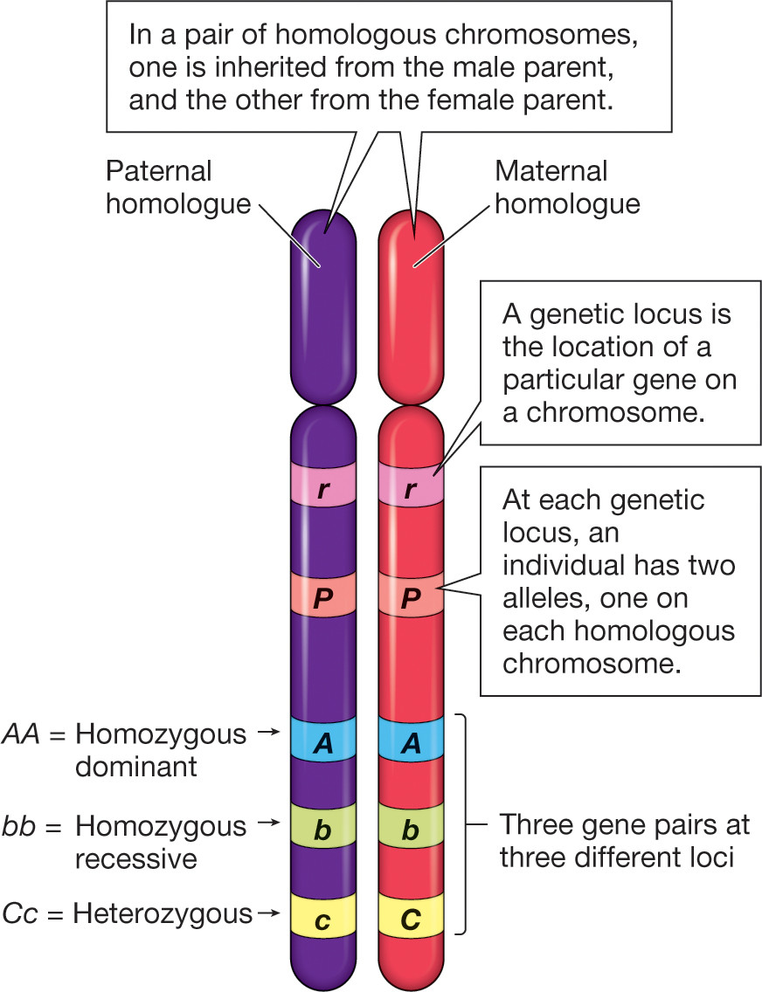
ALLELES
alternative forms of a gene which give rise to different inherited characteristics
https://biology.stackexchange.com/questions/59287/what-are-homologous-chromosomes

Slide 10
Sources: Edexcel IGCSE Biology (Pearson)
Cambridge IGCSE Biology Coursebook 2nd ed.
Biology for Cambridge IGCSE Coursebook 4th ed
Images from Google

