Slide 1
Multiplication and Division
Begin to understand multiplication as sets and recognise patterns
Objectives
Day 1
Count in 10s and 2s. Recognise and describe patterns.
Day 2
Count in 10s. Begin to understand multiplication as repeated addition.
Notes:
Before teaching, be aware that:
On Day 1 you can also use Number grid ITP to model the patterns.

Slide 2
Multiplication and Division
Begin to understand multiplication as sets and recognise patterns
Starters
Day 1
Count in 2s (pre-requisite skills)
Day 2
Count in 10s (simmering skills)
Notes:
Choose starters that suit your class by dragging and dropping the relevant slide or slides below to the start of the teaching for each day.

Slide 3
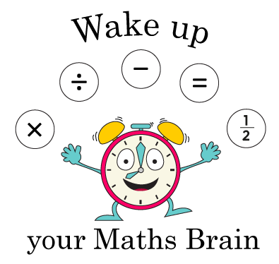
Multiplication and Division
Begin to understand multiplication as sets and recognise patterns
Starter
Count in 2s
Notes:
Pre-requisite skills – to use this starter, drag this slide to the start of Day 1
Highlight 2 on Number grid ITP. What is 2 more? Highlight 4. Repeat, highlighting 6. How many are we adding each time? Ask children to say the next numbers until you reach 20. Then use the highlighted numbers to count in 2s.

Slide 4
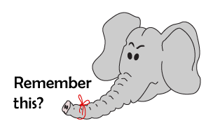
Multiplication and Division
Begin to understand multiplication as sets and recognise patterns
Starter
Count in 10s
Notes:
Simmering skills – to use this starter, drag this slide to the start of Day 2
Throw a soft ball to a child and say 10! They throw the ball to another child and say 20! That child throws to another child and says 30! Continue until you reach at least 100. Repeat, starting with a different child each time, ensuring all children have at least two turns.

Slide 5
Multiplication and Division
Begin to understand multiplication as sets and recognise patterns
Objectives
Day 1
Count in 10s and 2s. Recognise and describe patterns.

Slide 6
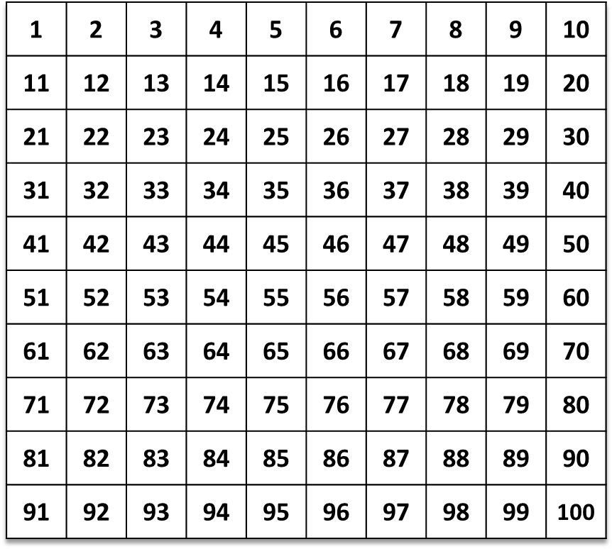
Day 1: Count in 10s and 2s; Recognise and describe patterns.
Let’s count in 10s…
What do you notice about the multiples of 10?
Multiples of 10 always end with a zero!

Slide 7
Day 1: Count in 10s and 2s; Recognise and describe patterns.
Let’s read some numbers…
23
60
87
120
346
910
Which of these are multiples of 10?
How can you tell?
Multiples of 10 always end in a zero...

Slide 8
Day 1: Count in 10s and 2s; Recognise and describe patterns.
What do you notice about the multiples of 2?
Multiples of 2 always end with either a
0, 2, 4, 6 or 8!
Is 80 a multiple of 2? How do you know?
Is 35 a multiple of 2? How do you know
Is 91 a multiple of 2? How do you know?
They are all even numbers!
Is 53 a multiple of 2? How do you know?

Slide 9
Day 1: Count in 10s and 2s; Recognise and describe patterns.
Let’s look at our list of numbers…
23
60
87
120
346
910
Which of these are multiples of 2?
How can you tell?
Can you think of some more large numbers that are definitely
multiples of 2?

Slide 10
Day 1: Count in 10s and 2s; Recognise and describe patterns.
Multiples of 10 are now in 2 colours!
What can you say about all multiples of 10?
All multiples of 10 are also multiples of 2!

Slide 11
Day 1: Count in 10s and 2s; Recognise and describe patterns.
Can you predict the number I’m going to click on next? What’s my pattern?
Write the next 3 numbers in the sequence on your
whiteboards.
Let’s check…

Slide 12
Day 1: Count in 10s and 2s; Recognise and describe patterns.
If I can carry on, will I get to 57? 82? Explain…
Let’s check…

Slide 13
Day 1: Count in 10s and 2s; Recognise and describe patterns.
How can you describe this counting pattern? Which three numbers will be next?
What do you notice about all the numbers in the pattern?
If we continue will 21 and 38 be highlighted? How do you know?
Let’s check…
They are all odd numbers!
Let’s check…
Notes:
Today would be a great day to use a problem-solving investigation – Clapping Times – as the group activity, which you can find in this unit’s IN-DEPTH INVESTIGATION box on Hamilton’s website.
Alternatively, children can now go on to do differentiated GROUP ACTIVITIES. You can find Hamilton’s group activities in this unit’s TEACHING AND GROUP ACTIVITIES download.
WT/ ARE: Continue number patterns, using knowledge and understanding of counting in 2s and 10s.
GD: Investigating statement about multiples.

Slide 14
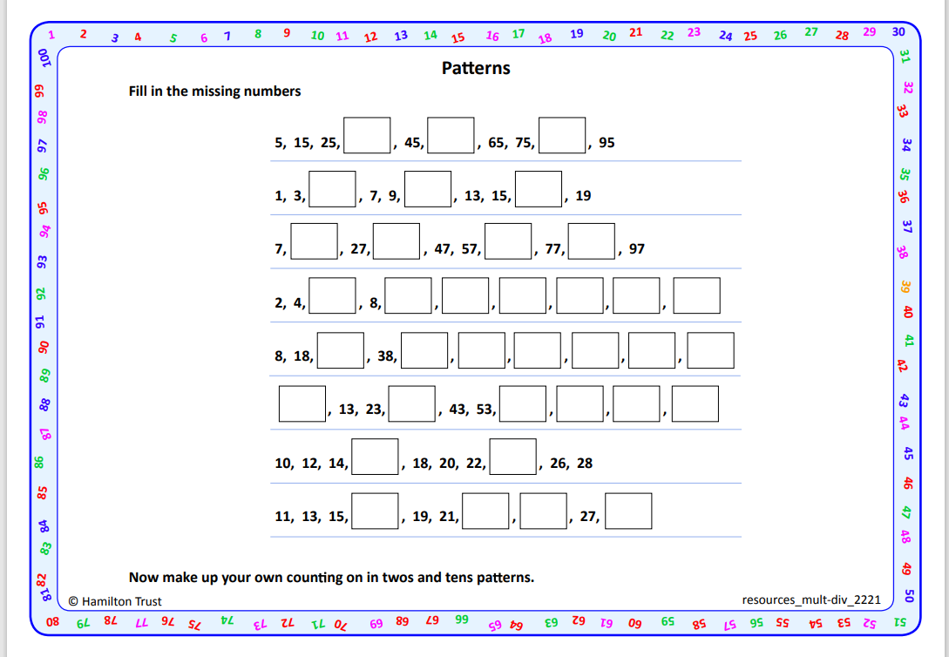
Task 1 – Pair/Group Work
Work in pairs to complete ‘Patterns’ (see resources). Describe the pattern to each other.
Afterwards, make up your own counting on in 10s or 2s pattern and see if your partner can continue it.

Slide 15
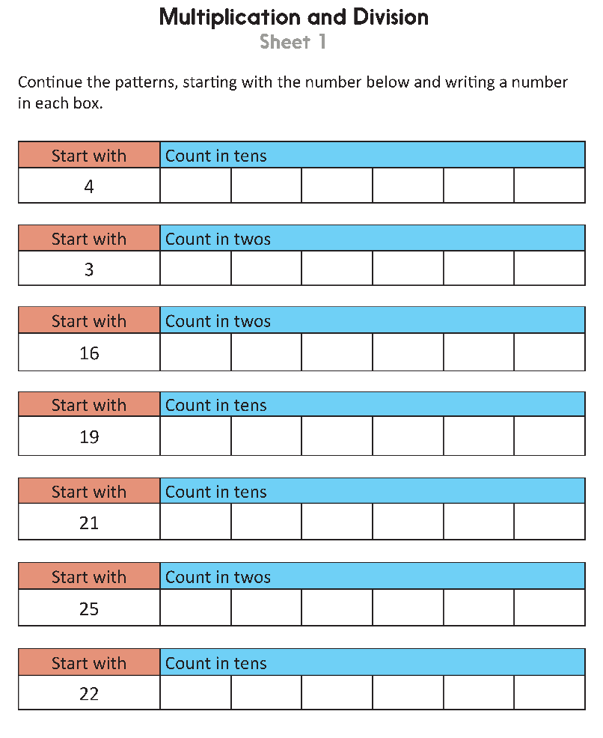
Task 2 – Independent Work
Challenge
Notes:
The Practice Sheet on this slide is suitable for most children.
Differentiated PRACTICE WORKSHEETS are available on Hamilton’s website in this unit’s PROCEDURAL FLUENCY box.
WT: Multiplication and Division Sheet 1, allow children to use 1-100 grid.
ARE: Multiplication and Division Sheet 1.
GD: Multiplication and Division Sheet 2.

Slide 16
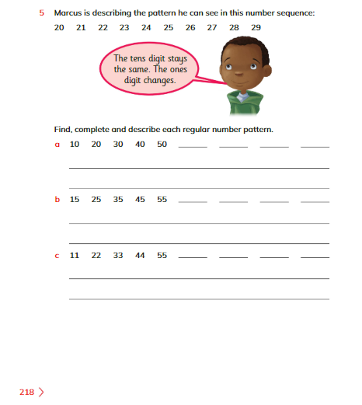
Plenary
Solve Q5 on page 218, Learners book and discuss with your partner.

Slide 17
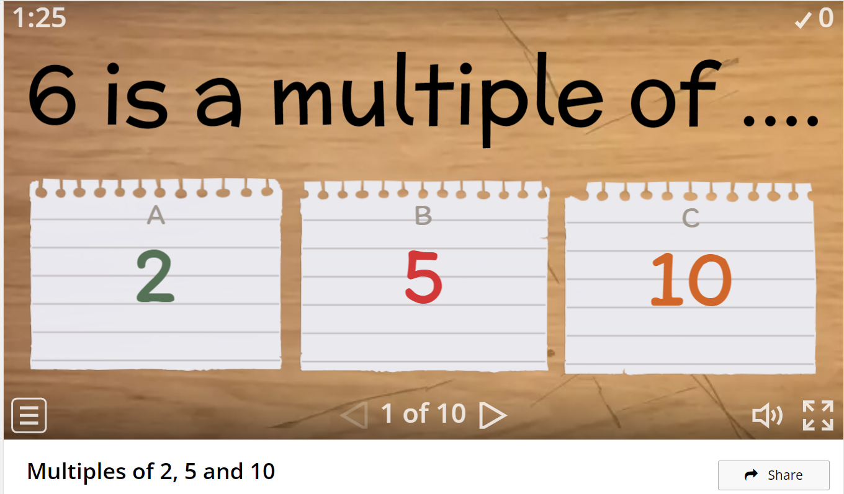
Homework
Play https://wordwall.net/resource/13422392/multiples-of-2-5-and-10

