Slide 1
Measures
Tell the time to ¹/₄ hour
Begin to tell to 5 mins
Objectives
Day 1
Read time on digital and analogue clocks to the half hour.
Day 2
Order time to the half hour, using digital and analogue clocks.
Day 3
Read time on analogue clocks to nearest quarter hour.
Day 4
Tell the time to the nearest quarter hour. Begin to tell the time to the nearest five minutes.
Notes:
Before teaching, be aware that:
On Day 1 children will need mini-whiteboards and pens, you can use a geared teaching clock or ITP ‘Tell the time’ to provide further examples.
On Day 2 children will need mini-whiteboards and pens.
On Day 3 children will need a paper circle, whiteboards and pens.
On Day 4 you can use a geared teaching clock or ITP ‘Tell the time’ to provide further examples.

Slide 2
Measures
Tell the time to ¹/₄ hour
Begin to tell to 5 mins
Starters
Day 1
Halves and quarters (pre-requisite skills)
Day 2
Read o’clock and half past times (analogue) (pre-requisite skills)
Day 3
Tell time to the quarter hour (pre-requisite skills)
Day 4
Match digital times to analogue (pre-requisite skills)
Notes:
Choose starters that suit your class by dragging and dropping the relevant slide or slides below to the start of the teaching for each day.

Slide 3
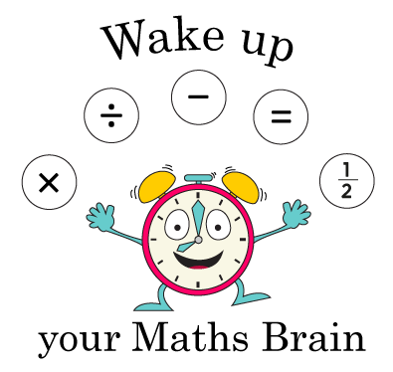
Measures
Tell the time to 1/4 hour
Begin to tell to 5 mins
Starter
Halves and quarters
Notes:
Pre-requisite skills – to use this starter, drag this slide to the start of Day 1
Display or draw a variety of squares, rectangles and circles on the board and divide each into 2 or 4 parts, some equal, some not. Which of these are divided into halves/quarters and which are not? How do you know? Give each pair of children a piece of squared paper. One child draws a shape, the other shades 1/2 or 1/4. If the first child agrees, the second child wins a cube. Swap and repeat.

Slide 4
Measures
Tell the time to 1/4 hour
Begin to tell to 5 mins
Starter
Read o’clock and half past times (analogue)
Notes:
Pre-requisite skills – to use this starter, drag this slide to the start of Day 2
Give each pair a number fan and 2 cards: ‘o’clock’ and ‘half past’. Draw half past 7 on the Hamilton clock (see resources). Children work in pairs to use their number fan and cards to show you the time when you say ‘Show me!’ Repeat with other o’clock and half past times.

Slide 5
Measures
Tell the time to 1/4 hour
Begin to tell to 5 mins
Starter
Tell time to the quarter hour
Notes:
Pre-requisite skills – to use this starter, drag this slide to the start of Day 3
Show children a large clock. Briefly recap the fact that a clock can be divided into 4. Recap o’clock, quarter past, half past and quarter to. Position hands to show quarter past 4. What is the time? Show quarter to 5. What time is it now? Explain that it has not reached the next hour yet so we say quarter to. Repeat with other examples.

Slide 6
Measures
Tell the time to 1/4 hour
Begin to tell to 5 mins
Starter
Match digital times to analogue
Notes:
Pre-requisite skills – to use this starter, drag this slide to the start of Day 4
Give children small analogue clocks, working in pairs or individually depending on the number of clocks available. Hold a digital clock or use one on the Interactive Whiteboard. Show a time. Children discuss the time shown and then make it on their analogue clocks. Repeat with other examples.

Slide 7
Measures
Tell the time to ¹/₄ hour
Begin to tell to 5 mins
Objectives
Day 1
Read time on digital and analogue clocks to the half hour.

Slide 8
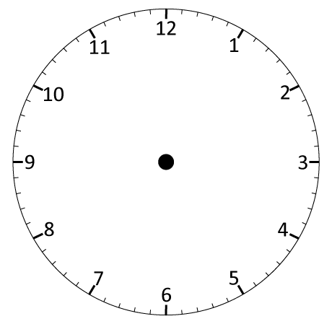
Day 1: Read time on digital and analogue clocks to the half hour.
09:30
09:00
10:00
Now look at the digital clock. There are 60 minutes in an hour so 09:30 is half past 9.
The number
before the 2 dots tells us the hour. There is a 0 before the 9 - digital times have 4 digits!
This is a digital clock. Where have you seen this sort of clock?
What time will it be in half an hour?
It’s 9 o ’clock!
It’s half past 9!
It’s 10 o’ clock!

Slide 9
Day 1: Read time on digital and analogue clocks to the half hour.
02:30
02:00
03:00
What time will it be in another half an hour? Write the digital time on your whiteboards.
What time will it be in half an hour?
It’s 3 o’ clock!
It’s half past 2!
It’s 2 o’ clock!

Slide 10
Day 1: Read time on digital and analogue clocks to the half hour.
07:30
08:00
08:30
What time will it be in another half an hour? Write the digital time on your whiteboards.
What time will it be in half an hour?
It’s 8 o’ clock!
It’s half past 8!
It’s half past 7!

Slide 11
Day 1: Read time on digital and analogue clocks to the half hour.
03:00
04:30
04:00
03:30
What time will it be in half an hour later? Write the digital time on your whiteboards.
What time will it be in another half an hour? Write the digital time on your whiteboards.
What time will it be in half an hour? Write the digital time on your whiteboards.
It’s 4 o’ clock!
It’s half past 4!
It’s half past 3!
It’s 3 o’ clock!
Notes:
Children can now go on to do differentiated GROUP ACTIVITIES. You can find Hamilton’s group activities in this unit’s TEACHING AND GROUP ACTIVITIES download.
WT/ARE/GD: Practise reading and writing equivalent times (o’clock and half past) on analogue and digital clocks OR Play Time bingo game (see resources).

Slide 12
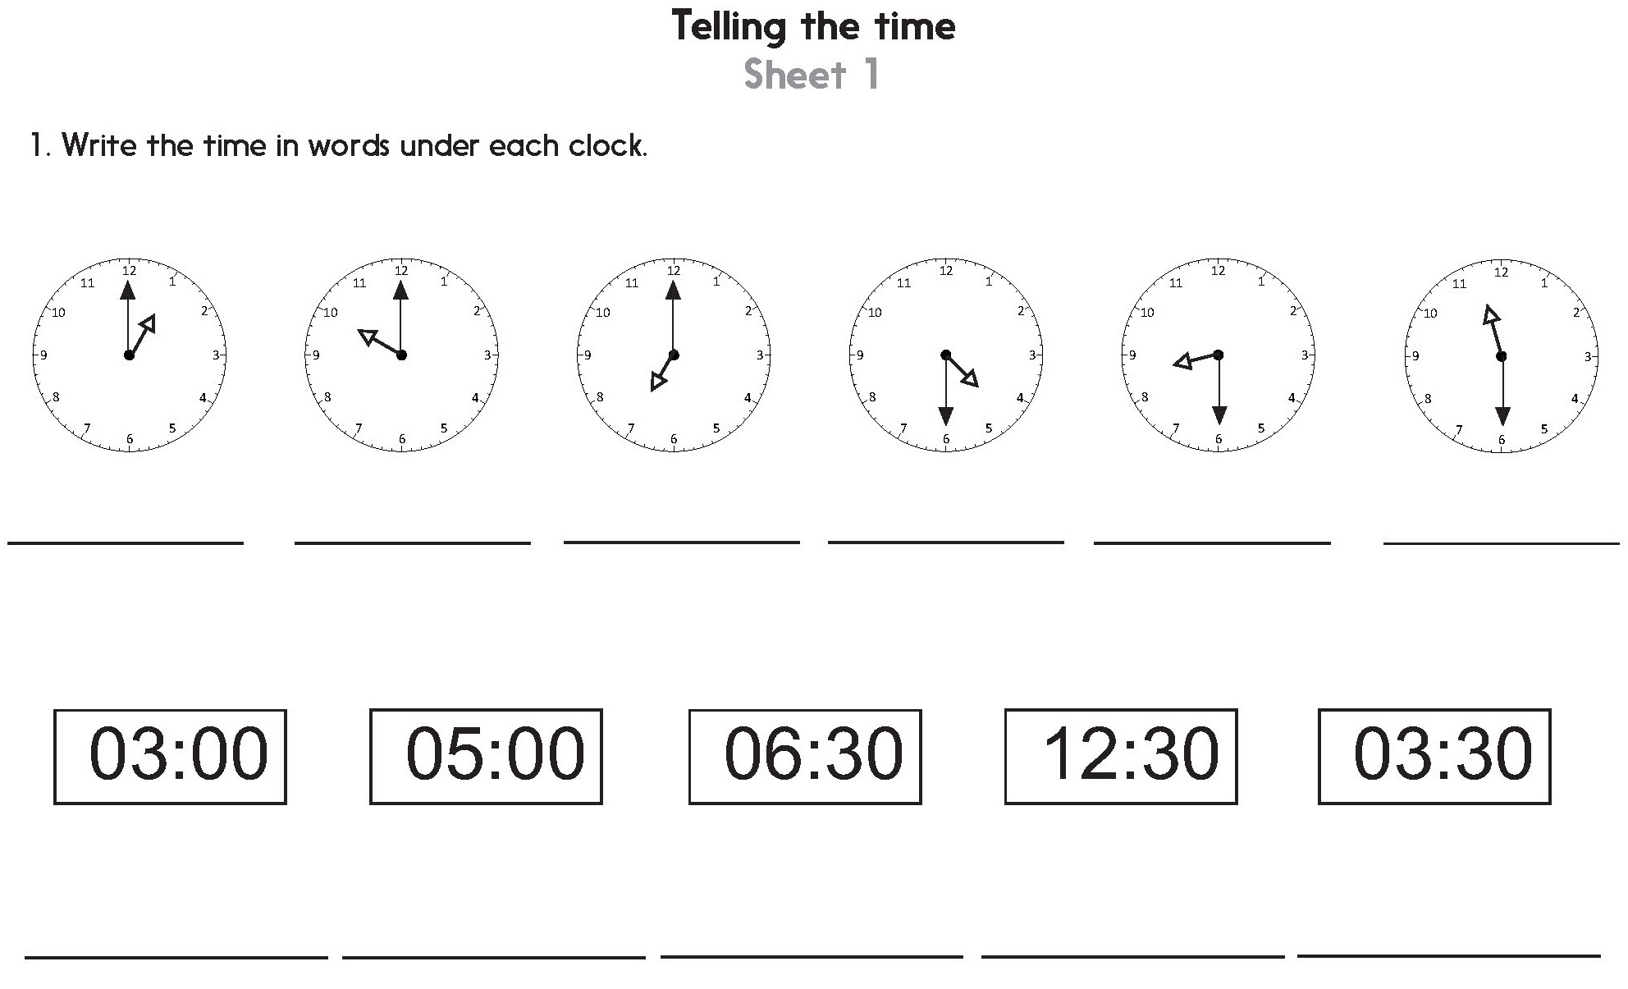
Notes:
The Practice Sheet on this slide is suitable for most children.
Differentiated PRACTICE WORKSHEETS are available on Hamilton’s website in this unit’s PROCEDURAL FLUENCY box.
WT: Telling the time Sheet 1 (2 sheets).
ARE: Telling the time Sheet 1 (2 sheets).
GD: Telling the time Sheet 2 (2 sheets).

Slide 13
Day 2: Order time to the half hour, using digital and analogue clocks.
10:30
Talk to a partner about the time each clock shows. The clock showing 12 o’ clock is ‘midday’. The other times are all in the morning.
What might we be doing at these times during the day?

Slide 14
Day 2: Order time to the half hour, using digital and analogue clocks.
10:30
Let’s check…
Work with a partner to put the times in chronological order.
Remember 12 is midday and the others are all in the morning.
10:30

Slide 15
Day 2: Order time to the half hour, using digital and analogue clocks.
10:30
Let’s check…
What if the clocks showing 2 o’ clock and 10:30 were now after midday?
Agree with your partner what the new order will be.
10:30
Notes:
Children can now go on to do differentiated GROUP ACTIVITIES. You can find Hamilton’s group activities in this unit’s TEACHING AND GROUP ACTIVITIES download.
WT: Making times on geared clocks and ordering them.
ARE/GD: Ordering a set of digital and analogue times.

Slide 16
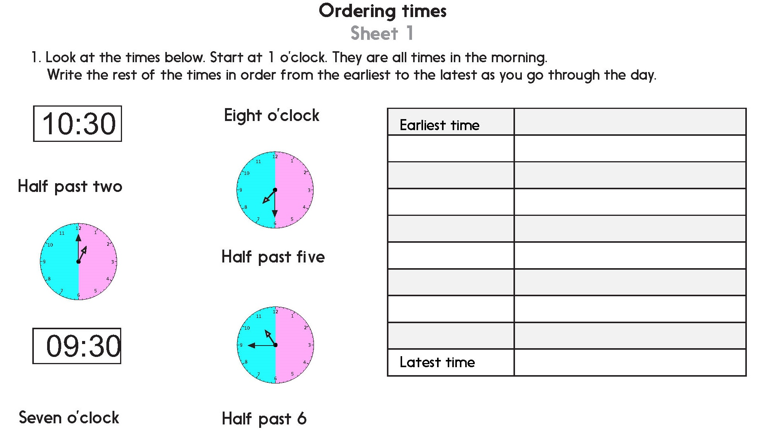
Notes:
The Practice Sheet on this slide is suitable for most children.
Differentiated PRACTICE WORKSHEETS are available on Hamilton’s website in this unit’s PROCEDURAL FLUENCY box.
WT: Ordering times Sheet 1 (2 sheets), with support.
ARE: Ordering times Sheet 1 (2 sheets).
GD: Ordering times Sheet 2 (2 sheets).

Slide 17
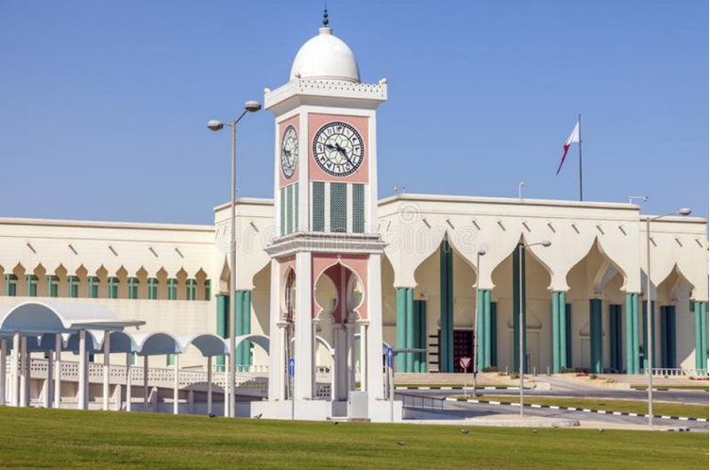
QNID
Clock tower in Qatar

Slide 18
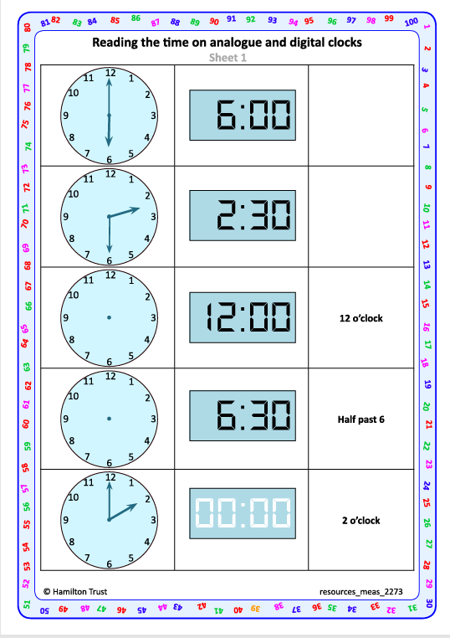
Task 1 – Pair/Group Work
In pairs, work through the set of activity sheets to practise reading and writing equivalent times (o’clock and half past) on analogue and digital clocks.
Discuss each one, say the time out loud quietly to each other, then write or draw the missing time(s) as necessary.

Slide 19
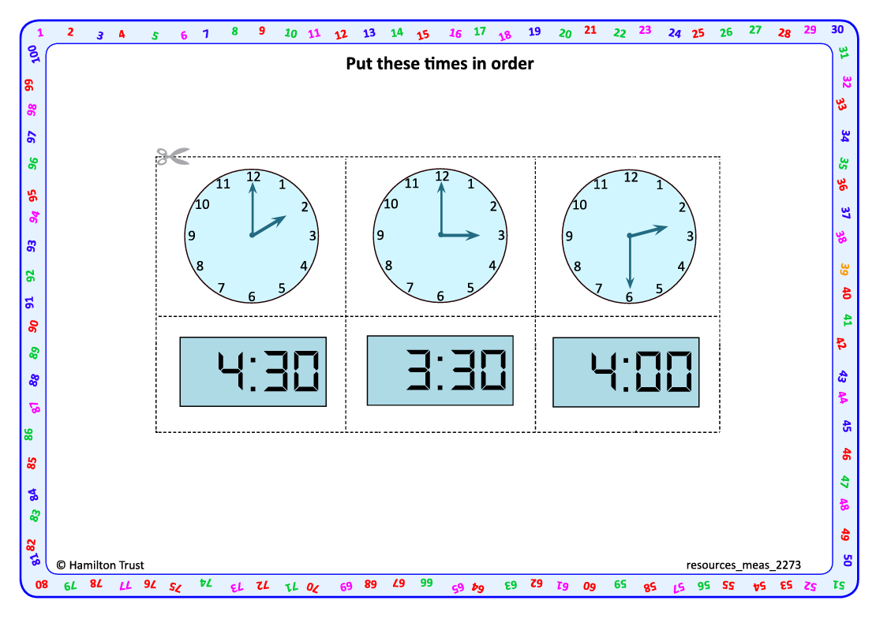
Task 2- Pair Work
Work in pairs to cut out the times shown on the activity sheets, one sheet at a time
Choose a time.
Say that time aloud (quietly) to each other and discuss what you might be doing at that time.
Repeat for each time, so that you agree what time it is.
Together, discuss and agree on the order of the times, then stick them in this order.

Slide 20
Task 3 – Independent Work
Notes:
The Practice Sheet on this slide is suitable for most children.
Differentiated PRACTICE WORKSHEETS are available on Hamilton’s website in this unit’s PROCEDURAL FLUENCY box.
WT: Telling the time Sheet 1 (2 sheets).
ARE: Telling the time Sheet 1 (2 sheets).
GD: Telling the time Sheet 2 (2 sheets).

Slide 21
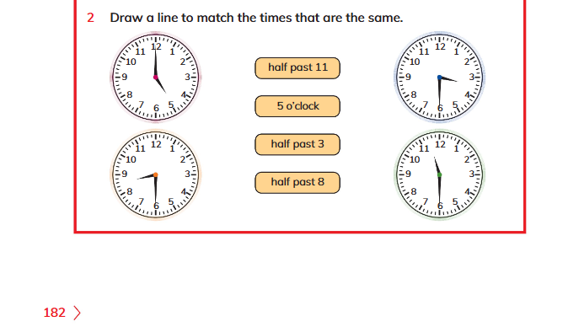
Plenary
Children will attempt Q 2 on page 182 Learners book.

Slide 22
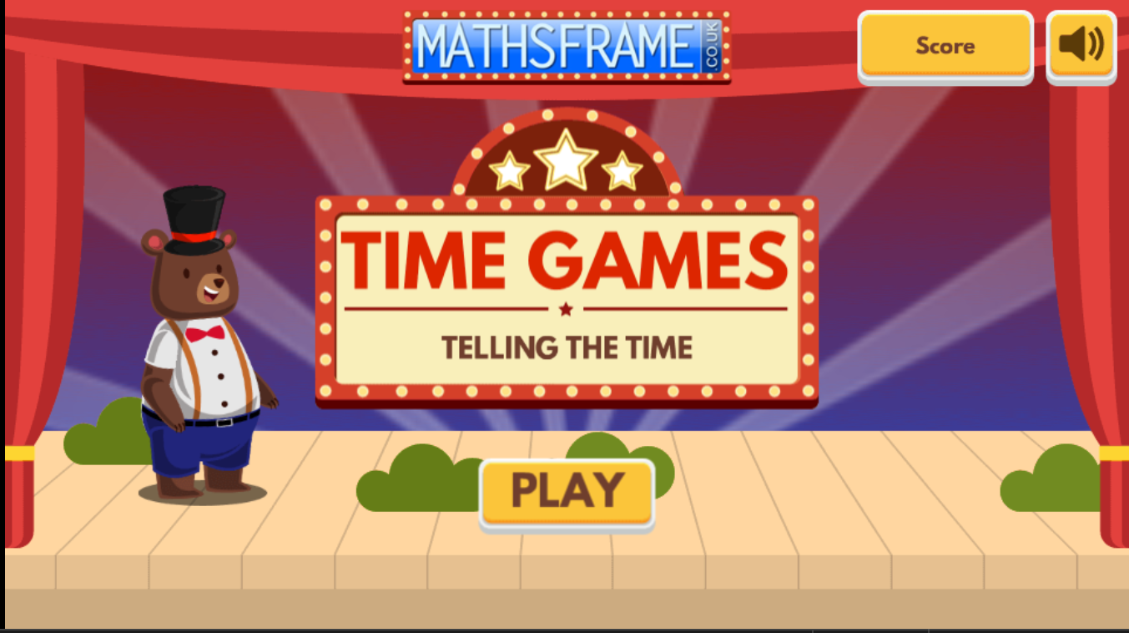
Homework
Play this game:
https://mathsframe.co.uk/en/resources/resource/116/telling-the-time
.Choose "Read time to the hour and half hour."

Slide 23
Measures
Tell the time to ¹/₄ hour
Begin to tell to 5 mins
Objectives
Day 3
Read time on analogue clocks to nearest quarter hour.

Slide 24
Day 3: Read time on analogue clocks to nearest quarter hour.
12
Fold your circle in half. Now fold it in half again so that you have 4 equal parts. What do we call these parts?
The circle is a bit like a clock face. Let’s put 12 at the top.
Where should 3 go on our circle?
Where should 9 go on our circle?
What number goes at the bottom?
When the minute hand is at 9, it has ¹/₄ of an hour to go until the next o’ clock time.
3 is a ¼ of the way round the clock face. When the minute hand is here, it is ¼ of an hour past an o’ clock time.
9
3
6

Slide 25
Day 3: Read time on analogue clocks to nearest quarter hour.
It’s 9 o’ clock. On this clock the pink tells as ‘past’ times and the blue tells us ‘to’ times.
Now it’s only ¼ of an hour before 10 o’ clock. We can write that as quarter to 10 or ¼ to 10.
Now it’s ¼ of an hour after 9 o’ clock. We can write that as quarter past 9
or ¼ past 9.
What time is it now?
What time is it now?
What time is it now?

Slide 26
Day 3: Read time on analogue clocks to nearest quarter hour.
Quarter past 10.
Watch carefully what happens each time the clock moves forward
1 hour.
Write the new times on your whiteboards.
What changed?
What stayed the same?
Notes:
Children can now go on to do differentiated GROUP ACTIVITIES. You can find Hamilton’s group activities in this unit’s TEACHING AND GROUP ACTIVITIES download.
WT/ARE/GD: Write times to the quarter hour from given clock images OR Play Time cards game (making times on analogue cocks).

Slide 27
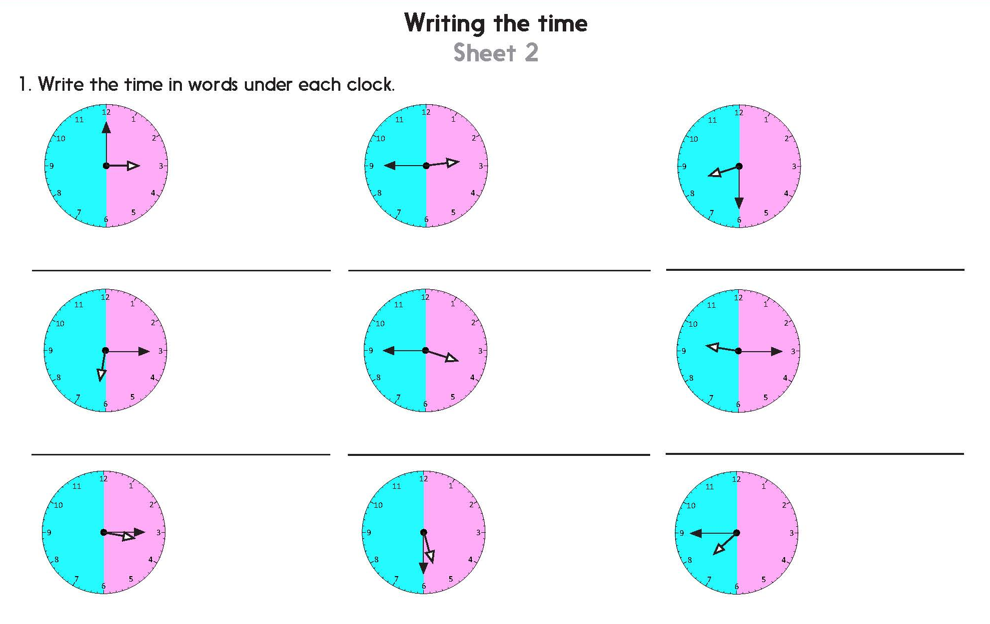
Notes:
The Practice Sheet on this slide is suitable for most children.
Differentiated PRACTICE WORKSHEETS are available on Hamilton’s website in this unit’s PROCEDURAL FLUENCY box.
WT: Writing the time Sheet 1 (2 sheets).
ARE: Writing the time Sheet 2 (2 sheets) - do question 1 and challenge.
GD: Writing the time Sheet 2 (2 sheets).

Slide 28
Measures
Tell the time to ¹/₄ hour
Begin to tell to 5 mins
Objectives
Day 4
Tell the time to the nearest quarter hour. Begin to tell the time to the nearest five minutes.

Slide 29
Day 4: Tell the time to the nearest quarter hour; Begin to tell the time to the nearest five minutes.
Let’s check…
All these times are in the afternoon. Which one is the earliest? Latest? Work with a partner to write the 4 times in order from earliest to latest.
Remember! On this clock the pink tells as ‘past’ times and the blue tells us ‘to’ times.
02:45 or
Quarter to 3
03:00 or
3 o’ clock
03:15 or
Quarter past 3
03:45 or
Quarter to 4

Slide 30
Day 4: Tell the time to the nearest quarter hour; Begin to tell the time to the nearest five minutes.
08:00
08:15
08:30
08:45
09:00
09:15
09:30
09:45
10:00
10:15
10:30
10:45
11:00
11:15
11:30
11:45
12:00
It is 8 o’clock in the morning. Joel is having his breakfast.
What time is it now?
Let’s continue in 15 minute steps until 12 o’ clock. What is Joel doing at each time?
What time is it now?
What time is it now?
What time is it now?
He’s getting his shoes and coat on, and picking up his book bag ready to go to school.
Now he’s in the classroom ready for the day!
He’s finished his breakfast and needs to get dressed, wash and brush his teeth.
He’s meeting his friends in the school playground.

Slide 31
Day 4: Tell the time to the nearest quarter hour; Begin to tell the time to the nearest five minutes.
12:00
12:05
12:10
12:15
12:20
12:25
12:30
We can also begin to count round in 5 minute intervals…
Notes:
Children can now go on to do differentiated GROUP ACTIVITIES. You can find Hamilton’s group activities in this unit’s TEACHING AND GROUP ACTIVITIES download.
WT/ARE: Match pairs of analogue and digital times.
GD: Explore telling time to the nearest 5 minutes.

Slide 32
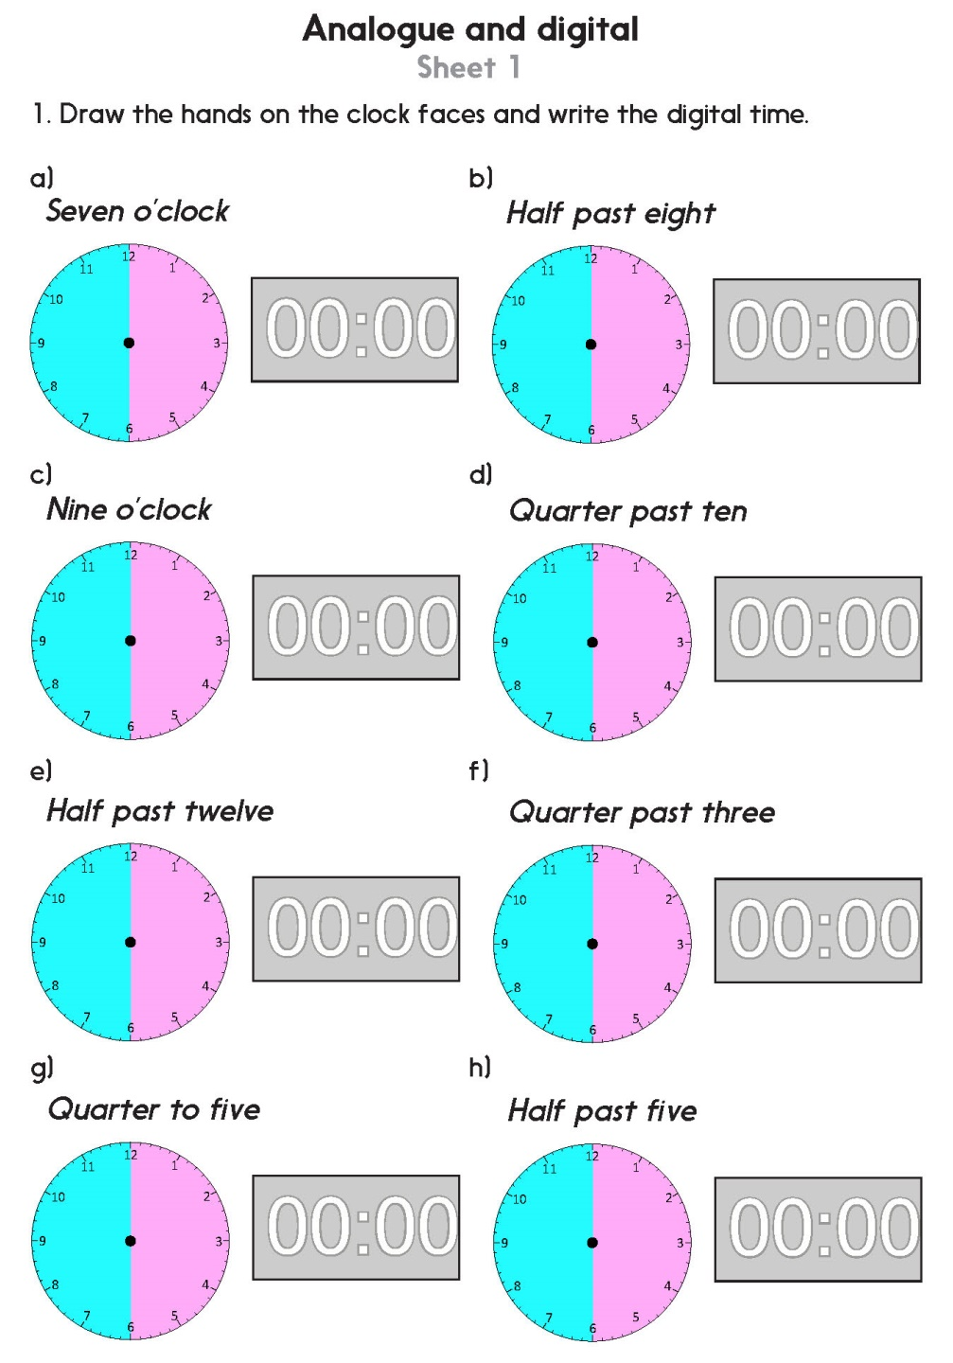
Notes:
The Practice Sheet on this slide is suitable for most children.
Differentiated PRACTICE WORKSHEETS are available on Hamilton’s website in this unit’s PROCEDURAL FLUENCY box.
WT: Analogue and digital Sheet 1 (2 sheets), with support.
ARE: Analogue and digital Sheet 1 (2 sheets).
GD: Analogue and digital Sheet 2 (2 sheets).

Slide 33
Measures
Tell the time to ¹/₄ hour
Begin to tell to 5 mins
Well Done! You’ve completed this unit.
Objectives
Day 1
Read time on digital and analogue clocks to the half hour.
Day 2
Order time to the half hour, using digital and analogue clocks.
Day 3
Read time on analogue clocks to nearest quarter hour.
Day 4
Tell the time to the nearest quarter hour. Begin to tell the time to the nearest five minutes.
Notes:
You can now use the Mastery: Reasoning and Problem-Solving questions to assess children’s success across this unit. Go to the next slide.

Slide 34
Problem solving and reasoning questions
Using digital format, write the times that each of these events happens:
⬥ Tea time  Bed time
⬥ School start time  Playtime
Use a circle of paper.
Draw the minute hand in the correct place for each time listed. Use the colour indicated.
• Quarter to (blue) Half past (red) Quarter past (black)
Write the missing digits in these times:
Quarter past 4 is 0 4 : [___]
Half past 6 is 0 6 : [___]
Quarter to [___] is 0 8 : 4 5
If the time is five past 10, how would it show on a digital clock?
If the time is 1:45 draw the position of the hands on an analogue clock.

Slide 35
Problem solving and reasoning: Answers
Using digital format, write the times that each of these events happens:
⬥ Tea time 5:00  Bed time 7:00
⬥ School start time 9:00  Playtime 10:30
Answers will obviously vary but should be in correct format; times such as 5:00 can be written (at this stage) without the initial zero.
Use a circle of paper.
Draw the minute hand in the correct place for each time listed.
Quarter to (blue)
Half past (red)
Quarter past (black)
Write the missing digits in these times:
Quarter past 4 is 0 4 : 15 Half past 6 is 0 6 : 30 Quarter to 9 is 0 8 : 4 5
If the time is five past 10, how would it show on a digital clock? 10:05 - a common error is to write this as 10:5.
If the time is 1:45 draw the position of the hands
on an analogue clock.

