Slide 1
CHORES WELL DONE
awarded to
KIANA ANDERSON
for completing this week’s
chores without complaint
DATE
PRESENTED BY

Slide 2
awarded to
for completing your math homework
without being nagged
DATE
PRESENTED BY

Slide 3
BIG QUESTIONS:
Why do you think it’s important for us to ask Allah not to give us burdens that are too heavy? How might it make us feel when we face difficult challenges? Can you think of a story from the Quran where a prophet faced a big challenge? How do you think they felt, and how does that connect to the dua we learned? -Can you share a time when you felt overwhelmed or had a big challenge? How did you overcome it, and how can this dua help you in similar situations in the future?

Slide 4
To introduce the dua and help students understand the importance of asking Allah for help with burdens.
Learn and Understand Rabbana Dua by discussing the translation in groups and memorizing it through oral drills.

Slide 5
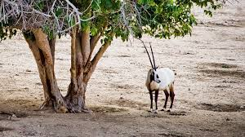
QATAR IDENTITY:
LITERACY: PHONIC SOUND OF QURANIC AYAHS.
NUMERACY: RECEIVING 10 BLESSINGS AS REWARD ON EACH LETTER OF SURAH.
CONNECTING TO QATARI IDENTITY (5 MINUTES):
DISCUSS HOW ASKING FOR HELP AND SUPPORT IS A PART OF THE QATARI SPIRIT, WHERE COMMUNITY AND FAMILY PLAY A VITAL ROLE IN OVERCOMING CHALLENGES.

Slide 7
RABBANA - OUR LORD
LA - DO NOT
TUHAMILNA - BURDEN US
ISRAN - A BURDEN (OR DIFFICULTY)
KAMA - LIKE (OR AS)
HAMALTAHU - YOU PLACED (OR CARRIED)
ALALLADHINA - ON THOSE WHO
MIN - FROM
QABLINA - BEFORE US

Slide 8
HOOK ACTIVITY:
THE HEAVY BAG ACT:
“How do you think it feels to carry a heavy bag alone?”
Rabbana la tuakhizna video: https://www.youtube.com/watch?v=EOxsd-vvekA
https://www.youtube.com/watch?v=x41VEPGcHso

Slide 9
Surah Takathur Interpretation:
https://www.youtube.com/watch?v=0wwKC2wpYrM
Surah Takathur Wordwall: https://wordwall.net/resource/6500538/quran/surah-at-takathur-quiz
Qaida lesson 11
https://alquran.islam.gov.qa/droos/Dr1.shtml

Slide 10
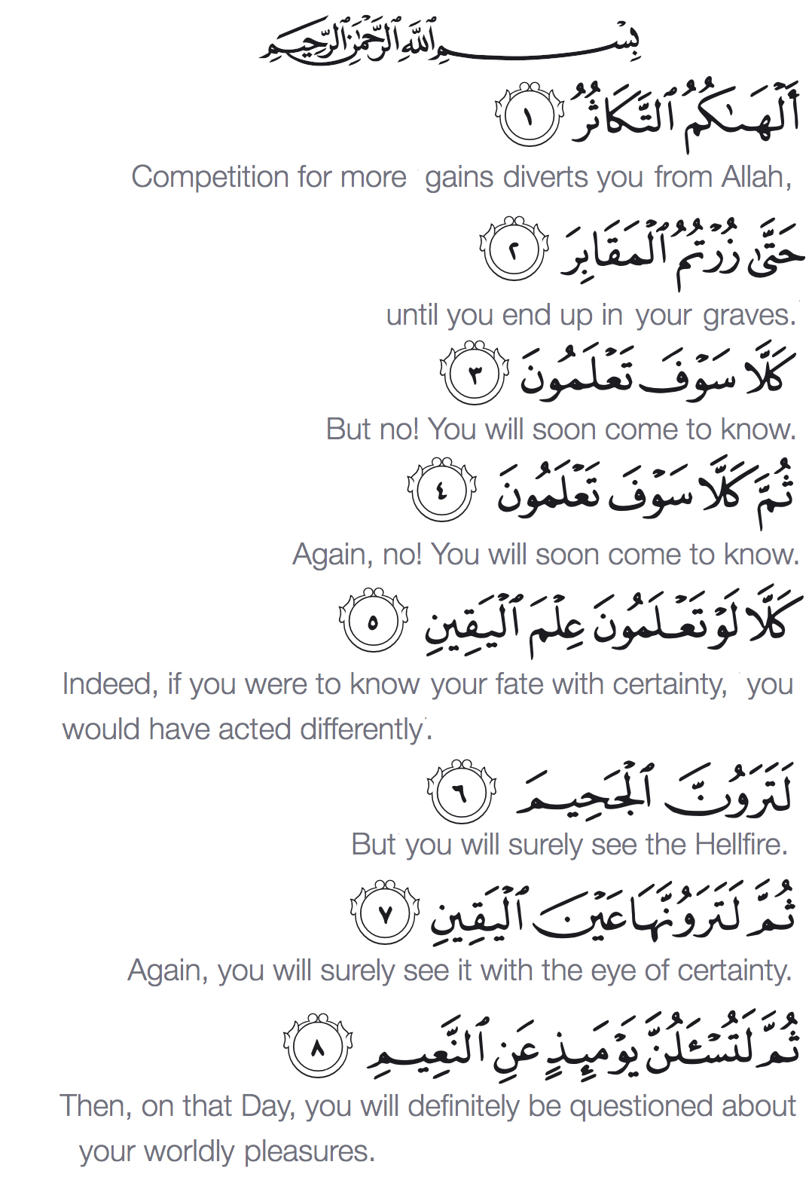
https://wordwall.net/resource/6500538/quran/surah-at-takathur-quiz

Slide 11
HOME WORK
Learn Surah Takathur with tajweed for formal formativethrough the following link:
https://www.youtube.com/watch?v=8EPVk1JTVCo&t=690s

