Slide 1
Revision Day 3
Objectives
Add/subtract multiples of 10
Add/subtract 11, 12, 21, 22, etc
Notes:
Before teaching, be aware that:
On Day 1 children will need 100-bead strings. You may prefer to use a real 100-bead bar.

Slide 2
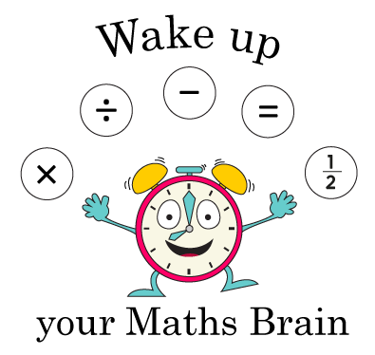
Starter
Next multiple of 10
Notes:
Pre-requisite skills – to use this starter, drag this slide to the start of Day 1
Hold a 1p and 2p coin behind your back.
I’ve got 2 coins which total 3p. What are the coins?
Continue to hide coins and then reveal to check answers.
I’ve got 3 coins that total 6p. What are the coins?
I’ve got 2 coins that total 6p; what are they?
I’ve got 2 coins that total 20p; what are they?
I’ve got 3 coins that total 15p; what are they?
Continue to practise further examples.
Increase the level of this activity by asking open ended questions.
I’m holding some coins that total 15p. None of them are 1p coins. What could they be?
I’m holding some coins that total 20p. None of them are bronze coins. What could they be?

Slide 3
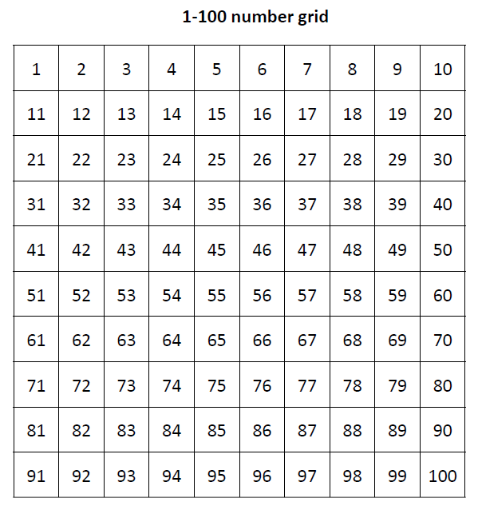
Station 1: Add and subtract 20, 30, 40, 50 to/from 2-digit numbers using the 1-100 grid.
What has spider done? How much has been added?
43 + 20 = 63
Spider doesn’t have to count in 1s!

Slide 4
Station 1: Add and subtract 20, 30, 40, 50 to/from 2-digit numbers using the 1-100 grid.
What has Spider done this time?
How much has been subtracted?
43 – 20 = 23

Slide 5
Station 1: Add and subtract 20, 30, 40, 50 to/from 2-digit numbers using the beaded line.
Show me 45 on your bead strings.
We are going to
add 30 by
counting on in 10s.
+10
+10
+10
45
75
45 + 30 = 75

Slide 6
Station 2: Add and subtract 20, 30, 40, 50 to/from 2-digit numbers using the beaded line.
Show me 92 on your bead strings.
We are going to subtract 50 by counting back in 10s.
-10
-10
-10
-10
-10
42
92
92 – 50 = 42
Notes:
Today would be a great day to use a problem-solving investigation – The Number Square! – as the group activity, which you can find in this unit’s IN-DEPTH INVESTIGATION box on Hamilton’s website.
Alternatively, children can now go on to do differentiated GROUP ACTIVITIES. You can find Hamilton’s group activities in this unit’s TEACHING AND GROUP ACTIVITIES download.
WT/ARE: Select pairs of numbers to practise adding or subtracting 20, 30, 40 or 50.
GD: Investigate patterns when adding and subtracting multiples of 10 to 2-digit numbers.

Slide 7
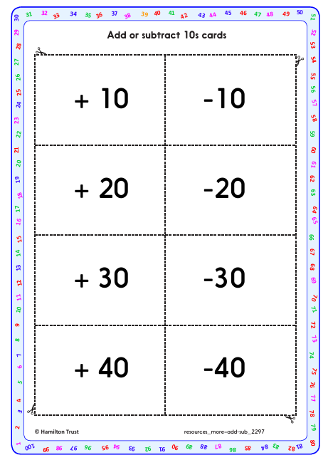
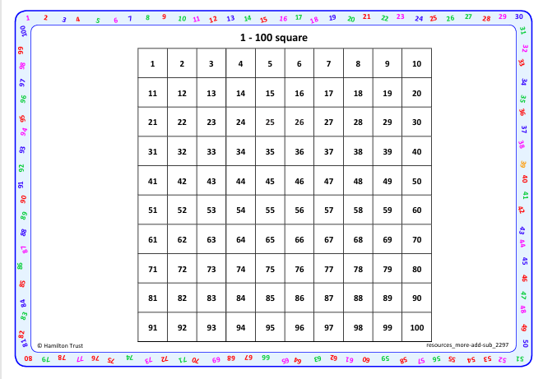
Task 1 – Pair/Group Work
Using the 1-100 grid and addition and subtraction cards, play the game with provided instructions.

Slide 8
Station 2: Add 11, 12, 13, 21, 22 and 23.
Talk me through how to find 46 + 12.
How much quicker is it to add 10 and then add on 2 more than counting on in 1s?!

Slide 9
Station 2: Add 11, 12, 13, 21, 22 and 23.
We can also use Spider to help us add 21 and 22.
45 + 21 = 66
45 + 21

Slide 10
Station 2: Add 11, 12, 13, 21, 22 and 23.
We can also use Spider to help us add 21 and 22.
45 + 22 = 67
45 + 22

Slide 11
Day 2: Add 11, 12, 13, 21, 22, 23, 31, 32, and 33
+10
+10
+1
35
56
35 + 21 = 56
35 + 21

Slide 12
Station 2: Add 11, 12, 13, 21, 22, 23, 31, 32, and 33
+10
+10
+2
46
68
46 + 22 = 68
46 + 22

Slide 13
Task 2 – Pair/Group Work
Using the 1-100 grid or bead bar, find the total of your chosen snack and drink

