Slide 1

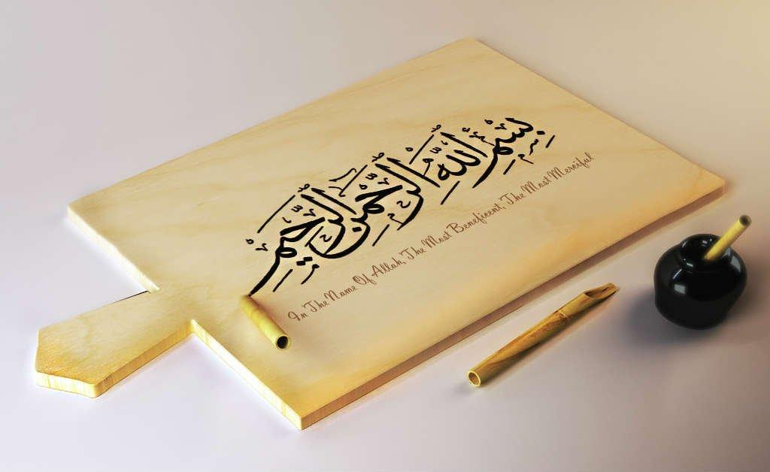
https://youtu.be/Sta_p-oB_d4?si=PSzflbzQ7wHiQ1tU

Slide 2
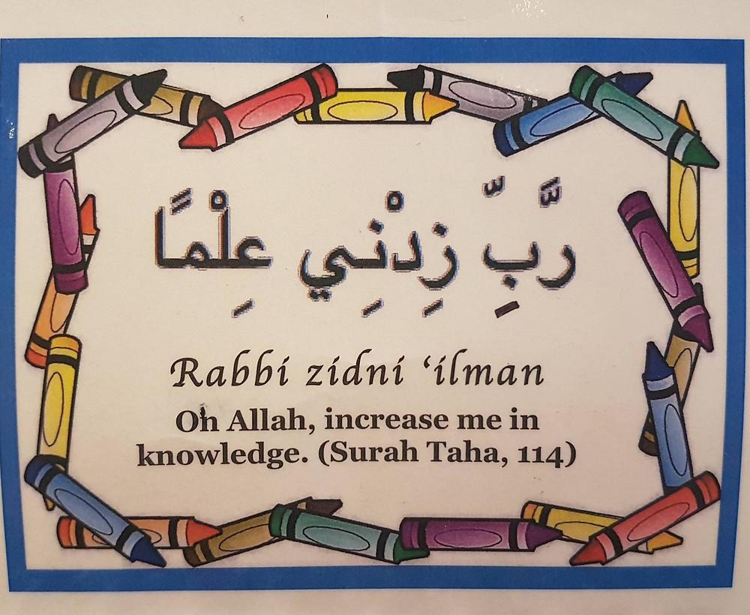
https://youtu.be/Sn3ElZG_WwQ?si=XDsPu9P89Av1dU5L

Slide 3
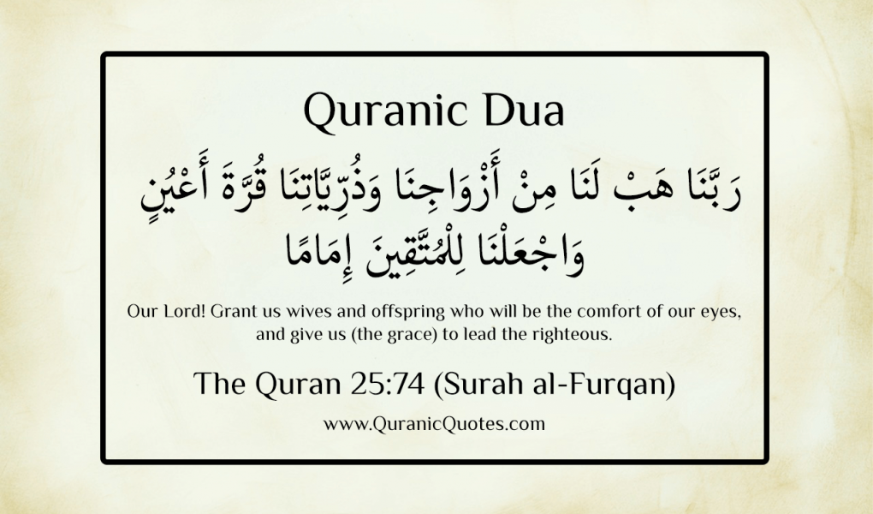
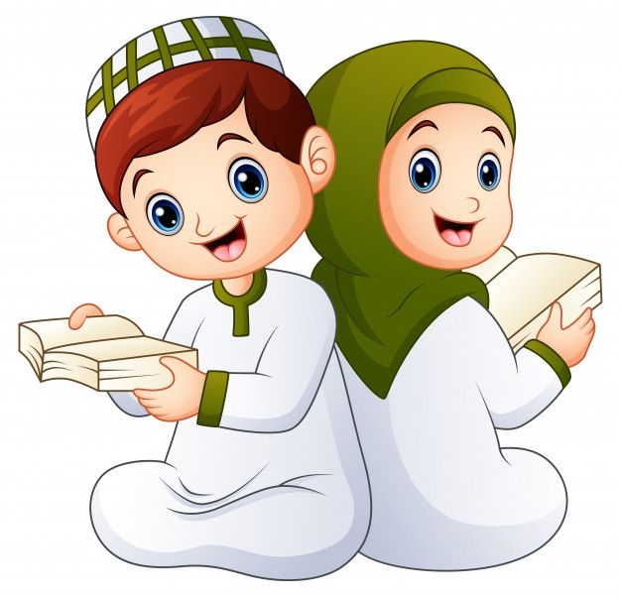

Slide 4
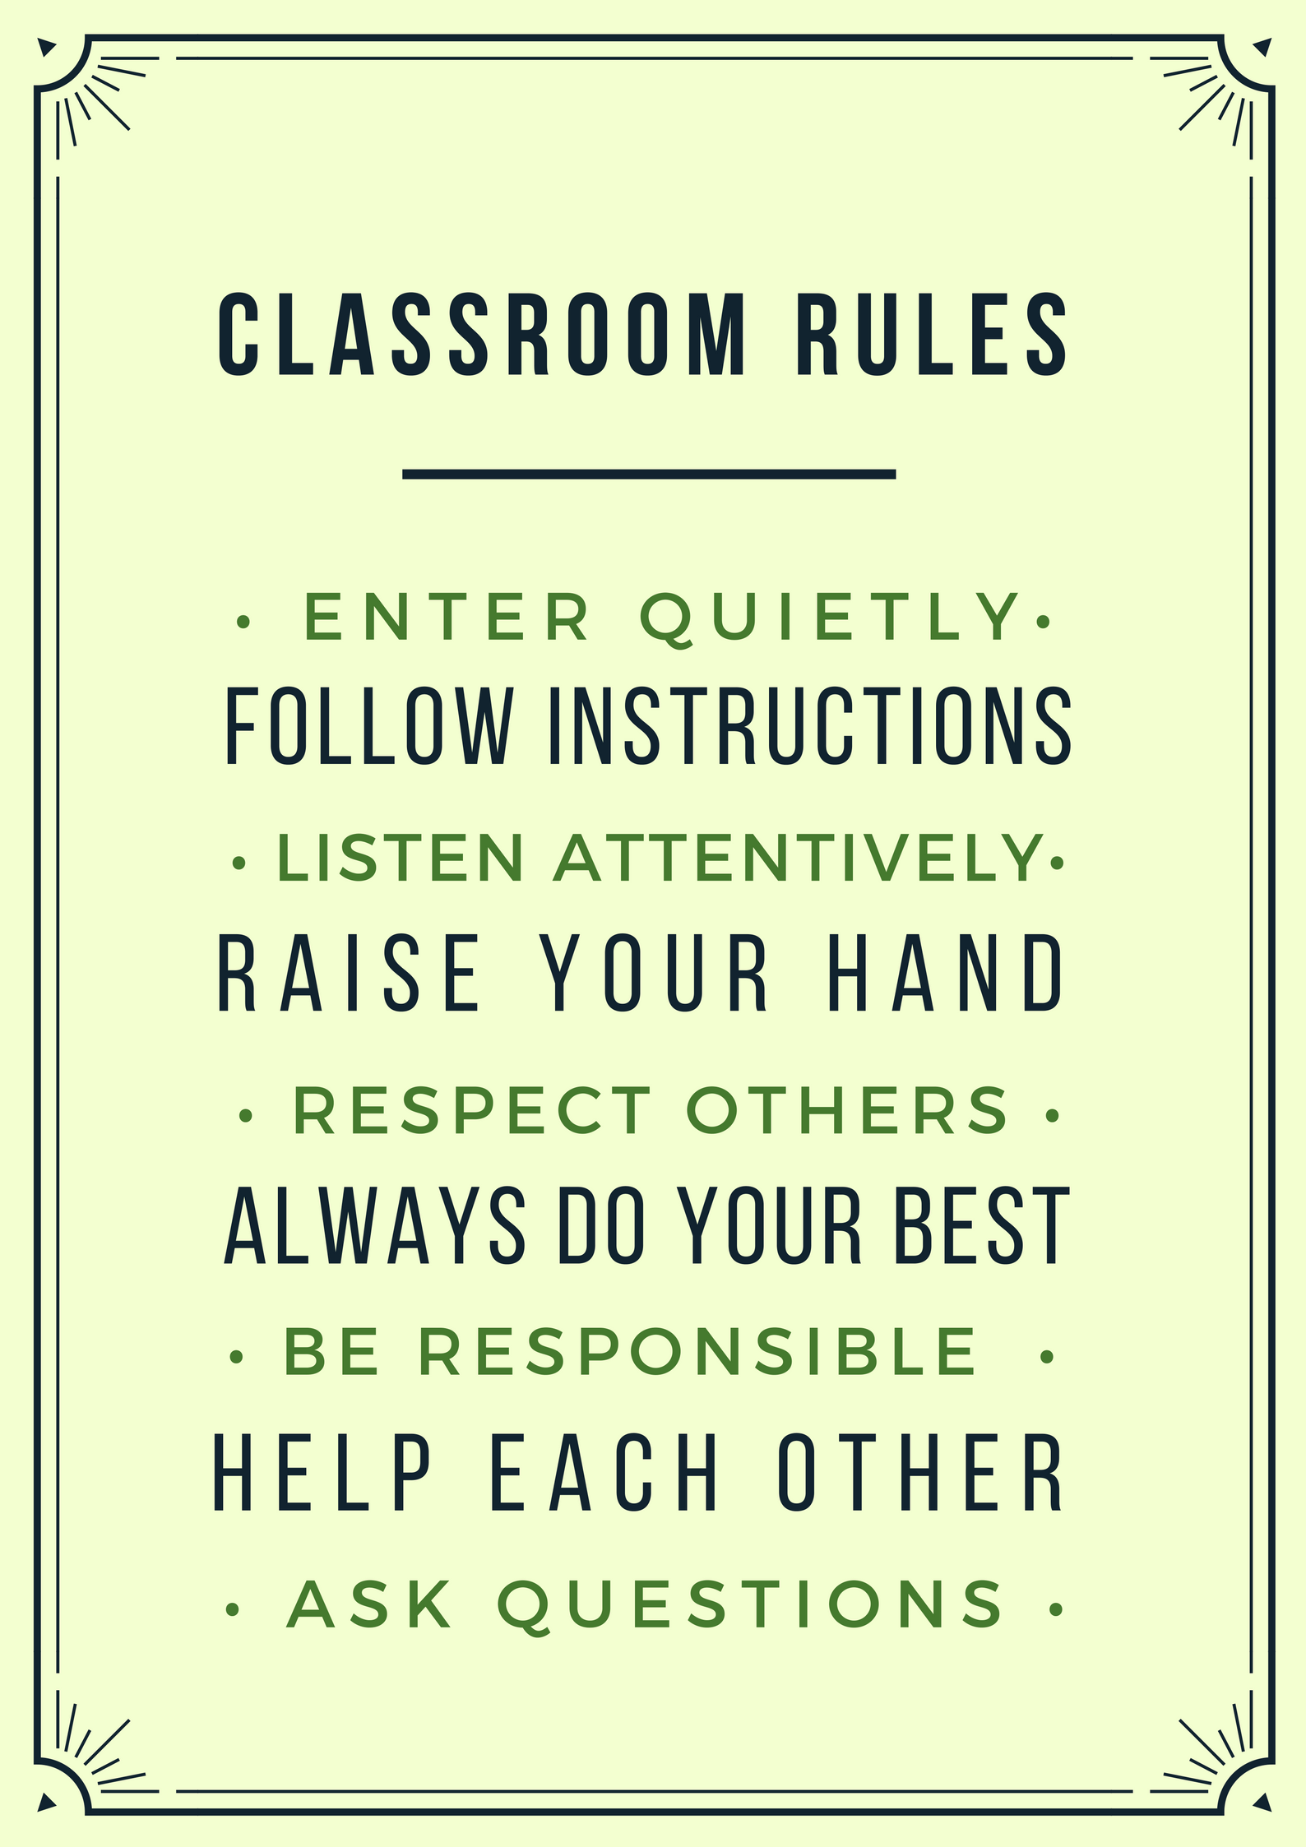
QUR'AN CLASS RULES
Please maintain silence and Respect Qur'an (speech of Allah)

Slide 5
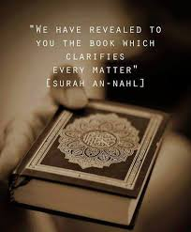
How much reward will you get for reciting morning azkar?

Slide 6

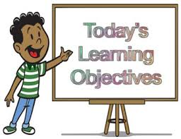
OBJECTIVE
By the end of the lesson learners will be able
• Evaluate the Morning Dua with tajweed rules after practicing through drilling.
• Identify the lip letter in Moring dua and create a list of lip letters and throat letters after going through the provided link on sticky notes. https://www.alqasaslearning.com/blog-1/the-5-main-makharij

Slide 7

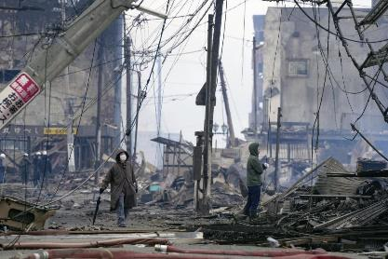
QATAR IDENTITY
https://www.qf.org.qa/events/holy-quran-program-for-memorizing-revising-and-mastering-recitatio
Minaratein Center offers the Holy Quran program for memorizing, revising, and mastering recitation. The program is available for all ages, morning and evening sessions, for males and females.

Slide 8
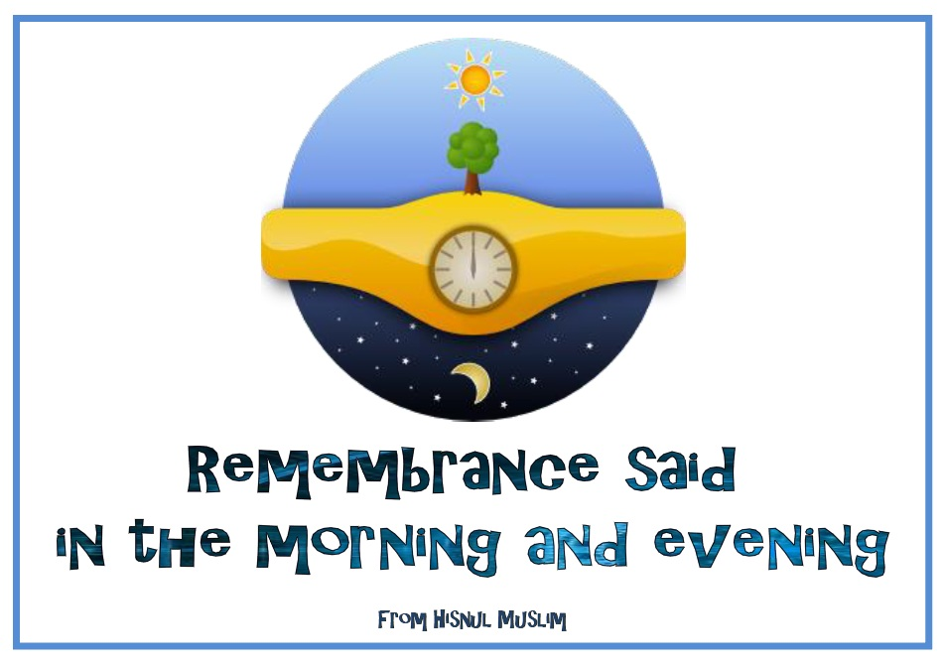
REPEATITION TIME
https://www.youtube.com/watch?v=jldIY3-PBM0

Slide 9
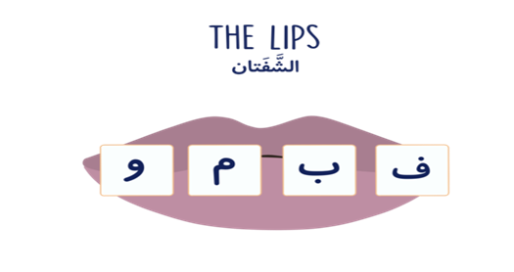
LIP LETTERS
https://www.alqasaslearning.com/blog-1/the-5-main-makharij

Slide 10
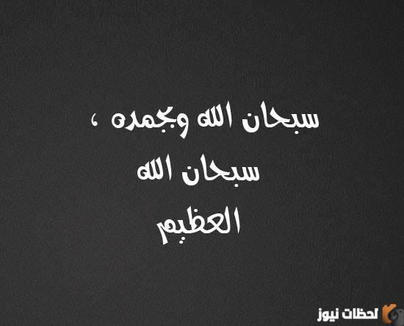
MORNING DUA
Morning dua- Learn, Reflect and Write benefits.
https://www.youtube.com/watch?v=qD_FJjO2ML4&t=417s

Slide 11
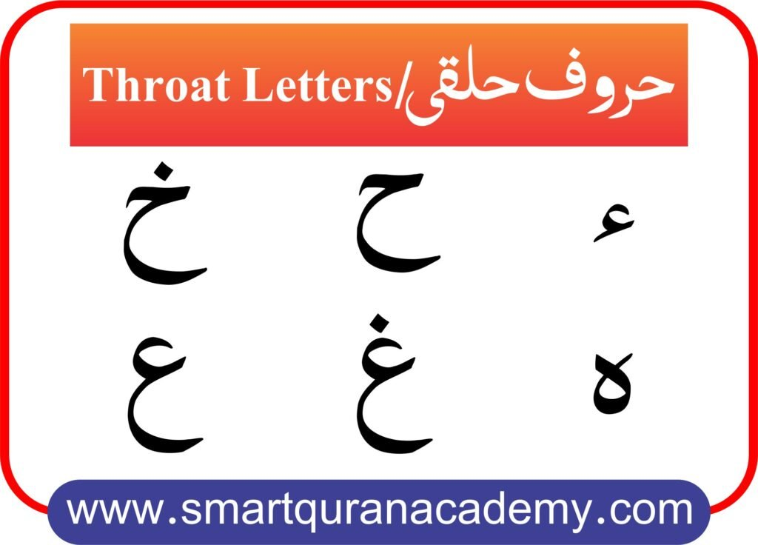

Slide 12
GIVE ME FIVE
At what time we should recite this Dua?
Who commanded us to recite this Dua?
If we recite this Dua what we will receive from Allah SWT?

Slide 13
END…….
ANY QUESTIONS OR DOUBTS????

