Slide 1
Science - Year 4
Living Things & their Habitats – Block 4LvH2
Help Our Habitats!
Session 2
PowerPoint
© Original resource copyright Hamilton Trust, who give permission for it to be adapted as wished by individual users.
We refer you to our warning, at the foot of the block overview, about links to other websites.

Slide 2
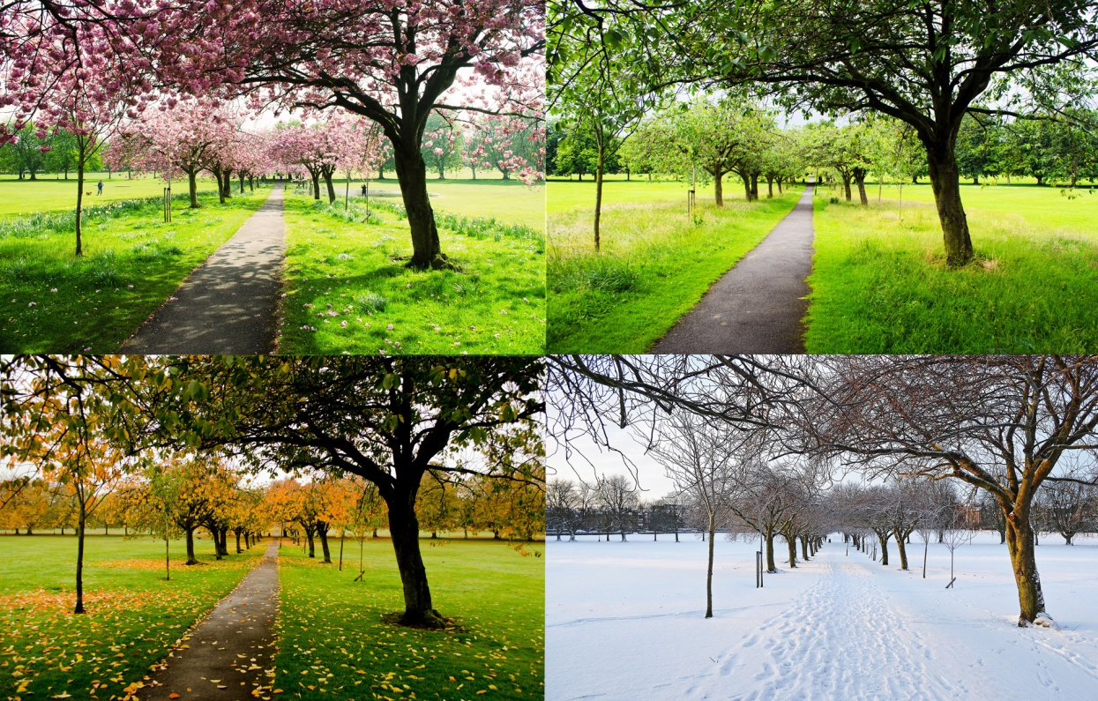
How do some living things adapt to natural changes in their environment?
Choose the correct answer in each scenario that follows.

Slide 3
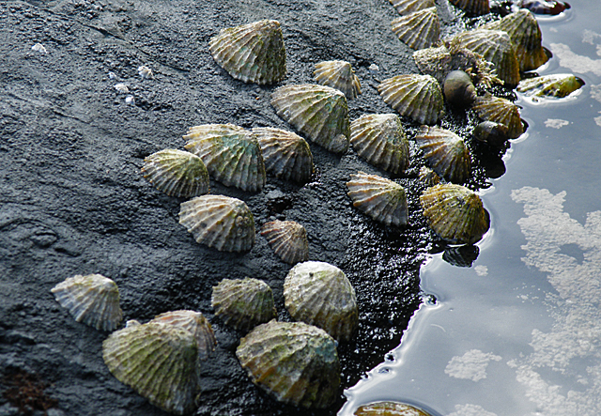
When the tide goes out, a limpet stays safe from predators by…..
1…clamping tightly to a rock (which also stops them from drying out).
2…spitting out poison.

Slide 4
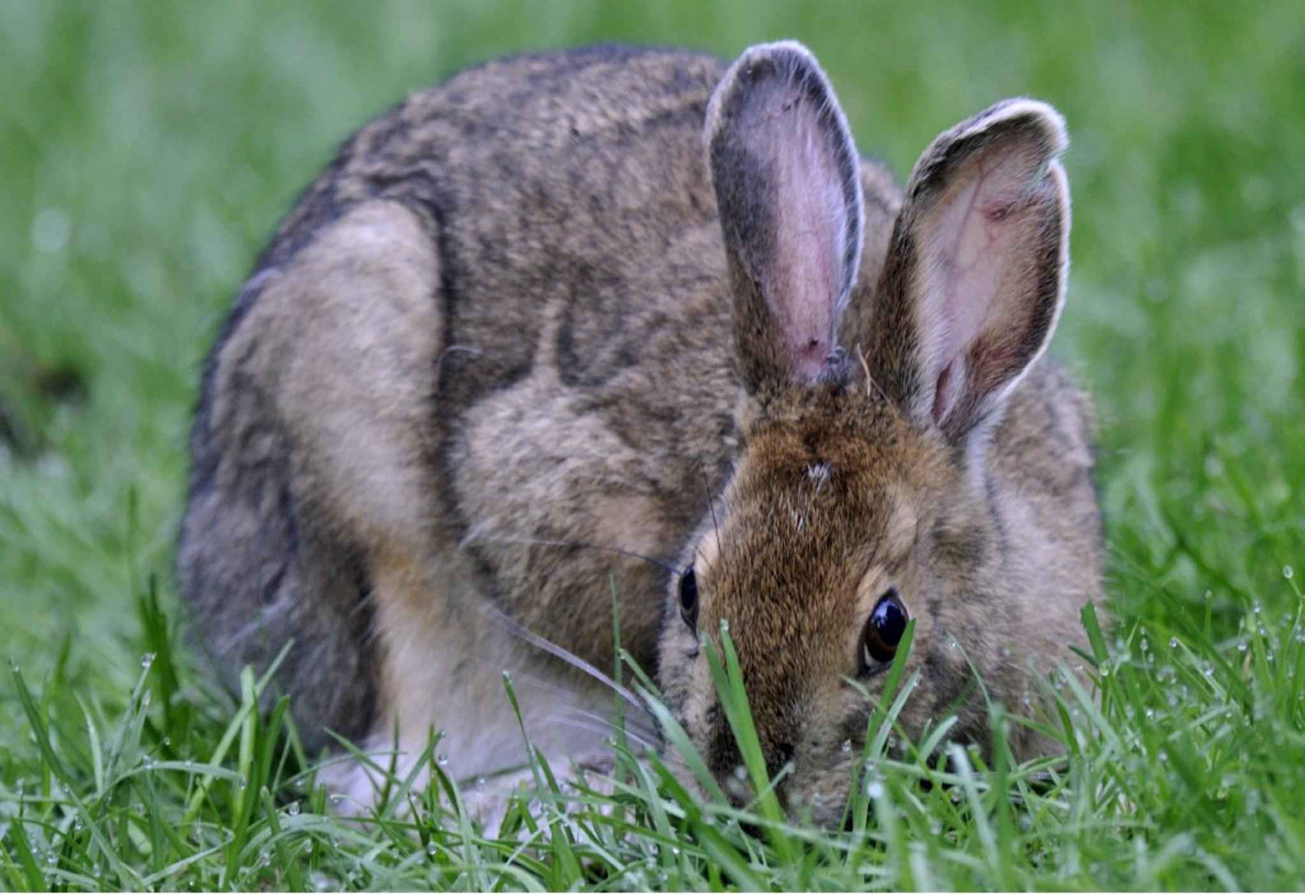
During Winter, much of Canada is covered in snow. To hide from predators a snowshoe hare will…..
1…hibernate.
2…change from having brown fur to white fur.

Slide 5
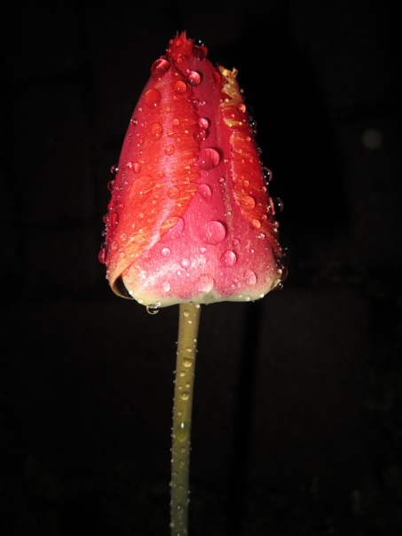
At night, a tulip flower will close up…..
1…to stop the dew from getting the pollen wet.
2…to protect it from frost.
Actually, scientists aren’t really sure why, but both of these theories are considered a possibility.

Slide 6
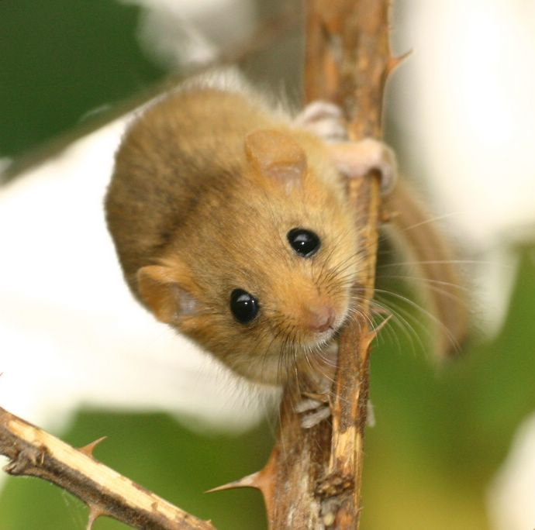
Dormice survive the cold winter by…..
1…hibernating for 6 months.
2…growing thicker fur.

Slide 7
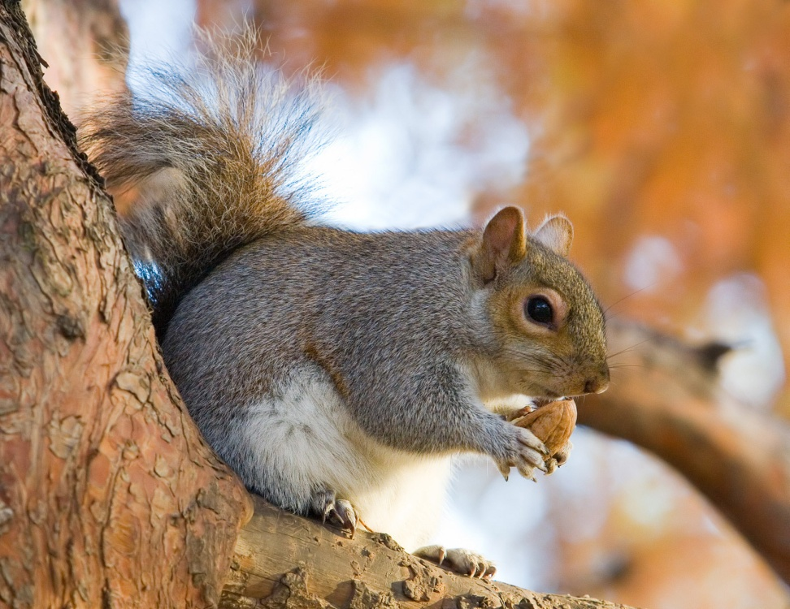
To cope with less available food during winter, a squirrel will …..
1…fatten up over summer so it doesn’t need to eat.
2…spend the summer and autumn storing food for the winter months.

Slide 8
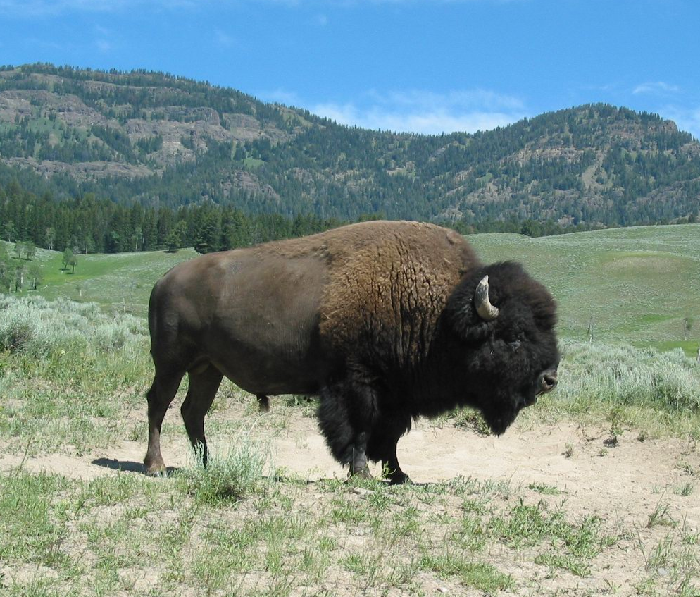
An American bison will cool down in the summer by…..
1…shading under a tree.
2…shedding their thick, brown coats.

Slide 9
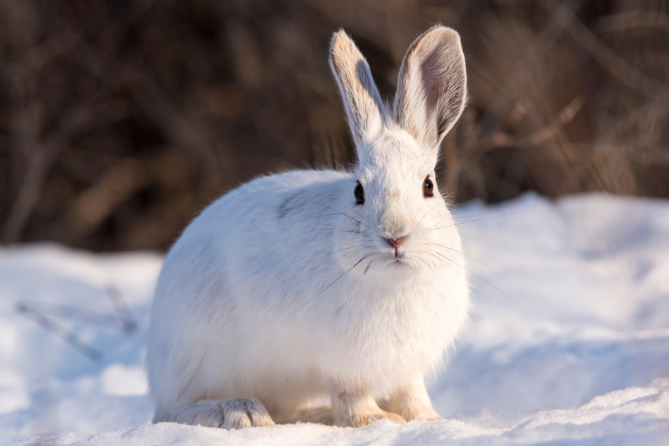
Answers
Limpets 1
Snowshoe Hare 2
Tulip 1 & 2 (Actually, scientists aren’t really sure why, but both of these theories are considered a possibility.)
Dormouse 1
Squirrel 2
Bison 2

