Slide 1
Addition and Subtraction
Adding by counting on (numbers to 20)
Starter
Adding by counting on
Notes:
Pre-requisite skills – to use this starter, drag this slide to the start of Day 2
Show 2 large dice, 5 on left as children look at them and the other showing 2. Count how many spots there are all together, 1, 2, … 7. Keep the first dice showing 5, and roll the second dice. Let’s count them all to see how many spots are showing, 1, 2, … Repeat, keeping the first dice showing 5 and rolling the second, counting all the spots each time. Do we need to count every spot? Agree that the first dice always shows 5 and so you can count on from 5. Do this, pointing to the 5, and then counting on 6, 7, … Repeat keeping the first dice showing 5, and counting on the number of spots on the second dice.

Slide 2
Addition and Subtraction
Adding by counting on (numbers to 20)
Objectives
Day 2
Find 2 more/less than any number up to 20, recording the hops on a beaded line.

Slide 3
Day 2: Find 2 more/less than any number up to 20, recording the hops on a beaded line.
Shuffle a pack of 1-20 cards and select one. Ask a child to draw a tag under that bead.
13
13
Make a tower using this number of cubes.

Slide 4
Day 2: Find 2 more/less than any number up to 20, recording the hops on a beaded line.
+ 2
13
Where is this number on the beaded line?
How many cubes now?
Notes:
Add 2 more cubes to the tower.

Slide 5
Day 2: Find 2 more/less than any number up to 20, recording the hops on a beaded line.
+ 2
13
What number sentence can we write?
13 + 2 = 15

Slide 6
Day 2: Find 2 more/less than any number up to 20, recording the hops on a beaded line.
- 2
11
13
Where is this number on the beaded line?
How many cubes now?
Notes:
Return to the tower of 13 and explain that now you are going to take 2 cubes off the tower.

Slide 7
Day 2: Find 2 more/less than any number up to 20, recording the hops on a beaded line.
- 2
11
13
What number sentence can we write?
13 – 2 = 11

Slide 8
Day 2: Find 2 more/less than any number up to 20, recording the hops on a beaded line.
Notes:
Choose another number card and repeat several times, in each case asking children what will happen if 2 is added or subtracted to that number.
Model the hops on the beaded line and ask children what number sentence you should write for each example.
Include starting with 9 and 11 so you show crossing 10.
Children can now go on to do differentiated GROUP ACTIVITIES. You can find Hamilton’s group activities in this unit’s TEACHING AND GROUP ACTIVITIES download.
WT/ARE: Work out addition and subtraction number sentences by drawing hops on a beaded line.
GD: Work out addition and subtraction number sentences by drawing hops on a beaded line.

Slide 9
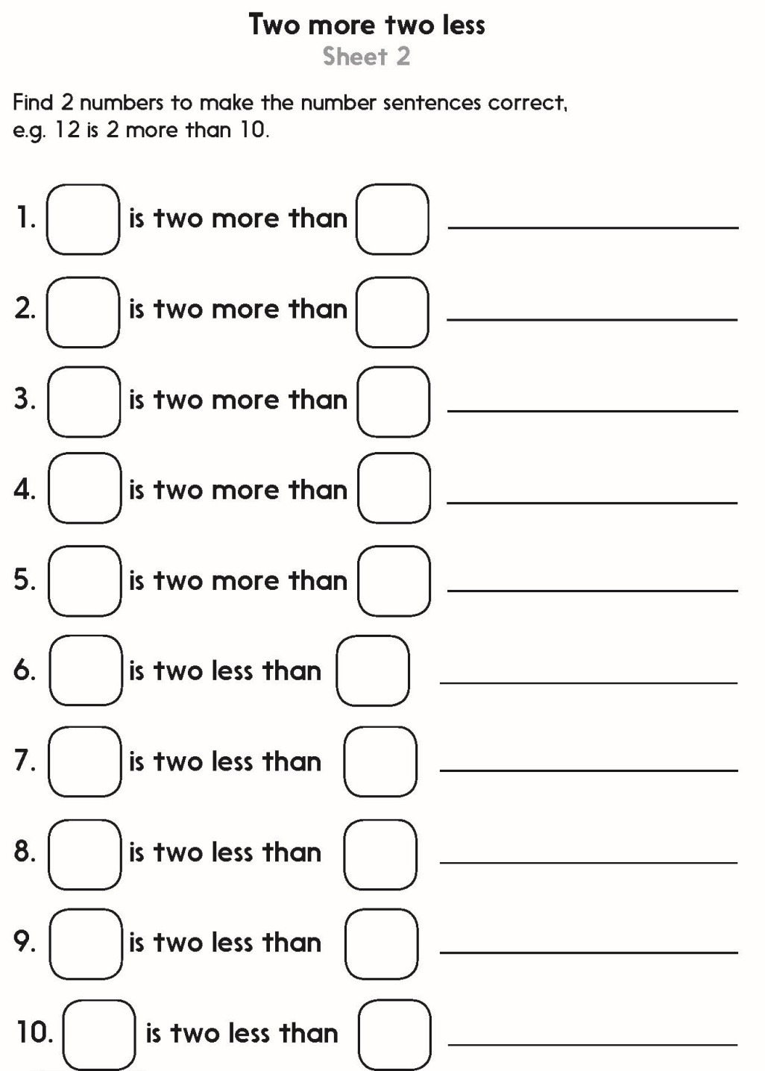
Challenge
Notes:
The Practice Sheet on this slide is suitable for most children.
Differentiated PRACTICE WORKSHEETS are available on Hamilton’s website in this unit’s PROCEDURAL FLUENCY box.
WT: Two more two less Sheet 1
ARE/GD: Two more two less Sheet 2

Slide 10
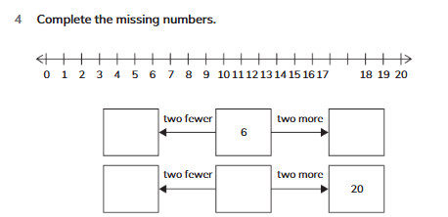
Book Exit
Complete Workbook page 121 no. 4

