Slide 1
Measures
Tell the time to ¹/₄ hour
Begin to tell to 5 mins
Objectives
Day 1
Read time on digital and analogue clocks to the half hour.
Day 2
Order time to the half hour, using digital and analogue clocks.
Day 3
Read time on analogue clocks to nearest quarter hour.
Day 4
Tell the time to the nearest quarter hour. Begin to tell the time to the nearest five minutes.
Notes:
Before teaching, be aware that:
On Day 1 children will need mini-whiteboards and pens, you can use a geared teaching clock or ITP ‘Tell the time’ to provide further examples.
On Day 2 children will need mini-whiteboards and pens.
On Day 3 children will need a paper circle, whiteboards and pens.
On Day 4 you can use a geared teaching clock or ITP ‘Tell the time’ to provide further examples.

Slide 2
Measures
Tell the time to ¹/₄ hour
Begin to tell to 5 mins
Starters
Day 1
Halves and quarters (pre-requisite skills)
Day 2
Read o’clock and half past times (analogue) (pre-requisite skills)
Day 3
Tell time to the quarter hour (pre-requisite skills)
Day 4
Match digital times to analogue (pre-requisite skills)
Notes:
Choose starters that suit your class by dragging and dropping the relevant slide or slides below to the start of the teaching for each day.

Slide 3
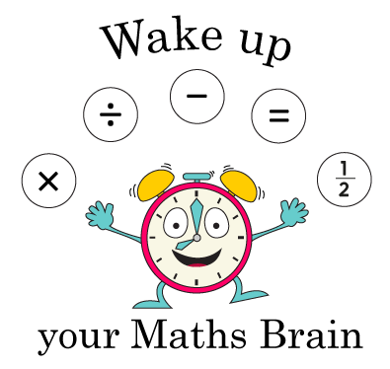
Measures
Tell the time to 1/4 hour
Begin to tell to 5 mins
Starter
Halves and quarters
Notes:
Pre-requisite skills – to use this starter, drag this slide to the start of Day 1
Display or draw a variety of squares, rectangles and circles on the board and divide each into 2 or 4 parts, some equal, some not. Which of these are divided into halves/quarters and which are not? How do you know? Give each pair of children a piece of squared paper. One child draws a shape, the other shades 1/2 or 1/4. If the first child agrees, the second child wins a cube. Swap and repeat.

Slide 4
Measures
Tell the time to 1/4 hour
Begin to tell to 5 mins
Starter
Read o’clock and half past times (analogue)
Notes:
Pre-requisite skills – to use this starter, drag this slide to the start of Day 2
Give each pair a number fan and 2 cards: ‘o’clock’ and ‘half past’. Draw half past 7 on the Hamilton clock (see resources). Children work in pairs to use their number fan and cards to show you the time when you say ‘Show me!’ Repeat with other o’clock and half past times.

Slide 5
Measures
Tell the time to 1/4 hour
Begin to tell to 5 mins
Starter
Tell time to the quarter hour
Notes:
Pre-requisite skills – to use this starter, drag this slide to the start of Day 3
Show children a large clock. Briefly recap the fact that a clock can be divided into 4. Recap o’clock, quarter past, half past and quarter to. Position hands to show quarter past 4. What is the time? Show quarter to 5. What time is it now? Explain that it has not reached the next hour yet so we say quarter to. Repeat with other examples.

Slide 6
Measures
Tell the time to 1/4 hour
Begin to tell to 5 mins
Starter
Match digital times to analogue
Notes:
Pre-requisite skills – to use this starter, drag this slide to the start of Day 4
Give children small analogue clocks, working in pairs or individually depending on the number of clocks available. Hold a digital clock or use one on the Interactive Whiteboard. Show a time. Children discuss the time shown and then make it on their analogue clocks. Repeat with other examples.

Slide 7
Measures
Tell the time to ¹/₄ hour
Begin to tell to 5 mins
Objectives
Day 3
Read time on analogue clocks to nearest quarter hour.

Slide 8
Day 3: Read time on analogue clocks to nearest quarter hour.
12
Fold your circle in half. Now fold it in half again so that you have 4 equal parts. What do we call these parts?
The circle is a bit like a clock face. Let’s put 12 at the top.
Where should 3 go on our circle?
Where should 9 go on our circle?
What number goes at the bottom?
When the minute hand is at 9, it has ¹/₄ of an hour to go until the next o’ clock time.
3 is a ¼ of the way round the clock face. When the minute hand is here, it is ¼ of an hour past an o’ clock time.
9
3
6

Slide 9
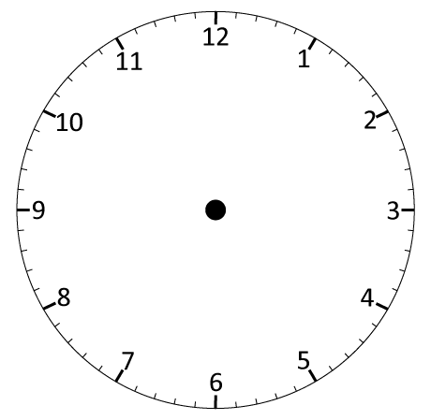
Day 3: Read time on analogue clocks to nearest quarter hour.
It’s 9 o’ clock. On this clock the pink tells as ‘past’ times and the blue tells us ‘to’ times.
Now it’s only ¼ of an hour before 10 o’ clock. We can write that as quarter to 10 or ¼ to 10.
Now it’s ¼ of an hour after 9 o’ clock. We can write that as quarter past 9
or ¼ past 9.
What time is it now?
What time is it now?
What time is it now?

Slide 10
Day 3: Read time on analogue clocks to nearest quarter hour.
Quarter past 10.
Watch carefully what happens each time the clock moves forward
1 hour.
Write the new times on your whiteboards.
What changed?
What stayed the same?
Notes:
Children can now go on to do differentiated GROUP ACTIVITIES. You can find Hamilton’s group activities in this unit’s TEACHING AND GROUP ACTIVITIES download.
WT/ARE/GD: Write times to the quarter hour from given clock images OR Play Time cards game (making times on analogue cocks).

Slide 11
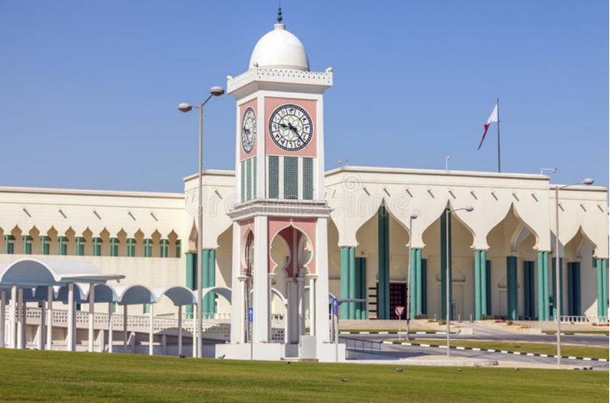
QNID

Slide 12
.
Task 1 – Pair/Group Work
Choose a Sheet: Each child picks one worksheet from three options:
Plain clocks (no colors). (MILD)
Clocks with some pink/blue shading. (SPICY)
Clocks with full pink/blue shading. (HOT)
Get Your Clock: Take a small, geared clock to help you.
Look at Each Clock: For each clock on your sheet:
Discuss with a partner or teacher:
Is the time showing ‘past’ the hour or ‘to’ the next hour?
Write the Time: Write the time in words under each clock or in your notebook. Example: "Quarter past 2" or "Half past 7".
Work Together: Go through each clock one by one with your partner or group, talking about the time as you go

Slide 13
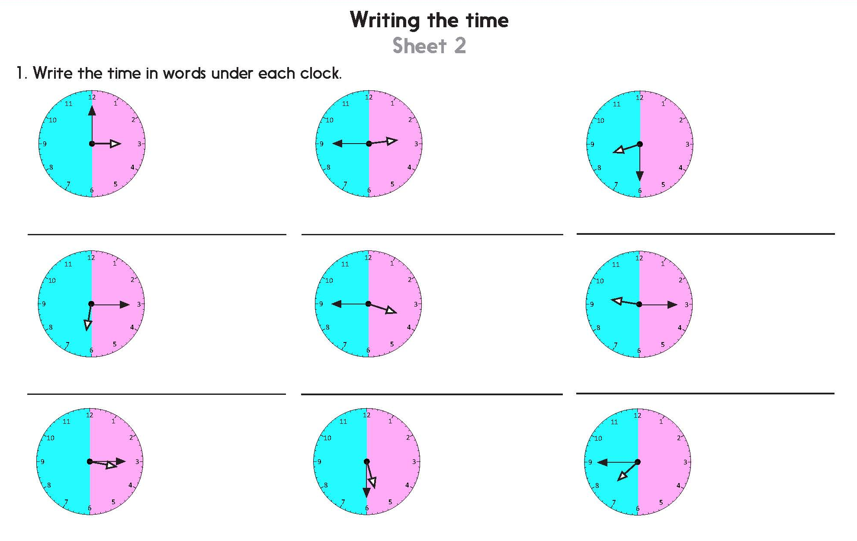
Task 2 – Independent Work
Notes:
The Practice Sheet on this slide is suitable for most children.
Differentiated PRACTICE WORKSHEETS are available on Hamilton’s website in this unit’s PROCEDURAL FLUENCY box.
WT: Writing the time Sheet 1 (2 sheets).
ARE: Writing the time Sheet 2 (2 sheets) - do question 1 and challenge.
GD: Writing the time Sheet 2 (2 sheets).

Slide 14
Plenary
Children will work together and make a time table for their class where every lesson has only 15 minutes. How will lessons go and when will the school finish off?

Slide 15
Homework
Play this game
https://www.tinytap.com/activities/g314z/play/oclock-telling-the-time-practice

