Slide 1
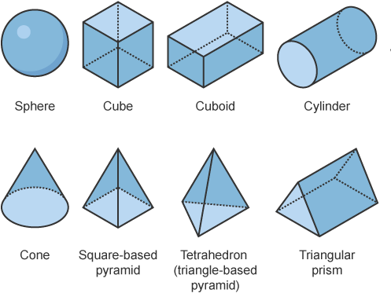
Nets of 3D Shapes

Slide 2
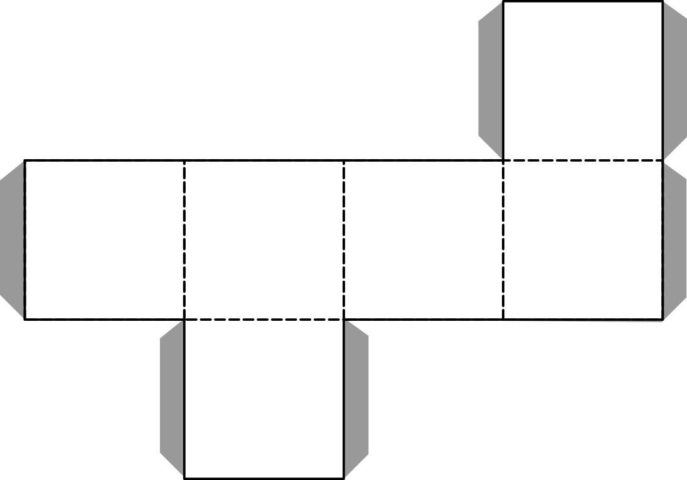
CUBE

Slide 3
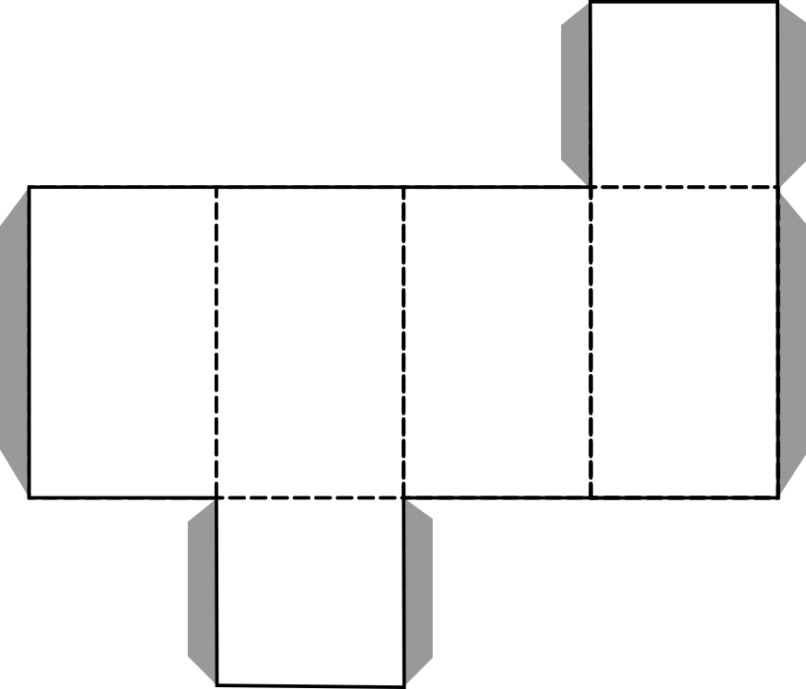
CUBOID

Slide 4
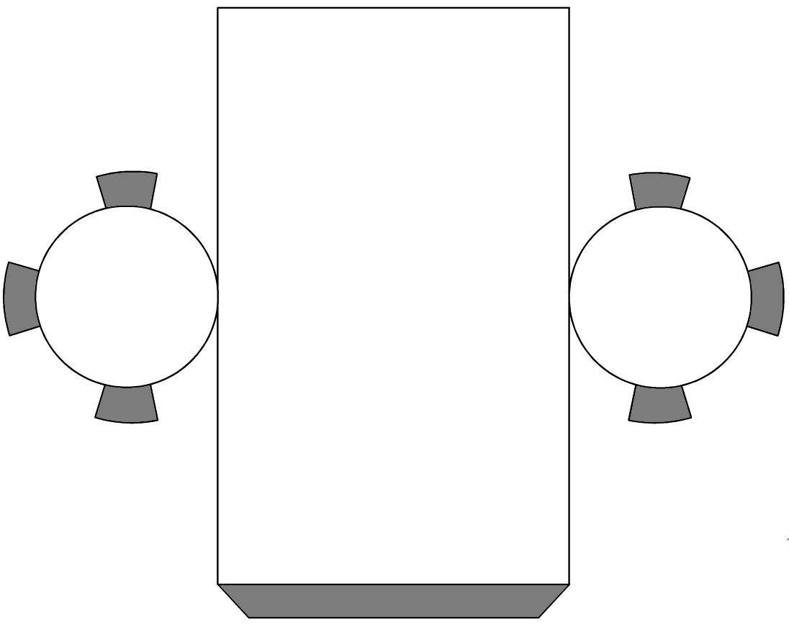
CYLINDER

Slide 5
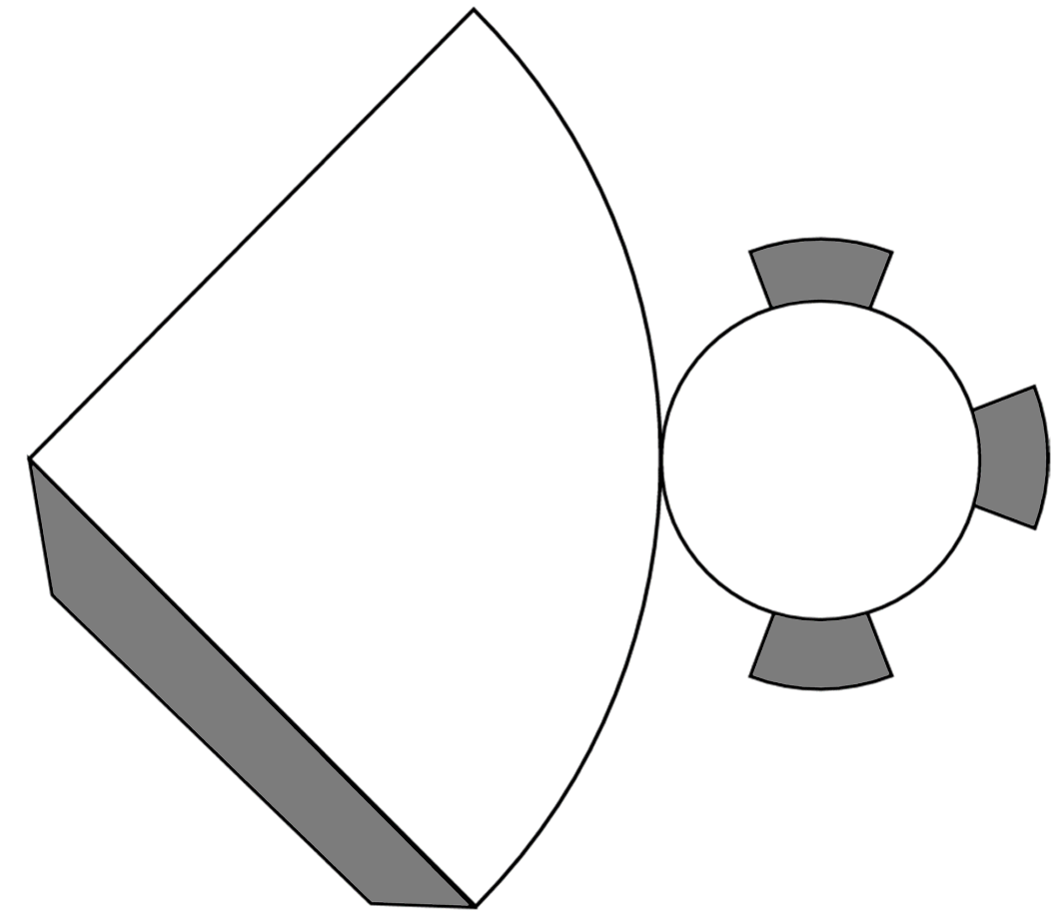
CONE

Slide 6
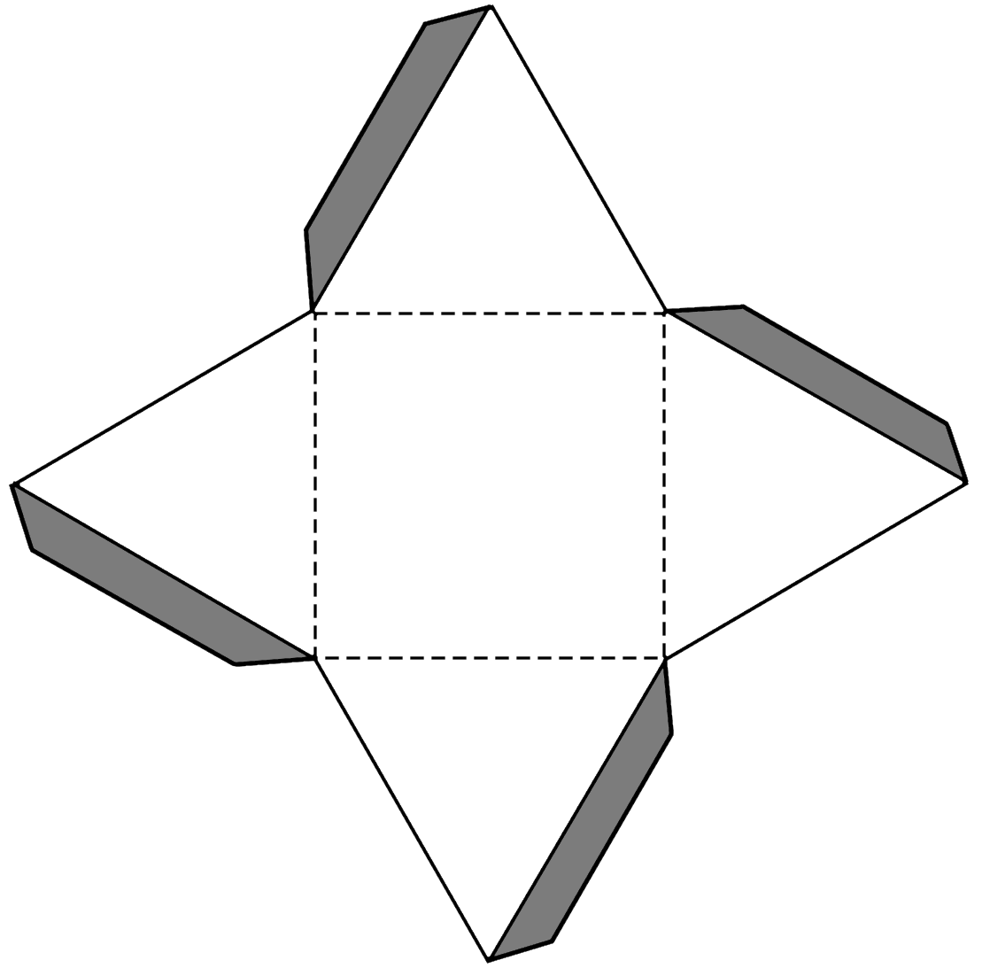
SQUARE-BASED PYRAMID

Slide 7
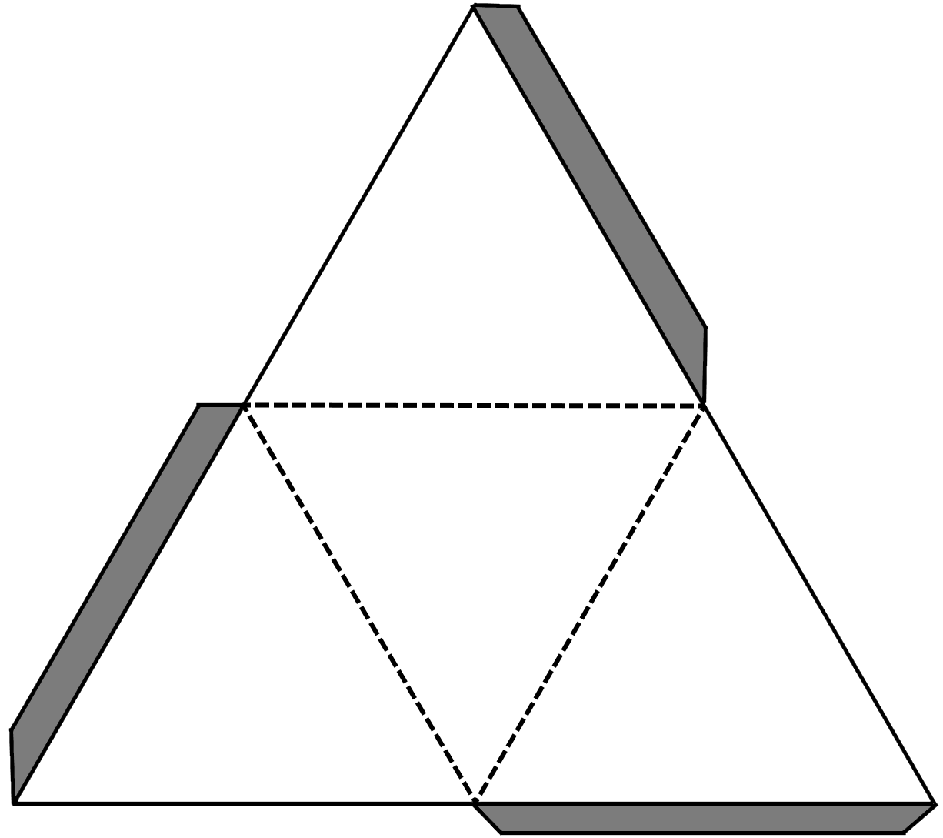
TRIANGLE-BASED PYRAMID

Slide 8
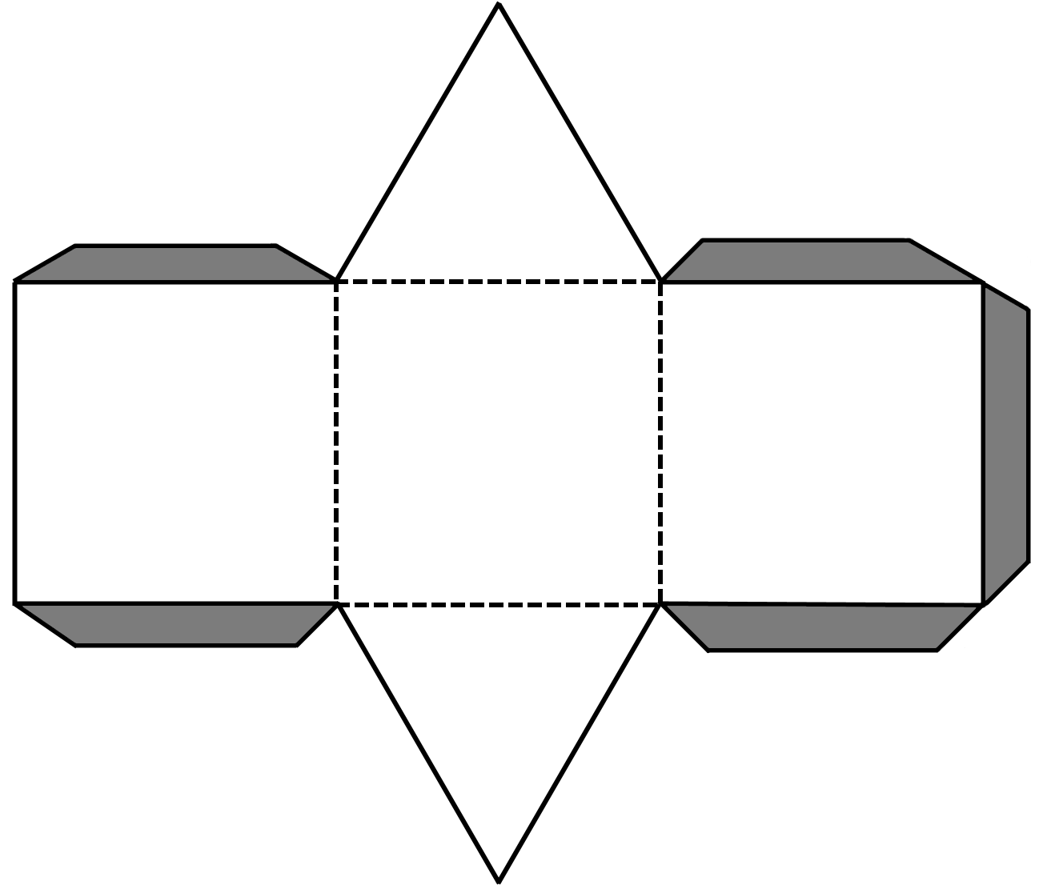
TRIANGULAR PRISM

