Slide 1

Unit 8: Be a musician
YR 3 CS T2 Wk 6 D1

Slide 2
Learning objective
confidently understand the functioning of the MakeCode platform for the Micro:bit, gaining a fundamental understanding of block-based programming concepts. predict the outcome of a change to an algorithm create programs to produce an output from an input device

Slide 3
Key Vocabulary
Volume: how loudly or quietly a sound is played
Big Question:
When you change specific parts of the algorithm, what happens to the Micro:bit's output?

Slide 4
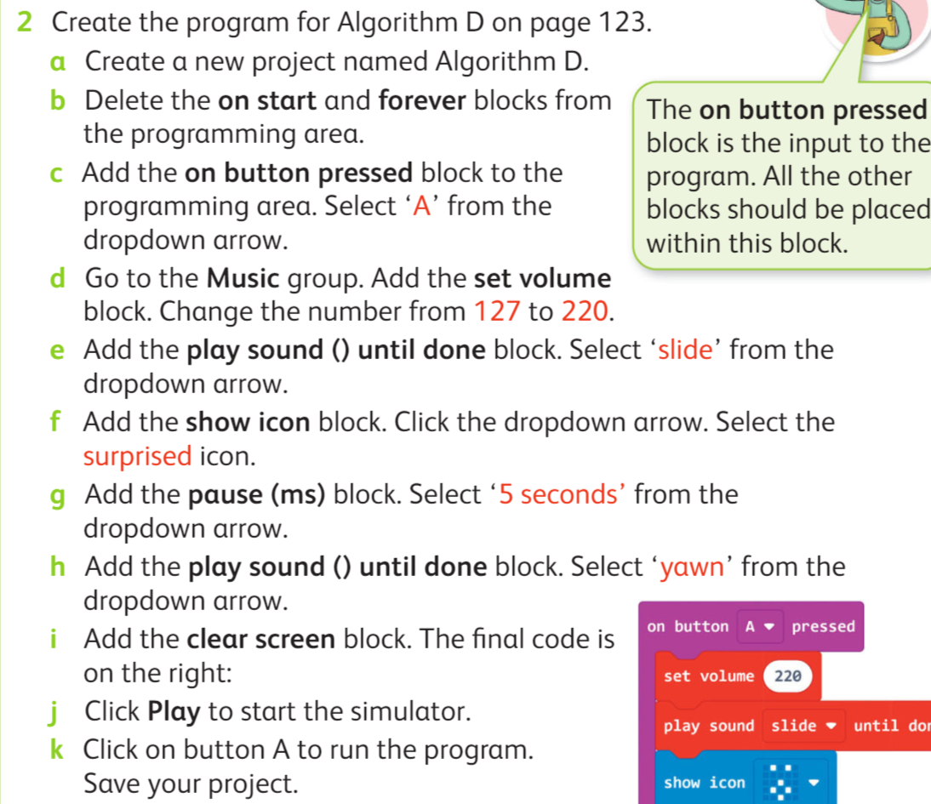
Hook Activity

Slide 5
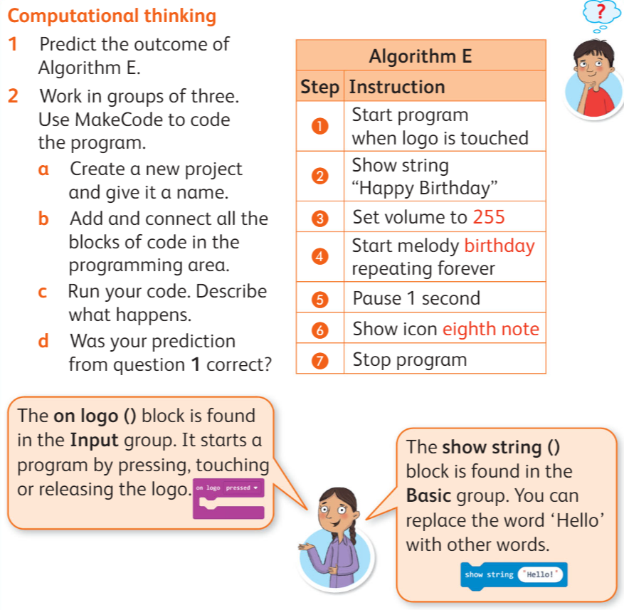
Main Activity

Slide 6
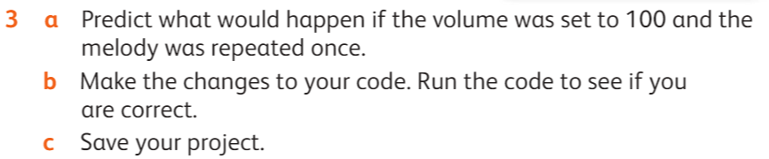
Extension Task

