Slide 1
Qatar Identity
Week 30

Slide 2
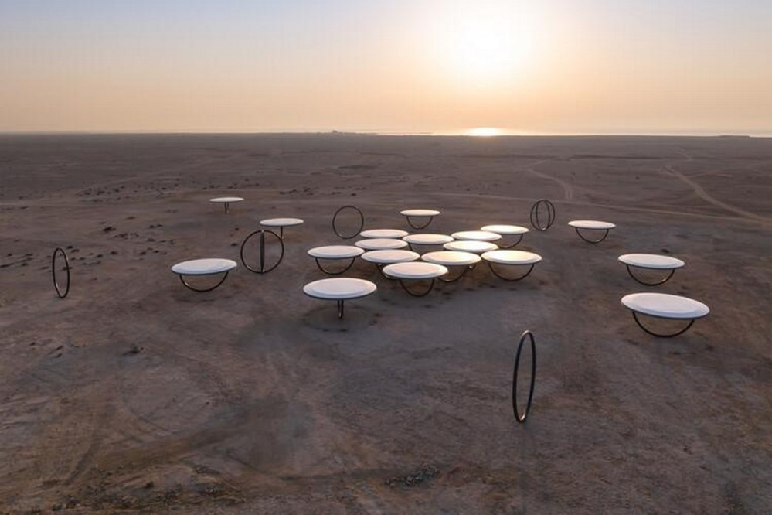
“Shadows Travelling on the Sea of the Day” Opens in Doha, Qatar

Slide 3
Artistic Statement by Olafur Eliasson:
Shadows travelling on the sea of the day is reached by driving through the rugged desert landscape, northwards from Doha, past Fort Zubarah and the village of Ain Mohammed. You may already glimpse the artwork from afar, situated on the horizon like a small informal settlement or industrial site. When you finally approach the artwork on foot, the uncertainty of what you are in fact seeing may stay with you a little while longer. The landscape – a vast, sandy plane dotted with desert plants, traces of animals, and rock formations – extends around you for many kilometres in all directions. Perhaps the shimmering line of the horizon is the artwork’s outer limit.

