Slide 1
To p i c
Input Devices
C O M P U T E R S C I E N C E
Y E A R 8

Slide 6
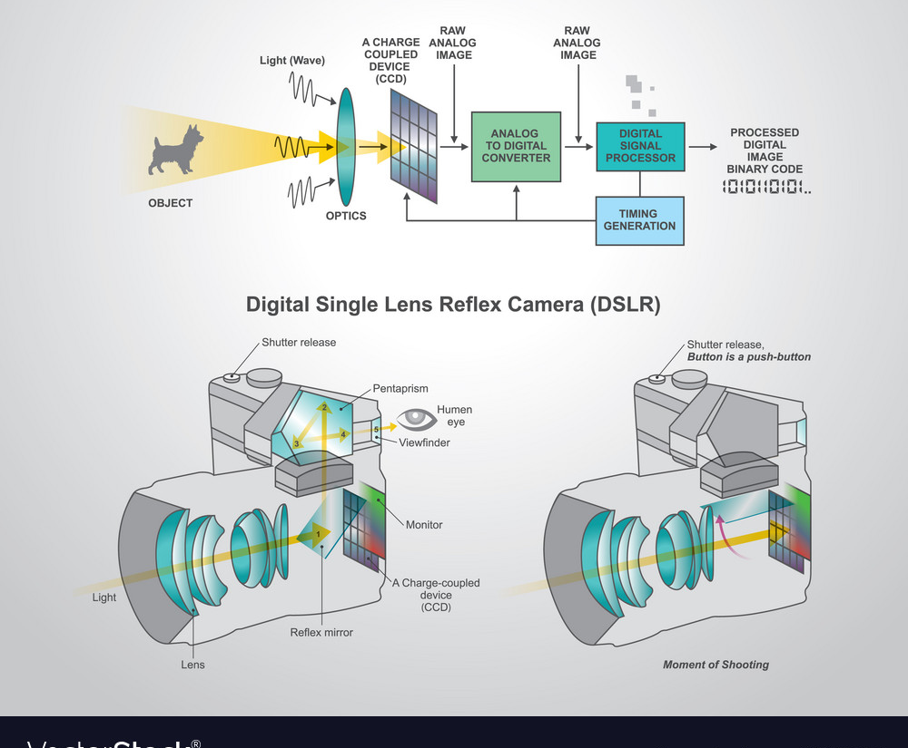
How Digital
Camera
Works?

Slide 13
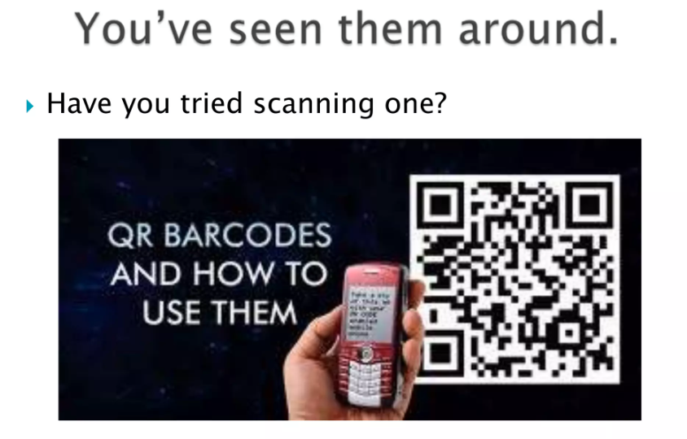

Slide 15
Thank You!

