Slide 1
CALCULATE
Work out from given facts, figures or information

Slide 2
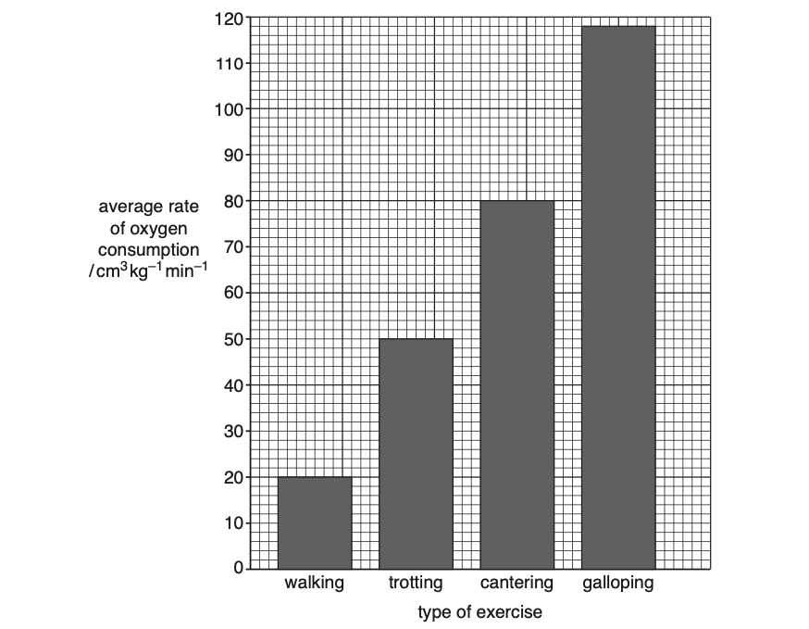
Calculate the percentage increase in the average rate of oxygen consumption as the horses change from walking to trotting. Show your working. [2]

Slide 3
ANSWER
46%

Slide 4
REVISION TIPS
Read what is asked carefully.
Percentage decrease is commonly mistaken with difference.
Show your working.
Check the significant figures and decimal places.
Include units if needed.

