Slide 1

To p i c
FOR TO NEXT LOOP
C O M P U T E R S C I E N C E
Y E A R 8

Slide 2


Slide 3
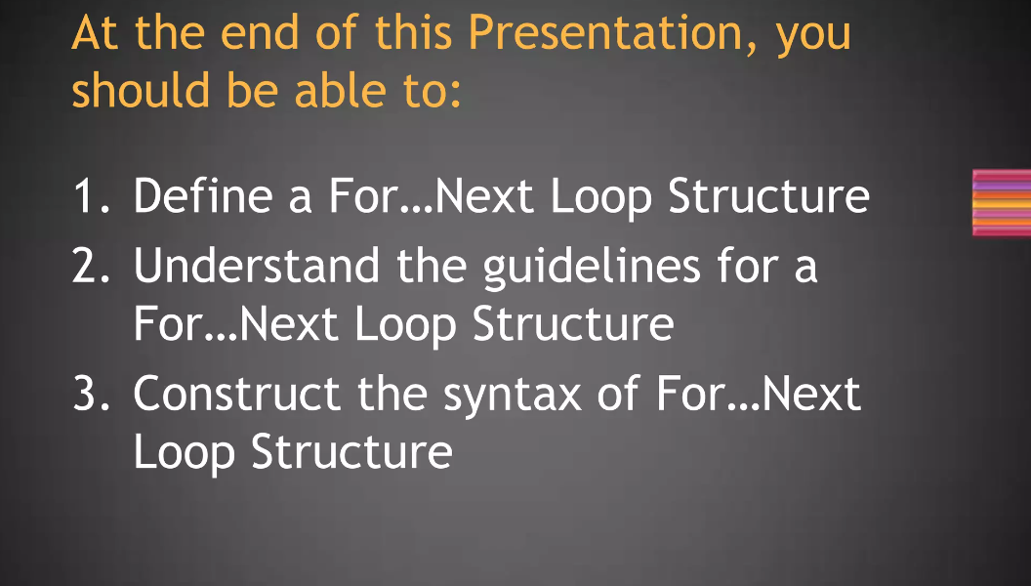

Slide 4
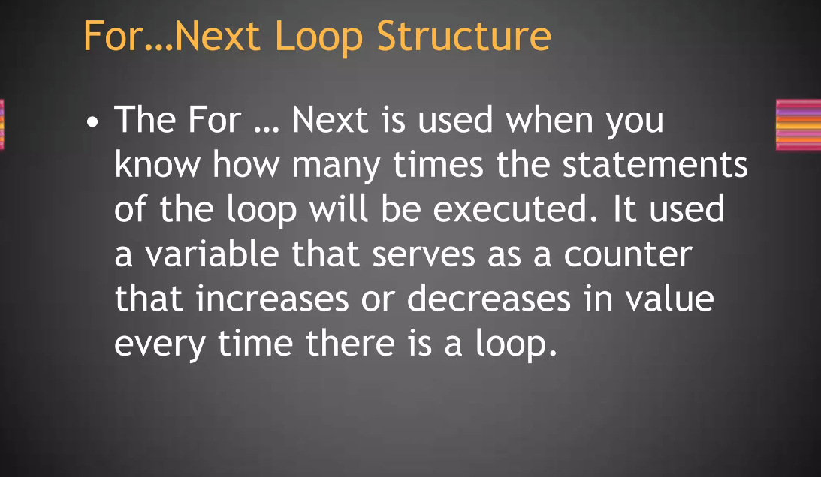

Slide 5
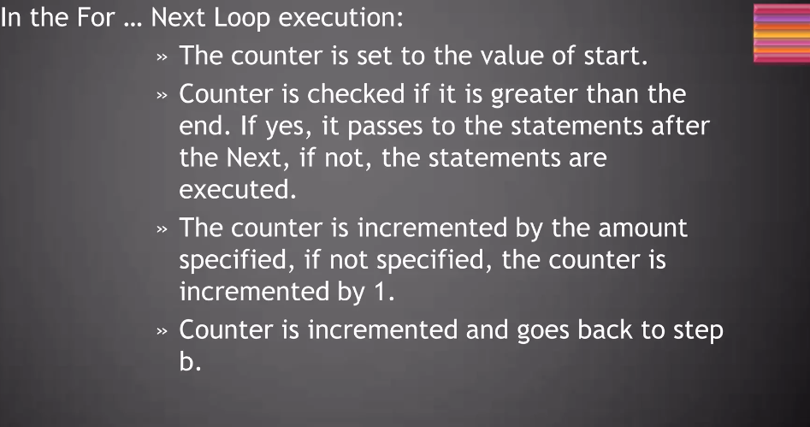

Slide 6
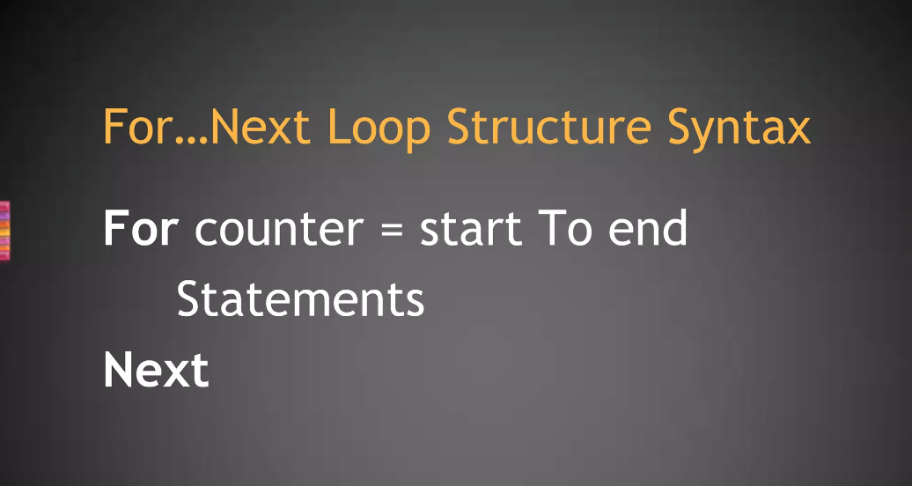

Slide 7
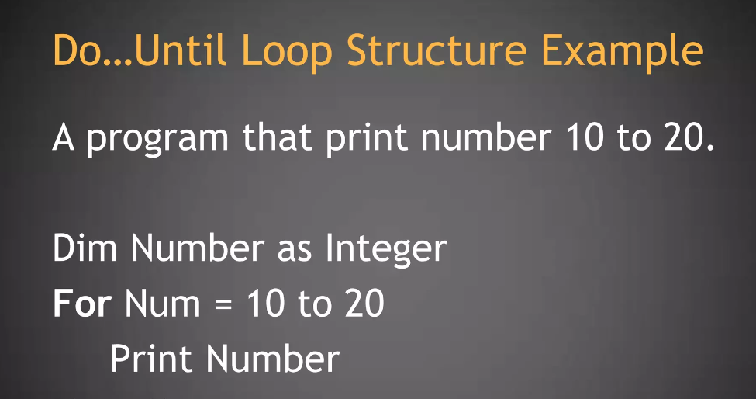

Slide 8
Thank You!

