Slide 1
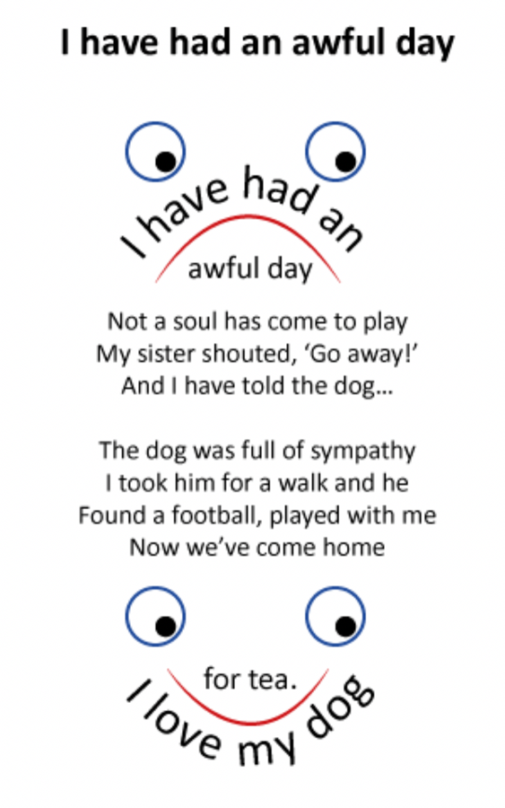
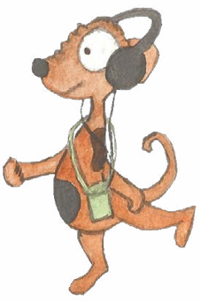
Shape Poems
Tense
1. Past and present (simple)
2. Progressive form of verbs: present and past
3. Perfect form of verbs

Slide 2

Verbs
Verbs indicate that someone or something is
doing, feeling or being.
verbs
verbs
Omar loves his cat.
Omar’s cat sleeps all day long.
I sympathise.
I absolutely adore my budgie.
Usually verbs have the name of a person or thing or a pronoun in front of them.
Can you spot these?

Slide 3

Verbs have a tense.
They can tell us when the action happened.
Omar’s cat caught a mouse.
In the past
or in the present.
My budgie sings all day long.
Write a sentence in the present tense.
Example
Ask your partner to rewrite it in the past tense.
I play football every Saturday.
I played football every Saturday.

Slide 4
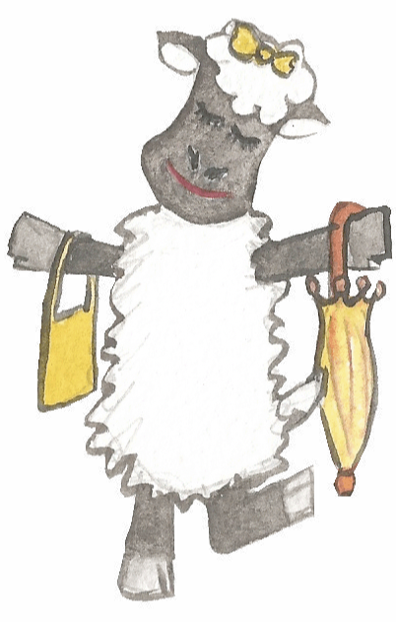
Verbs have a tense.
They can tell us when the action happened.
Past tense | Present tense
The sheep walked.
The sheep walks.
She carried a bag.
She carries a bag.
I ate an ice-cream.
I eat an ice-cream.
You did not have to smile.
You do not have to smile.

Slide 5

For regular verbs we add ed to show that an action is
in the past and complete.
walked
jumped
scored
danced
skated
listened
balanced
Irregular verbs take different forms when showing past tense; we learn them through hearing them used.
ran
won
did
threw

Slide 6
ANSWERS
Past tense
Simple past | Simple present
It rains and rains.
Omar carries the cat.
We do not want to go.
We are lost!
Change these verbs into simple past tense.

Slide 7
ANSWERS
Past tense
Simple past | Simple present
It rained and rained.
It rains and rains.
Omar carried the cat.
Omar carries the cat.
We did not want to go.
We do not want to go.
We were lost!
We are lost!
Change these verbs into simple past tense.

Slide 8
ANSWERS
Present tense
Simple past | Simple present
My budgie squawked.
Omar grabbed his cat.
We found the cage.
I was relieved.
Turn these verbs into simple present tense.

Slide 9
ANSWERS
Present tense
Simple past | Simple present
My budgie squawked.
My budgie squawks.
Omar grabbed his cat.
Omar grabs his cat.
We found the cage.
We find the cage.
I was relieved.
I am relieved.
Turn these verbs into simple present tense.

Slide 10


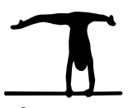
Progressive form of verbs:
Present and past progressive (continuous)
She was running.
Alice is balancing.
They are playing.

Slide 11

The progressive form is continuous.
It suggests that the action progresses,
for a period of time.
Tom’s tortoise was waiting for his lettuce.
or progresses at the time something else happens or happened.
Tom’s tortoise was waiting when he saw the lawnmower.
This can be in the present (happening now)
or in the past (happened then).
WOW!
It missed me!
EEK! There’s a lawnmower

Slide 12

Progressive form of verbs: present and past progressive
Past progressive | Present | Present progressive
He was walking
He walks
He is walking
She was running
She runs
She is running
The dog was whining
The dog whines
The dog is whining
We were listening
We listen
We are listening

Slide 13

Progressive form of verbs: past progressive
Think of a sentence which shows that the children did this verb for a while.
Think of a sentence which shows that the children did this verb once.
The children leapt.
leap
The children were leaping.
This past progressive form shows the action continued for a while.
Hint: use were
The children were leaping about when the teacher opened the classroom door.
Can you use past progressive form?

Slide 14

Progressive form of verbs: past progressive
Think of a sentence which shows that we did this verb when the teacher arrived.
Think of a sentence which shows that we did this verb for a short time.
We quarrelled.
quarrel
Hint: use were
We were quarrelling when the teacher arrived.
This past progressive form shows the action continued when something else occurred.
Can you use past progressive form?
The children were quarrelling about the snake!

Slide 15
Choosing past simple or past progressive form
Would this be a short action or a longer one?
The whole class is having its best day ever.
The whole class had its best day ever.
Which verb form sounds longer?
The whole class was having its best day ever.
A day takes a while so the past progressive form is best.
How would you write this in the past form?

Slide 16


To make verbs progressive:
Add one of… is, are, am, was, were
Use -ing participle of the verb
Present progressive
Past progressive
She makes a mess.
She is making a mess.
She was making a mess.
auxiliary verb indicates the tense
He chirps softly.
He is chirping softly.
He was chirping softly.
They fly around.
They are flying around.
They were flying around.
Try changing these verb forms to present and past progressive.

Slide 17
Perfect form of verbs
She has won all of her fights in this competition.
Ali has achieved a top score.
We have tried our best.

Slide 18
Perfect form
The perfect form of the past tense suggests that
a past action is still affecting the present.
still affecting the present.
Ali punctured the ball in the past and it is still flat.
Simple past | Perfect form
Ali punctured the ball.
Ali has punctured the ball.
I injured my knee in the past and it still hurts!
I injured my knee.
I have injured my knee.
We had a horrible day .
We have had a horrible day.
We had a horrible day in the past and we are still in it!

Slide 19
Perfect Form
The perfect form is created using the verb ‘have/has’.
Omar has collected four trophies.
She has skated here for years.
We have picked our teams already.
Ali has taken the last drink.
I have forgotten my kit.
Tom has swum in three competitions.

Slide 20
Perfect form
Change these sentences into the simple past,
Perfect Form
has/have + verb-ed
and then the perfect form.
Omar balances carefully .
We ride our bikes.
Ali catches the ball.
Simple past | Perfect form
Omar balanced carefully.
Omar has balanced carefully.
Ali caught the ball.
Ali has caught the ball.
We rode our bikes.
We have ridden our bikes.

Slide 21
ANSWERS
Perfect form of past tense
Simple past | Perfect form
My day sucked.
Omar was cross with me.
The teacher shouted.
I sulked all evening.
Turn these verbs into perfect form.

Slide 22
ANSWERS
Perfect form of past tense
Simple past | Perfect form
Omar was cross with me.
Omar has been cross.
The teacher shouted.
The teacher has shouted.
I sulked all evening.
I have sulked all evening.
Turn these verbs into perfect form.

Slide 23
End

