Slide 1
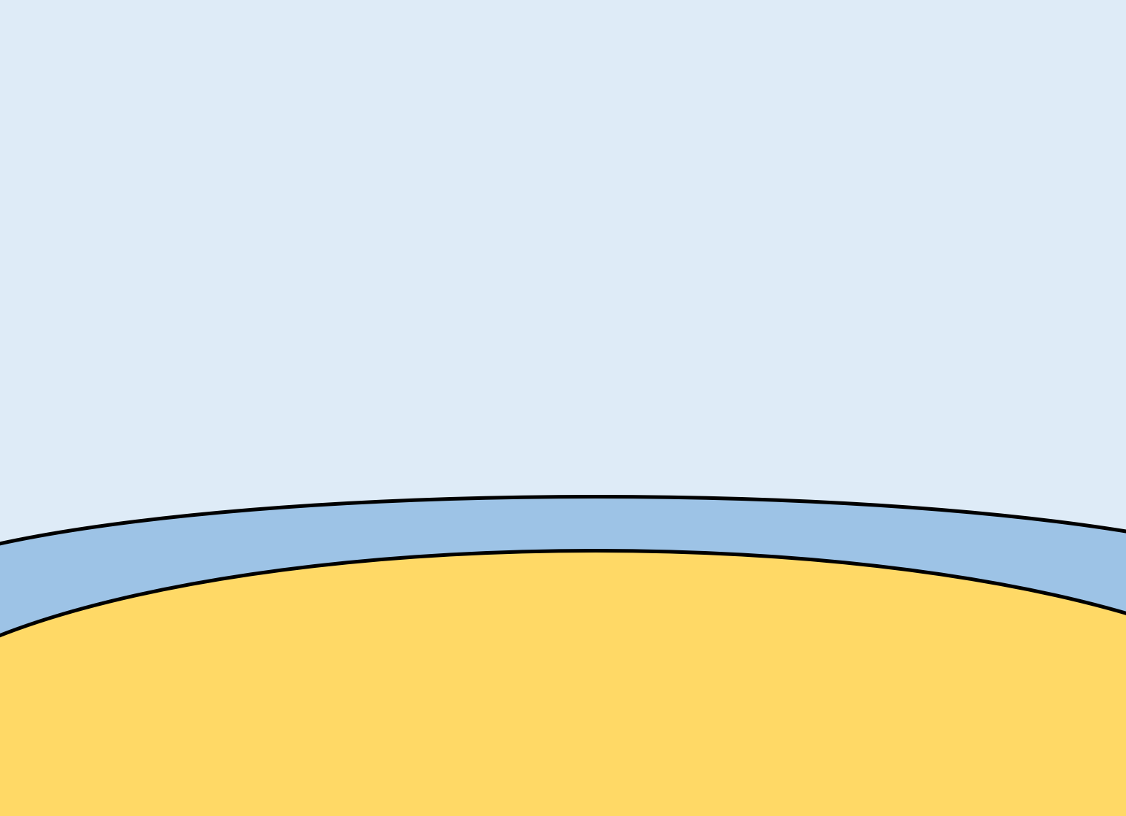
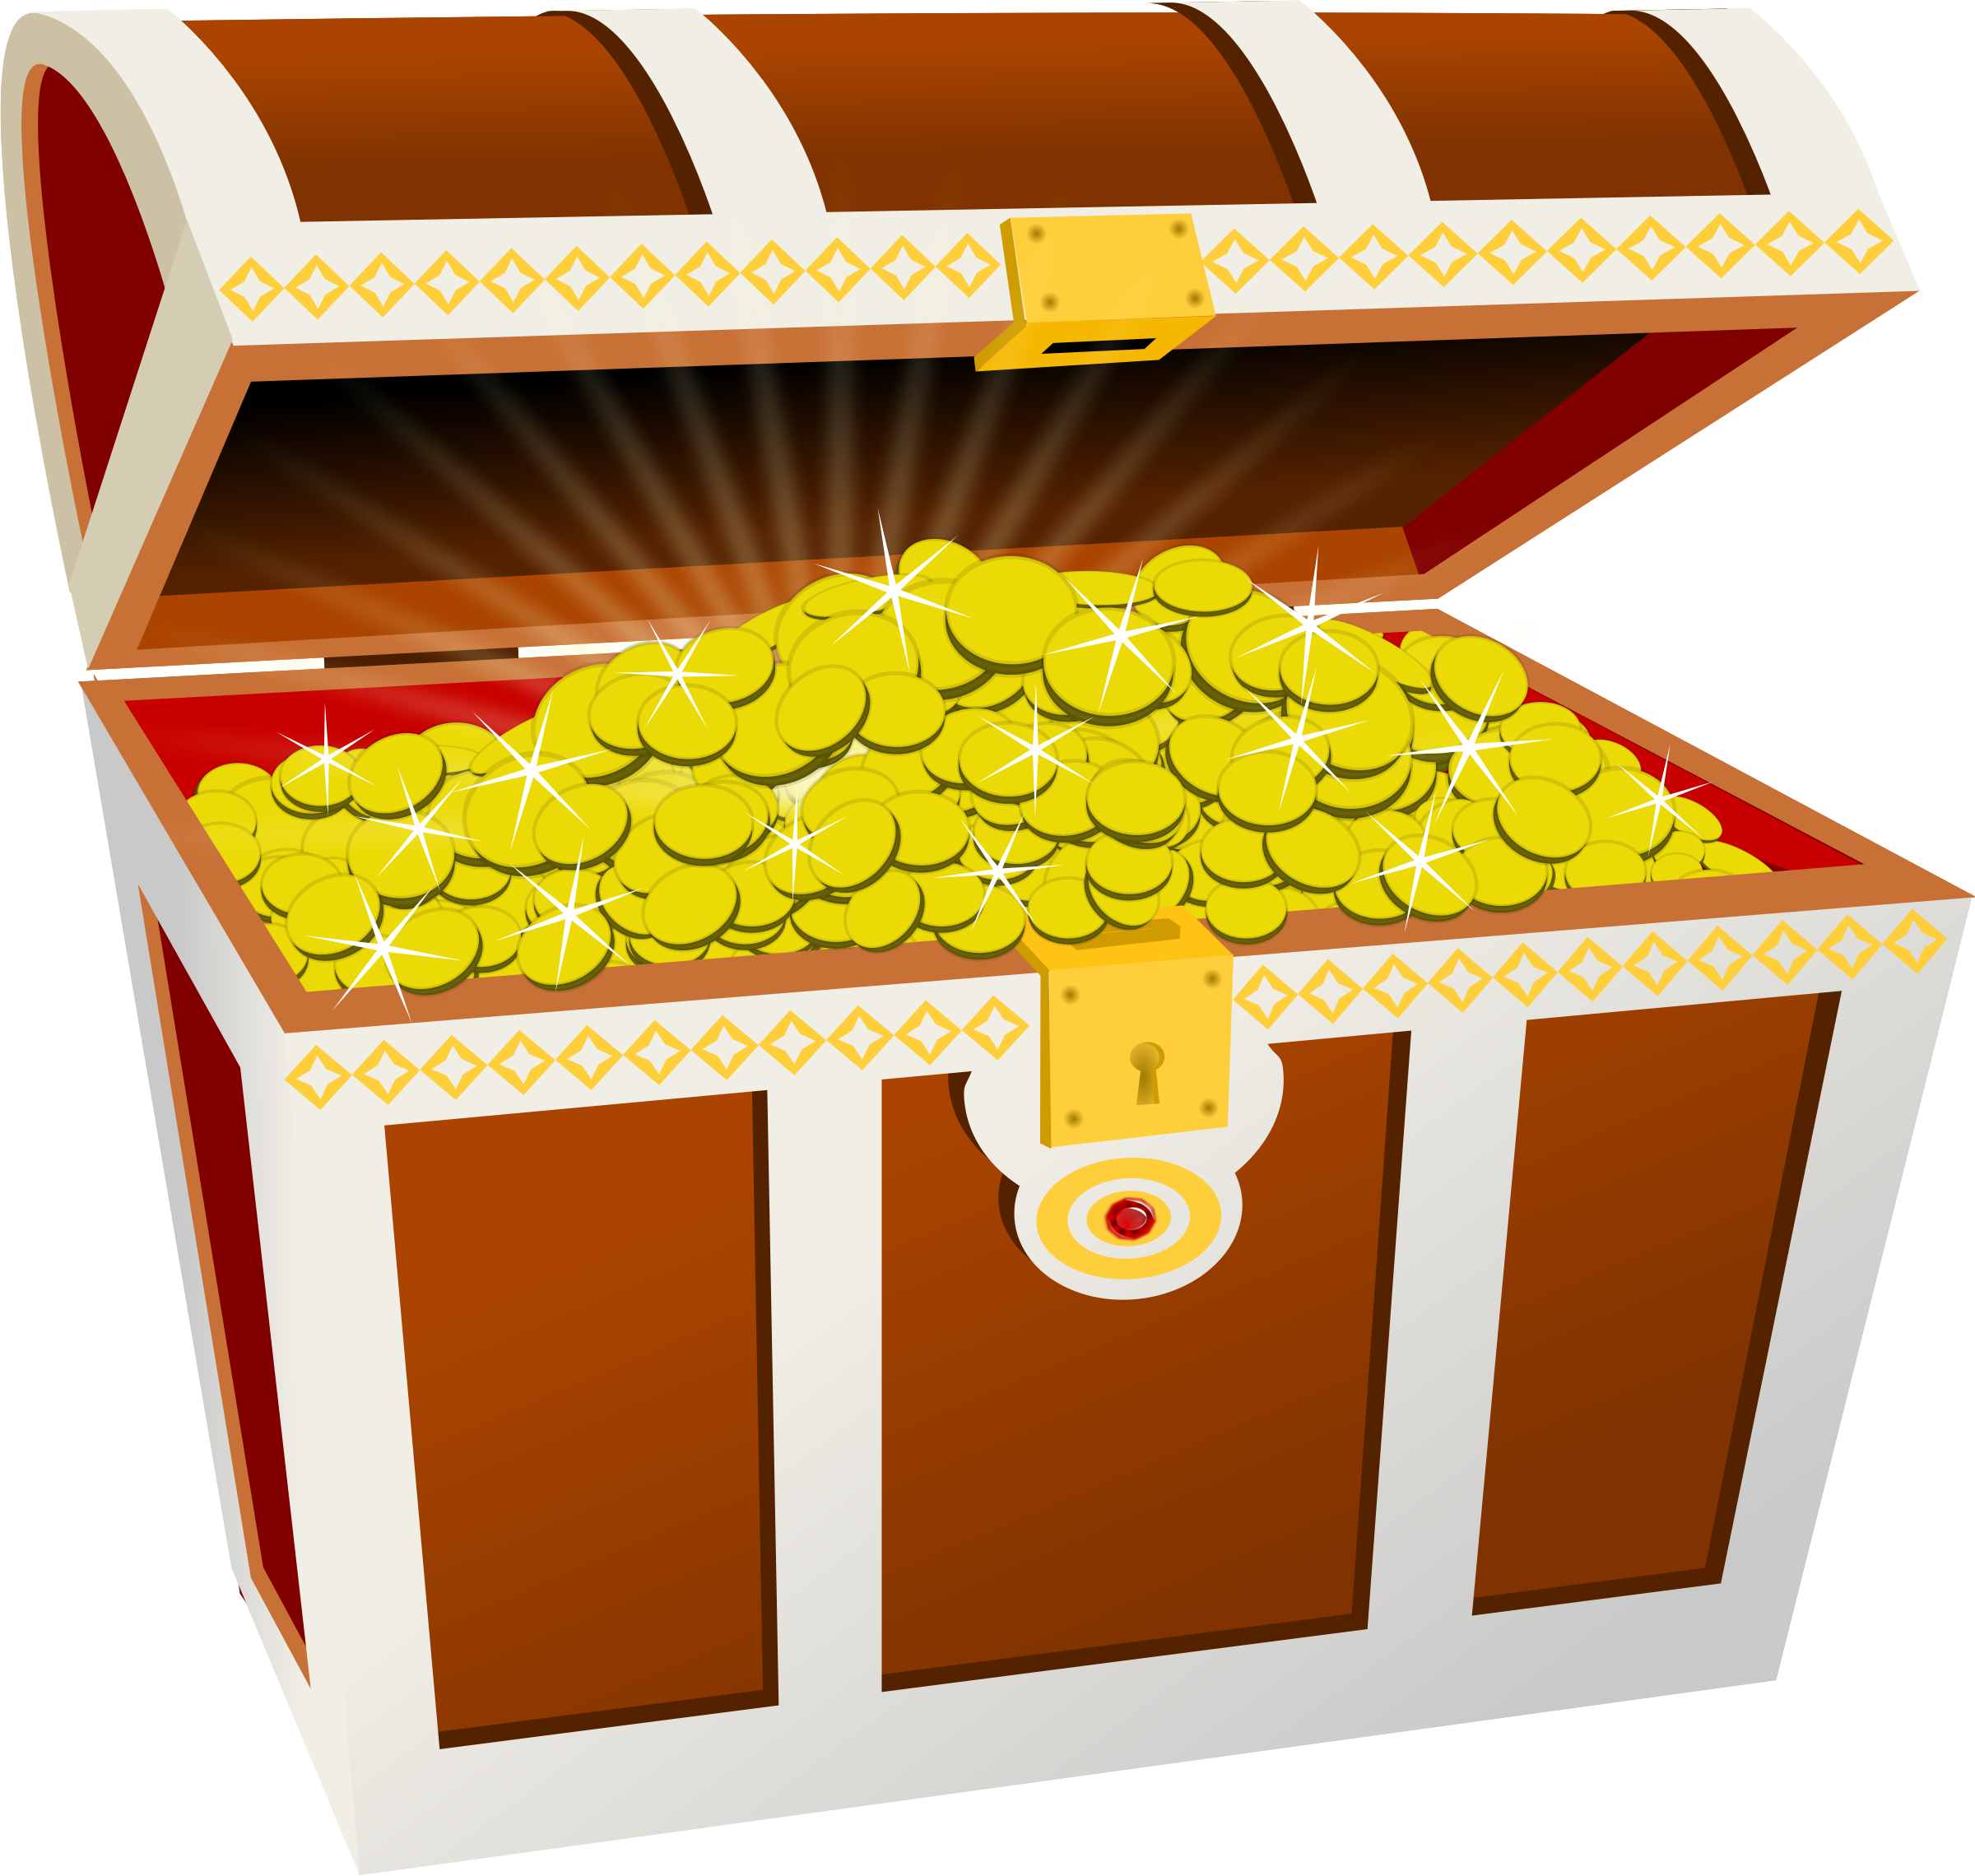
Treasure TRAIL
Ratio

Slide 2
1:5
I
Find the ratio of squares to circles and simplify.

Slide 3
£300
L
Janice was mixing a drink.
She needed to mix concentrate to water
in the ratio 3:4
She had 240ml of concentrate.
How much water did she need?

Slide 4
£16
N
Find the ratio of hexagons to triangles.
What fraction of the shapes are triangles?

Slide 5
$$\frac{1}{3}$$
H
Sam & Pam & Dan stole £360!
They shared it in the ratio 1:2:3
How much did Pam & Dan get together?

Slide 6
125ml
C
56:77
Write this ratio in its simplest form.

Slide 7
1:4
E
Michael was mixing a drink.
He needed to mix concentrate to water
in the ratio 5:6
He had 150ml of water.
How much concentrate did he need?

Slide 8
£50
F
Find the ratio of triangles to circles.
What fraction of the shapes are triangles?

Slide 9
320ml
B
Tom & Dom got their
pocket money in the ratio 4:5
Dom got £20 a week.
How much did Tom get a week?

Slide 10
8:11
A
Two ninjas stole £300!
The first ninja got £50.
What ratio did they share the money in?

Slide 11
3:2
O
John & Jane stole £250!
They shared it in the ratio 4:1
How much did Jane get?

Slide 12
£250
J
240:320
Write this ratio in its simplest form.

Slide 13
£80
P
What is the ratio of hearts to stars?

Slide 14
4:5
M
Danny was mixing a drink.
He mixed concentrate to water
in the ratio 6:5
She used 250ml of water.
How much concentrate did she use?

Slide 15
300ml
D
Tam & Sam stole £450!
They shared it in the ratio 5:4
How much did Tam get?

Slide 16
3:4
K
Mick & Rick stole £140!
They shared it in the ratio 3:4
How much did Rick get?

Slide 17
$$\frac{2}{5}$$
G
Hannah & Anna got £20 and £25
for their birthday from their aunt.
What ratio is this?

Slide 18
Answer Sheet
Sheet | Answer | Sheet | Answer

Slide 19
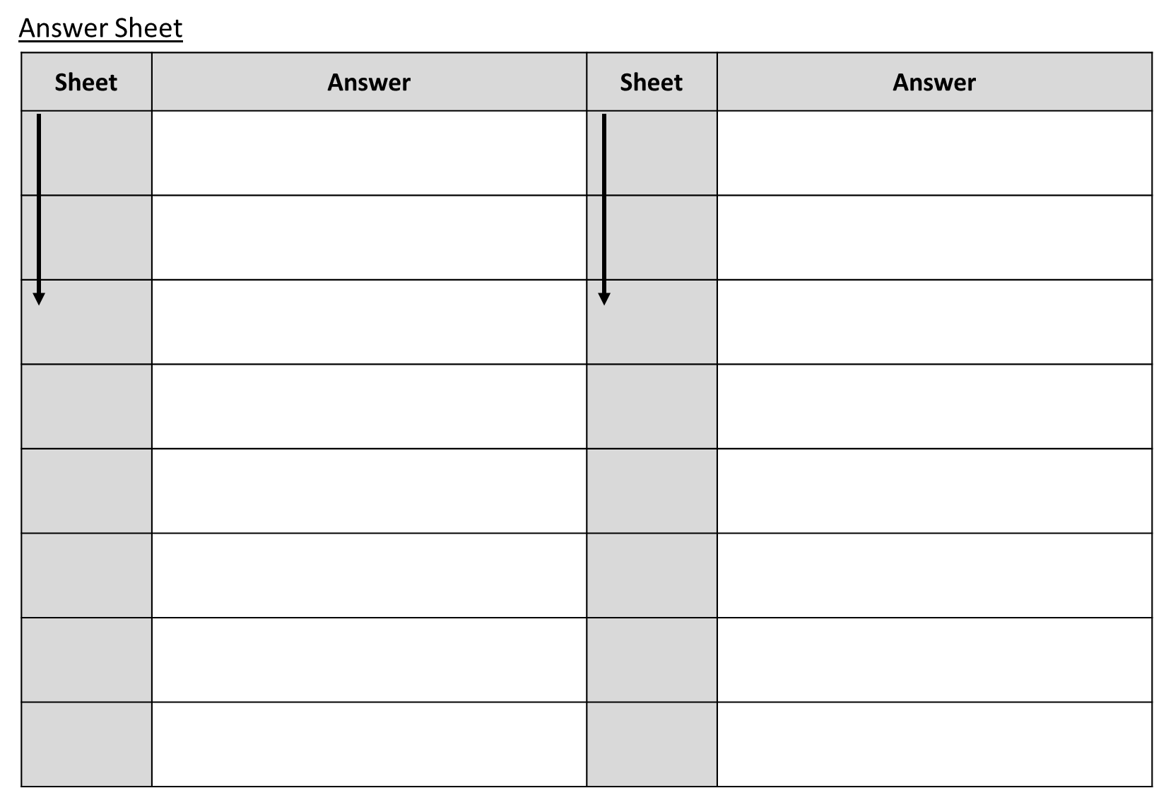

Slide 20
Teacher’s Answer Sheet
Sheet | Answer | Sheet | Answer
A | 1:5 | G | 4:5
I | 3:2 | M | 300ml
O | £50 | D | £250
F | 1/3 | J | 3:4
H | £300 | K | £80
L | 320ml | P | 1:4
B | £16 | E | 125ml
N | 2/5 | C | 8:11

