Slide 1
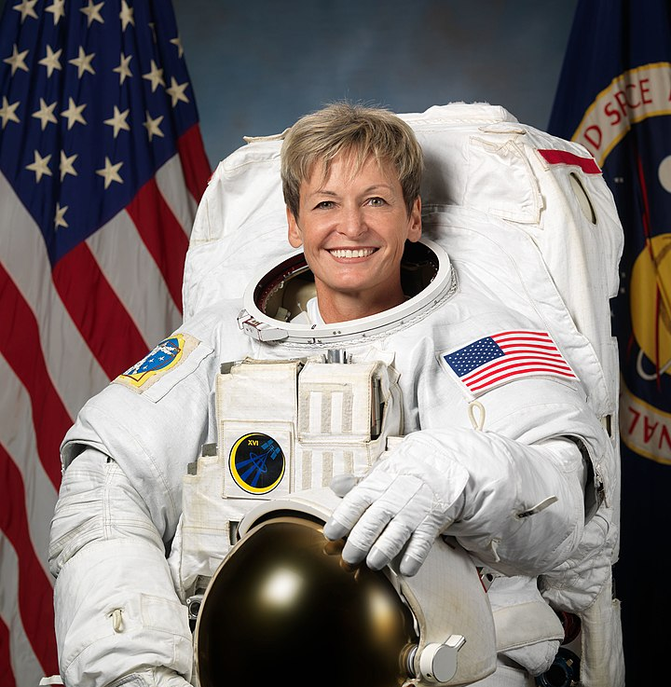
Conjunctions to express time, place and cause
Amazing Records
Notes:
NASA / CC BY-SA (https://creativecommons.org/licenses/by-sa/3.0)

Slide 2
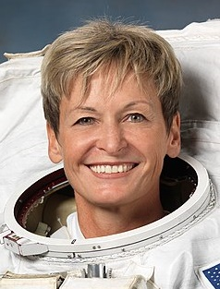
Why?
Conjunctions
Conjunctions are joining words.
They help add more detail by joining extra clauses
explaining when or why or where something might be.
because
as
so
conjunctions
Peggy Whitson is a record breaker.
Peggy Whitson is a record breaker because she is the oldest woman to fly into space.
Peggy Whitson is a record breaker as she has spent longer in space than any other American.
So she could be an astronaut, Peggy trained for many years.
We call an extra clause which adds to the main information a subordinate clause.

Slide 3
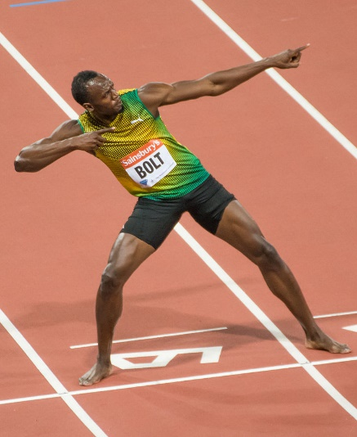
Conjunctions
Conjunctions are joining words.
They help add more detail by joining extra clauses
explaining when or why or where something might be.
When?
conjunctions
Usain Bolt became famous.
before
after
when
while
as
until
Usain Bolt became famous while breaking several records.
Usain Bolt became famous when he became the world’s fastest man.
After many years of training, Usain Bolt became famous.
More detail is given by adding a subordinate clause.
Notes:
https://creativecommons.org/licenses/by-sa/3.0/

Slide 4
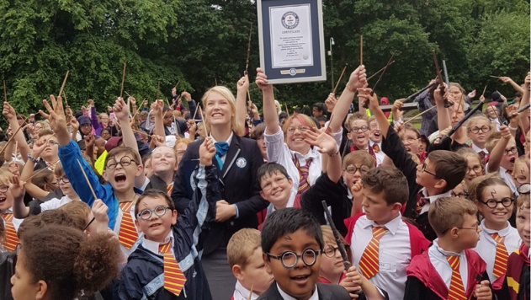
where
wherever
Conjunctions
Conjunctions are joining words.
They help add more detail by joining extra clauses
explaining when or why or where something might be.
conjunctions
Children dressed as Harry Potter gathered.
Where?
Children dressed as Harry Potter gathered where a record was to be broken.
Wherever locals looked, they could see glasses, scars and Hogwarts scarves.
An adjudicator counted the 676 children where they stood in Bolton town square.
The (extra) subordinate clause can go before or after the main information.
Notes:
https://www.guinnessworldrecords.com/news/2017/6/hundreds-of-kids-dress-up-as-harry-potter-to-celebrate-20th-anniversary-of-iconic-478394/

Slide 5

Joining clauses using Conjunctions
This Bulldog broke a record
when
he achieved fastest 100 m by a dog in 2009.
Tilman caused a stir
wherever
he went on his skateboard.
Tilman the skateboarding dog
He loved skateboarding
as
he was a bit of a thrill seeker!
Which conjunctions could you use to join these clauses?
When?
before
after
when
while
as
until
Why?
because
as
so
When did he break the record?
Where did he cause a stir?
Why did he love skateboarding?
Where?
where
wherever
Notes:
https://www.guinnessworldrecords.com/news/2015/10/tillman-the-fastest-dog-on-a-skateboard-has-died-404387

Slide 6
Joining clauses using Conjunctions
This Bulldog broke a record
when
he achieved fastest 100 m by a dog in 2009.
Tilman caused a stir
wherever
he went on his skateboard.
Tilman the skateboarding dog
He loved skateboarding
as
he was a bit of a thrill seeker!
When he achieved fastest 100 m by a dog in 2009, this Bulldog broke a record.
When?
before
after
when
while
as
until
Wherever he went on his skateboard, Tilman caused a stir.
Why?
because
as
so
When did he break the record?
Where did he cause a stir?
Why did he love skateboarding?
Can you hear the pause as you say these? We
use a comma to show this.
Where?
where
wherever
As he was a bit of a thrill seeker, he loved skateboarding.
We can swap the order, starting with the conjunction and subordinate clause.
Notes:
https://www.guinnessworldrecords.com/news/2015/10/tillman-the-fastest-dog-on-a-skateboard-has-died-404387 As Tilman is no longer with us, past tense form has been used.

Slide 7
Conjunctions in information writing
Why?
because
as
so
When?
before
after
when
while
as
until
as
We can use conjunctions to give more information on our topics.
When did the record take place?
Why was it a record?
Where did it happen?
Where?
where
wherever
When we elaborate we give more information or explain further.

Slide 8
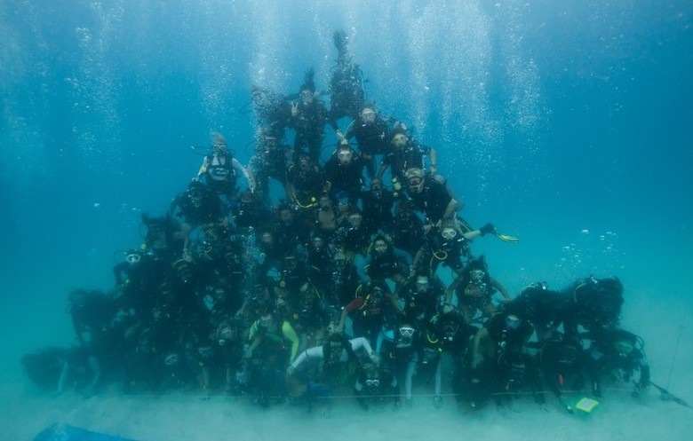
We can explain more about this record using conjunctions.
This image is a record breaker because
This image is a record breaker because it shows the largest underwater human pyramid.
It happened when
It happened when 62 people were brought together in 2013 by three divers.
The record was achieved where
We can add a subordinate clause to explain further or give more information.
The record was achieved where the waters were safest in Thailand.
Notes:
https://www.guinnessworldrecords.com/world-records/largest-underwater-human-pyramid?fb_comment_id=706040809509847_946125542168038

Slide 9
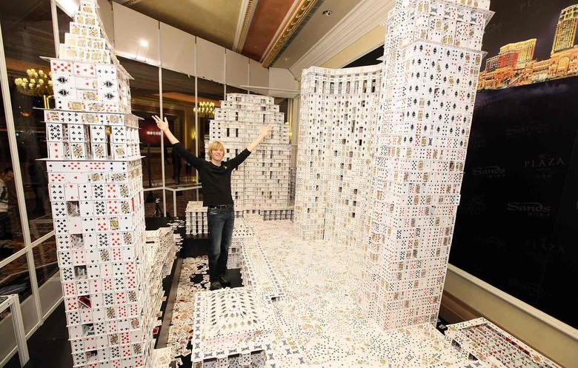
Conjunctions help us to give detailed information.
Record: The largest playing card structure
Location: China
Record Holder: Bryan Berg
Date: 10 March 2010
Time taken: 44 days
Number of cards: 218,792
Other facts:
a replica of a real hotel complex in China
10.39 m long, 2.88 m tall, and 3.54 m wide
a trained architect & professional card stacker
What do you think this record is about?
Use conjunctions to give more information about this record (where, when and why), by writing sentences with subordinate clauses.
Notes:
https://www.guinnessworldrecords.com/world-records/largest-playing-card-structure?fb_comment_id=673553416096967_993533797432259/

Slide 10

This is a Hamilton Trust Presentation. For more fantastic resources visit our website
https://www.hamilton-trust.org.uk/ .

