Slide 1
Importance of data.
Week 8 LP 02

Slide 2
1. Retail:
Inventory Management: Retailers analyze sales data to optimize stock levels, reducing overstock and stock outs.
Customer Insights: Data from purchase history helps tailor marketing strategies and improve customer experience through personalized recommendations.

Slide 3
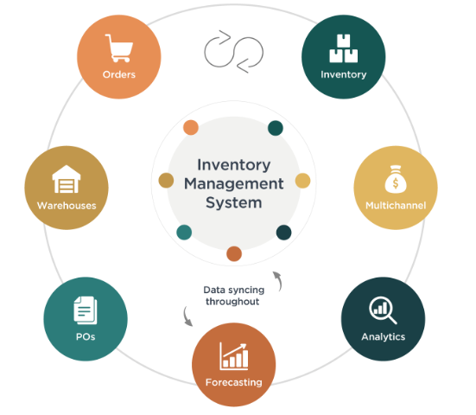

Slide 4
Healthcare
Patient Outcomes: Analyzing patient data helps in identifying effective treatments, improving care quality, and reducing costs.
Operational Efficiency: Hospitals use data to optimize staffing, reduce wait times, and streamline processes.

Slide 6
Manufacturing
Quality Control: Data analytics helps in monitoring production processes, identifying defects, and minimizing waste.
Predictive Maintenance: Machine data is analyzed to predict failures and schedule maintenance, reducing downtime.

Slide 7
