Slide 1
PETROLEUM AND ITS PRODUCTS

Slide 2
GETTING STARTED
What are the three major fossil fuels?
How has the use of these resources benefitted our lives?
Environmental concerns mean that we need to explore alternatives to some uses of these resources. What changes do you feel are the most crucial?

Slide 3
Fossil Fuels
Coal –mixture of organic compounds from fossil plant material
Petroleum (Crude Oil)- mixture of organic compounds
  Organic material shale rocks squeezing out oil and gas
Natural gas- mainly methane and butane and other hydrocarbon gases

Slide 4
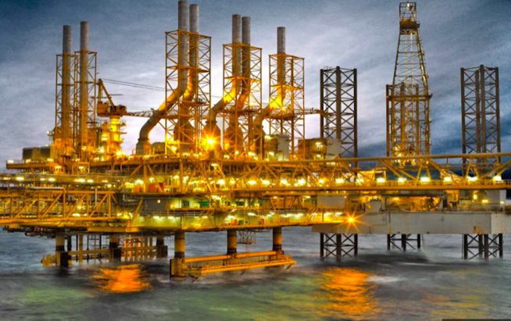
Al Shaheen Oil Field

Slide 5
KEY WORDS
non-renewable (finite) resources: sources of energy, such as fossil fuels, and other resources formed in the Earth over many millions of years, which we are now using up at a rapid rate and cannot replace
chemical feedstock: a chemical element or compound which can be used as a raw material for an industrial process making useful chemical products
fractional distillation: a method of distillation using a fractionating column, used to separate liquids with different boiling points

Slide 6
KEY WORDS
fractions (from distillation): the different mixtures that distil over at different temperatures during fractional distillation
fractionating column: the vertical column that is used to bring about the separation of liquids in fractional distillation

Slide 7
Various Petroleum Fractions
Fraction | Number of Carbon Atoms | Approximate boiling range /º C
Refinery gas | 1-4 | Below 25
Gasoline/ petrol | 4-12 | 40-100
naphtha | 7-14 | 90-150
Kerosine/paraffin | 12-16 | 150-240
Diesel/gas oil | 14-18 | 220-300
Fuel oil | 19-25 | 250-320
Lubricating oil | 20-40 | 300-350
bitumen | Over 70 | Above 350

Slide 8
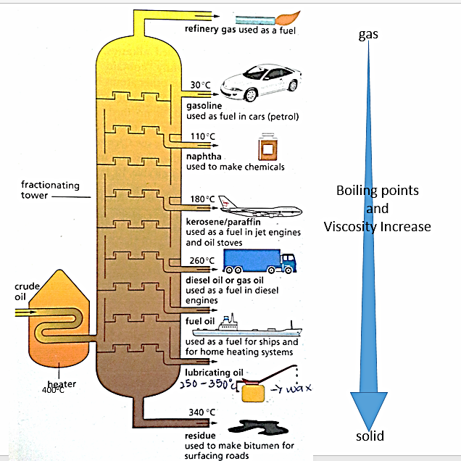
Fractional distillation of Petroleum
https://sites.google.com/site/kim15096sci/chemistry/c8---organic-chemistry/fractional-distillation

Slide 9
Catalytic cracking
When larger molecules from heavier fractions are broken into smaller, more valuable, molecules.
  Decane Octane + ethene
  * Propene and But-1-ene can also be the alkene fragment

Slide 10
Discussion questions
How are the different fractions obtained?
Evaluate the environmental impact of petroleum extraction and usage. Considering both the benefits and drawbacks, propose a comprehensive strategy that balances economic growth with environmental sustainability.

Slide 11
REFINED SUDOKU ACTIVITY
(ACTIVITY 20.1 page 385)
The puzzle is based on a grid and you need to work out the contents of the blank squares. The rules for filling in the grid are:
  No entry in the horizontal square can be repeated
  No entry in the vertical square can be repeated
  There can be no repeat entries in each of the 3x3 boxes in the grid

Slide 12
Sources
Edexcel IGCSE (9-1) Biology (Pearson)
Cambridge IGCSE Chemistry Coursebook
Complete Chemistry for Cambridge IGCSE 3rd ed. Revision Guide
Chemistry for Cambridge IGCSE Coursebook 5th ed.

