Slide 1
INDUSRIAL INORGANIC CHEMISTRY
HABER PROCESS

Slide 2
AMMONIA
COLOURLESS
DISTINCTIVE SMELL
LESS DENSE THAN AIR
VERY SOLUBLE IN WATER TO GIVE AN ALKALINE SLOUTION

Slide 3
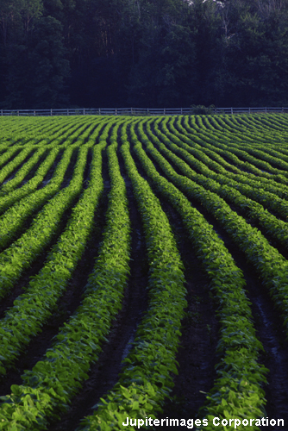
What is ammonia?
Ammonia is an important compound in the manufacture of fertilizer and other chemicals such as cleaning fluids and floor waxes.
It is made industrially by reacting nitrogen with hydrogen in the Haber process. It is a reversible reaction, so it never goes to completion.
Why is this a problem for companies making ammonia?
nitrogen
+
hydrogen
ammonia
N₂ (g)
+
3H₂ (g)
2NH₃ (g)
Notes:
Photo credit: © 2007 Jupiterimages Corporation

Slide 4
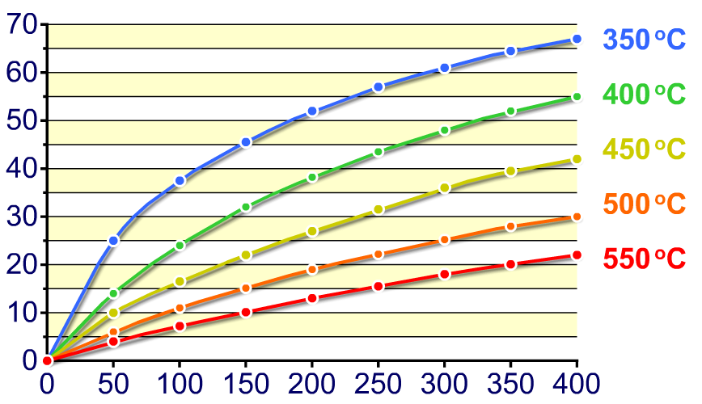
What is yield?
The amount of product made in a reaction is called the yield and is usually expressed as a percentage.
The yield of ammonia produced by the Haber process depends on the temperature and pressure of the reaction.
ammonia yield (%)
Lowering temperature
Increasing pressure(atm)→
Notes:
Teacher notes
See the ‘Quantitative Chemistry’ presentations for more information on yields.

Slide 5
HABER PROCESS

Slide 6
HABER PROCESS

Slide 7
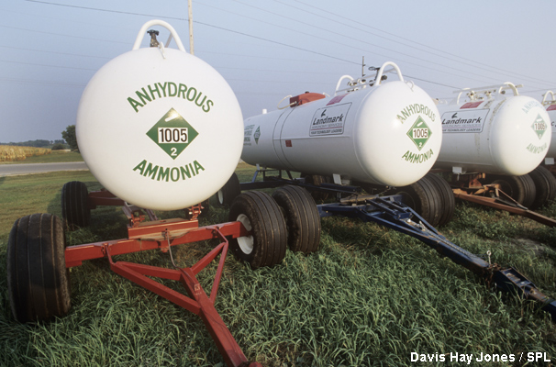
What is the Haber compromise?
The highest yield of ammonia is theoretically produced by using a low temperature and a high pressure.
In practice, though, these conditions are not used. Why?
Lowering the temperature slows down the rate of reaction. This means it takes longer for ammonia to be produced.
Increasing the pressure means stronger, more expensive equipment is needed. This increases the cost of producing the ammonia.
A compromise is reached to make an acceptable yield in a reasonable timeframe while keeping costs down.
Notes:
Photo credit: Davis Hay Jones / Science Photo Library

Slide 8
Maximizing productivity
What else can be done to maximise productivity in the manufacture of ammonia?
An iron catalyst is used to increase the rate of reaction. It speeds up both the forward and backward reaction, so the position of equilibrium is not affected.
The ammonia is cooled, liquefied and then removed as it is produced. This causes the equilibrium to shift to the right to produce more ammonia.
Unreacted nitrogen and hydrogen are recycled and given another chance to react.

Slide 9
TWO MAIN TYPES OF FERTILISERS
Straight N fertilisers
Ammonium nitrate NH₄NO₃
Ammonium sulfate (NH₄)₂SO₄
Urea CO(NH₂)₂
NPK compound fertilisers made of:
nitrogen (N) – healthy leaves
phosphorous (P) – healthy roots
potassium(K) – production of flower and fruits

Slide 10
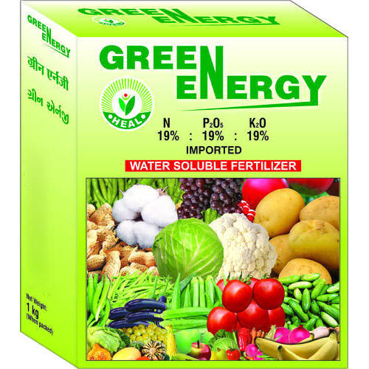
NPK fertilisers

Slide 11
Sources
Images from Google
Cambridge IGCSE Chemistry 4th ed.
Boardworks.com

