Slide 1
Place Value and Fractions
Ordinal numbers, Place value
Properties of 2-digit numbers, Rounding
Objectives
Day 3
Round 2-digit numbers to nearest multiple of 10.
.
Notes:
Before teaching, be aware that:
On Day 1 you will need a selection of age birthday cards (to include 1st, 2nd, 3rd, 6th, 9th; children will need mini-whiteboards and pens.
On Day 2 you will need 0-100 landmarked line (see resources), black card strips and fasteners to make <, and > signs, cubes, card, 0-9 cards.
On Day 3 you would be best-served by using a 0-100-bead bar and tags; children will need mini-whiteboards and pens.
On Day 4 you will need items for sale with price labels [17p, 25p, 32p, 49p, 55p, 63p, 74p, 86p and 99p], a 0-100 landmarked line (see resources).

Slide 2
Place Value and Fractions
Ordinal numbers, Place value
Properties of 2-digit numbers, Rounding
Starters
Day 3
Place value (simmering skills)
Notes:
Choose starters that suit your class by dragging and dropping the relevant slide or slides below to the start of the teaching for each day.

Slide 3
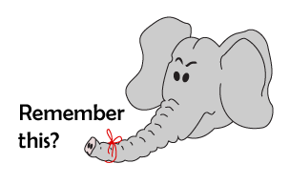
Place Value and Fractions
Ordinal numbers, Place value
Properties of 2-digit numbers, Rounding
Starter
Place value
Notes:
Simmering skills – to use this starter, drag this slide to the start of Day 3
Show children how to show 35 using hands. Close your hands, flash 10, three times, and then hold up 5 fingers. Hold up a 2-digit number, say 3, 2, 1. Children show the number. Repeat.

Slide 4
Day 3: Round 2-digit numbers to nearest multiple of 10.
32
Where would 32 go on this line?
Is it nearer to 30 or 40?
To round 32 to the nearest 10 we round it ‘down’ to 30 because that’s the closest multiple of 10.
If we were adding the prices of lots of toys, and just needed to know roughly how much the whole lot would be, we could round each price to the nearest £10 and then add them.

Slide 5
Day 3: Round 2-digit numbers to nearest multiple of 10.
68
Where would 68 go on this line?
Is it nearer to 60 or 70?
To round 68 to the nearest 10 we round it ‘up’ to 70 because that’s the closest multiple of 10.

Slide 6
Day 3: Round 2-digit numbers to nearest multiple of 10.
43
Where would 43 go on this line?
What is 43 rounded to the nearest 10?
To round 43 to the nearest 10 we round it down to 40 because that’s the closest multiple of 10.

Slide 7
Day 3: Round 2-digit numbers to nearest multiple of 10.
97
To round 97 to the nearest 10 we round it up to 100 because that’s the closest multiple of 10.
Where would 97 go?
Round it to the nearest 10…

Slide 8
Day 3: Round 2-digit numbers to nearest multiple of 10.
45
Talk to your partner.
What is 45 rounded to the nearest 10?
Where would 45 go on this line?
So, 45 is in the middle of 40 and 50.
We need a rule for rounding numbers that sit half-way between the target multiples.
We always round up.
45 rounded to the nearest 10 is 50.

Slide 9
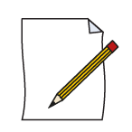
Day 3: Round 2-digit numbers to nearest multiple of 10.
25
75
95
What is 25 rounded to the nearest 10?
What is 75 rounded to the nearest 10?
What is 95 rounded to the nearest 10?
Notes:
Children can now go on to do differentiated GROUP ACTIVITIES. You can find Hamilton’s group activities in this unit’s TEACHING AND GROUP ACTIVITIES download.
WT: Make 2-digit numbers and round them to the nearest 10, using a beaded line to support locating numbers.
ARE/ GD: Shopping activity: make 2-digit prices and round them to the nearest 10, using a landmarked penny line to support locating numbers.

Slide 10
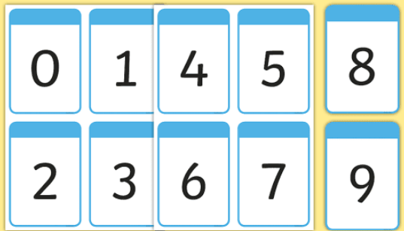
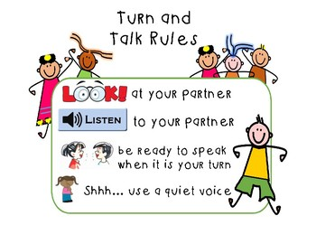
Task 1
Can you work with your partner to make two 2-digit numbers from the shuffled cards? Then, round them up and mark on the 0-100 beaded line.

Slide 11
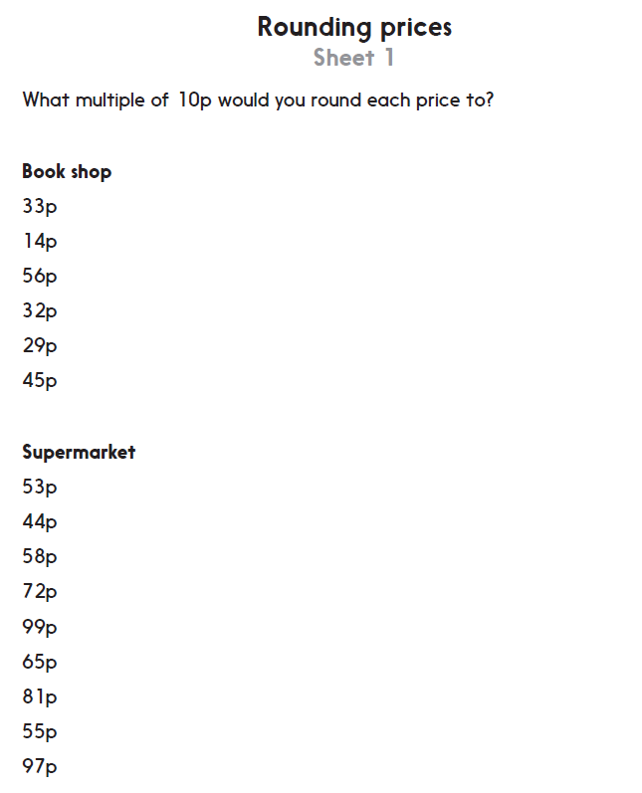
Task 2
Challenge
Notes:
The Practice Sheet on this slide is suitable for most children.
Differentiated PRACTICE WORKSHEETS are available on Hamilton’s website in this unit’s PROCEDURAL FLUENCY box.
WT/ ARE/ GD: Rounding amounts of money to the nearest 10p. Challenge to investigate totals with or without rounding to estimate (Sheet 1)

Slide 12
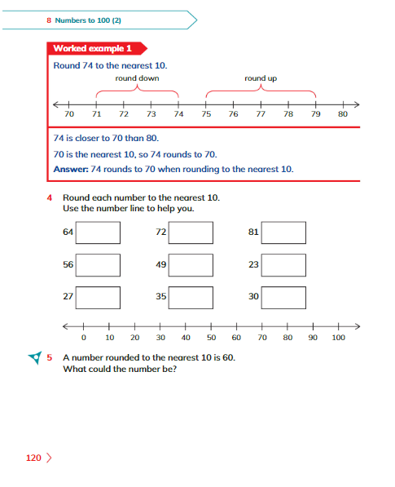
Plenary
Answer Learner’s Book page 120, Exercise 8.1, no. 4.

Slide 13
Homework
Play https://www.topmarks.co.uk/maths-games/rocket-rounding
Select upto 99 to the enarest 10

