Slide 1
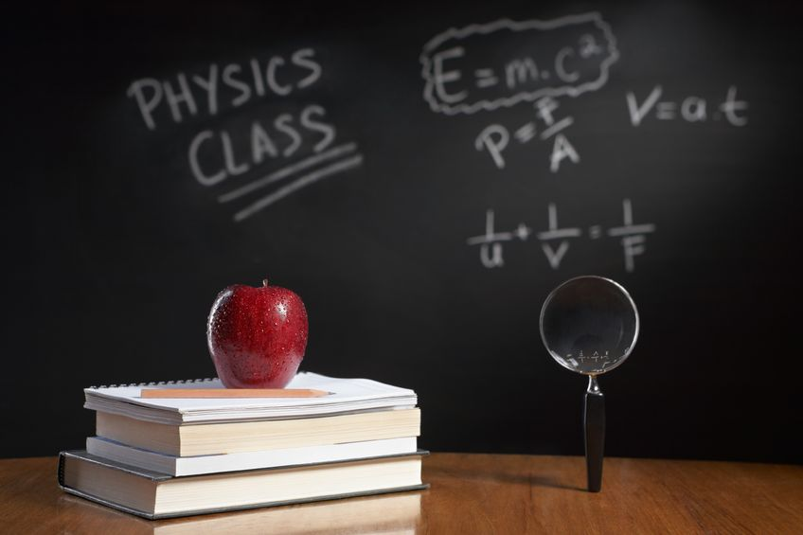
PHYSICS – Electrical quantities (1)

Slide 2
LEARNING OBJECTIVES
Core •State that there are positive and negative charges • State that unlike charges attract and that like charges repel • Describe simple experiments to show the production and detection of electrostatic charges • State that charging a body involves the addition or removal of electrons Distinguish between electrical conductors and insulators and give typical examples State that current is related to the flow of charge • Use and describe the use of an ammeter, both analogue and digital • State that current in metals is due to a flow of electrons | Supplement State that charge is measured in coulombs • State that the direction of an electric field at a point is the direction of the force on a positive charge at that point • Describe an electric field as a region in which an electric charge experiences a force • Describe simple field patterns, including the field around a point charge, the field around a charged conducting sphere and the field between two parallel plates (not including end effects) • Give an account of charging • Recall and use a simple electron model to distinguish between conductors and insulators Show understanding that a current is a rate of flow of charge and recall and use the equation I = Q / t • Distinguish between the direction of flow of electrons and conventional current

Slide 3
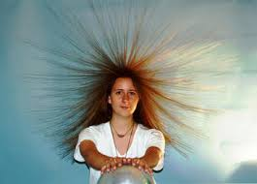
Static Electricity
http://www.physics.upenn.edu/undergraduate/undergraduate-physics-labs/experiments/electric-charge-and-static-electricity

Slide 4
Static Electricity
http://www.physics.upenn.edu/undergraduate/undergraduate-physics-labs/experiments/electric-charge-and-static-electricity
Static electricity is all about charges which are not free to move.
As a result they build up in one place, resulting in a spark or shock when they do move.

Slide 5
Static Electricity
Insulating materials, such as polythene and perspex, can be charged by rubbing them with a dry woollen cloth.
+
-
-
+
+
-
http://www.physics.upenn.edu/undergraduate/undergraduate-physics-labs/experiments/electric-charge-and-static-electricity
+
-
Static electricity is all about charges which are not free to move.
+
-
+
-
As a result they build up in one place, resulting in a spark or shock when they do move.
Perspex
Polythene

Slide 6
Static Electricity
Insulating materials, such as polythene and perspex, can be charged by rubbing them with a dry woollen cloth.
+
+
-
-
-
-
+
+
+
+
-
-
http://www.physics.upenn.edu/undergraduate/undergraduate-physics-labs/experiments/electric-charge-and-static-electricity
+
+
-
-
Static electricity is all about charges which are not free to move.
+
+
-
-
+
+
-
-
As a result they build up in one place, resulting in a spark or shock when they do move.
Like charges will try to repel each other.

Slide 7
Static Electricity
Insulating materials, such as polythene and perspex, can be charged by rubbing them with a dry woollen cloth.
+
-
+
-
-
-
+
+
+
-
+
-
http://www.physics.upenn.edu/undergraduate/undergraduate-physics-labs/experiments/electric-charge-and-static-electricity
+
-
+
-
Static electricity is all about charges which are not free to move.
+
-
+
-
+
-
+
-
As a result they build up in one place, resulting in a spark or shock when they do move.
Unlike charges will try to attract each other.

Slide 8
Static Electricity
Insulating materials, such as polythene and perspex, can be charged by rubbing them with a dry woollen cloth.
+
-
+
-
-
-
+
+
+
-
+
-
http://www.physics.upenn.edu/undergraduate/undergraduate-physics-labs/experiments/electric-charge-and-static-electricity
+
-
+
-
Static electricity is all about charges which are not free to move.
+
-
+
-
+
-
+
-
As a result they build up in one place, resulting in a spark or shock when they do move.
The closer the charges, the greater the force between them.

Slide 9

Static Electricity
Only electrons move, never the positive charges!

Slide 10
Static Electricity
Only electrons move, never the positive charges!
-
-
-
-
-
-
-
+
+
+
Electrons move from the rod onto the duster.
+
The rod becomes positively charged, and the duster becomes negatively charged.
+
+
Perspex

Slide 11
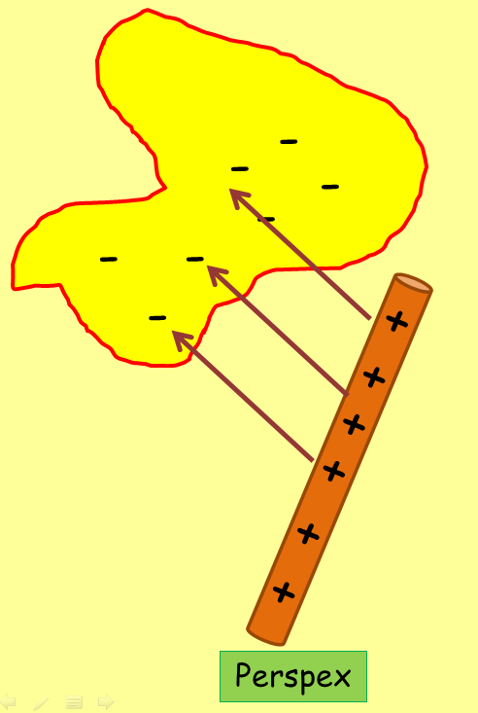
Static Electricity
Only electrons move, never the positive charges!
+
+
+
+
+
+
+
-
-
-
Electrons move from the duster onto the rod.
-
The rod becomes negatively charged, and the duster becomes positively charged.
-
-
Polythene

Slide 12
Uses of Static Electricity
1. Electrostatic smoke precipitators.
As particles of smoke or dust rise up the chimney they are attracted to the charged plates on either side.
+
-
+
-
+
-
+
-
+
-
+
-

Slide 13

Uses of Static Electricity
1. Electrostatic smoke precipitators.
2. Spray painting
_
_
As particles of smoke or dust rise up the chimney they are attracted to the charged plates on either side.
+
_
+
+
+
-
+
-
+
-
+
-
+
-
The spray nozzle is connected to a positive terminal.
Each spray drop is now +ve.
The drops repel and spread out.
The car is connected to the earth (or –ve).
+ve drops attracted to the –ve car.
+
-

Slide 14
Uses of Static Electricity
1. Electrostatic smoke precipitators.
2. Spray painting
_
_
As particles of smoke or dust rise up the chimney they are attracted to the charged plates on either side.
+
_
+
+
+
-
+
-
+
-
+
-
+
-
The spray nozzle is connected to a positive terminal.
Each spray drop is now +ve.
The drops repel and spread out.
The car is connected to the earth (or –ve).
+ve drops attracted to the –ve car.
+
-
3. Photocopiers make use of static to attract black toner to the paper.

Slide 15

Distinguish between electrical conductors and insulators and give typical examples

Slide 16
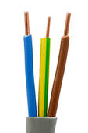
CONDUCTORS – allow electrons to pass through them. Metals have ‘free’ electrons between the individual atoms, and this makes them excellent conductors. The free electrons also make them good conductors of thermal energy (heat).
Distinguish between electrical conductors and insulators and give typical examples
Copper (conductor)

Slide 17
CONDUCTORS – allow electrons to pass through them. Metals have ‘free’ electrons between the individual atoms, and this makes them excellent conductors. The free electrons also make them good conductors of thermal energy (heat).
Distinguish between electrical conductors and insulators and give typical examples
Copper (conductor)
INSULATORS – electrons are held tightly to their atoms so are not free to move, and so do not conduct electricity (but electrons can be transferred by rubbing – static charging).
PVC
(insulator)

Slide 18
CONDUCTORS – allow electrons to pass through them. Metals have ‘free’ electrons between the individual atoms, and this makes them excellent conductors. The free electrons also make them good conductors of thermal energy (heat).
Distinguish between electrical conductors and insulators and give typical examples
Copper (conductor)
INSULATORS – electrons are held tightly to their atoms so are not free to move, and so do not conduct electricity (but electrons can be transferred by rubbing – static charging).
PVC
(insulator)
SEMI-CONDUCTORS – neither an insulator or a conductor. Poor conductors when cold, but much better conductors when warm.

Slide 19
CONDUCTORS – allow electrons to pass through them. Metals have ‘free’ electrons between the individual atoms, and this makes them excellent conductors. The free electrons also make them good conductors of thermal energy (heat).
Distinguish between electrical conductors and insulators and give typical examples
Eg. Metals (copper, gold) and carbon
Copper (conductor)
INSULATORS – electrons are held tightly to their atoms so are not free to move, and so do not conduct electricity (but electrons can be transferred by rubbing – static charging).
PVC
(insulator)
SEMI-CONDUCTORS – neither an insulator or a conductor. Poor conductors when cold, but much better conductors when warm.
Eg. Silicon and germanium
Eg. Plastics, glass, dry air

Slide 20

So what’s all this ‘current’ stuff about?
State that current is related to the flow of charge.
Use and describe the use of an ammeter, both analogue and digital.
State that current in metals is due to a flow of electrons.

Slide 21
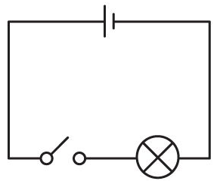

So what’s all this ‘current’ stuff about?
State that current is related to the flow of charge.
Use and describe the use of an ammeter, both analogue and digital.
State that current in metals is due to a flow of electrons.
Let’s go back to basics and consider what is happening in an electrical circuit.

Slide 22
So what’s all this ‘current’ stuff about?
State that current is related to the flow of charge.
Use and describe the use of an ammeter, both analogue and digital.
State that current in metals is due to a flow of electrons.
Let’s go back to basics and consider what is happening in an electrical circuit.
Electricity is the flow of electrons around a circuit.

Slide 23
So what’s all this ‘current’ stuff about?
State that current is related to the flow of charge.
Use and describe the use of an ammeter, both analogue and digital.
State that current in metals is due to a flow of electrons.
Let’s go back to basics and consider what is happening in an electrical circuit.
+
-
Conventional current flow
Electricity is the flow of electrons around a circuit.

Slide 24
So what’s all this ‘current’ stuff about?
State that current is related to the flow of charge.
Use and describe the use of an ammeter, both analogue and digital.
State that current in metals is due to a flow of electrons.
Let’s go back to basics and consider what is happening in an electrical circuit.
+
-
Electrons actually flow from the –ve to the +ve, opposite to the conventional current flow.
Electricity is the flow of electrons around a circuit.

Slide 25
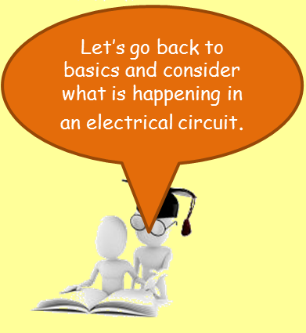
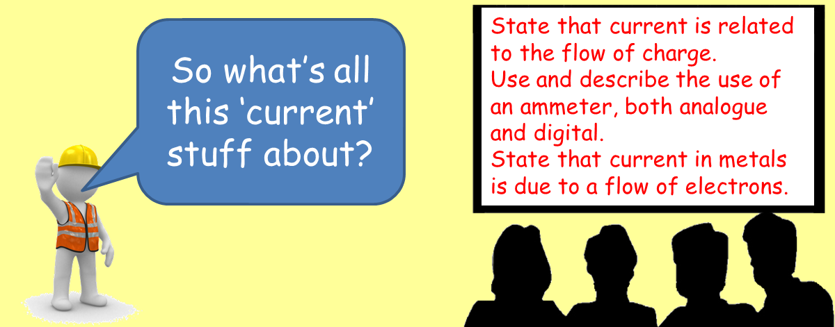
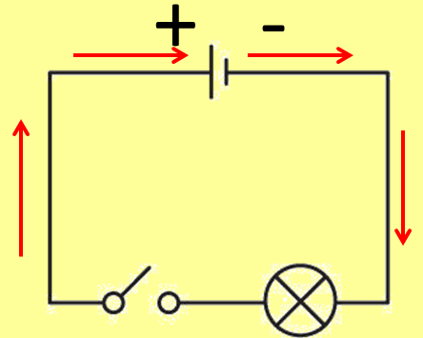
Electric current will only flow if there are charges which can move freely.
+
+
+
-
-
-
+
+
-
+
-
+
+
-
+

Slide 26
Electric current will only flow if there are charges which can move freely.
+
+
+
-
-
-
+
+
-
+
-
+
+
-
+
Metals have a “sea” of free electrons (-ve charge) that are free to flow through the metal

Slide 27
Electric current will only flow if there are charges which can move freely.
+
+
+
-
-
-
+
+
-
+
-
+
+
-
+
Metals have a “sea” of free electrons (-ve charge) that are free to flow through the metal
This is why metals are such good conductors of electricity.

Slide 28
Electric current will only flow if there are charges which can move freely.
+
+
+
-
-
-
+
+
-
+
The flow of charge is called an electric current. The higher the current, the greater the flow of charge.
-
+
+
-
+
Metals have a “sea” of free electrons (-ve charge) that are free to flow through the metal
This is why metals are such good conductors of electricity.

Slide 29

State that current is related to the flow of charge.
Use and describe the use of an ammeter, both analogue and digital.
State that current in metals is due to a flow of electrons.
The unit of current is the ampere (A). This is usually abbreviated to the amp.

Slide 30
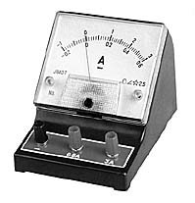
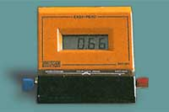
State that current is related to the flow of charge.
Use and describe the use of an ammeter, both analogue and digital.
State that current in metals is due to a flow of electrons.
The unit of current is the ampere (A). This is usually abbreviated to the amp.
Current is measured using an ammeter.

Slide 31
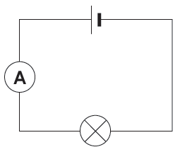
State that current is related to the flow of charge.
Use and describe the use of an ammeter, both analogue and digital.
State that current in metals is due to a flow of electrons.
The unit of current is the ampere (A). This is usually abbreviated to the amp.
Current is measured using an ammeter.
To measure the current flowing through a circuit, the ammeter is connected in series.

Slide 32
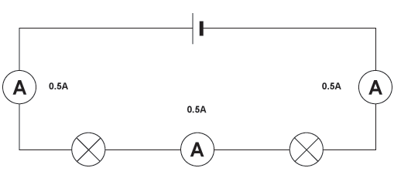
Measuring current
Ammeters can be placed anywhere in a series circuit and will all give the same reading.
http://www.bbc.co.uk/bitesize/ks3/science/energy_electricity_forces/electric_current_voltage/revision/6/

Slide 33
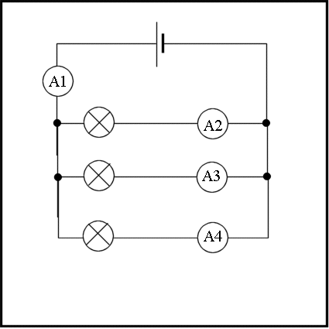
Measuring current
In a parallel circuit the current through each component depends upon its resistance.

Slide 34
Measuring current
In a parallel circuit the current through each component depends upon its resistance.
5.5A
1.5A
3A
1A
The total current flowing around the circuit is equal to the total of all the currents in the separate branches.

Slide 35
Measuring current
In a parallel circuit the current through each component depends upon its resistance.
5.5A
1.5A
3A
1A
The total current flowing around the circuit is equal to the total of all the currents in the separate branches.
A1 = A2 + A3 + A4

Slide 36
Measuring current
In a parallel circuit the current through each component depends upon its resistance.
5.5A
1.5A
3A
1A
The total current flowing around the circuit is equal to the total of all the currents in the separate branches.
A1 = A2 + A3 + A4
5.5 = 1.5 + 3 + 1

Slide 37
LEARNING OBJECTIVES
Core •State that there are positive and negative charges • State that unlike charges attract and that like charges repel • Describe simple experiments to show the production and detection of electrostatic charges • State that charging a body involves the addition or removal of electrons Distinguish between electrical conductors and insulators and give typical examples State that current is related to the flow of charge • Use and describe the use of an ammeter, both analogue and digital • State that current in metals is due to a flow of electrons | Supplement State that charge is measured in coulombs • State that the direction of an electric field at a point is the direction of the force on a positive charge at that point • Describe an electric field as a region in which an electric charge experiences a force • Describe simple field patterns, including the field around a point charge, the field around a charged conducting sphere and the field between two parallel plates (not including end effects) • Give an account of charging • Recall and use a simple electron model to distinguish between conductors and insulators Show understanding that a current is a rate of flow of charge and recall and use the equation I = Q / t • Distinguish between the direction of flow of electrons and conventional current

Slide 38
PHYSICS – Electrical quantities (1)

