Slide 2
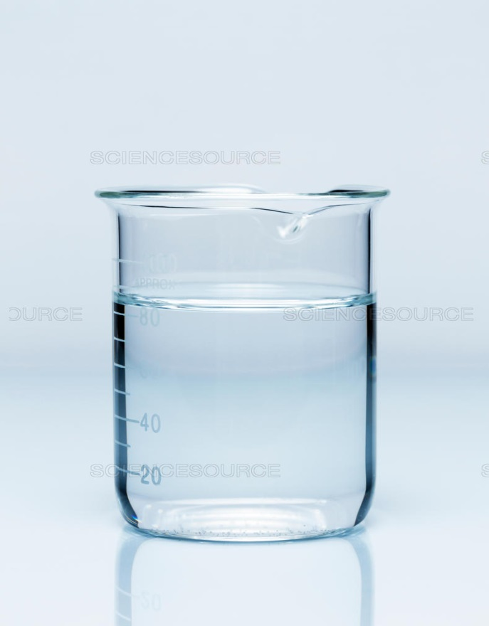
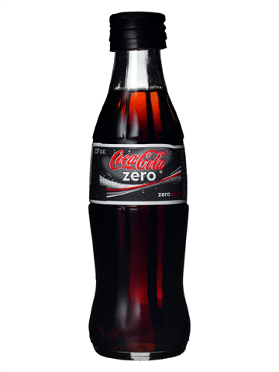
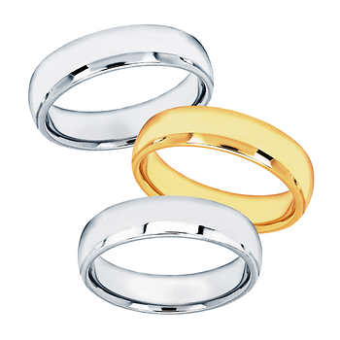

Slide 3
MATTER
Anything that has a mass and takes up space.

Slide 4
Learning Objective
State the distinguishing properties of solids, liquids and gases
Describe changes of state in terms of melting, boiling, evaporation, freezing, condensation and sublimation

Slide 5
STATES OF MATTER

Slide 6
Solid, Liquid and Gas

Slide 7
Changes of Physical State

Slide 8
Interconvertions Between The Three States of Matter

Slide 9
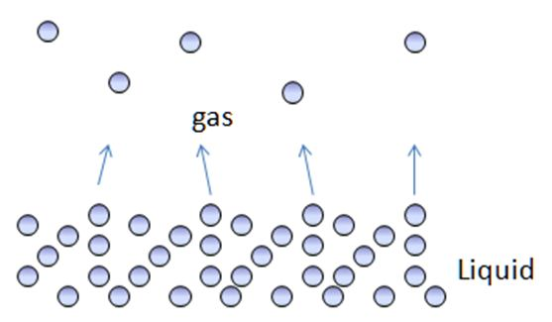
Vaporisation
Boiling-only occurs at one temperature (boiling point)
Evaporation-occurs at any temperature
e.g. puddles of water disappear at -5°C

Slide 10
Volatile
A liquid which evaporates easily and has a relatively low boiling point
Example: Ethanol (b.p. 78°C) is a more volatile liquid than water (b.p. 100°C)

Slide 11
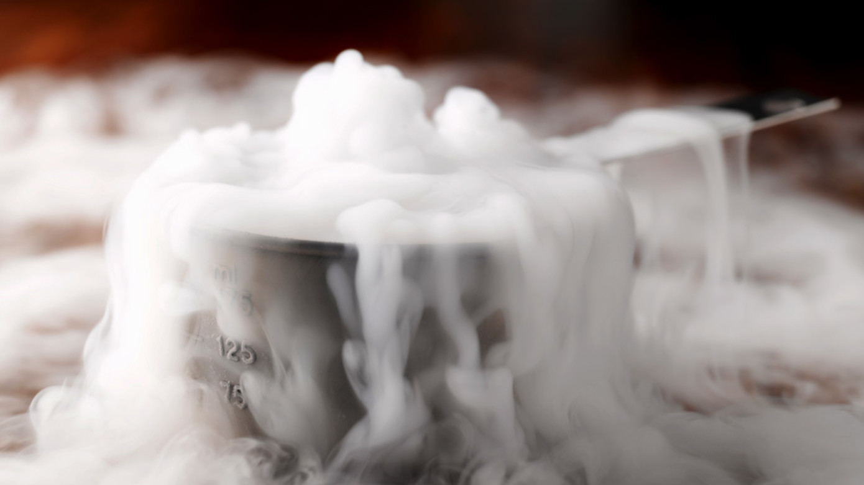
Sublimation
Dry ice or solid carbon dioxide

Slide 13
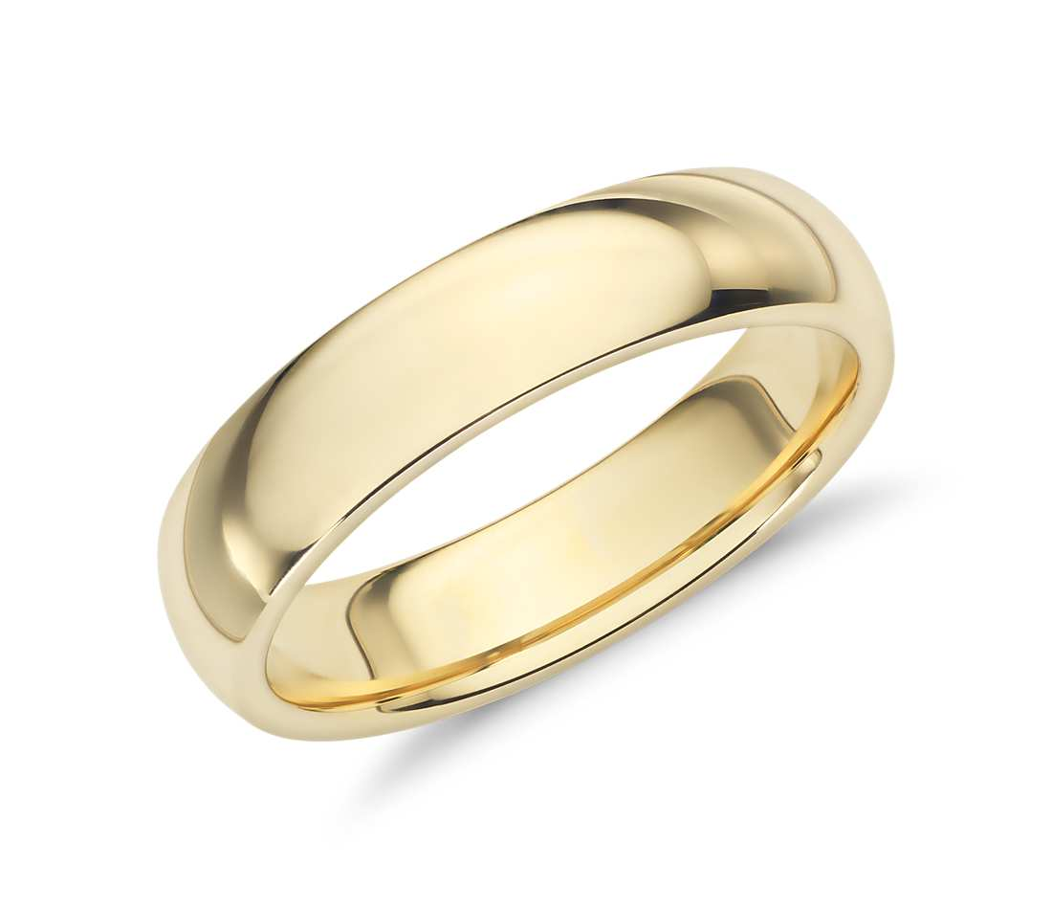

Slide 14
Learning Objective
State that pure substances have precise melting and boiling point- their sharpness can be taken as an indication of the degree of purity of a substance
Construct a heating or cooling curve of a substance
Recognise the types of mixtures

Slide 15
Pure Substance
It consists of only one substance
No contaminating impurities
It melts and boils at definite temperatures
It can be an element or a compound

Slide 16
Melting and boiling Point of some Chemical substances
Substance | Melting Point | Boiling Point
Oxygen | - 219 °C | - 183 °C
Nitrogen | -210 °C | -196 °C
Water | 0°C | 100 °C
Copper | 1083°C | 2600°C
Carbon dioxide | -78°C
Note: In science, room temperature is between 20 and 25° C

Slide 17
The Effect of Impurities
Lowers the melting point
Raises the boiling point of the substance

Slide 18
HEATING CURVES

Slide 19
COOLING CURVES

Slide 20
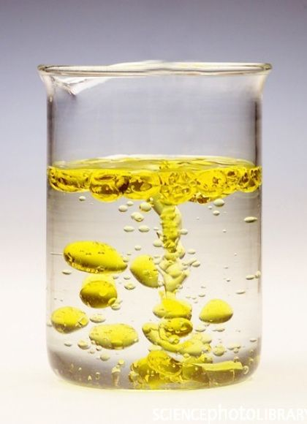
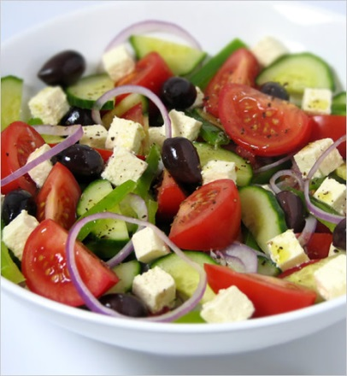
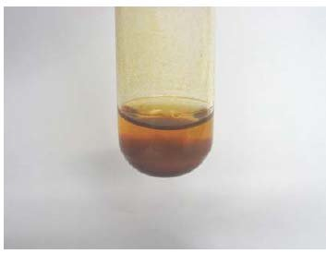
Types of Mixtures
1. Heterogeneous Mixture

Slide 21
Types of Mixtures
1. Homogeneous Mixture

Slide 22
Solution
Solute- solid dissolves in the liquid
Solvent- the liquid in which the solid dissolves

Slide 23
Sources:
Cambridge IGCSE Chemistry Coursebook 4th ed.
Images from Google
https://2012books.lardbucket.org/books/introduction-to-chemistry-general-organic-and-biological/s11-solids-liquids-and-gases.html
http://home.miracosta.edu/myeager/108prep/liquidssolids/
https://www.scienceabc.com/nature/differece-between-evaporation-boiling-drying-similar-phenomenon.html
http://www.diy-cocktails.com/tag/dry-ice/
http://www.bbc.co.uk/bitesize/standard/physics/energy_matters/heat_in_the_home/revision/3/
https://www.youtube.com/watch?v=n88R4paxy_Q
https://www.pinterest.com/pin/247698048230943608/
https://environmentalgeography.wordpress.com/2011/09/29/project-proposal-nothing-with-a-face-food-festival/
https://www.researchgate.net/figure/Ferrite-powder-suspension-in-water-left-without-PMMA-coating-with-PMMA-coating_fig2_236875768
https://www.sciencesource.com/archive/Table-salt-solution-SS21027632.html
http://denisebelisle.com/the-honest-coca-cola-obesity-commercial/
https://www.costco.com/6mm-Comfort-Fit-Wedding-Ring.product.100417160.html
https://www.koreanair.com/global/en/skypass.html
https://picknotebook.com/blog/best-fortnite-laptops/
https://www.amazon.com/100-Copper-Mug-Moscow-Mule/dp/B00YBDXVMG
https://www.bluenile.com/18k-yellow-gold-wedding-ring_18

