Slide 1
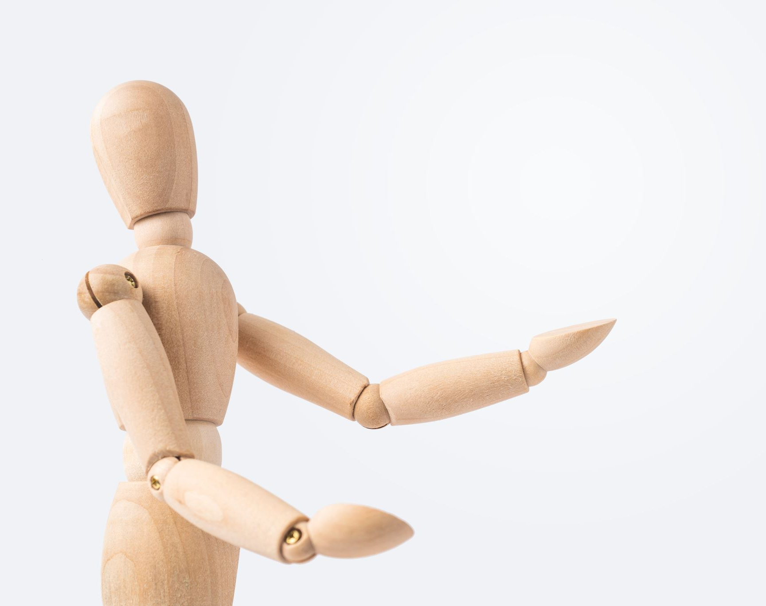
Unit 6: Be a Storyteller
YR 3 CS Wk 3 D1

Slide 2
Big Question
How logical thinking ease to make program?

Slide 3
Pair Work
Prince Character |  | Horse Character
Each pair will brainstorm and put the steps in the algorithm below in the correct order in the Project 1 sheet.

Slide 4
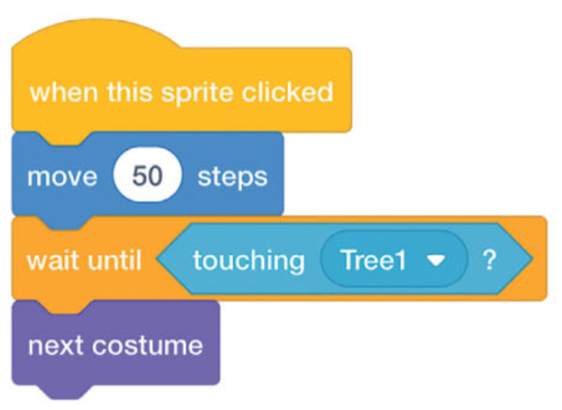
Individual Task – Project 1
Create a program to match the corrected algorithms above.
Add two Backdrops to your project: Castle 1 and Woods.
Click on the Backdrop thumbnail and add code so that:
When the Green flag is clicked, the backdrop switches to the Castle 1 Backdrop.
After five seconds, the backdrop switches to the Woods Backdrop.
Add the Tree 1 sprite as a static object.
Change the code created in part 2 so the Horse speaks for twice as long.
Add the following code to the Horse sprite. Run your final program and save it.
Extension Task:
Once you have finished, you can extend the story. You could:
add extra lines of conversation.
get the Horse and Prince to move.
change the backdrops and continue the story.

Slide 5
Feedback Time

