Slide 1

To p i c
Secondary Storage: Optical Disc
C O M P U T E R S C I E N C E
Y E A R 8

Slide 2
Key Vocabulary:
Optical Storage
CD (Compact Disc)
DVD (Digital Versatile Disc)
Blu-ray Disc
Storage Capacity

Slide 3
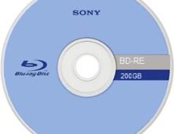

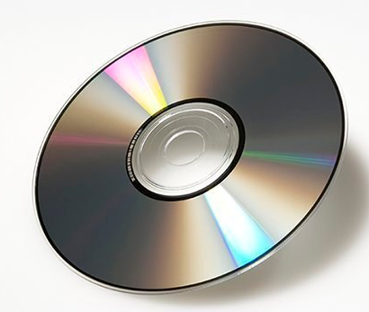
Hookup Activity
What do you know about this disk?

Slide 4
Introduction
  What do you know about CDs, DVDs, and Blu-ray discs?
  How do you think data is stored on these discs?
  Can you name any advantages of using optical discs for storage?
  How do you think CDs, DVDs, and Blu-ray discs differ from each other?

Slide 5
Objective
Students will be able to differentiate between CD, DVD, and Blu-ray technologies after having explored their features, storage capacities.

Slide 6
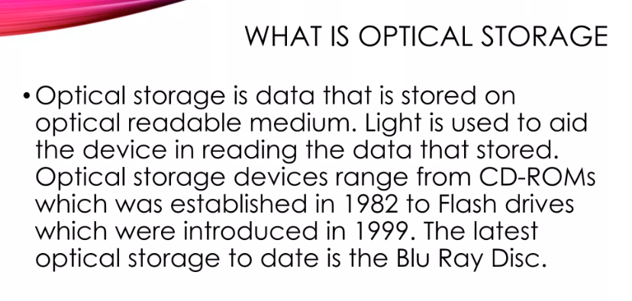

Slide 7
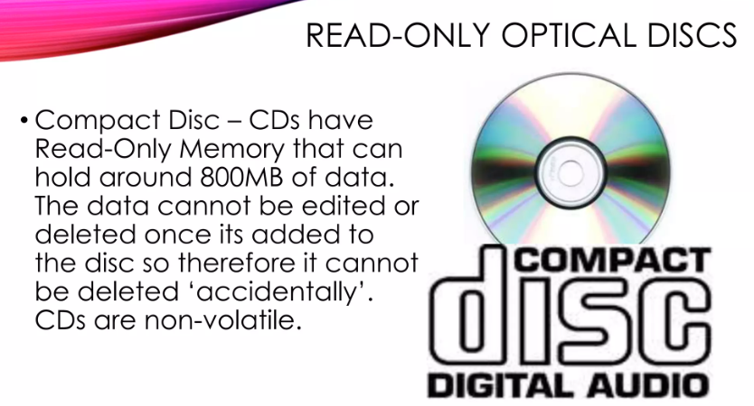

Slide 8
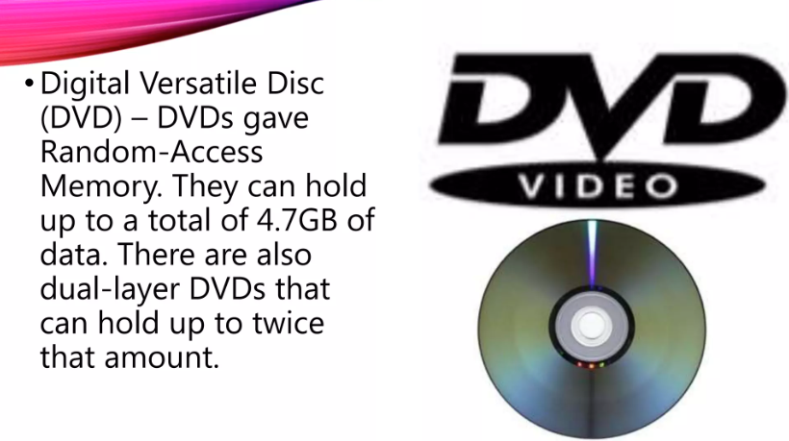

Slide 9
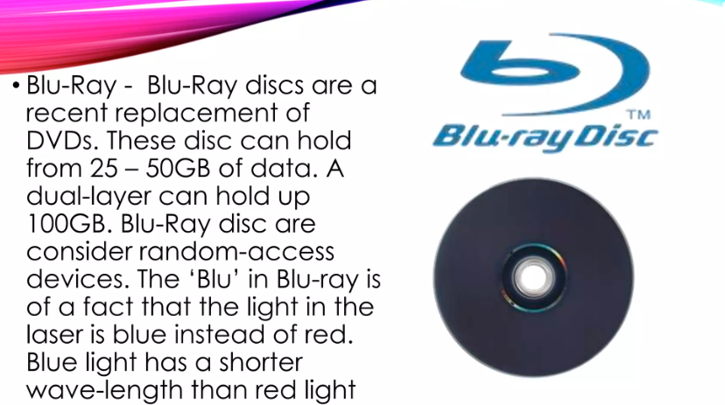

Slide 10
Differentiated Activities
Group A
Students will create a poster illustrating the basic features of CDs, DVDs, and Blu-ray discs.
Group B
Students will write the uses of optical storage in different industries and create a poster depicting real-life examples.
Group C
Students will write the environmental impact of optical storage compared to other forms of data storage.

Slide 11

Plenary

Slide 12
Thank You!

