Slide 1

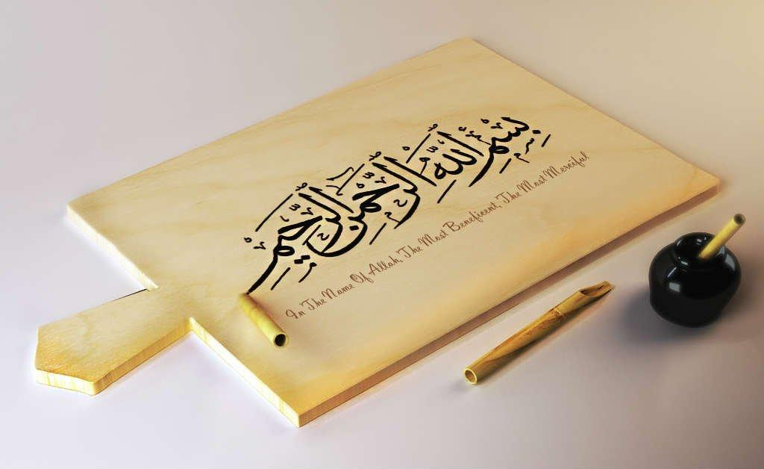
https://youtu.be/Sta_p-oB_d4?si=PSzflbzQ7wHiQ1tU

Slide 2
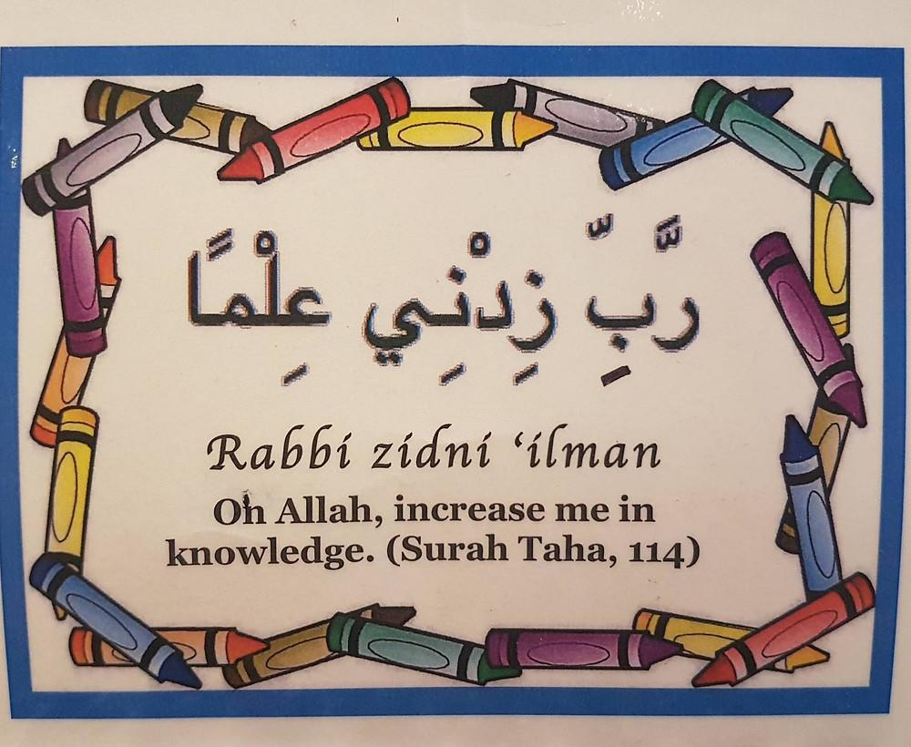
https://youtu.be/Sn3ElZG_WwQ?si=XDsPu9P89Av1dU5L

Slide 3
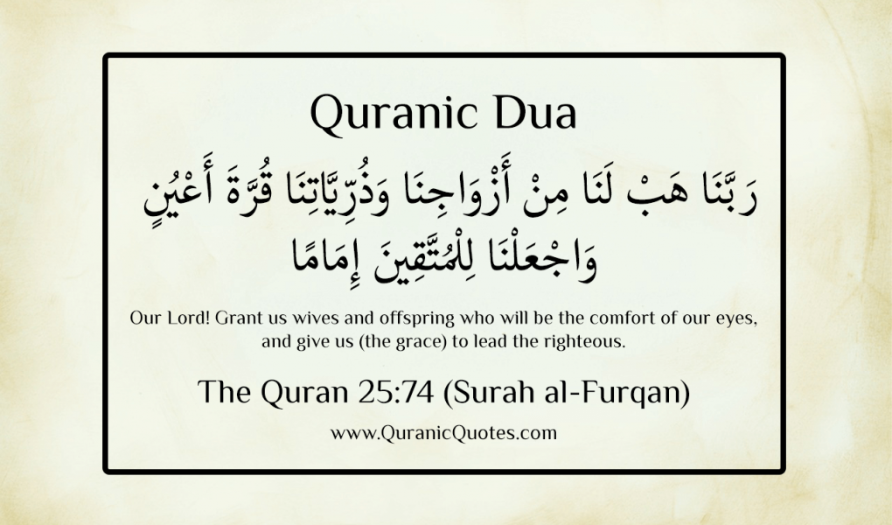
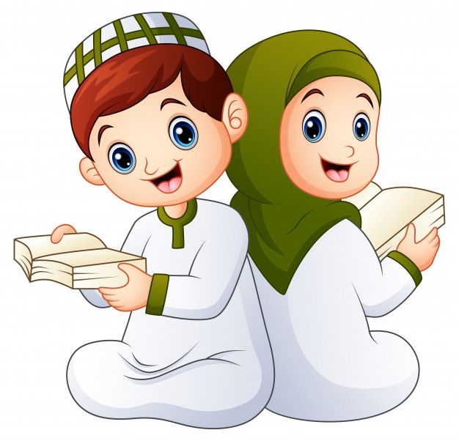

Slide 4
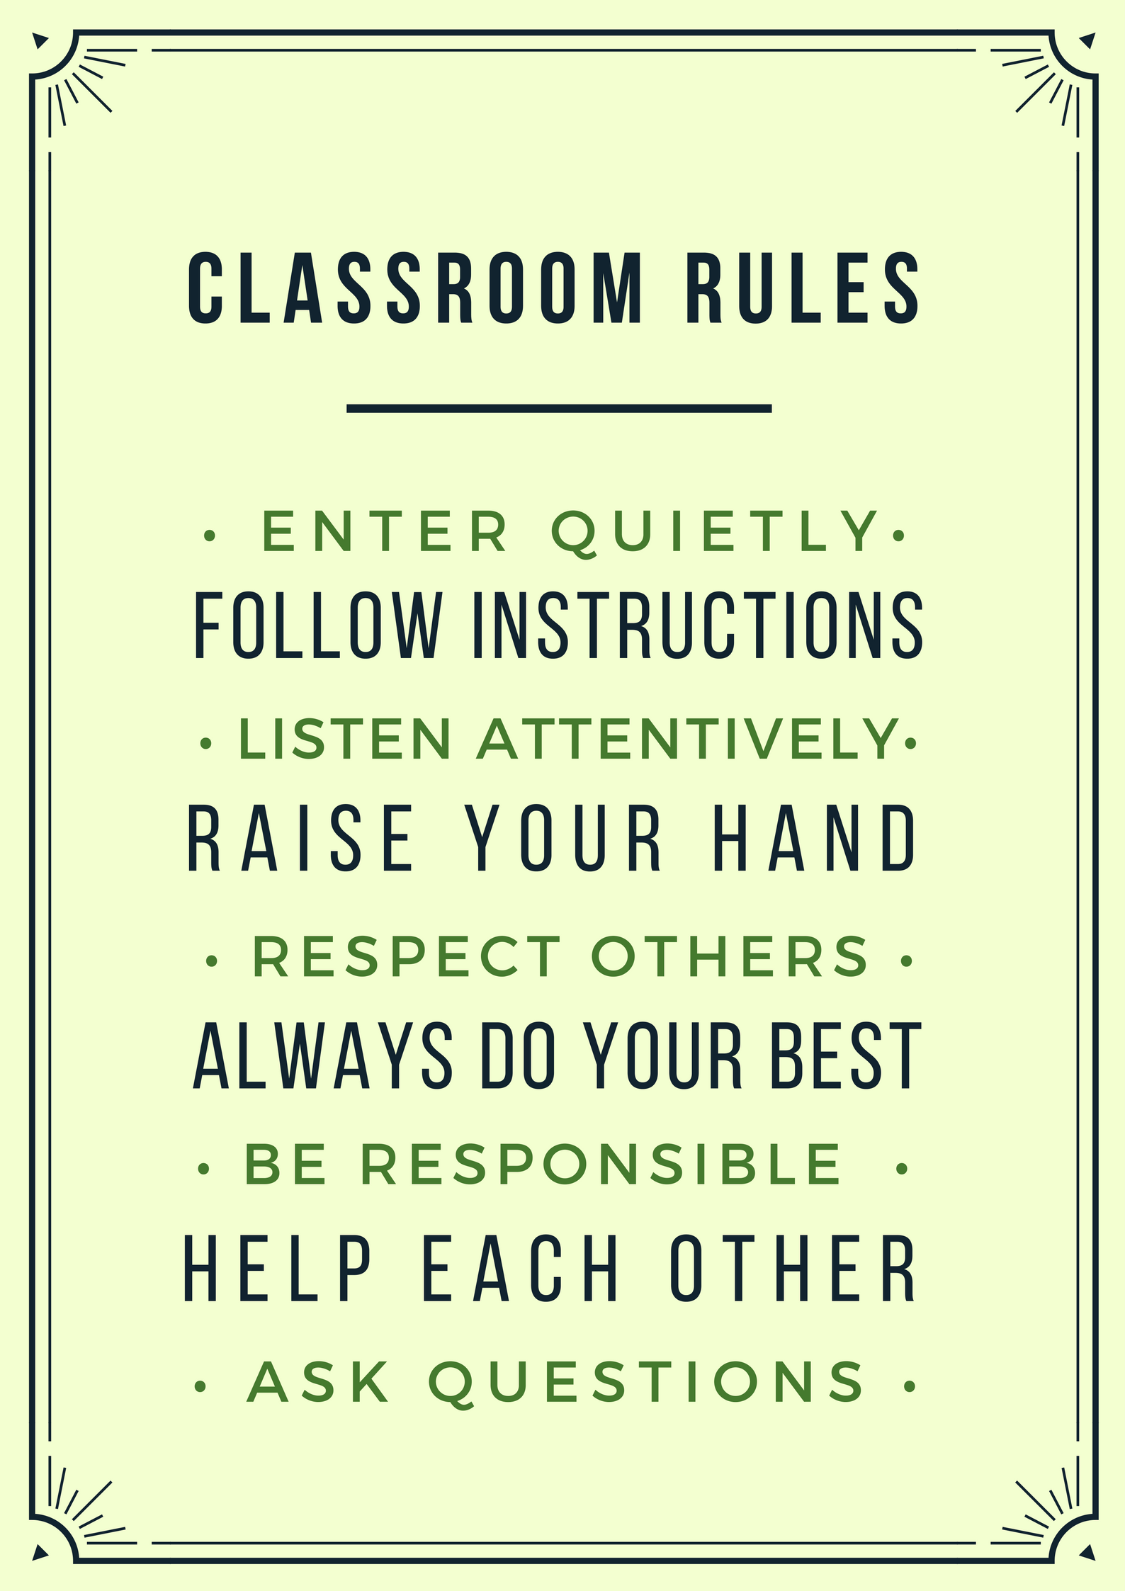
QUR'AN CLASS RULES
Please maintain silence and Respect Qur'an (speech of Allah)

Slide 5


OBJECTIVE
By the end of the lesson learners will be able
Emphasise the goal of deepening their understanding of the surah and expressing its key themes creatively.
Reinforcement of the Rabbana Dua 7 with tajweed rules after practising through drilling.

Slide 6

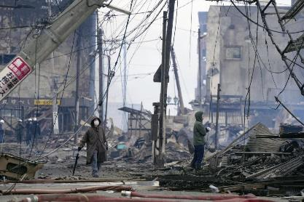
QATAR IDENTITY
https://www.qf.org.qa/events/holy-quran-program-for-memorizing-revising-and-mastering-recitatio
Minaratein Center offers the Holy Quran program for memorizing, revising, and mastering recitation. The program is available for all ages, morning and evening sessions, for males and females.

Slide 7
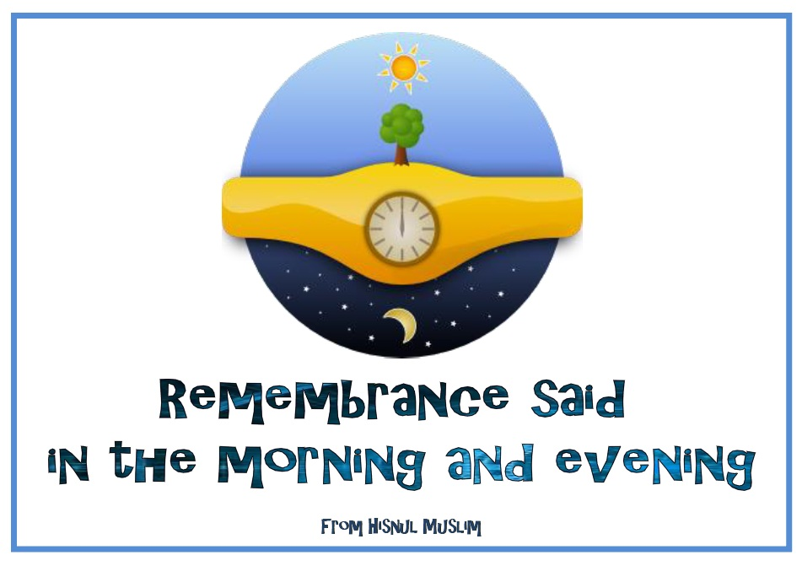
REPEATITION TIME
https://www.youtube.com/watch?v=jldIY3-PBM0

Slide 8
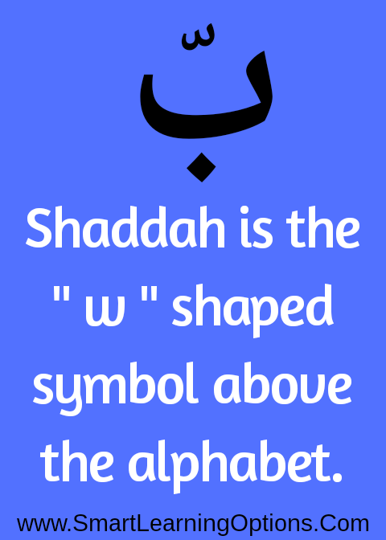
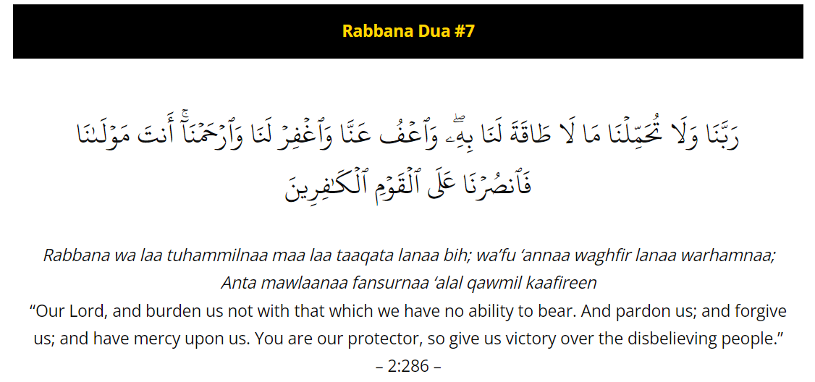
https://alquran.islam.gov.qa/droos/Dr3.shtml

Slide 9
Activity
students in groups of 4-5 and help students revise through drilling and will assign one student from each group to listen from each member of the group
Teacher will explain to the students that they will be creating a booklet focused on Surah Al-Qariah
Teacher will Assign each student or group a set of verses from Surah Al-Qariah

Slide 10
Home work
Memorise the Rabbana Dua 7

Slide 11
END…….
ANY QUESTIONS OR DOUBTS????

