Slide 1
Science - Year 3
Light – Block 3L
Light and Shadows
Session 5
Investigation PowerPoint
© Original resource copyright Hamilton Trust, who give permission for it to be adapted as wished by individual users.
We refer you to our warning, at the foot of the block overview, about links to other websites.

Slide 2
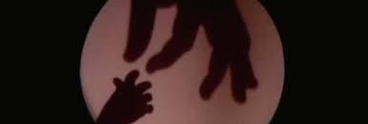
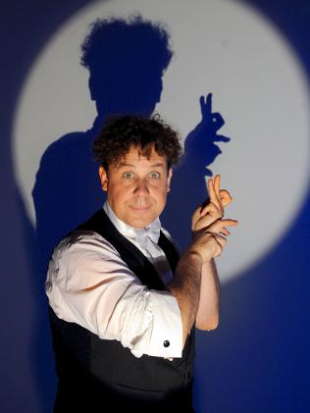
t
Let’s investigate shadow sizes!

Slide 3
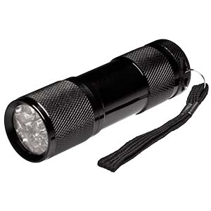
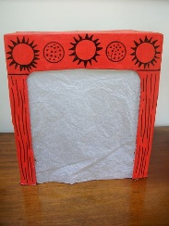
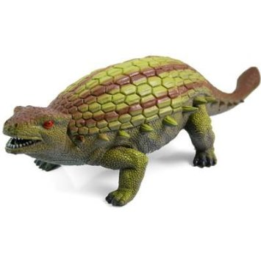
You will need:
A bright torch
Your shadow theatre
A play figure to make a shadow

Slide 4
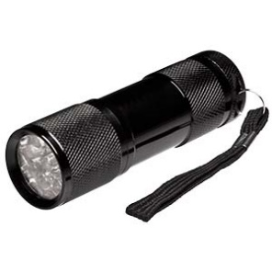
Screen
Theatre box
Set up your equipment like this.

Slide 5
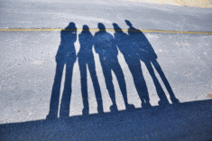
Now investigate these questions:
How can you make the smallest shadow?
How can you make the largest shadow?
How can you make the clearest shadow?

Slide 6
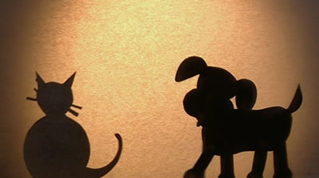
So let’s recap on what we have discovered
The shadow is more focused and clear if the puppet or object is close to the screen
If you move the light source closer to the object, the shadow gets larger
If you move the light source away from the object, the shadow gets smaller

Slide 7
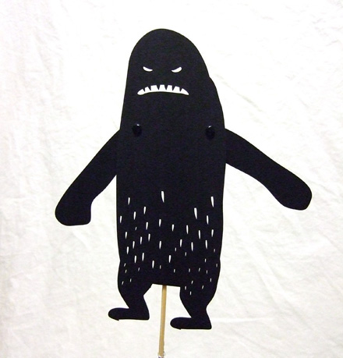
This discovery is very useful to you as shadow puppeteers. You can make a character seem to get bigger, closer and scarier just by moving the light source closer!
You could also make your puppets appear to get smaller as if they are walking (or flying) off by moving the light source further away!

Slide 8
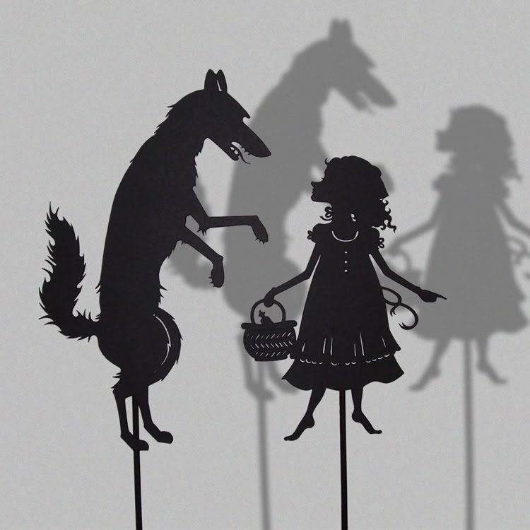
But as puppeteers we need to find out a bit more
How much difference does moving the light source actually make, for example, if you move the light source 5cm further away, how much will the shadow shrink?
Can you make a shadow that is smaller than the object?
How much larger than the object can the shadow actually get?

Slide 9
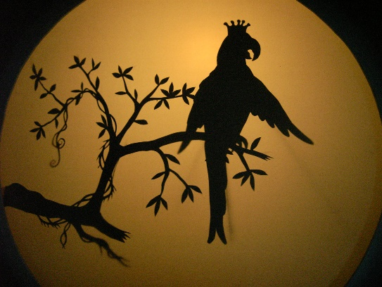
Let’s think about the first question:
How much difference does moving the light source actually make, for example, if you move the light source 5cm further away, how much will the shadow shrink?
What can we do to answer this question?
Discuss your ideas
Yes! You will need to get measuring!

Slide 10
What will you measure?
The distance between the light source and the object and the size of the shadow.

Slide 11
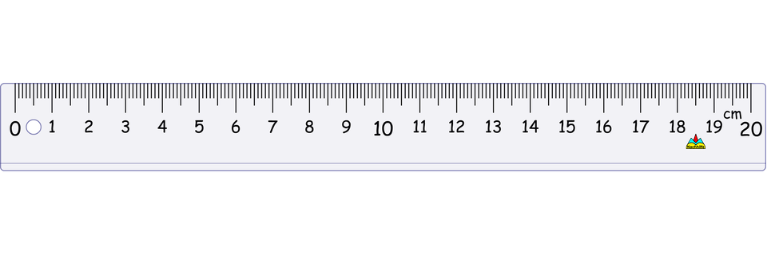
How can you measure it?
Place your object close to the screen as this will give a nice clear shadow that you can measure easily.
You will then be able to measure different distances with your torch and measure the effect this has on the size of the shadow.

Slide 12
You will need to keep your object in exactly the same place.
Why?
Because you need to know exactly how far away the light source is.

Slide 13
Here are some ideas to help you keep your measurements accurate and scientific.
1. Stick a length of masking tape to the table where you be will be working to mark the place where your screen will be.
© Original resource copyright Hamilton Trust, who give permission for it to be adapted as wished by individual users.
We refer you to our warning, at the foot of the block overview, about links to other websites.

Slide 14
Screen
Theatre box
2. Place your theatre screen up against this tape. Then stick another small strip of tape behind the screen to mark the place where you will put your object. This will help you to keep it always in the same place as you move the torch.

Slide 15
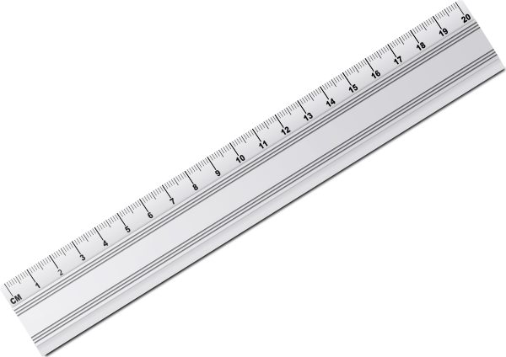
Line up a ruler with the back edge of the masking tape and the closest part of the object. You can now use the ruler to measure the distance of the torch. Your screen and your object always stay in exactly the same place.

Slide 16
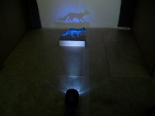
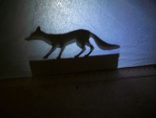
This is how it will look inside your theatre as you gradually change the distance of your light source.
But how will you measure the shadow?
Use a ruler to measure the length of the shadow from outside of the theatre. Remember the shadow can be seen on this side too because the screen is translucent!

Slide 17
You are almost ready to start your investigation.
Try to work together as a team and share the tasks fairly so everyone gets a chance to measure the shadow, to write down the measurements and to move the torch.
Remember good scientists try to be as careful and accurate as they can.

Slide 18
Once you have finished, think about your results
Are they what you expected?
Does the shadow get bigger and smaller by the same amount as you move the light source?
Why might this be?
Try to answer the questions on your task sheet
Discuss your ideas with the group

