Slide 1
Science - Year 3
Light – Block 3L
Light and Shadows
Session 6
Answers PowerPoint
© Original resource copyright Hamilton Trust, who give permission for it to be adapted as wished by individual users.
We refer you to our warning, at the foot of the block overview, about links to other websites.

Slide 2
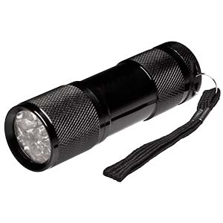
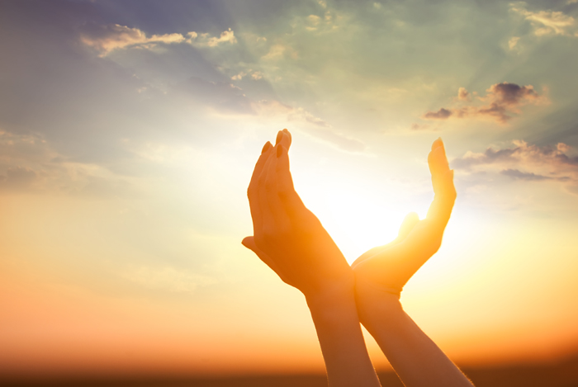
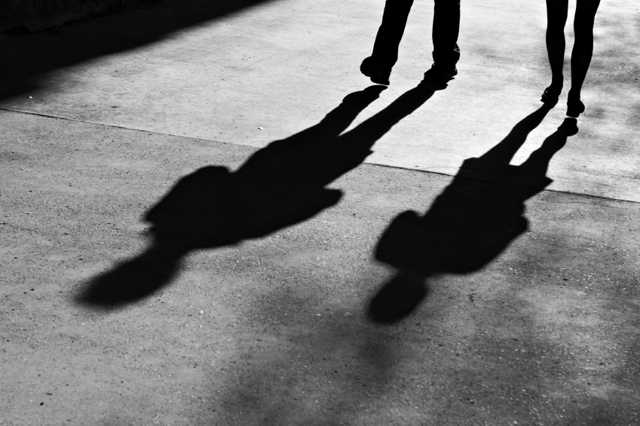
Light and Shadows
Quiz

Slide 3
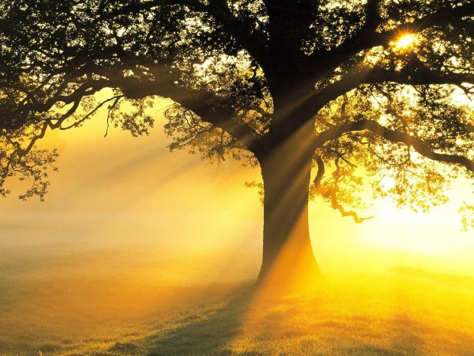
On each slide there is a question and some possible answers. Each answer has a letter. Choose the letter that is beside the right answer and write it on your sheet.
Some are quite easy, others are a bit harder. If you’re not sure, give it your best guess.

Slide 4
1. Total darkness is the same thing as …
A
Being in space
B
No light
C
Black light

Slide 5
2. If there is no light you …
B
can only see once your eyes get used to the dark
C
can only see in black and white
A
cannot see at all

Slide 6
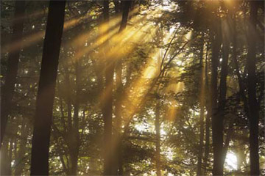
3. Light travels at …
A
B
C
300,000 metres
per second
300,000 miles
per second
300,000,000 metres
Per second

Slide 7
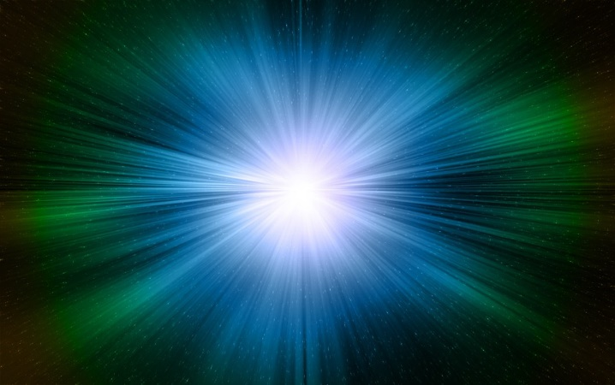
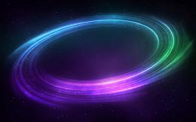
4. Light travels in…
A Waves
B
Straight lines
C
Circles

Slide 8
5. White light is in fact made of a spectrum of
A
5 different colours
B
6 different colours
C
7 different colours

Slide 9
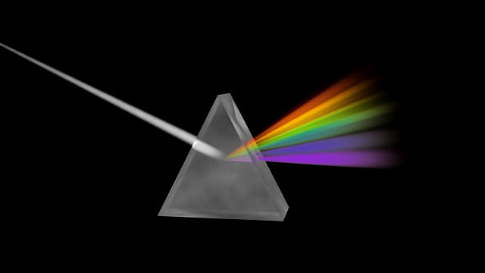
6. The last colour of the visible light spectrum is…
A
purple
B
violet
C
mauve

Slide 10
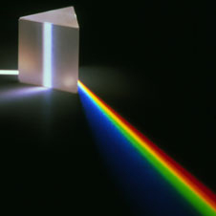
7. When white light is split into a spectrum, this is called …
A
Reduction
B
Restriction
C
Refraction

Slide 11
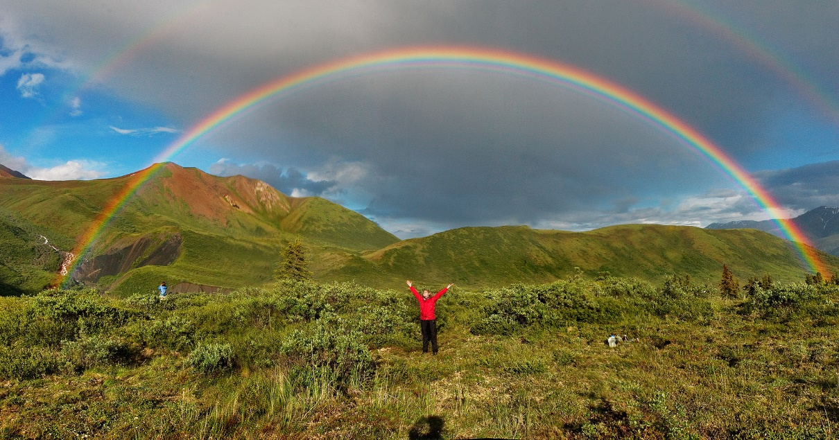
8. A rainbow is made when sunlight is refracted by
A
Low flying aircraft
C
Dust particles in the air
B
Raindrops

Slide 12
9. A light source…
A
generates light
B
reflects light
C
absorbs light

Slide 13
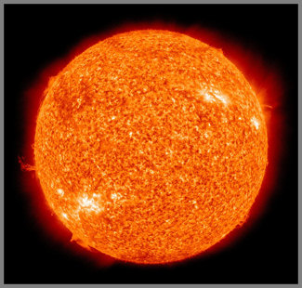
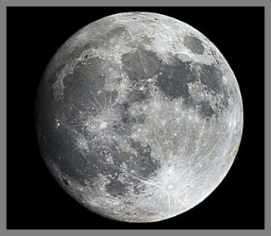
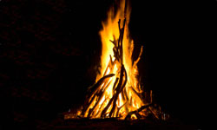
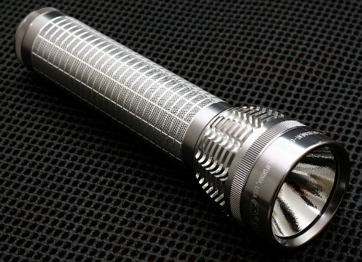
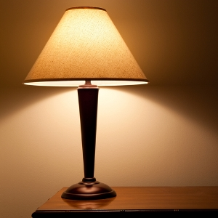
10. These are all light sources except for…
A
the fire
B
the sun
C
the moon

Slide 14
11. Looking directly at the sun is …
A
a bit risky but only a problem if you stare at it
B
extremely dangerous and can cause blindness
C
not recommended for young children but okay for adults

Slide 15
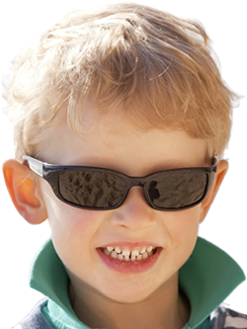
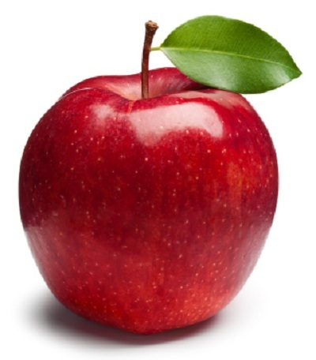
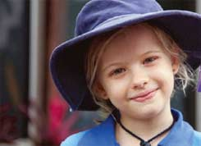
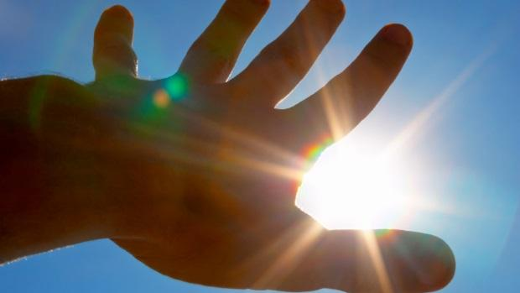
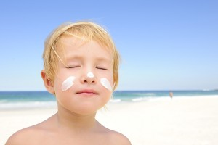
12. You can protect your eyes and skin from the dangers of strong sunlight by …
D
Never looking at the sun
E
Using sun screen
A
Wearing shades
B
Wearing a sun hat
C
Eating fruit
Four of these are true! Write down the letter of the one that is false.

Slide 16
13. When light shines from a source, it bounces off objects. This is called …
A
Refraction
B
Reflection
C
Reaction

Slide 17
14. Some colours reflect more light than others. Which of these colours would be easiest to see in a dark room?
A
B
C

Slide 18
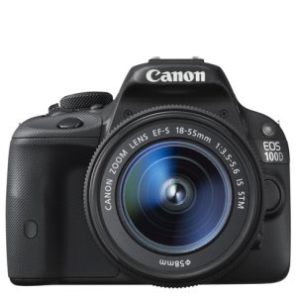
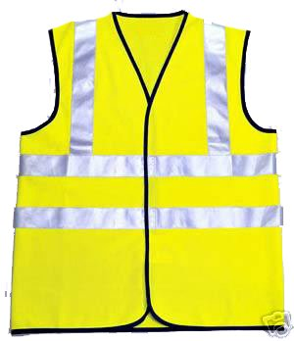
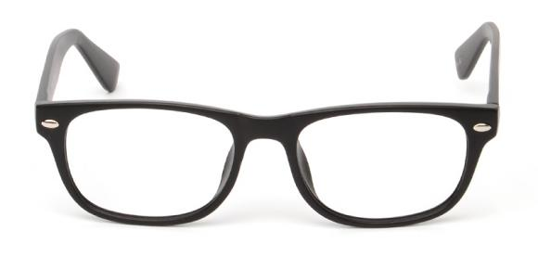
15. Which of these objects is designed to reflect a beam of light
A
B
C

Slide 19
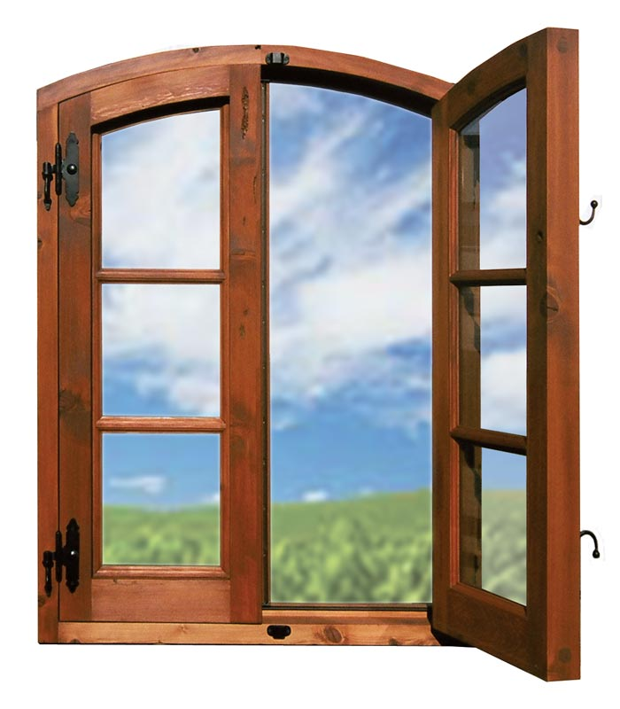
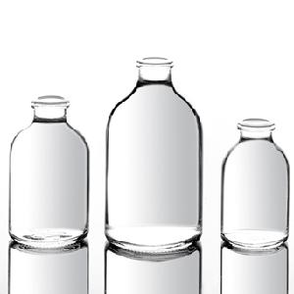
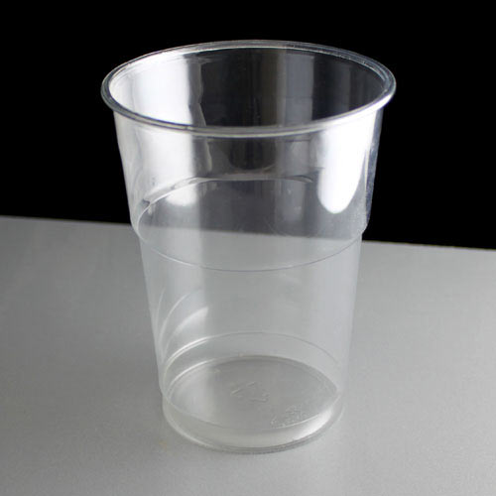
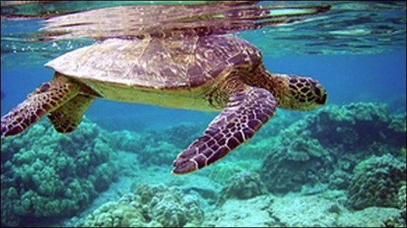
16. Some materials allow almost all light to pass straight through them. This means that you can see clearly through to the other side. These materials are …
A
Opaque
B
Translucent
C
Transparent

Slide 20
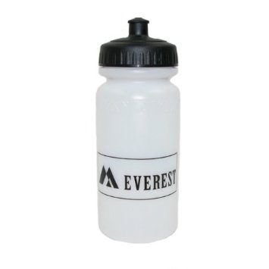
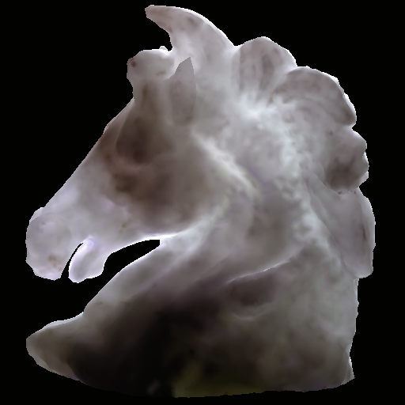
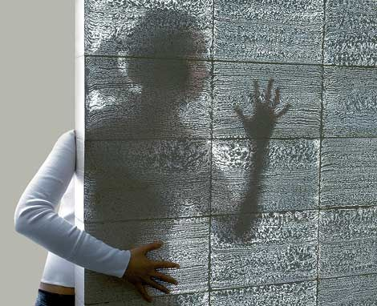
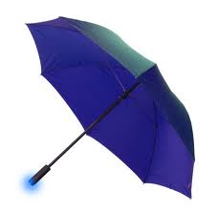
17. Some materials allow some light through but you cannot see clearly through them. These materials are ...
A
Opaque
B
Translucent
C
Transparent

Slide 21
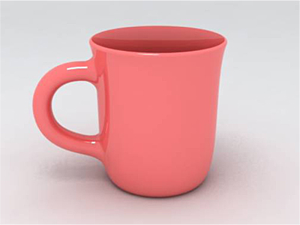
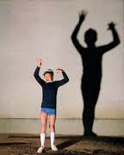
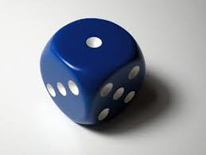
18. Some materials do not allow any light to shine through them. They block all the light that hits them, so they cast the darkest shadows. These objects are …
A
Transparent
B
Translucent
C
Opaque

Slide 22
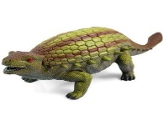
19. You can change a shadow by moving the light source. If you move the torch closer to the object, the shadow will
A
Get bigger
B
Get smaller
C
Get darker

Slide 23
20. If you move the torch further away from the object, the shadow will
A
Get blurry
B
Get smaller
C
Get Bigger

