Slide 1
Learning Objectives
Describe how breathing is brought about by the intercostal muscles and diaphragm
Know the reason for the differences of inspired air and expired air
Explain why breathing rate and depth increases during exercise, and remains high for some time afterwards

Slide 2
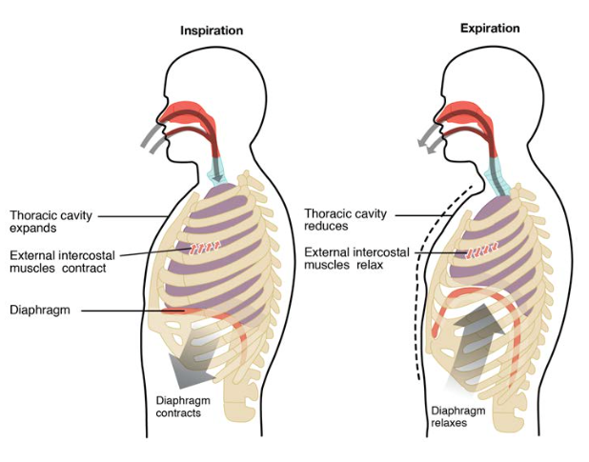
Breathing movements

Slide 3
Breathing movements
Inspiration (breathe in) | Expiration (breathe out)
External intercostals contract | Internal intercostals contract
Pulling ribs up and out | Pulling ribs down and in
Diaphragm contract | Diaphragm relax
Diaphragm pulls downward | Diaphragm normal dome shape
Low pressure than outside body | Higher pressure than outside body
Volume of thorax increases | Volume of thorax decreases

Slide 4
Differences between Respiration, Gas Exchange and Breathing
Respiration- a series of chemical reactions which happen in all living cells, in which food is broken down to release energy, usually by combining it with oxygen
Gas Exchange- the exchange of gases across a respiratory surface
Breathing- muscular movements which keep the respiratory surface supplied with oxygen

Slide 5
Composition of Inspired and Expired Air
 | Inspired Air | Expired Air
Oxygen | 21 % | 16%
Carbon dioxide | 0.04% | 4%
Argon and other noble gases | 1% | 1%
Water Content (Humidity) | Variable | Always high
Temperature | Variable | Always warm

Slide 6
Exercise and breathing rate
C₆H₁₂O₆ 2C₃H₆O₃ + energy
Glucose Lactic Acid

Slide 7
OXYGEN DEBT
The amount of oxygen needed to break down the lactic acid into carbon dioxide and water
  Increase breathing rate
  Increase depth of breathing
  Lactic acid + oxygen carbon dioxide + water
  (liver)

Slide 8
Changes in blood pH
If there is a lot of lactic acid or carbon dioxide in the blood, the pH level will fall
The brain will send signal to the intercostal muscles and the diaphragm to contract harder
Thus, faster breathing rate

Slide 9
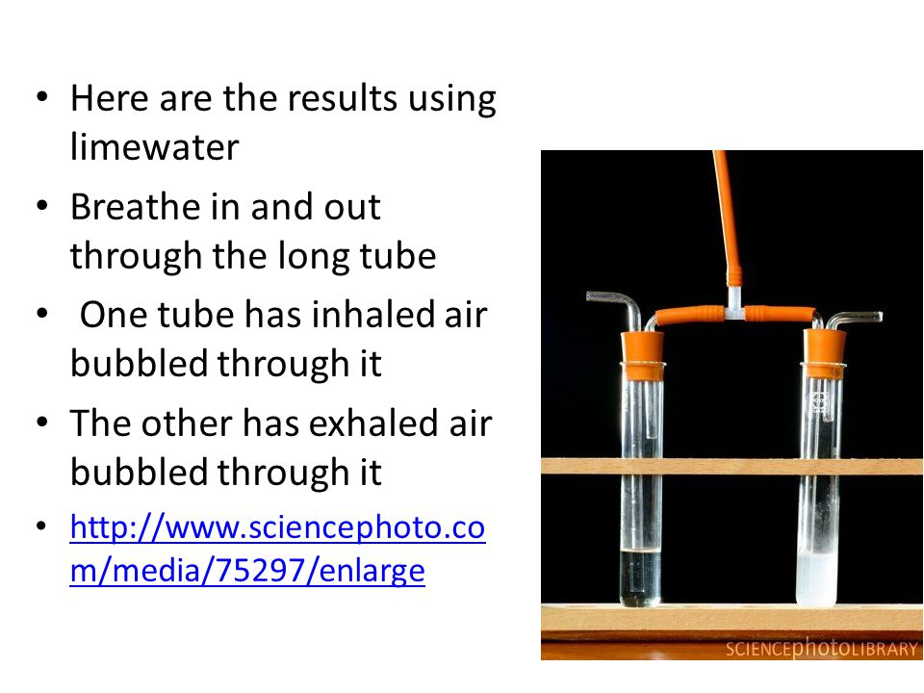
Comparing Carbon Dioxide Content

Slide 10
Answer the following.
1. Describe the breathing movements in your lungs during inspiration and expiration.

Slide 11
2. Give the reason for the difference of the composition of expired air and inspired air.
 | Inspired Air | Expired Air
a. Oxygen | 21 % | 16%
b. Carbon dioxide | 0.04% | 4%
Argon and other noble gases | 1% | 1%
c. Water Content (Humidity) | Variable | Always high
d. Temperature | Variable | Always warm

Slide 12
SOURCES
Cambridge IGCSE Biology 3rd ed.
Images from Google
https://courses.lumenlearning.com/suny-ap2/chapter/the-process-of-breathing-no-content/
http://slideplayer.com/slide/4157039/

