Slide 1
Learning Objectives
State the uses of energy in the human body and other organisms
Compare aerobic and anaerobic respiration

Slide 2
Respiration and Gas Exchange

Slide 3
Why do we need energy?

Slide 4
Why do we need energy?
Contracting muscles
Making protein molecules
Cell Division
Active Transport
Transmitting nerve impulses
Producing heat inside the body

Slide 5
Respiration
A series of metabolic reactions that break down the glucose molecules and release energy from them

Slide 6
Aerobic Respiration
When the cell release energy from glucose by combining it with oxygen. Most of the steps in aerobic respiration takes place in the mitochondria
C₆H₁₂O₆ + 6O₂ 6CO₂ + 6H₂O
Glucose

Slide 8
Anaerobic Respiration
The release of not much energy from glucose without using oxygen

Slide 9
Alcohol
- Yeast, a single-celled fungus can respire anaerobically, breaking down glucose to alcohol and gives off carbon dioxide
C₆H₁₂O₆ 2C₂H₅OH + CO₂
_{Glucose Alcohol}

Slide 10
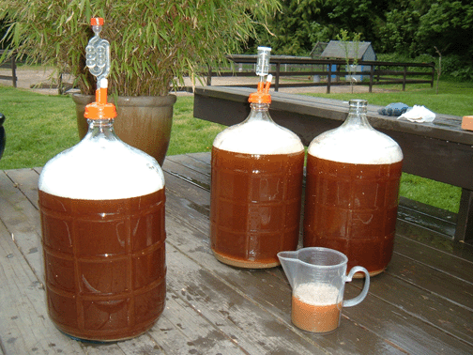
Making Alcoholic Drinks

Slide 11
Making Bread
Enzyme breaks down starch to sugar and are respired by the yeast.

Slide 12
Lactic Acid
muscle cells can respire anaerobically for a short time
due to lack of oxygen
C₆H₁₂O₆ 2C₃H₆O₃ + energy
Glucose Lactic Acid

Slide 13
Comparison of Aerobic and Anaerobic respiration
Aerobic respiration | Anaerobic respiration
Uses oxygen | Does not use oxygen
No alcohol or lactic acid made | Alcohol or lactic acid is made
Large amount of energy released from each molecule of glucose | Much less energy released from each molecule of glucose
Carbon dioxide made | Carbon dioxide is made by yeast and plants, but not by animals

Slide 14
Learning Objective
Recognize how the goblet cells, mucus and ciliated cells help to protect the pathway to the lungs
Construct the structure and functions of the organs of the human respiratory system
Explain the features of the human gas exchange surface that adapt it for its functions

Slide 15
Pathway to the lungs
Goblet cells – makes mucus
Cilia- tiny hair-like structures that sweeps the mucus and particles out

Slide 16
Lining of Respiratory Passages

Slide 17
THE STRUCTURE OF THE GAS EXCHANGE SYSTEM

Slide 19
Gas Exchange Surfaces
Thin to allow gases to diffuse quickly
Close to an efficient transport system to take gases to and from the exchange surface
Have a large surface area
Good supply of oxygen

Slide 20
SOURCES
Cambridge IGCSE Biology 3rd ed.
Images from Google
https://www.slideshare.net/khoocarolyn/2011-cellular-respiration
http://www.growbetterveggies.com/.a/6a00d8346ffdca53ef014e88da9a39970d-popup
https://wine.lovetoknow.com/wiki/Wine_Making
http://www.thefreshloaf.com/lessons/myfirstsourdough
https://www.slideshare.net/WendyWhyte/ss-respiratory-system-ch-10
https://www.s-cool.co.uk/a-level/biology/gas-exchange/revise-it/gas-exchange-in-humans
https://www.dreamstime.com/stock-illustration-alveolus-gas-exchange-pulmonary-alveoli-capillaries-lungs-image48200122

