Slide 1
PLASTICS

Slide 2
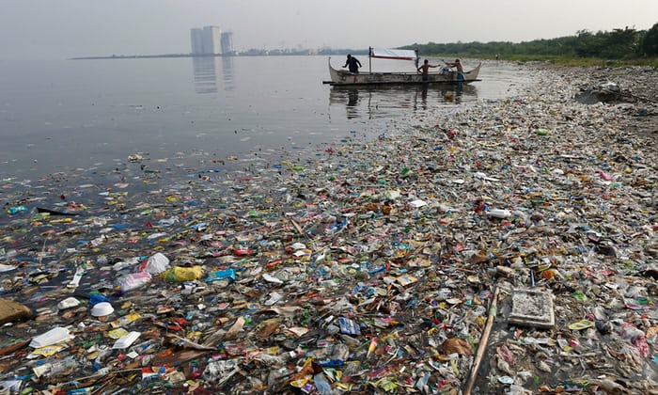
Problem with Plastic Pollution
https://www.theguardian.com/environment/2016/jan/24/plastic-new-epoch-human-damage

Slide 3
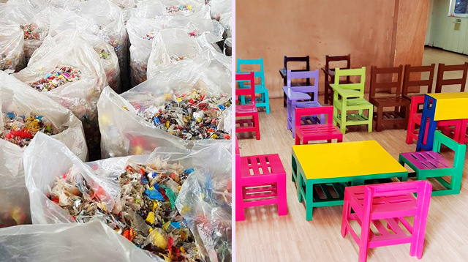
REUSE AND RECYCLE

Slide 4
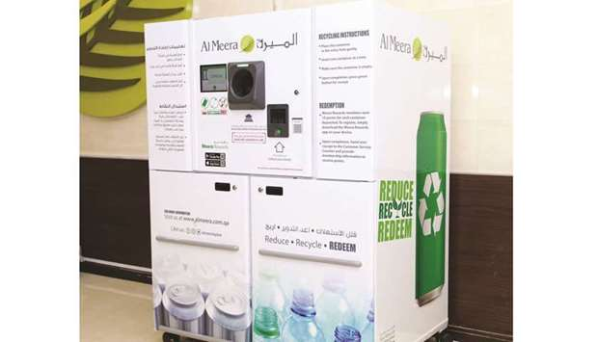
AL MEERA: REDUCE, RECYCLE, REDEEM

Slide 5
HYDROLYSIS
a chemical reaction between a covalent compound and water; covalent bonds are broken during the reaction and the elements of water are added to the fragments; can be carried out with acids or alkalis, or by using enzymes

Slide 6
HYDROLYSIS
a chemical reaction between a covalent compound and water; covalent bonds are broken during the reaction and the elements of water are added to the fragments; can be carried out with acids or alkalis, or by using enzymes

Slide 7
ENVIRONMENTAL CHALLENGES
to reduce the level of plastic packaging wherever possible
to avoid the use of 'single-use plastic (and the subsequent littering with it)
to reuse and recycle wherever possible.

Slide 8
PROBLEMS WITH PLASTICS
Incineration can be used to burn plastic waste can lead to acidic fumes of hydrogen chloride
Disposal in landfill sites suffers from the problem that most plastics are not biodegradable
Accumulation in oceans causes major problem harming ocean wildlife and sea birds

Slide 9
MICROPLASTICS
small pieces of plastic less than 5 mm in length that enter natural ecosystems from a variety of sources including cosmetics, clothing and industrial processes: nurdles and microbeads are different types of microplastic

Slide 10
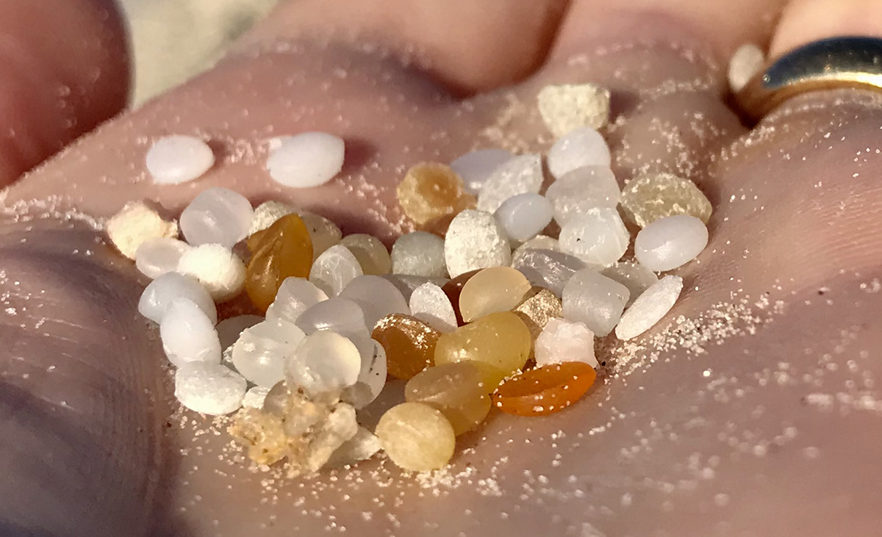
NURDLES

Slide 11
Discussion questions:
What are some real-world examples where innovative solutions have been successfully implemented to address polymer-related environmental issues?
What role do education and community initiatives play in reducing plastic pollution?

Slide 12
Sources:
Chemistry for Cambridge IGCSE Coursebook 5th ed.
Images from Google

