Slide 1
Revision Day 4
Objectives
Read time on digital and analogue clocks to the half hour.
Order time to the half hour, using digital and analogue clocks.
Read time on analogue clocks to nearest quarter hour.
Tell the time to the nearest quarter hour.
Notes:
Before teaching, be aware that:
On Day 1 children will need 100-bead strings. You may prefer to use a real 100-bead bar.

Slide 2
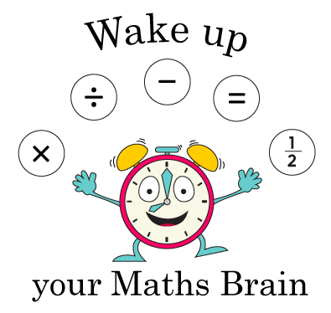
Bonds to 10 (simmering skills)
Notes:
Pre-requisite skills – to use this starter, drag this slide to the start of Day 1
Hold a 1p and 2p coin behind your back.
I’ve got 2 coins which total 3p. What are the coins?
Continue to hide coins and then reveal to check answers.
I’ve got 3 coins that total 6p. What are the coins?
I’ve got 2 coins that total 6p; what are they?
I’ve got 2 coins that total 20p; what are they?
I’ve got 3 coins that total 15p; what are they?
Continue to practise further examples.
Increase the level of this activity by asking open ended questions.
I’m holding some coins that total 15p. None of them are 1p coins. What could they be?
I’m holding some coins that total 20p. None of them are bronze coins. What could they be?

Slide 3
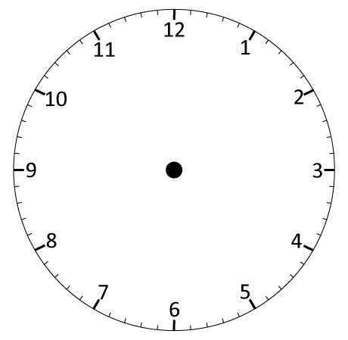
Day 1: Read time on digital and analogue clocks to the half hour.
09:30
09:00
10:00
Now look at the digital clock. There are 60 minutes in an hour so 09:30 is half past 9.
The number
before the 2 dots tells us the hour. There is a 0 before the 9 - digital times have 4 digits!
This is a digital clock. Where have you seen this sort of clock?
What time will it be in half an hour?
It’s 9 o ’clock!
It’s half past 9!
It’s 10 o’ clock!

Slide 4
Day 1: Read time on digital and analogue clocks to the half hour.
02:30
02:00
03:00
What time will it be in another half an hour? Write the digital time on your whiteboards.
What time will it be in half an hour?
It’s 3 o’ clock!
It’s half past 2!
It’s 2 o’ clock!

Slide 5
Day 3: Read time on analogue clocks to nearest quarter hour.
12
Fold your circle in half. Now fold it in half again so that you have 4 equal parts. What do we call these parts?
The circle is a bit like a clock face. Let’s put 12 at the top.
Where should 3 go on our circle?
Where should 9 go on our circle?
What number goes at the bottom?
When the minute hand is at 9, it has ¹/₄ of an hour to go until the next o’ clock time.
3 is a ¼ of the way round the clock face. When the minute hand is here, it is ¼ of an hour past an o’ clock time.
9
3
6

Slide 6
Day 3: Read time on analogue clocks to nearest quarter hour.
It’s 9 o’ clock. On this clock the pink tells as ‘past’ times and the blue tells us ‘to’ times.
Now it’s only ¼ of an hour before 10 o’ clock. We can write that as quarter to 10 or ¼ to 10.
Now it’s ¼ of an hour after 9 o’ clock. We can write that as quarter past 9
or ¼ past 9.
What time is it now?
What time is it now?
What time is it now?

Slide 7
Day 3: Read time on analogue clocks to nearest quarter hour.
Quarter past 10.
Watch carefully what happens each time the clock moves forward
1 hour.
Write the new times on your whiteboards.
What changed?
What stayed the same?
Notes:
Children can now go on to do differentiated GROUP ACTIVITIES. You can find Hamilton’s group activities in this unit’s TEACHING AND GROUP ACTIVITIES download.
WT/ARE/GD: Write times to the quarter hour from given clock images OR Play Time cards game (making times on analogue cocks).

Slide 8
Day 3: Read time on analogue clocks to nearest quarter hour.
12
Fold your circle in half. Now fold it in half again so that you have 4 equal parts. What do we call these parts?
The circle is a bit like a clock face. Let’s put 12 at the top.
Where should 3 go on our circle?
Where should 9 go on our circle?
What number goes at the bottom?
When the minute hand is at 9, it has ¹/₄ of an hour to go until the next o’ clock time.
3 is a ¼ of the way round the clock face. When the minute hand is here, it is ¼ of an hour past an o’ clock time.
9
3
6

Slide 9
Day 3: Read time on analogue clocks to nearest quarter hour.
It’s 9 o’ clock. On this clock the pink tells as ‘past’ times and the blue tells us ‘to’ times.
Now it’s only ¼ of an hour before 10 o’ clock. We can write that as quarter to 10 or ¼ to 10.
Now it’s ¼ of an hour after 9 o’ clock. We can write that as quarter past 9
or ¼ past 9.
What time is it now?
What time is it now?
What time is it now?

Slide 10
Day 3: Read time on analogue clocks to nearest quarter hour.
Quarter past 10.
Watch carefully what happens each time the clock moves forward
1 hour.
Write the new times on your whiteboards.
What changed?
What stayed the same?
Notes:
Children can now go on to do differentiated GROUP ACTIVITIES. You can find Hamilton’s group activities in this unit’s TEACHING AND GROUP ACTIVITIES download.
WT/ARE/GD: Write times to the quarter hour from given clock images OR Play Time cards game (making times on analogue cocks).

Slide 11
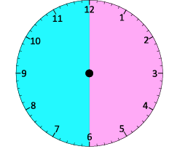
Station 1
You are given some empty clock faces and time on digital form written on cards.
Select a card and draw the hands on empty clock faces.
Do as many as you can in 2 minutes.

Slide 12
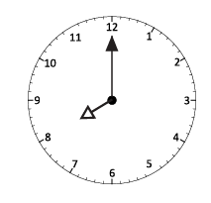
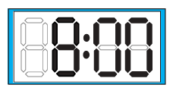
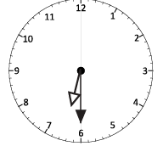
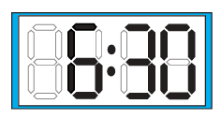
Station 2
You are given some cards with analogue and digital times written on it.
Compare the time and match the digital and analogue clocks.

Slide 13
Station 3
You are given some clock faces with time already mentioned on it.
Considering it starts at 12 noon, arrange the time from earliest to latest.

Slide 14
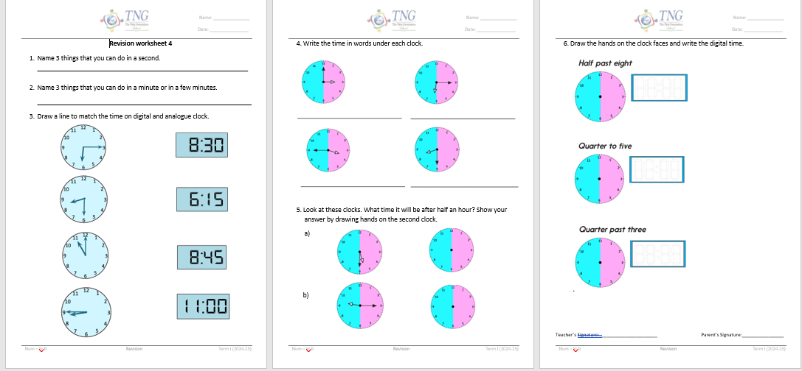
Independent task
Complete the revision worksheet

