Slide 1
Measures
Begin to understand hours, minutes, seconds
Objectives
Day 1
Have an idea of the length of 15, 30 and 60 seconds.
Day 2
Have a sense of the length of a minute.
Notes:
Before teaching, be aware that:
On Day 1 You will need a large stop-clock or a clock with a second hand; children will need whiteboards and pens
On Day 2 You will need a 1-minute sand timer.

Slide 2
Measures
Begin to understand hours, minutes, seconds
Starters
Day 1
Quarters (pre-requisite skills)
Day 2
Time to the half hour (pre-requisite skills)
Notes:
Choose starters that suit your class by dragging and dropping the relevant slide or slides below to the start of the teaching for each day.

Slide 3
Measures
Begin to understand hours, minutes, seconds
Starter
Quarters
Notes:
Pre-requisite skills – to use this starter, drag this slide to the start of Day 1
Draw a variety of shapes on the Interactive Whiteboard or flipchart, each divided in 4 parts, some equal and some not. Is this shape divided into quarters? Why/why not?
Children work in pairs. The first child draws a shape on squared paper, the second child shades 1/4. If the first child agrees, the second child wins a cube. Swap and repeat.

Slide 4
Measures
Begin to understand hours, minutes, seconds
Starter
Time to the half hour
Notes:
Pre-requisite skills – to use this starter, drag this slide to the start of Day 2
Give each pair a number fan and 2 cards: ‘o’clock’ and ‘half past’. Show half past 4 on a large analogue clock. Children work in pairs to use their number fan and cards to show the time when you say ‘Show me!’ Repeat with other o’clock and half past times.

Slide 5
Measures
Begin to understand hours, minutes, seconds
Objectives
Day 1
Have an idea of the length of 15, 30 and 60 seconds.

Slide 6
Day 1: Have an idea of the length of 15, 30 and 60 seconds.
Show children a large stop-clock or clock with a second hand. This hand takes one minute to move round the clock. Explain that there are 60 seconds in one minute.
Wait until the second hand is at the top and count as it moves, saying 1 second, 2 seconds, 3 seconds and so on until 21, then just say 22, 23, etc. until 60.
Repeat counting for 60 seconds, but this time, turn the clock away from the children. Discuss how far out you were as a class.

Slide 7
Day 1: Have an idea of the length of 15, 30 and 60 seconds.
Ask children to count 15 seconds in their head, and put up your hand when 15 seconds has passed. Shout Stop! when 15 seconds are up. Who has already put up their hand? Repeat for 30 seconds.
Ask children to estimate how many letters of the alphabet they could write in 30 seconds. Children write as many letters as they can on their whiteboards whilst you use the stop-clock to time 30 seconds.
Discuss how the actual number of letters written compare with the estimates.
Notes:
Children can now go on to do differentiated GROUP ACTIVITIES. You can find Hamilton’s group activities in this unit’s TEACHING AND GROUP ACTIVITIES download.
WT/ARE/GD: Estimating and timing events (15 or 30 seconds).

Slide 8
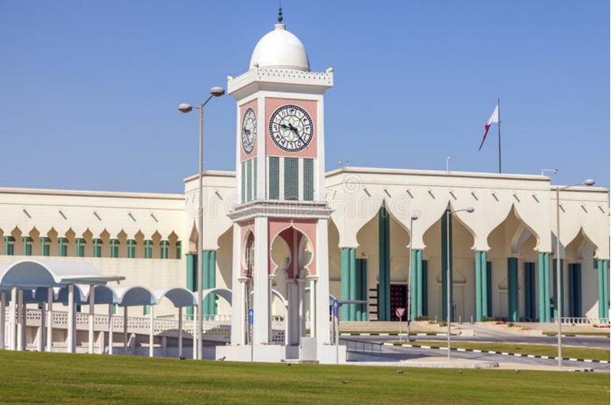
QNID
Clock tower in Qatar.

Slide 9
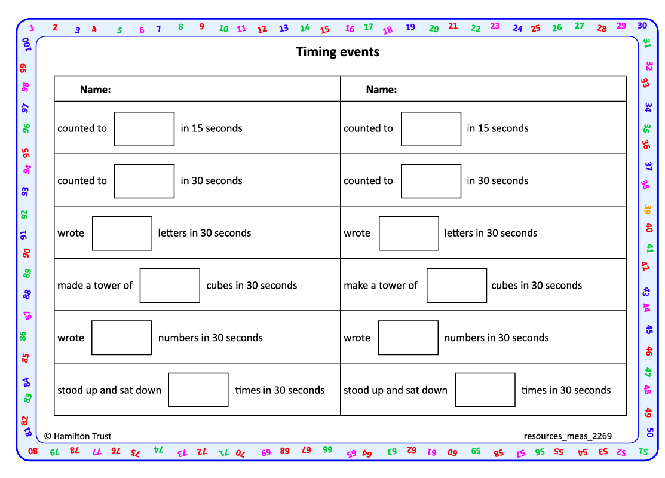
Task 1 – Pair/Group Work
Take it in turns to use a stop watch to time 15 or 30 seconds, as per the ‘Timing events’ recording sheet, to find out how many of the following activities your partner can do in that time:➢
Write as many letters of the alphabet as possible.➢
Write as many numbers as possible.➢
Build a tower using as many cubes as possible.➢
Stand up and sit down.
Record your results on the activity sheet.

Slide 10
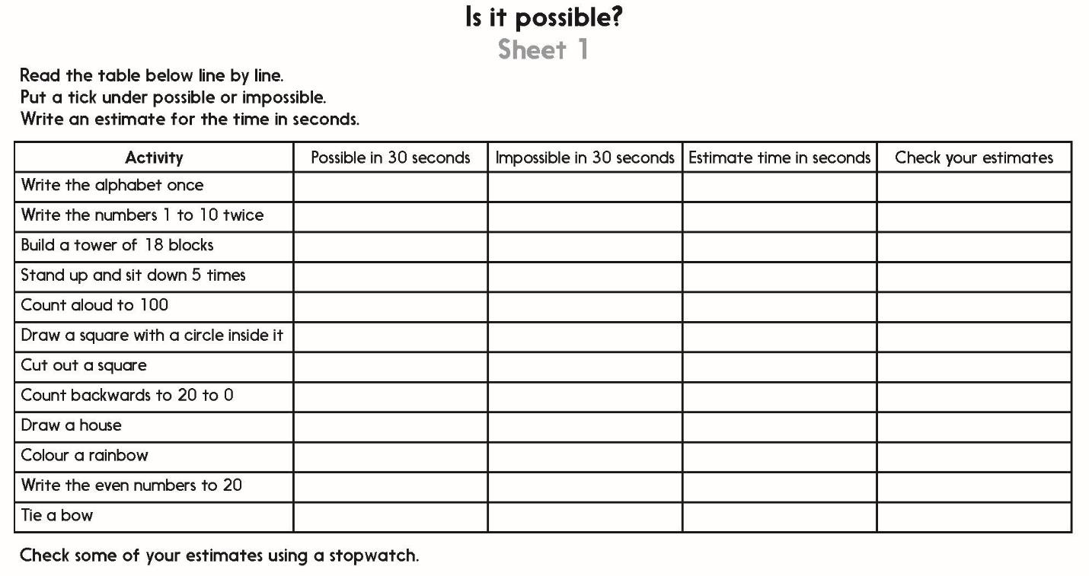
Task 2 – Independent Work
Challenge
Notes:
The Practice Sheet on this slide is suitable for most children.
Differentiated PRACTICE WORKSHEETS are available on Hamilton’s website in this unit’s PROCEDURAL FLUENCY box.
WT/ARE/GD: Is it possible? Sheet 1
A practical practice activity for mixed-attainment pairs or 3s.

Slide 11
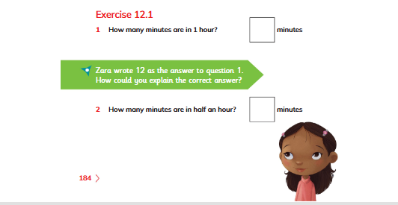
Plenary
complete Q1 and 2 on page 184, Learners’ book

Slide 12
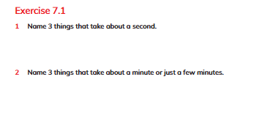
Homework
Solve Q1 and Q2, Exercise 7.1 on page 111, Learners book

