Slide 1
https://youtu.be/Sta_p-oB_d4?si=PSzflbzQ7wHiQ1tU

Slide 2
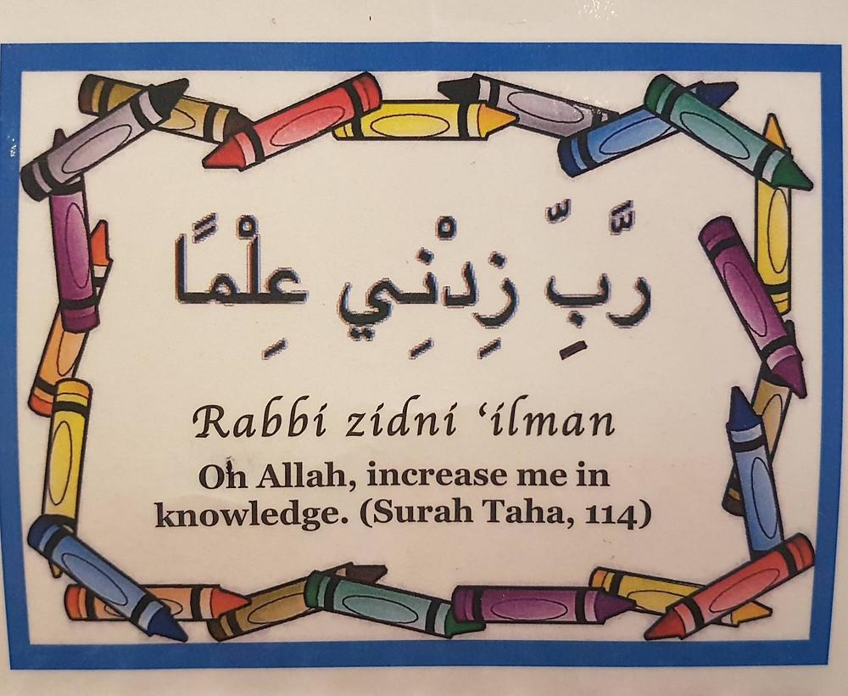
https://youtu.be/Sn3ElZG_WwQ?si=XDsPu9P89Av1dU5L

Slide 3
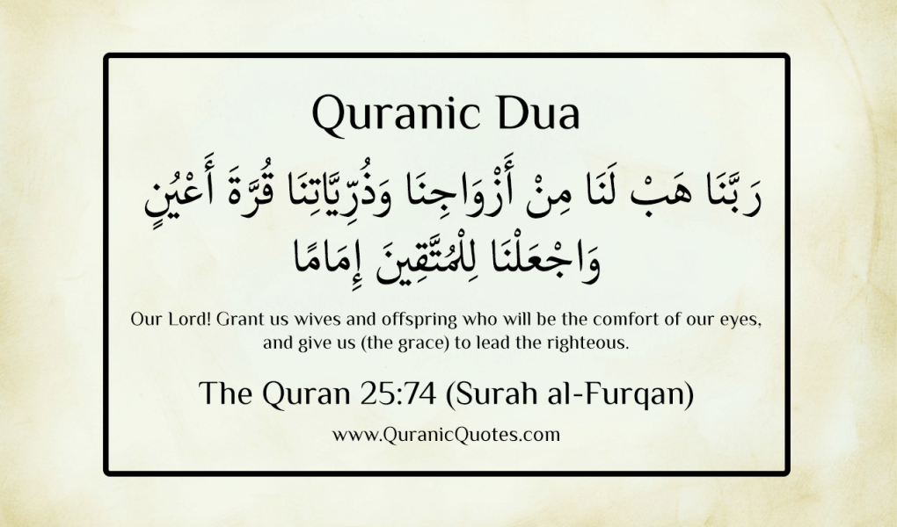
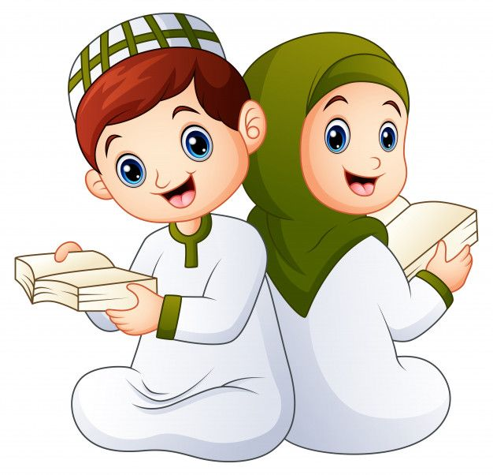

Slide 4
QUR'AN CLASS RULES
Please maintain silence and Respect Qur'an (speech of Allah)

Slide 5
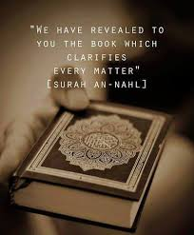
DO YOU KNOW WHO ARE THE BEST AMONG YOU????
Do you want to be the best among mankind?
The best among you are the ones who learn Qur'an and teaches to others “ (Prophet Muhammad Saw)

Slide 6
By the end of the lesson, students will be able to Memorise the surah by analysing its meaning and learning it by focusing on articulation points. Assess their learning through oral midterm assessment

Slide 7
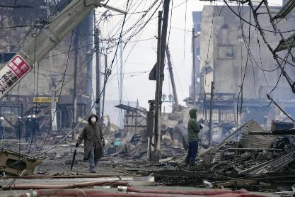
QATAR IDENTITY
Qatar Seismic Network recorded earthquake in the Pacific Ocean
An official source in the Meteorological Department at Qatar Civil Aviation Authority said that Qatar Seismic Network recorded today (17/9/2014) an earthquake with magnitude 6.7 at 45 km NW of Piti Village, Guam (Pacific Ocean). The earthquake occurred at 09:14:47 am (Local Time) and at a depth of 137 km. It was located at a distance of 9771 km NE of Doha.
Qatar Value: RESPONSIBILITY
Qatar Red Crescent has launched an instructional booklet for the safety of Students and all its citizens.
https://www.marhaba.qa/qatar-red-crescent-releases-earthquake-instruction-booklet-for-school-students/

Slide 8
REPEATITION TIME
https://www.youtube.com/watch?v=ubBnQnGESSA

Slide 9
SURAH al QARIAH
Task 2: Interpretation
Teacher will explain the main theme of the surah with the help of picture prompts used in videos.
101. Surah Al-Qariah | Ziyaad Patel | Understand & Memorize Quran Project | Juz 30 - YouTube
Learn the Quran for children : Surat 101 Al-Qari'ah (The Calamity) - YouTube

Slide 10
Online quiz: https://wordwall.net/resource/9684543/surah-al-qariah
Students will do the online quiz about surah Qariah through the above link.

Slide 11
QUESTION TIME
How will you learn/revise your surahs?
Do you think Salah is the best way to implement your new hifz surahs?

Slide 12
END……. ANY QUESTIONS OR DOUBTS????

