Slide 1
Factors Affecting Rate of Reactions

Slide 2
ACTIVATION ENERGY (E_{A})
The energy required to start a chemical reaction – for a reaction to take place the colliding particles must possess at least this amount of energy

Slide 3
COLLISION THEORY
A theory which states that a chemical reaction takes place when particles of the reactants collide with sufficient energy to initiate the reaction. The more often/frequent they collide, the more chance the particles have of reacting.

Slide 4
What is reaction rate?
A measure of how fast a reaction takes place

Slide 5
Factors Affecting Rate of Reactions
The surface area of any solid reactants
The concentration of the reacting solutions
The pressure of reacting gases
The temperature at which the reaction is carried out
Presence of catalyst

Slide 6
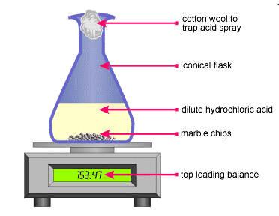
Influences of the surface area of any solid reactants
calcium carbonate + hydrochloric acid calcium chloride + water + carbon dioxide
CaCO_{3(s)} + 2HCl_{(aq)} CaCl_{2(aq)} + H2O_{(l)} +CO_{2(g)}
The experiment is carried out twice.
Independent Variable:
- surface area (small and large chips)
Controlled Variable:
Same mass of marble chips
Same volume of HCl
Same concentration of HCl
Dependent Variable:
- Loss in mass as CO₂ gas escape

Slide 7
Calcium carbonate and hydrochloric acid
To run the experiment investigating the effect of surface area on the rate of reaction:
1. Measure out a fixed volume of hydrochloric acid into a conical flask and place the flask on weighing scales.
2. Add a fixed mass of calcium carbonate chips to the flask, and place a cotton wool plug in the neck. This stops the liquid from spitting while allowing the CO₂ to escape.
3. Begin taking mass readings straight away, and continue until there is no further change in mass.
4. Repeat the experiment using the same mass of calcium carbonate but of a smaller chip size, and the same volume of hydrochloric acid. Compare the rate at which the mass of reactants decreases.

Slide 8
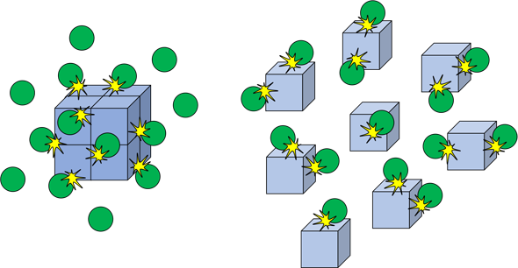
Influences of the surface area of any solid reactants
Sample A: Large Chips
Sample B: Small Chips

Slide 9
Interpret the Graph
-Which experiment has a steeper line?
- Why the same amount of gas is produced in the end?

Slide 10
Interpret the Graph
The reaction is fastest at the start. This is shown by the steepness of the curve over the first few minutes. Curve B is steeper than Curve A. This means that CO₂ gas is being produced faster with sample B. The sample with a smaller chips, with a greater surface area, reacts faster. Beyond this part of a graph, both reactions slow down as the reactants are used up.
The total volume of gas released is the same in both experiments. The mass of CaCO3 and the amount of acid are the same in both cases. Both curves flatten out at the same final volume. Sample B reaches the horizontal part of the curve first.

Slide 11
CONCLUSION
The rate of a reaction increases when the surface area of a solid reactant is increased.

Slide 12
Sources
Cambridge IGCSE Chemistry Workbook 5th ed.
IGCSE Chemistry Past Papers
Images from Google
https://www.youtube.com/watch?v=FJtwkum_QAY
Boardworks Ltd.

