Slide 1
Science - Year 3/4B Summer 2
Electricity
Electric Personalities
Session 4
Teaching PowerPoint
© Original resource copyright Hamilton Trust, who give permission for it to be adapted as wished by individual users.
We refer you to our warning, at the foot of the block overview, about links to other websites.

Slide 2
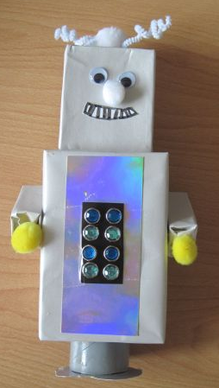
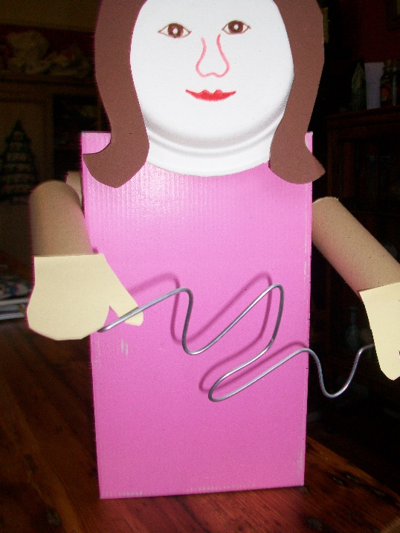
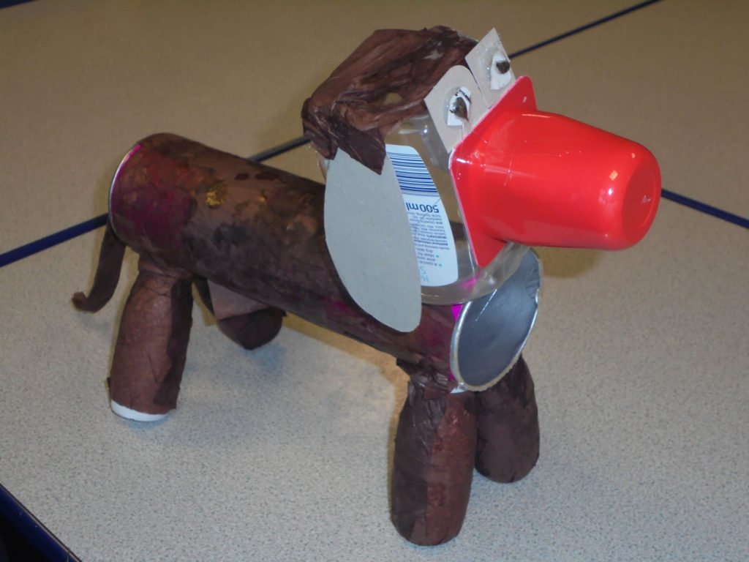
It’s time to design your own
Electric Personality
It could be …
or a person
A robot
or an animal

Slide 3
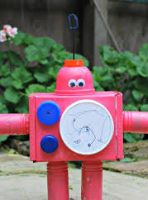
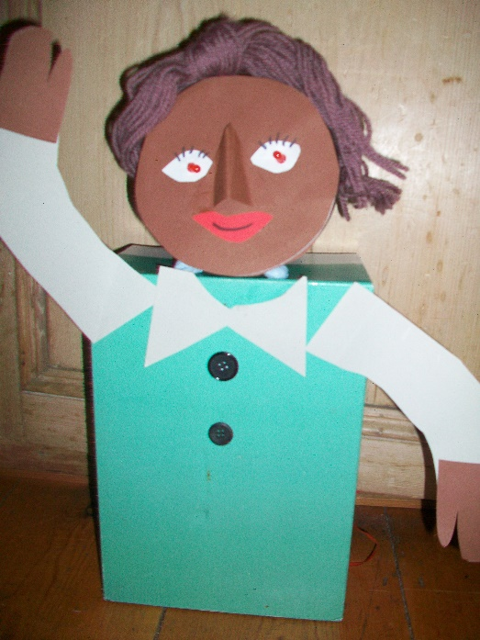
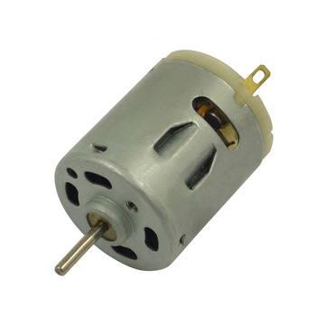
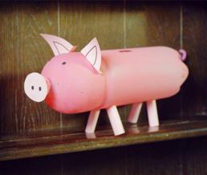
It will need to include an electrical circuit with a switch that makes something work.
Or even a nose that rotates
Perhaps a spinning bow tie
You could use a motor to make something spin round
Or revolving antennae

Slide 4
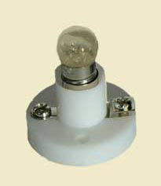
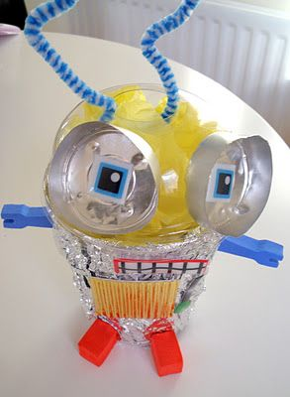
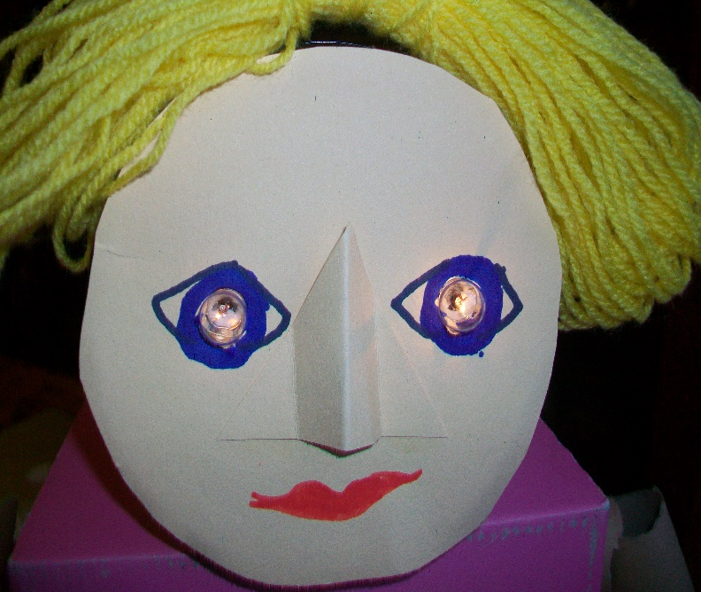
Or you could make something light up
Perhaps eyes
Or head
Or light up buttons

Slide 5
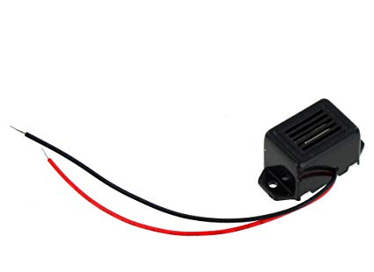
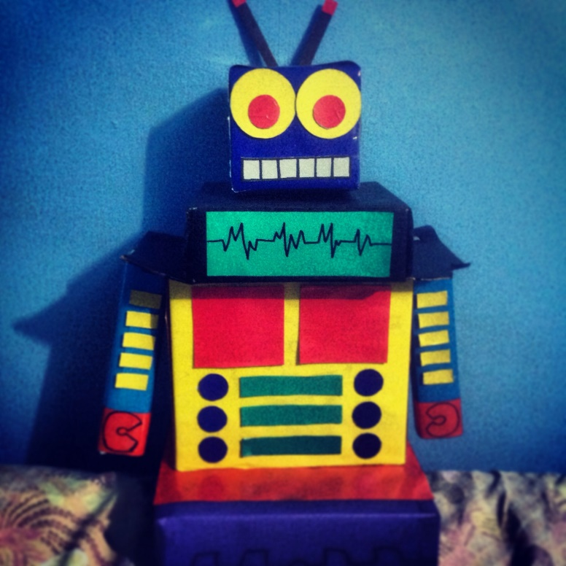
Or you could use a buzzer
Or your personality can hold a buzz wire game
So that your character can talk in a buzz language
The choice is yours!

Slide 6
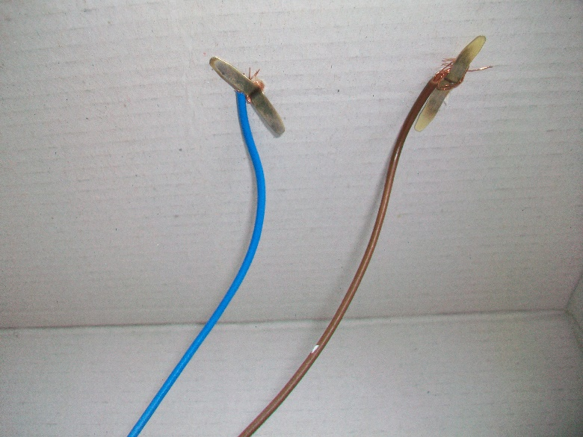
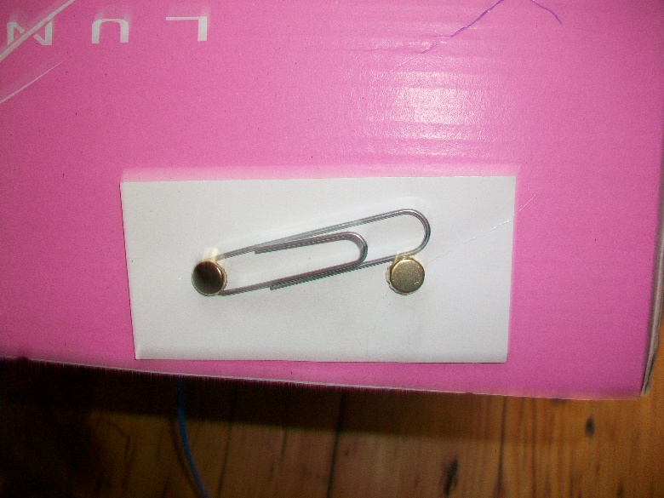
The switch for your circuit will go on the outside of your model but most of the wiring will be hidden neatly inside.
Here the split pins from the paperclip switch have been pushed through to the inside of the box where they have been wired up into a circuit
The switch could be a homemade paperclip switch or a bought switch that does the same job

Slide 7
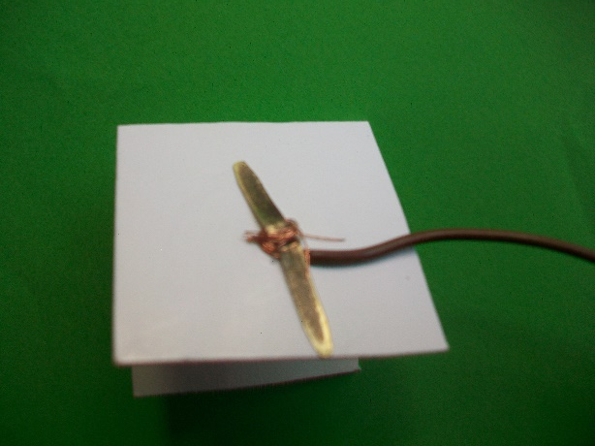
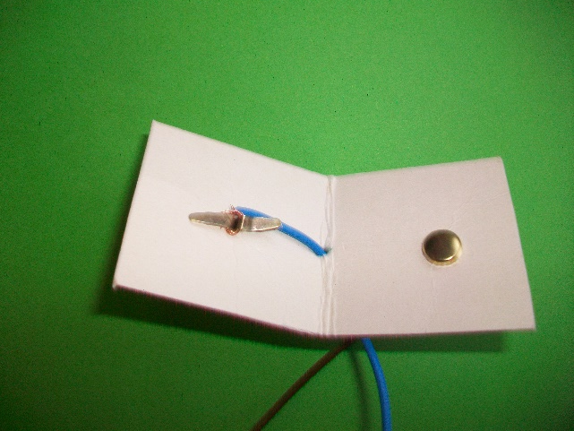
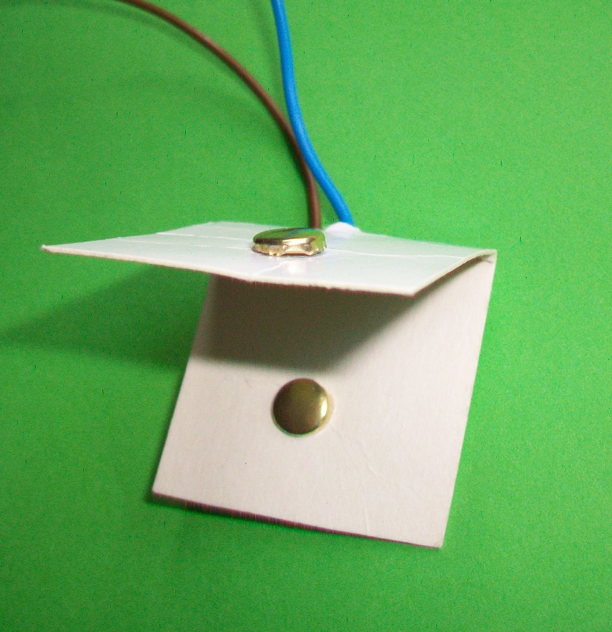
This is a different kind of switch called a pressure switch. When you press down on the button it closes the circuit (as the split pin touches the one underneath). When you stop pressing, it springs open again and the connection is broken. Both the split pins are neatly wired into a circuit from underneath.
Underneath
Inside
This is a bought pressure switch which works in the same way. It only connects the circuit when the button is pressed

Slide 8
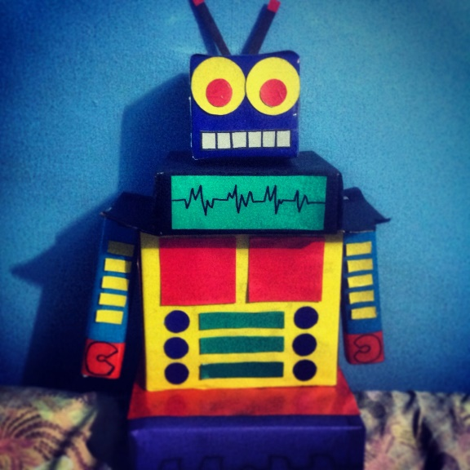
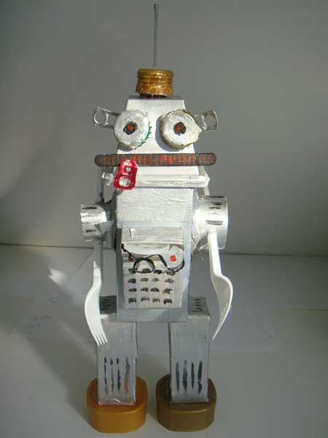
Think which type of switch would suit your model best. If you want to turn it on and leave it working, the on/off switch would be best, but if you want it to flash or make a series of quick buzzes, the pressure switch would be the right choice.

Slide 9
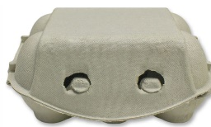
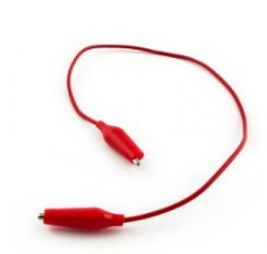
Here is your task for today – designing your electric personality
Decide what you want to make as your model and gather together the main items you will need for the head, body, eyes, feet or any other parts, e.g. boxes, tubs, paper cups or cardboard tubes. Put the items you need into your own named bag.
Decide on the components you will need in your electric circuit (a motor, bulb/bulbs or buzzer) and build your circuit using crocodile leads and cells in a battery holder. In a future session you will replace your crocodile leads with your own electrical wiring which will be more secure.
Decide what kind of switch you will need (either an on/off switch for a long connection or a pressure switch for short bursts). Make the switch with card and split pins or connect the right bought switch to your circuit.
Use your task sheet to plan your electric personality.
Let’s get started!

