Slide 1
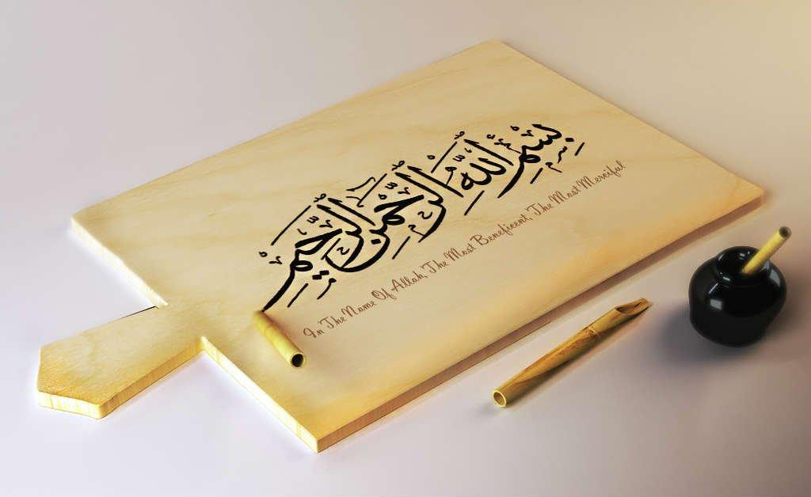
https://youtu.be/Sta_p-oB_d4?si=PSzflbzQ7wHiQ1tU

Slide 2
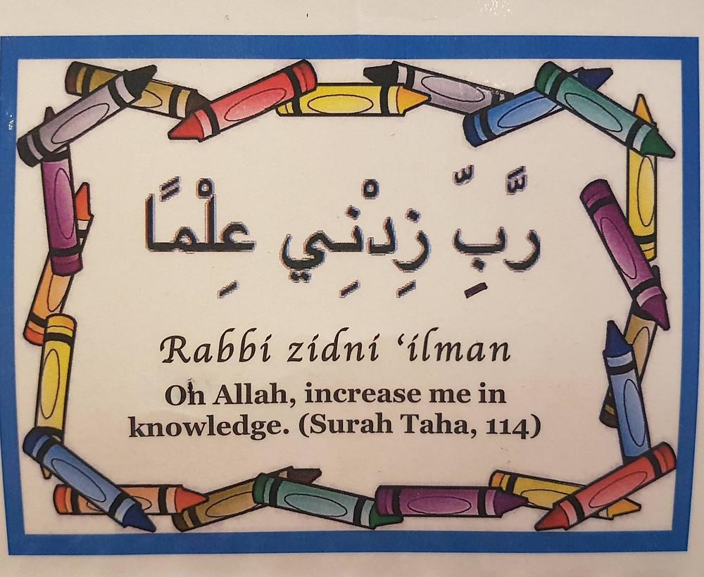
https://youtu.be/Sn3ElZG_WwQ?si=XDsPu9P89Av1dU5L

Slide 3
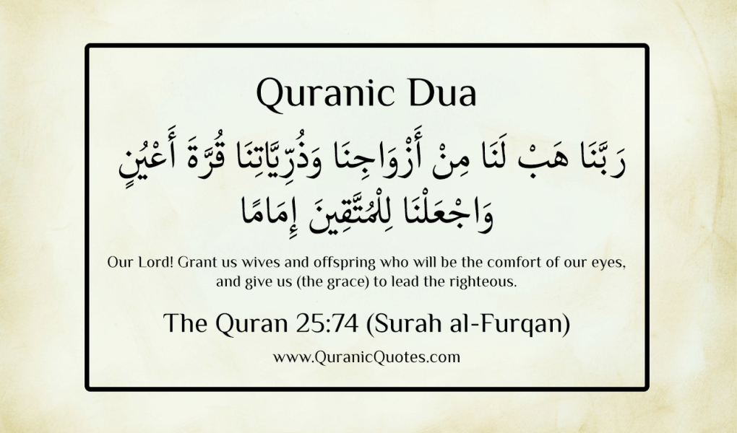
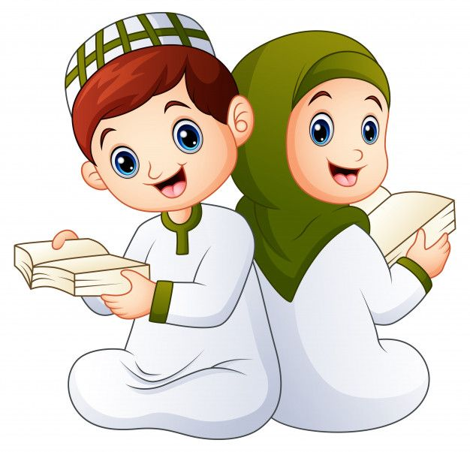

Slide 4
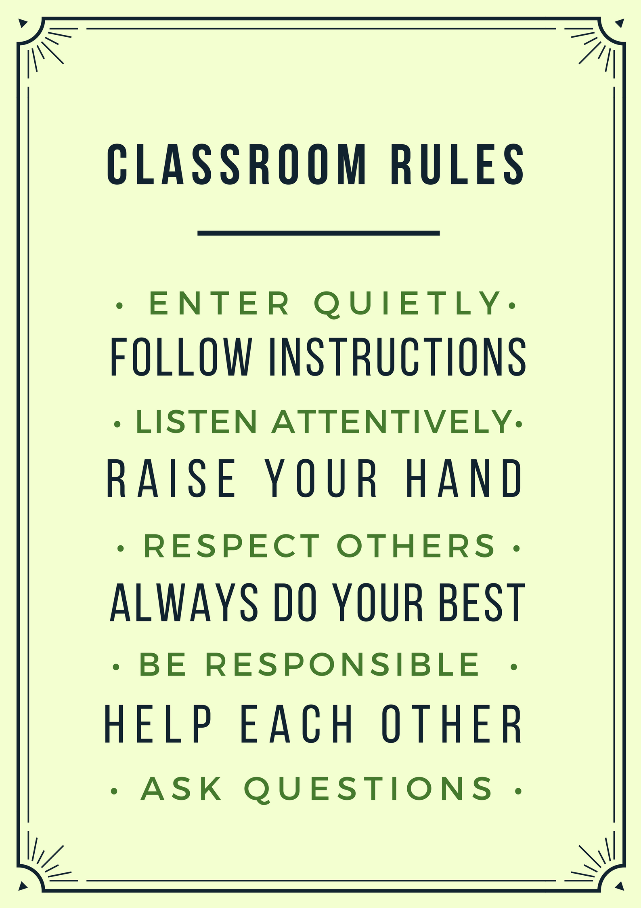
QUR'AN CLASS RULES
Please maintain silence and Respect Qur'an (speech of Allah)

Slide 6
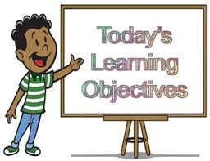
OBJECTIVE By the end of the lesson learners will be able Recognize, spell and pronounce words with shadda Qaida lesson 13 after going through Quran organiser and video presentation. Reinforcement of the Rabbana Dua 7 with tajweed rules after practicing through drilling.

Slide 7
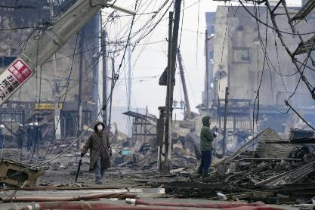
QATAR IDENTITY
https://www.qf.org.qa/events/holy-quran-program-for-memorizing-revising-and-mastering-recitatio
Minaratein Center offers the Holy Quran program for memorizing, revising, and mastering recitation. The program is available for all ages, morning and evening sessions, for males and females.

Slide 8
REPEATITION TIME
https://www.youtube.com/watch?v=jldIY3-PBM0

Slide 9
https://alquran.islam.gov.qa/droos/Dr3.shtml

Slide 10
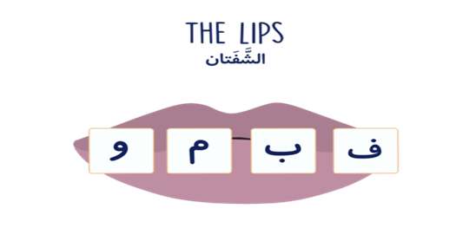
LIP LETTERS
https://www.alqasaslearning.com/blog-1/the-5-main-makharij

Slide 12
Activity
Explain the Qaida lesson and write some examples of the Shaddah letters from the provided Juz amma.
Open the Quran and find the Shaddah letters and try to use what you have learn.
Read the qaida lesson 13 properly from the given examples provided on the smartboard by the teacher

Slide 13
Home work
Memorise the Rabbana Dua 7

Slide 14
END……. ANY QUESTIONS OR DOUBTS????

