Slide 1

Persuasive Writing
EFL 500-Paper 2-Directed Writing -40 Marks

Slide 2
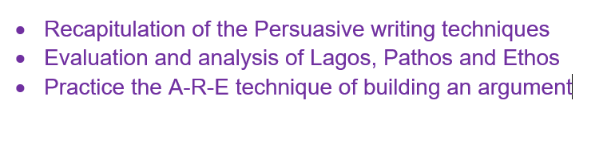
Lesson Objective:

Slide 3
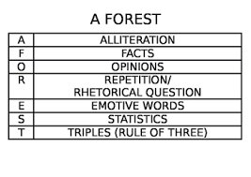

Slide 4
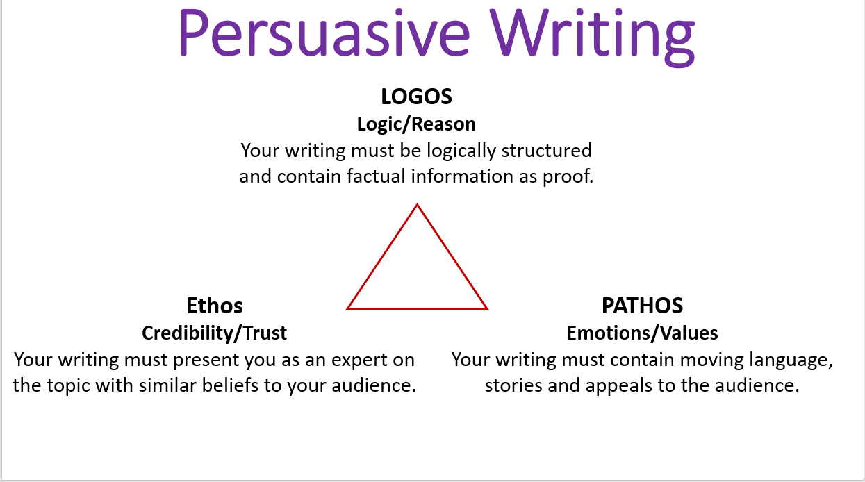

Slide 5
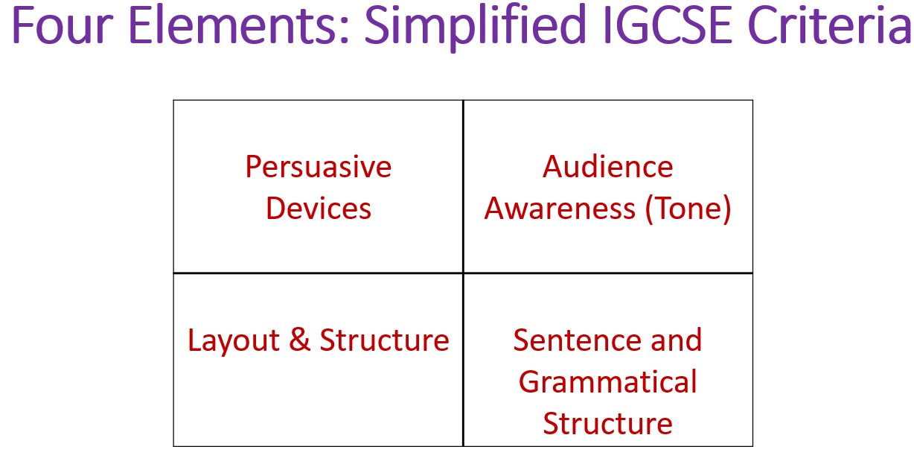

Slide 6
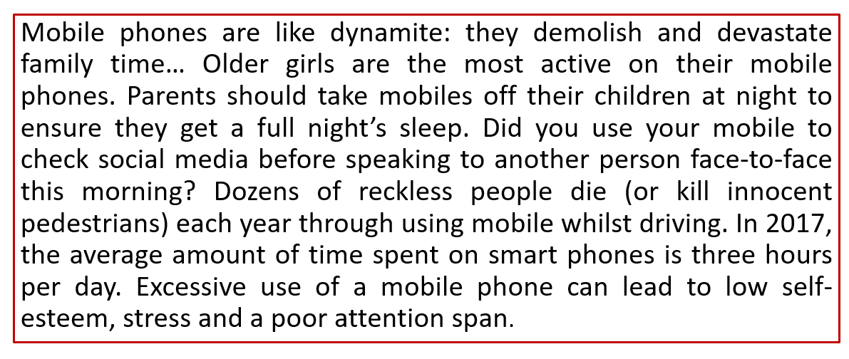
Evaluate and Identify Logos, Pathos and Ethos-

Slide 7
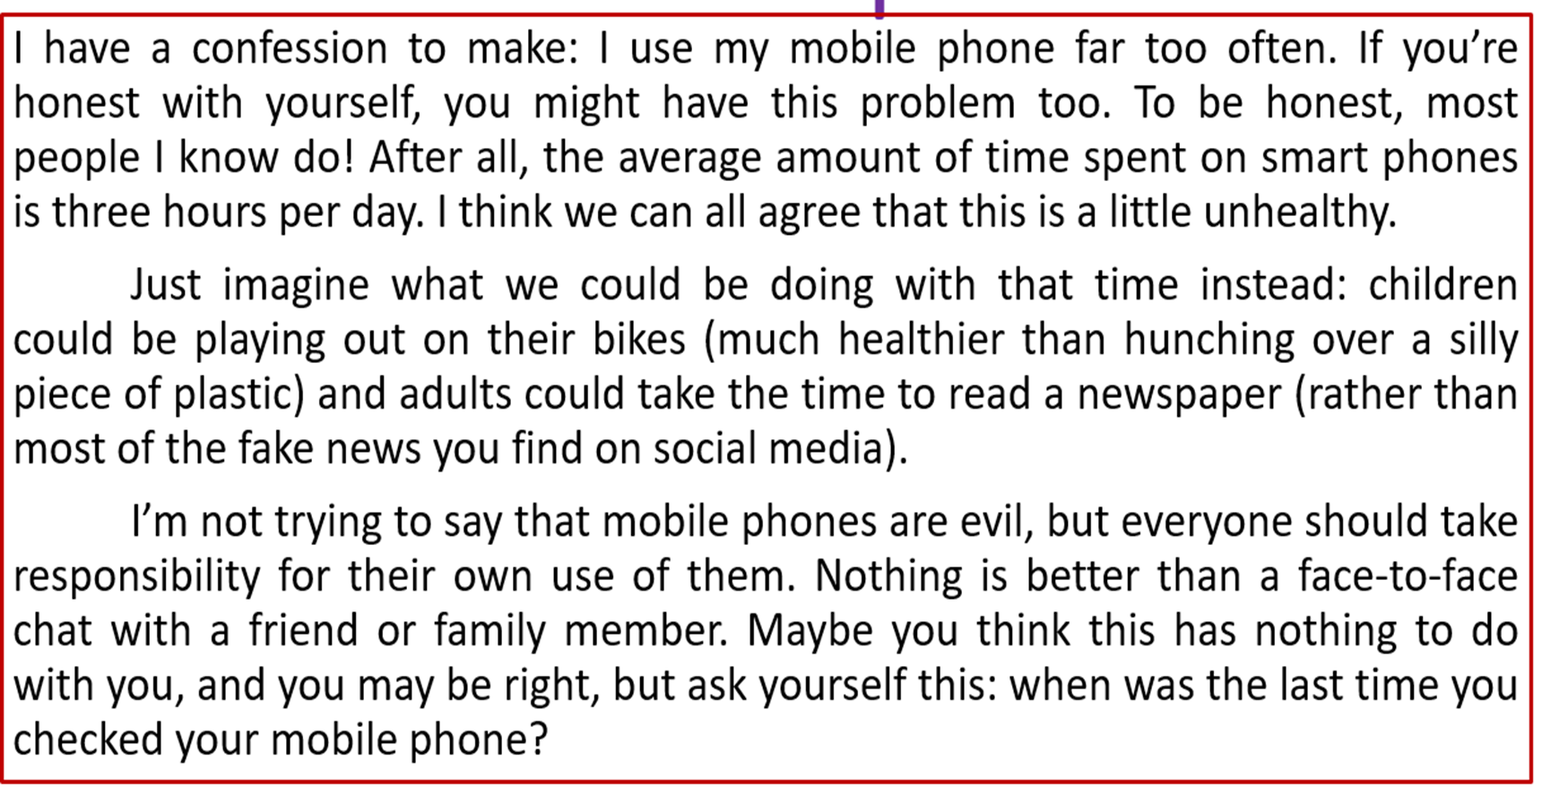
Evaluate and Identify Logos, Pathos and Ethos-

Slide 8
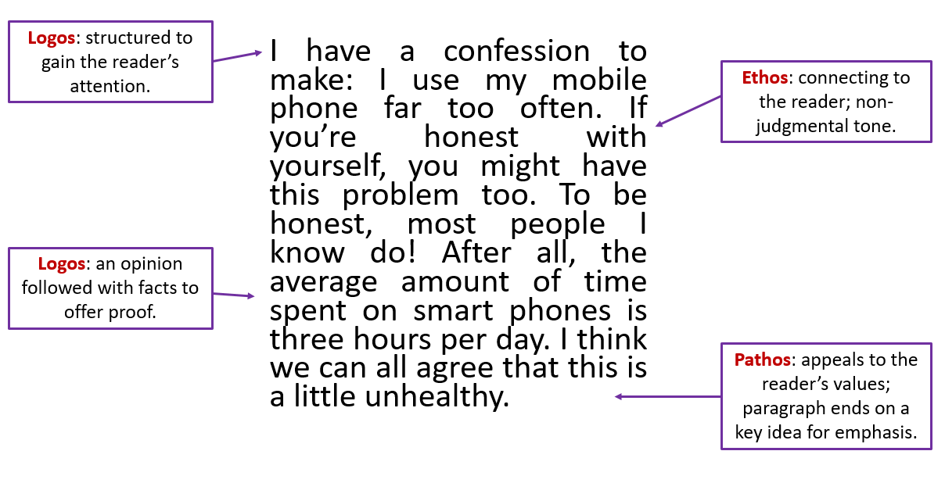

Slide 9
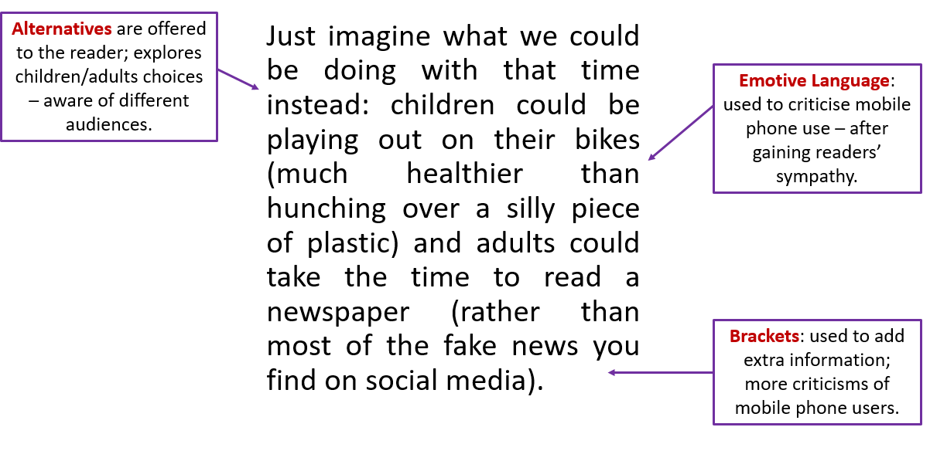

Slide 10


Slide 11
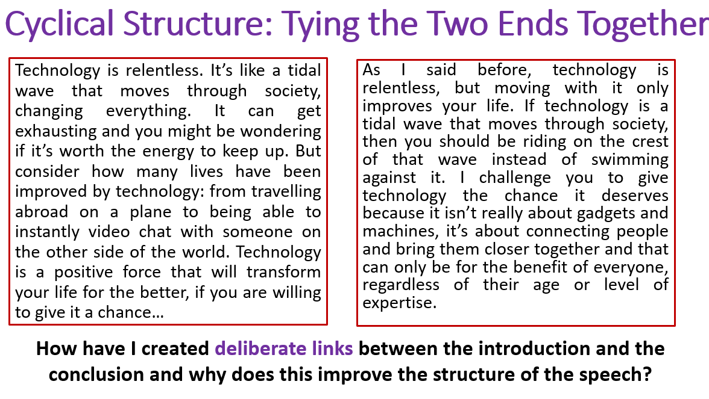

Slide 12
Create a persuasive speech
Write a persuasive speech using Persuasive writing techniques.
Incorporate Logos, Pathos and Ethos in your writing.
Take help of the introduction and conclusion shared.
Work in groups and create 1 argument and 1 counter-argument for the task.
You will get 15 mins to complete the task.

Slide 13
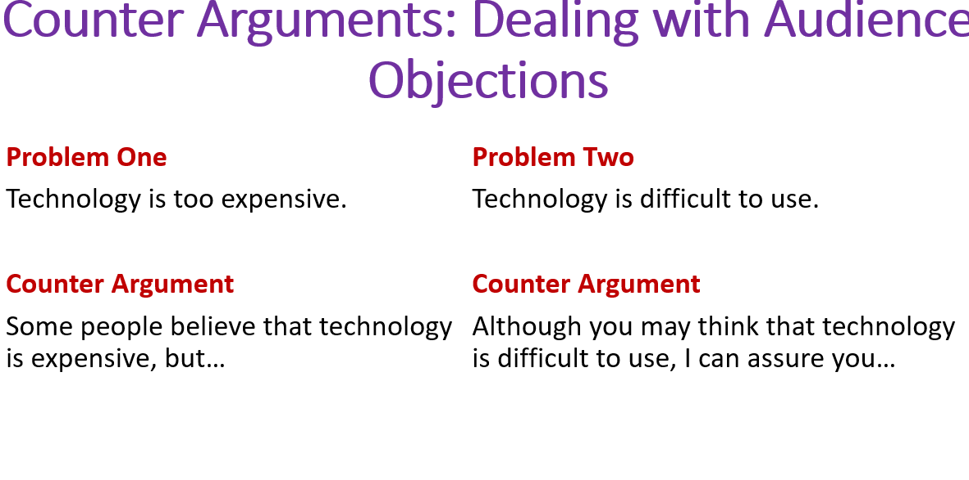

Slide 14
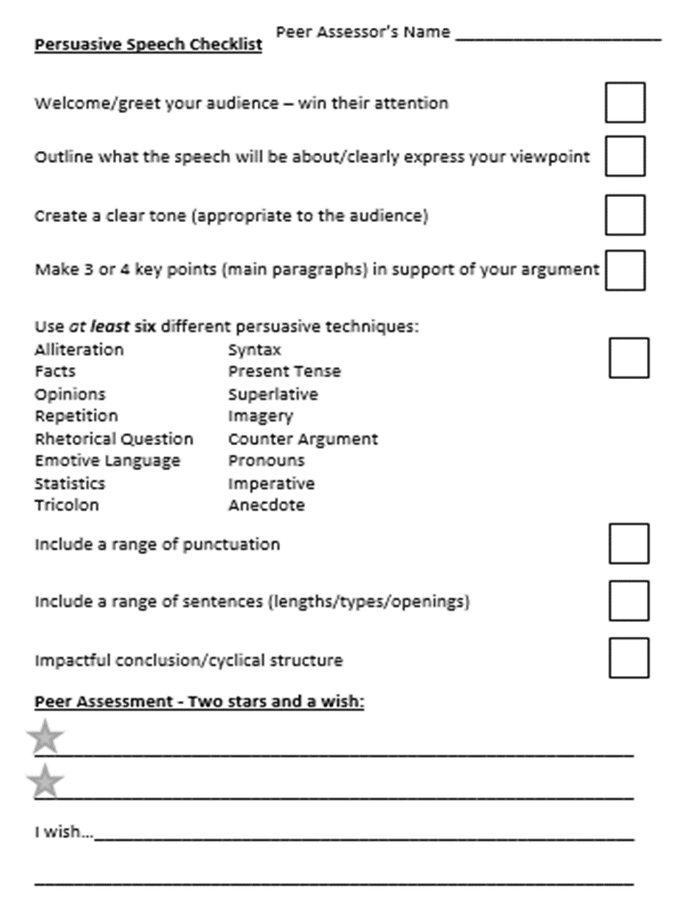
Use the Peer Assessment checklist to evaluate the arguments of other groups-

