Slide 1
More Addition and Subtraction
Add/subtract single digit numbers using facts and patterns
Objectives
Day 1
Add a 1-digit number to a 2-digit number, bridging 10.
Day 2
Add a 1-digit number to a 2-digit number, bridging 10.
Day 3
Subtract a 1-digit number from a 2-digit number, bridging 10.
Notes:
Before teaching, be aware that:
On Days 1 and 3 ideally you will need a real 100-bead bar. Alternatively use the slides.

Slide 2
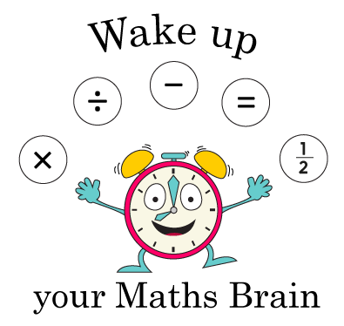
More Addition and Subtraction
Add/subtract single digit numbers using facts and patterns
Starter
Subtraction facts for 10
Notes:
Pre-requisite skills – to use this starter, drag this slide to the start of Day 3
Show 10 pegs on a hanger. Children close their eyes whilst you remove 4. How many have gone? Children hold up 4 fingers. Repeat.

Slide 3
More Addition and Subtraction
Add/subtract single digit numbers using facts and patterns
Objectives
Day 3
Subtract a 1-digit number from a 2-digit number, bridging 10.

Slide 4
Day 3: Subtract a 1-digit number from a 2-digit number, bridging 10.
Remember that these are special numbers.
26
32 – 6 =
26
If we count back 6, we will cross a multiple of ten (30).
This is the opposite of when we were adding.
Notes:
Count back 2 in one step (to 30) and then 4 in one step (to 26) on the grid.

Slide 5
Day 3: Subtract a 1-digit number from a 2-digit number, bridging 10.
Remember that these are special numbers.
26
45 – 7 =
38
If we count back 5, we will cross a multiple of ten (40).
Notes:
Count back 5 in one step (to 30) and then 2 in one step (to 26) on the grid.

Slide 6
Day 3: Subtract a 1-digit number from a 2-digit number, bridging 10.
27 – 5
22 – 5
33 – 4
38 – 4
22 – 6
27 – 6
53 – 7
48 – 6
Which will cross a ‘red’ number and ‘go up a line’ on the 100-grid; that is, they will ‘break’ into the next group of 10 beads on a bead bar?
Don’t cross a 10s number
Cross a 10s number
27 – 5
38 – 4
22 – 5
33 – 4
27 – 6
48 – 6
22 – 6
53 - 7
Notes:
Test out their ideas using the bead bar or the beaded line above.
Children can now go on to do differentiated GROUP ACTIVITIES. You can find Hamilton’s group activities in this unit’s TEACHING AND GROUP ACTIVITIES download.
WT/ARE/GD: Children sort and solve subtractions by bridging 10, using 1-100 number grids, beaded or landmarked lines.

Slide 7
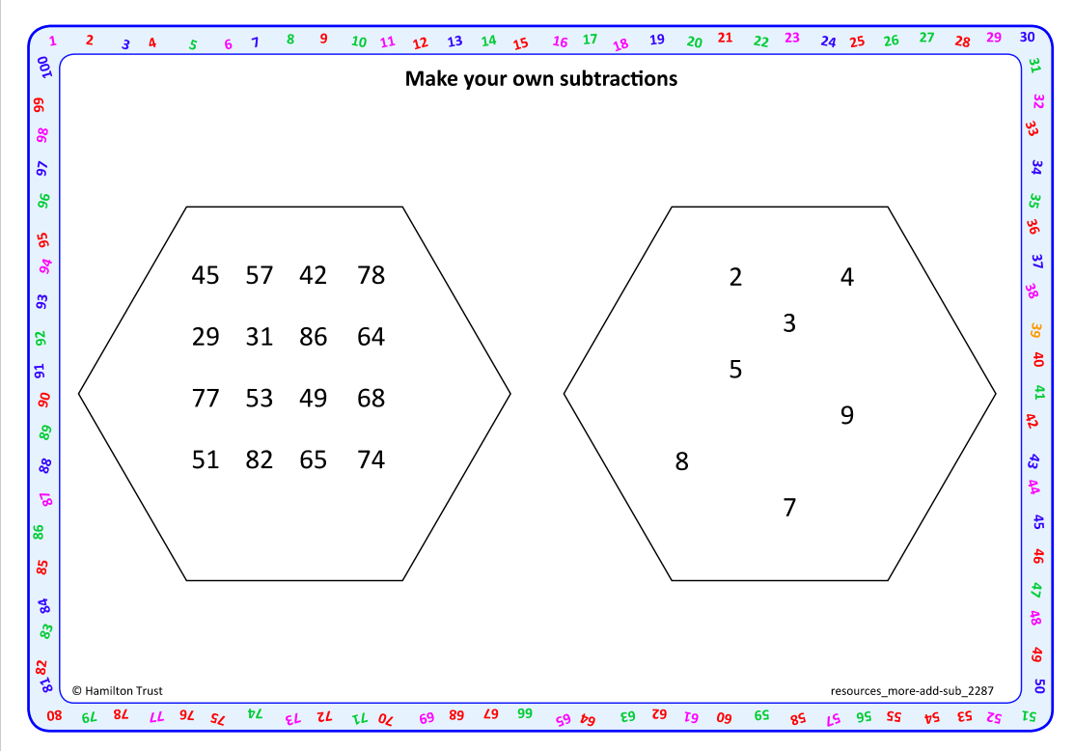
Task 1 – Pair/Group Work
Choose to use a beaded line or 1-100 grid with red multiples of 10 to help you.
Work in pairs to choose a number from each set from ‘make your own subtraction’ resource.
Draw either Y for yes or N for no beside it. Write Y if you think that you WILL have to cross a ‘red’ number (multiple of 10) when you subtract. Write N if you think you will NOT have to cross a ‘red’ number when you subtract.
Now perform the subtraction, drawing ‘hops’ on your beaded line or 1-100 grid. Record and compare answers.
Choose another pair of numbers and repeat the process.

Slide 8
Task 2 – Independent Work
Challenge
Notes:
The Practice Sheet on this slide is suitable for most children.
Differentiated PRACTICE WORKSHEETS are available on Hamilton’s website in this unit’s PROCEDURAL FLUENCY box.
WT: Matching up Sheet 1 – match subtractions to answers.
ARE:/GD: Matching up Sheet 2 – match more subtractions to answers. Greater depth do the challenge

Slide 9
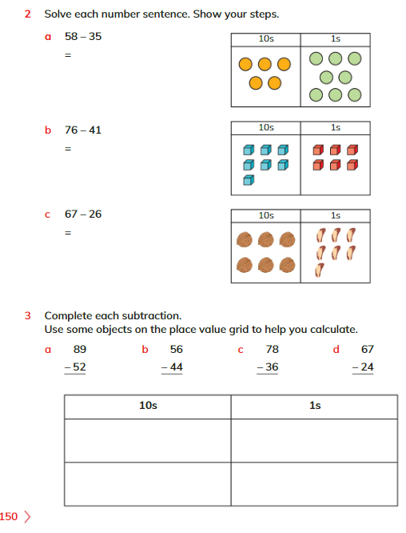
Plenary
Solve Q2 and Q3 on page 150, Learners book.

Slide 10
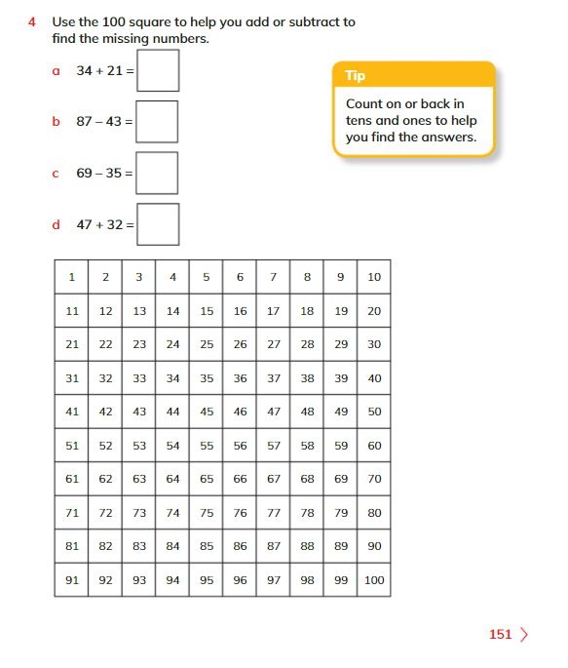
Homework
Solve Q4 on page 151, Learners book.

