Slide 1
More Addition and Subtraction
Add/subtract multiples of 10 to/from 2-digit numbers
Starters
Day 1
Count on and back in 10s, with 100 grid (pre-requisite skills)
Day 2
Count on and back in 10s, using a bead bar (pre-requisite skills)
Notes:
Choose starters that suit your class by dragging and dropping the relevant slide or slides below to the start of the teaching for each day.

Slide 2
More Addition and Subtraction
Add/subtract multiples of 10 to/from 2-digit numbers
Starter
Count on and back in 10s
Notes:
Pre-requisite skills – to use this starter, drag this slide to the start of Day 1
Place Spider on 2 on a 1-100 grid and move down the grid as you count on in 10s to 92, and then back again. Repeat, this time with Spider starting on 5. Children close their eyes and imagine Spider moving up and down the grid.

Slide 3
More Addition and Subtraction
Add/subtract multiples of 10 to/from 2-digit numbers
Starter
Count on and back in 10s
Notes:
Pre-requisite skills – to use this starter, drag this slide to the start of Day 2
Children count on in 10s from 3 to 93 and then back again as you move groups of 10 beads across the 0-100 bead bar (or use a 10s catcher). Repeat starting at 8.

Slide 4
More Addition and Subtraction
Add/subtract multiples of 10 to/from 2-digit numbers
Objectives
Day 2
Add and subtract 20, 30, 40, 50 to/from 2-digit numbers using the beaded line.

Slide 5
Day 2: Add and subtract 20, 30, 40, 50 to/from 2-digit numbers using the beaded line.
Show me 45 on your bead strings.
Now show me the number 10 more.
Now show me the number 10 more.
Now show me the number 10 more.
How much have we added on altogether?
What number sentence could we write?
45 + 30 = 75
You are Spider counting on the bead string!
Notice that the 1s digit doesn’t change.

Slide 6
Day 2: Add and subtract 20, 30, 40, 50 to/from 2-digit numbers using the beaded line.
Show me 45 on your bead strings.
We are going to
add 30 by
counting on in 10s.
+10
+10
+10
45
75
45 + 30 = 75

Slide 7
Day 2: Add and subtract 20, 30, 40, 50 to/from 2-digit numbers using the beaded line.
Show me 51 on your bead strings.
We are going to subtract 30 by
counting back in 10s.
-10
-10
-10
21
51
51 – 30 = 21

Slide 8
Day 2: Add and subtract 20, 30, 40, 50 to/from 2-digit numbers using the beaded line.
Show me 52 on your bead strings.
We are going to add 40 by counting on in 10s.
+10
+10
+10
+10
52
92
52 + 40 = 92

Slide 9
Day 2: Add and subtract 20, 30, 40, 50 to/from 2-digit numbers using the beaded line.
Show me 95 on your bead strings.
We are going to subtract 40 by counting back in 10s.
-10
-10
-10
-10
55
95
95 – 40 = 55

Slide 10
Day 2: Add and subtract 20, 30, 40, 50 to/from 2-digit numbers using the beaded line.
Show me 47 on your bead strings.
We are going to add 50 by counting on in 10s.
+10
+10
+10
+10
+10
47
97
47 + 50 = 97

Slide 11
Day 2: Add and subtract 20, 30, 40, 50 to/from 2-digit numbers using the beaded line.
Show me 92 on your bead strings.
We are going to subtract 50 by counting back in 10s.
-10
-10
-10
-10
-10
42
92
92 – 50 = 42
Notes:
Today would be a great day to use a problem-solving investigation – The Number Square! – as the group activity, which you can find in this unit’s IN-DEPTH INVESTIGATION box on Hamilton’s website.
Alternatively, children can now go on to do differentiated GROUP ACTIVITIES. You can find Hamilton’s group activities in this unit’s TEACHING AND GROUP ACTIVITIES download.
WT/ARE: Select pairs of numbers to practise adding or subtracting 20, 30, 40 or 50.
GD: Investigate patterns when adding and subtracting multiples of 10 to 2-digit numbers.

Slide 12
QNID
Expo 2023 Doha is held under the theme "Green Desert, Better Environment" and aims to promote sustainable innovations
55 local visitors went to Doha Expo on Sunday and 20 visitors went on Monday. How many visited altogether in both days.

Slide 13
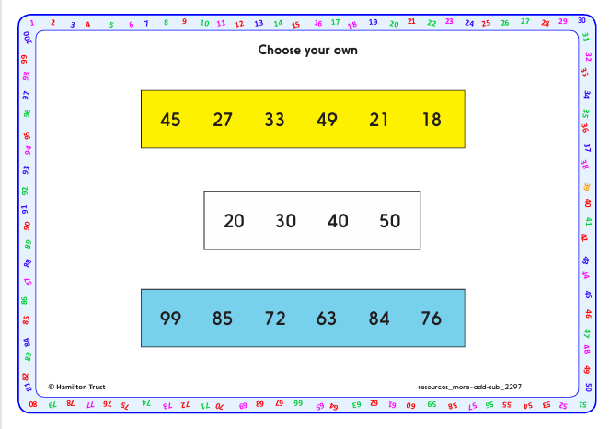
Task 1 – Pair/Group Work
Using choose your own sheet and the number lines given, follow the instructions given.

Slide 14
Task 2 – Independent Work
Notes:
The Practice Sheet on this slide is suitable for most children.
Differentiated PRACTICE WORKSHEETS are available on Hamilton’s website in this unit’s PROCEDURAL FLUENCY box.
WT: Add and subtract multiples of 10 Sheet 1 – add/subtract 20, 30 and 40 using jumps on the beaded line.
ARE: Add and subtract multiples of 10 Sheet 2 – add/subtract 20, 30 and 50 using jumps on the beaded line.
GD: Add and subtract multiples of 10 Sheet 3 – add/subtract 20, 30, 40 and 50 without the image of the beaded line. Work out missing numbers.

Slide 15
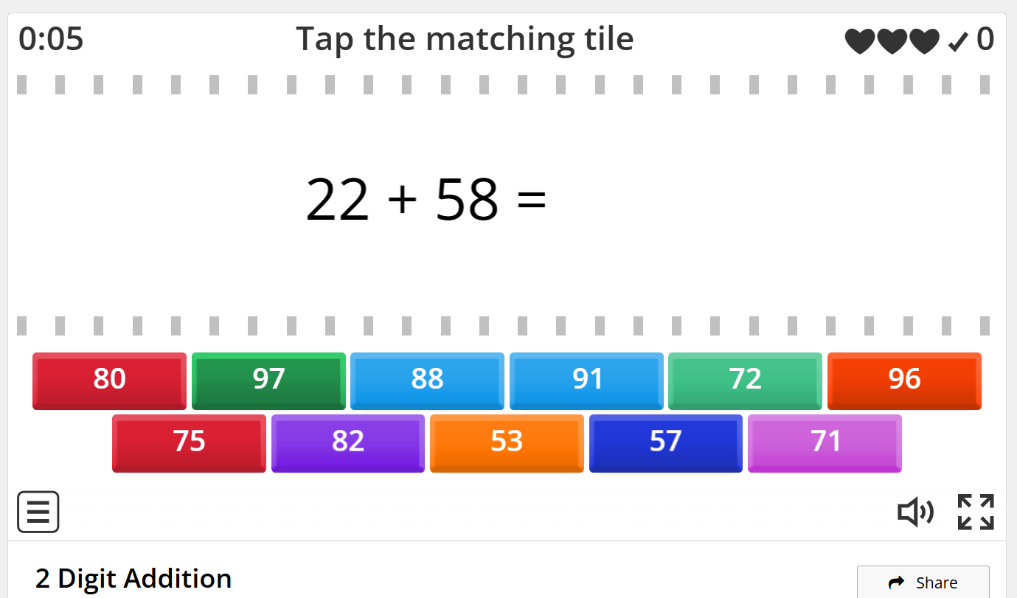
Plenary
Play in pairs
https://wordwall.net/resource/5467183/2-digit-addition

Slide 16
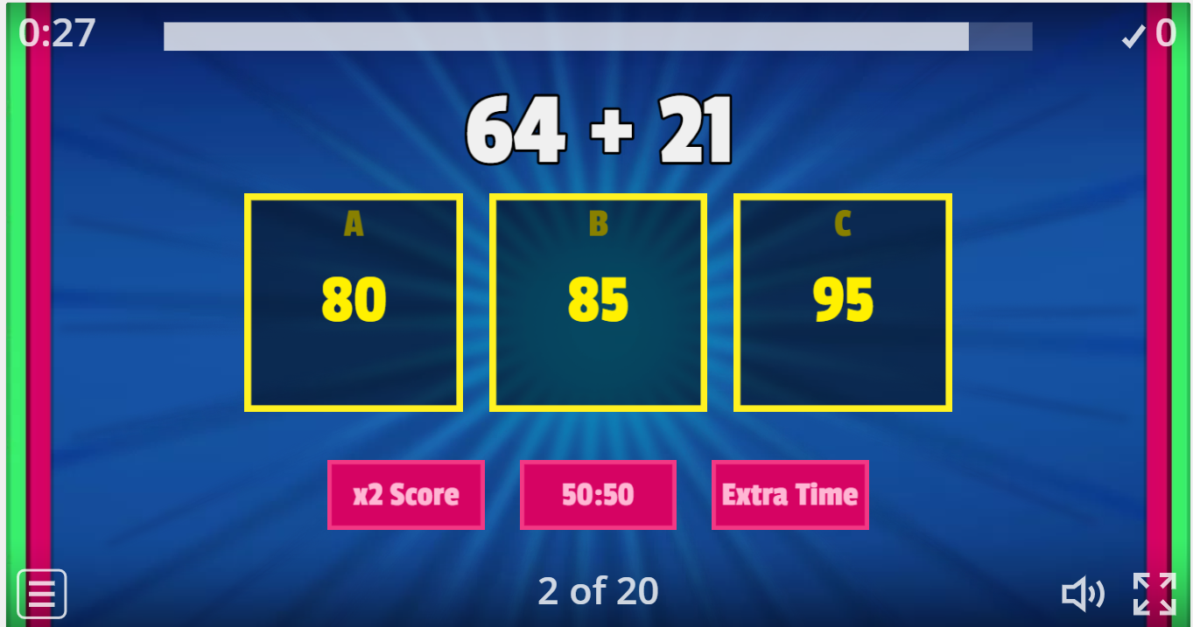
Homework
Play https://wordwall.net/resource/27253967/two-digit-addition-without-regrouping

