Slide 1
Year 2 Starters
Autumn Term
Test E
Play through the slides, giving children as much time as you think they need to answer each question. Most questions have a written answer; sometimes children may show a number of fingers.
Answers are given at the end of the test.
This is not a class competition! Can children beat their own personal best each week?
Which ride do they get to enjoy at the end?

Slide 2
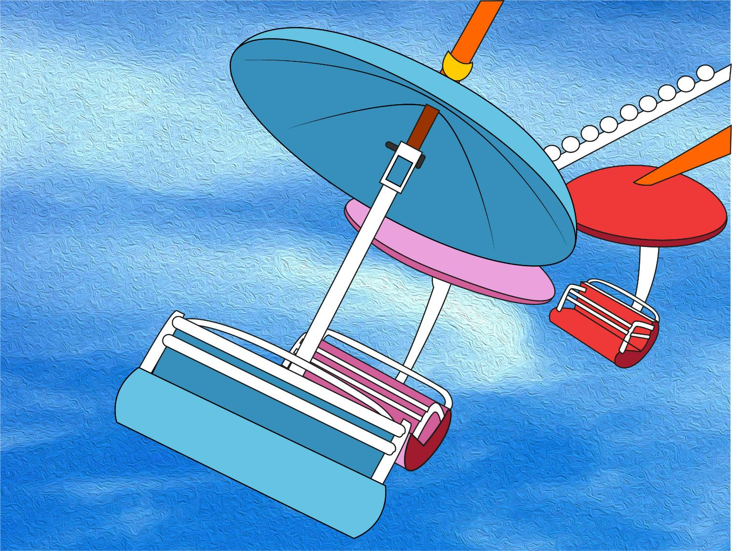
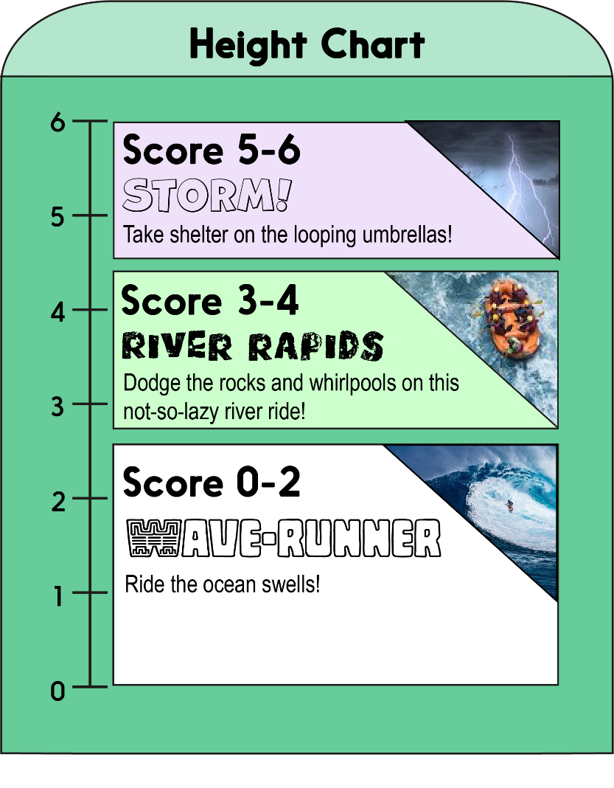
Score a mark on the chart for each correct answer on the test.
Which ride will you measure up for?!

Slide 3
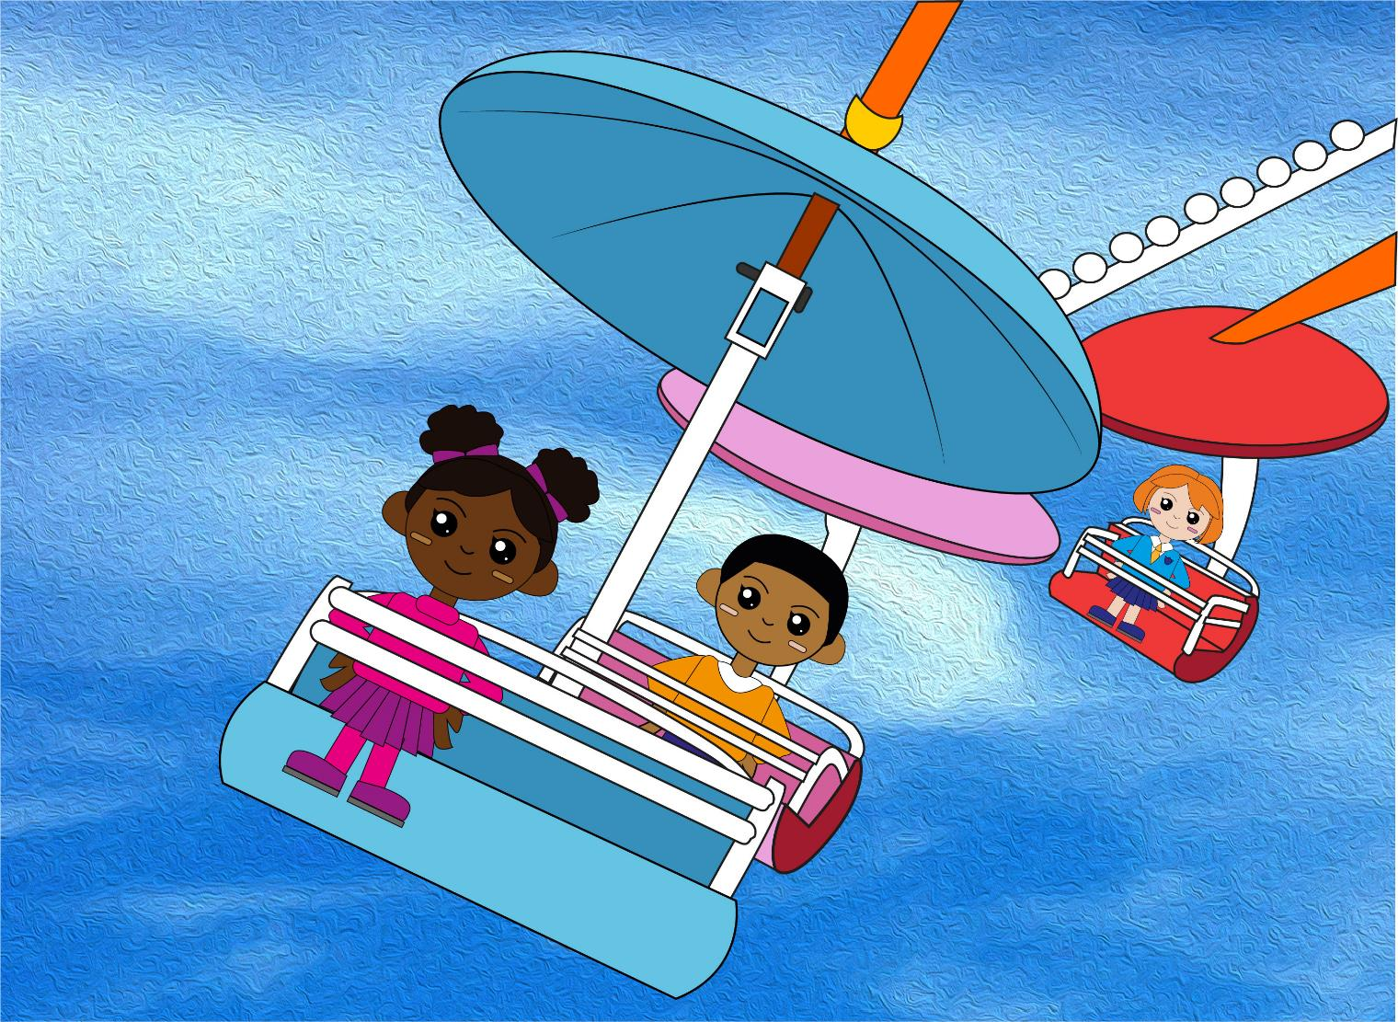
Question 1
Count back in 1s to find the next three numbers.
53, 52, 51, __, __, __
Write the three numbers.

Slide 4
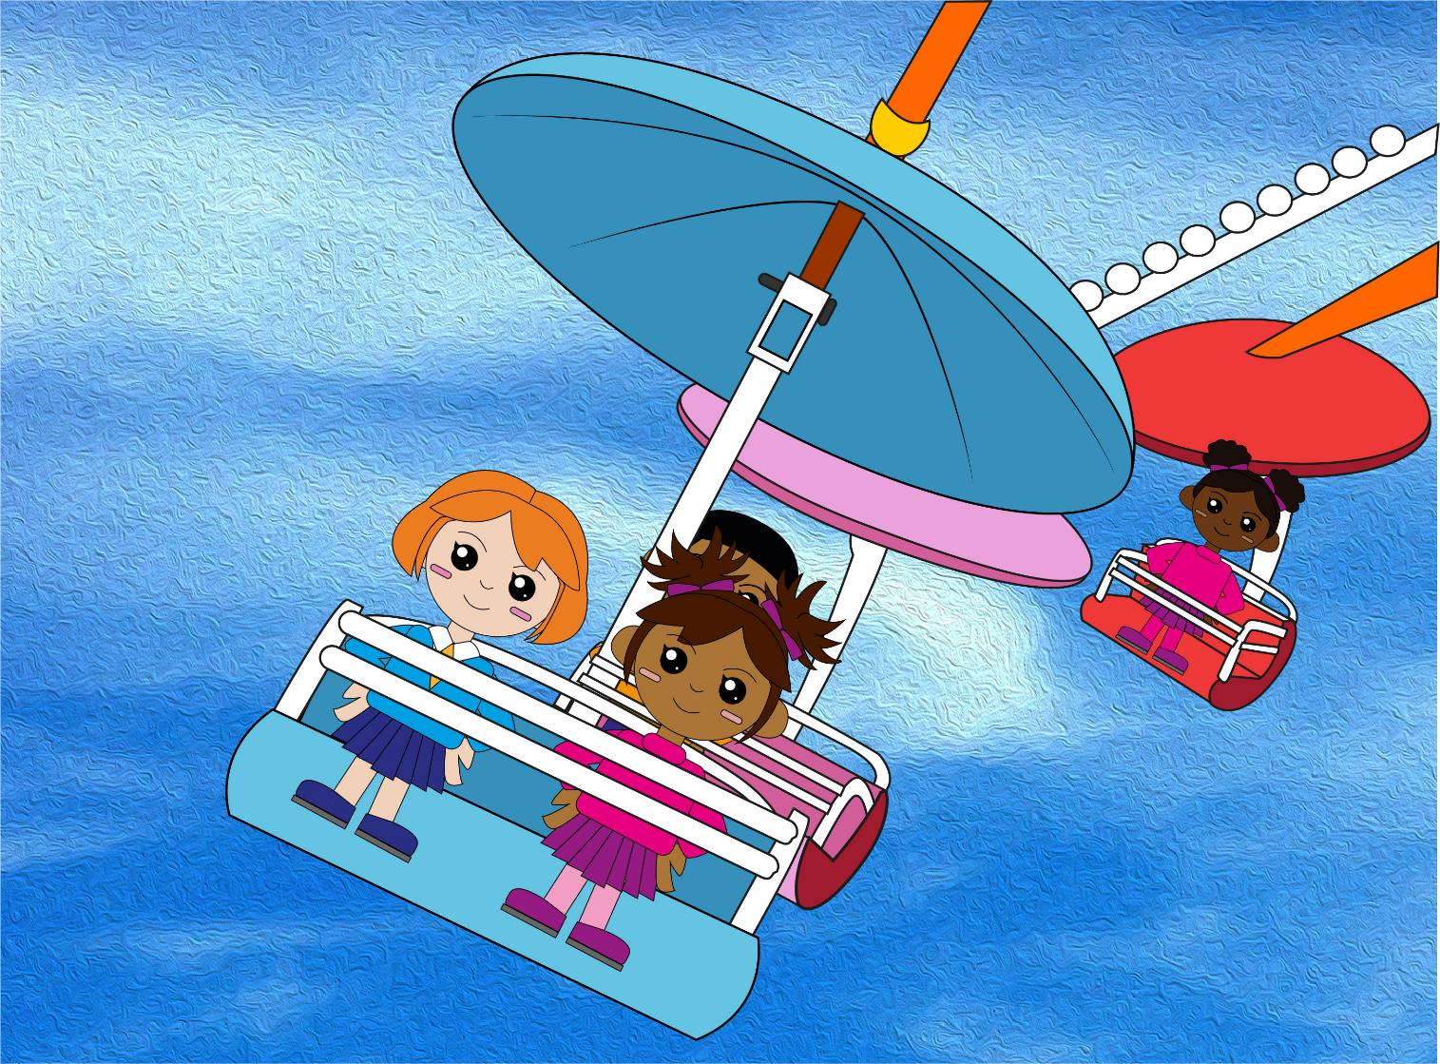
Question 2
Count in 2s to find the missing numbers.
12, 14, 16, __, 20, __, 24
text
Write the two numbers.

Slide 5
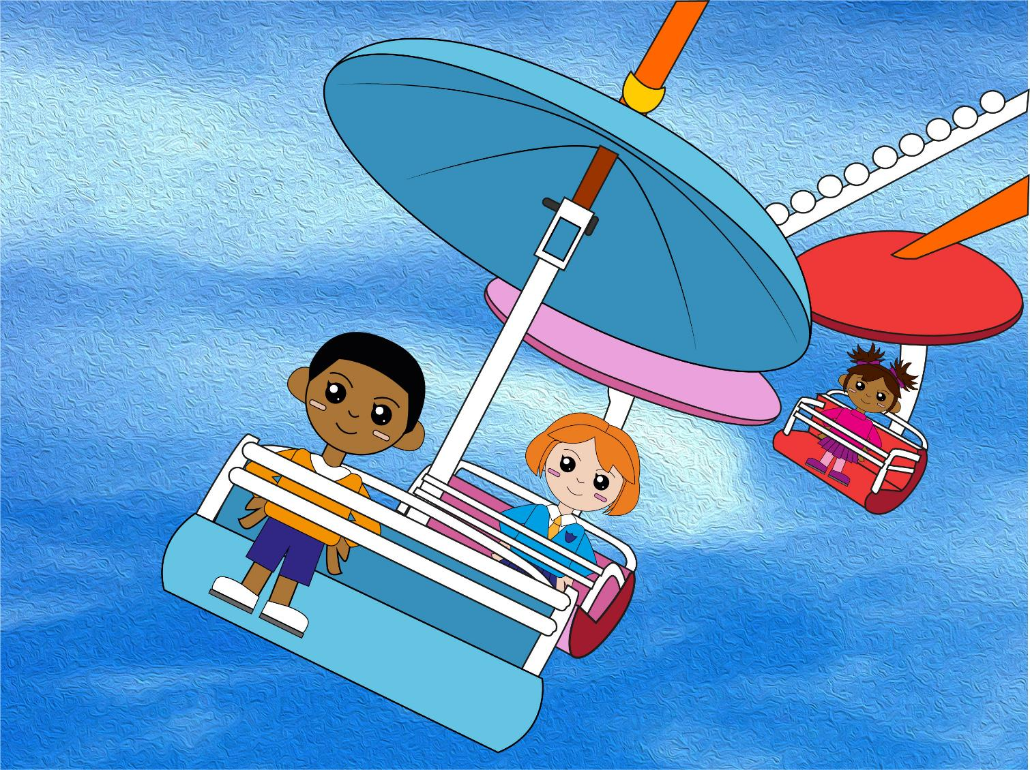
Question 3
Count back in 10s to find the missing numbers.
90, 80, 70, __, 50, __, 30
Write the two numbers.

Slide 6
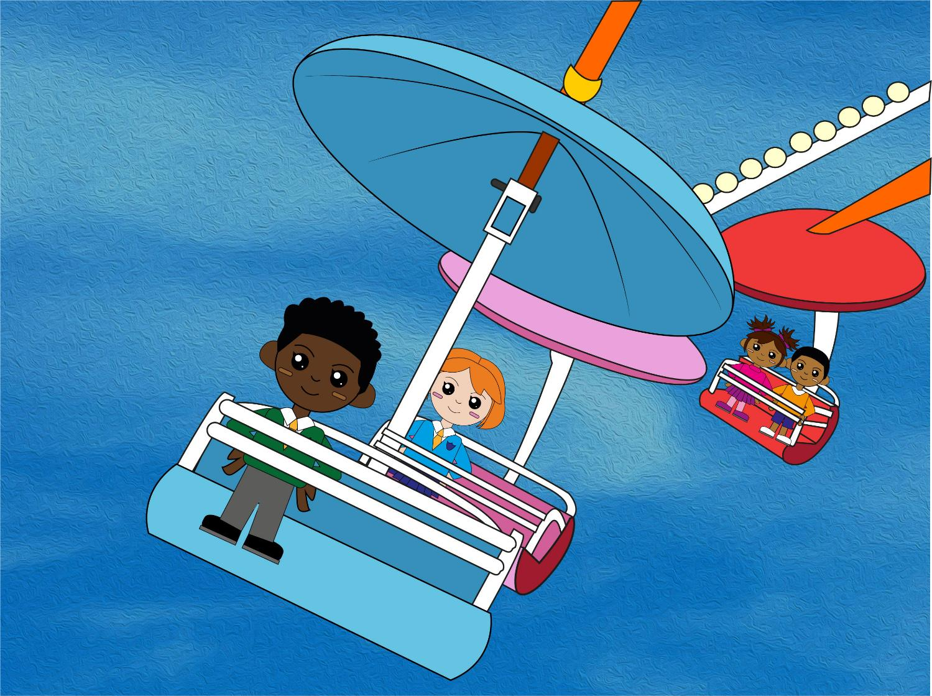
Question 4
6 x 2 = ?
text
Write your answer.

Slide 7
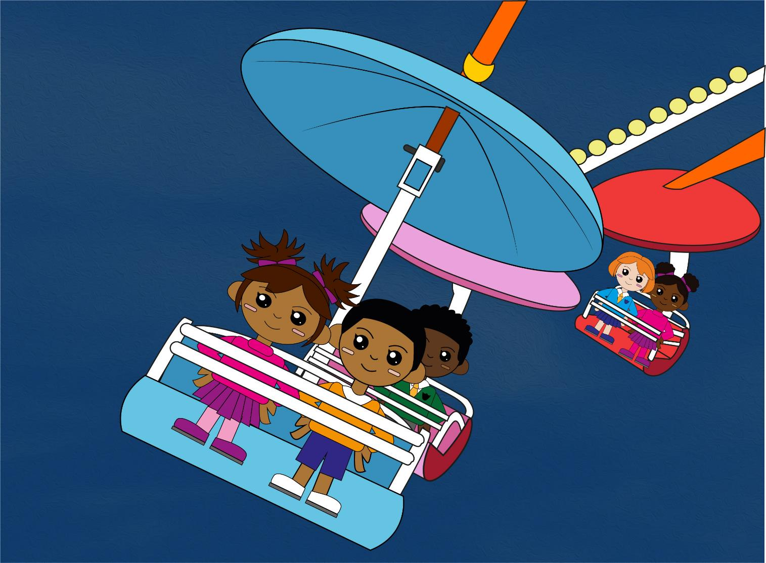
Question 5
4 x 10 = ?
Write your answer.

Slide 8
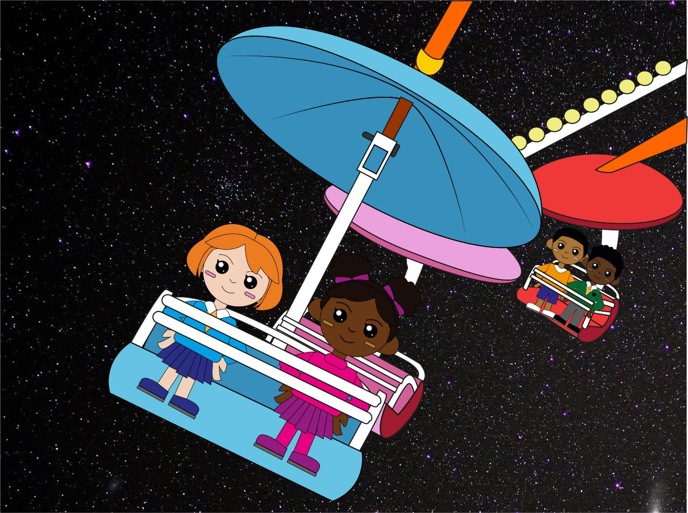
Question 4
8 x 2 = ?
Write your answer.

Slide 9
Q1
53, 52, 51, 50, 49, 48
Q2
12, 14, 16, 18, 20, 22, 24
Q3
90, 80, 70, 60, 50, 40, 30
Q4
6 x 2= 12
Q5
4 x 10 = 40
Q6
8 x 2 = 16
The answers!

Slide 10
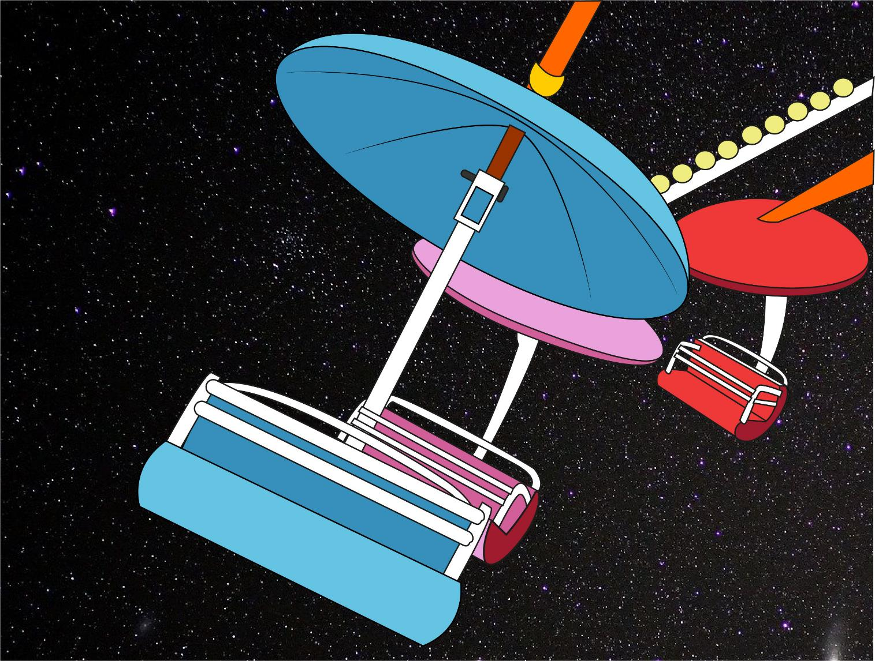
So, which ride do YOU measure up for?!
Did you beat YOUR personal best?

