Slide 1
Science - Year 3
Forces and Magnets – Block 3FM
Amazing Magnets
Session 2
Session PowerPoints
© Original resource copyright Hamilton Trust, who give permission for it to be adapted as wished by individual users.
We refer you to our warning, at the foot of the block overview, about links to other websites.

Slide 2
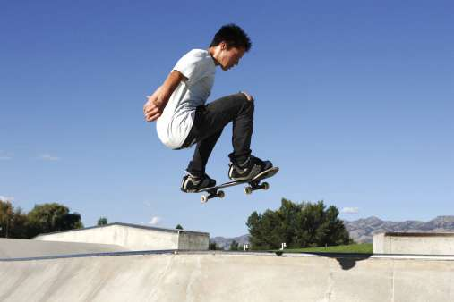
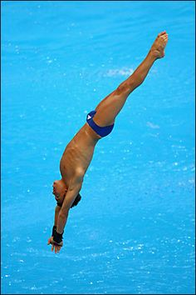
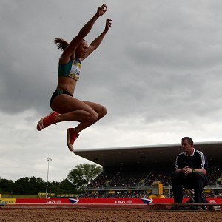
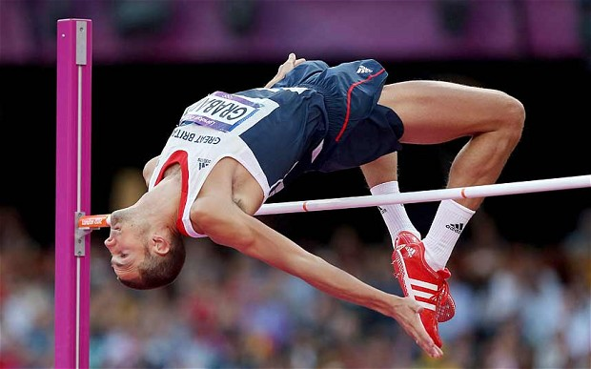
Sporty Forces

Slide 3
This is a team game that is all about how forces are at work in sport. Here’s how to play:
Each team will have their own picture of a sport. They should work together to get as many points as possible in the following ways:
By acting out the sport – 1 point
If the other groups can name the sport (after your acting /mime) -1 point
Explaining how the athlete uses forces (pushes and pulls) in that sport and what effect each one has – 1 point each

Slide 4
Once each team have their picture, the groups will have 10 minutes to work on their mime and write down all the ways they can think of that forces are at work in that sport.
You could split up so that some of you work on the acting/ mime and everyone else thinks about the forces.
Make sure your mime is done in a safe way. You could do the sport in slow motion. Just pretend you have equipment, e.g. a ball or racket, or you could use your hands rather than your whole body for some sports, e.g. high jump.

Slide 5
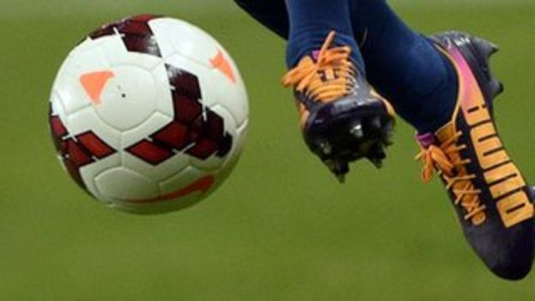
Imagine this was your team picture. You could collect points for:
Miming your sport (acting out a bit of the game with an imaginary football). You will get an extra point if the other children can name it – they can have more than one guess!
Explaining any of the ways forces are at work in football, e.g.
The player kicks the ball (Push)
The ball flies into the air and then falls back down to the ground because of gravity (pull)
The player’s studs push into the ground as she / he runs and the mud changes shape to make a footprint (push)
The player catches the ball for a throw in (pull)
The player takes a throw in (push)
If you said/ did all of these, your team would win 7 points
You might be able to think of even more examples

Slide 6
Clues to help you
Remember forces (pushes and pulls) can:
Start something moving
Stop something moving
Speed something up
Slow something down
Change the direction of something
Change the shape of something
The something could be:
A person
An object (e.g. ball, racquet, stick, boat, bike)
A surface or substance (e.g. water, air, sand, grass, mud)

Slide 7
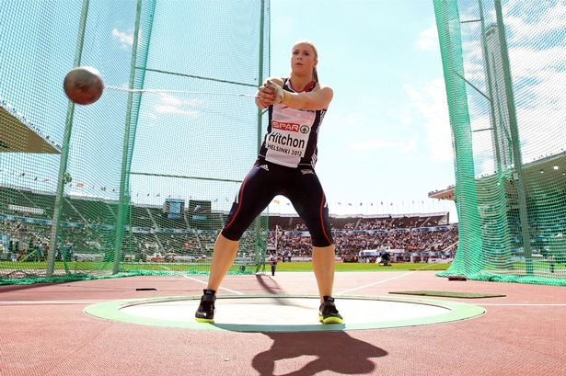
Your teacher will be the referee and they will add up all your points.
They will announce the winner at the end of the game – and their decision is final!
Remember to work together as a team!
Good Luck!

Slide 8
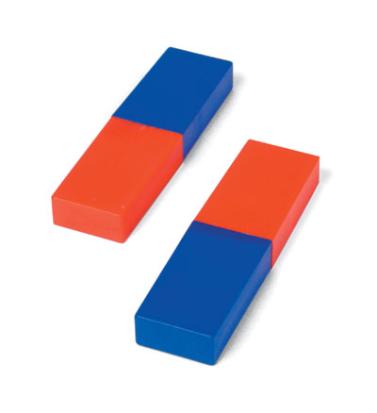
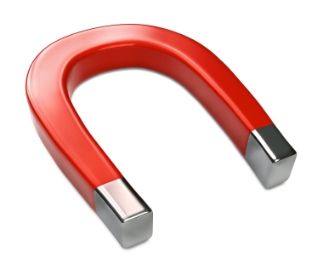
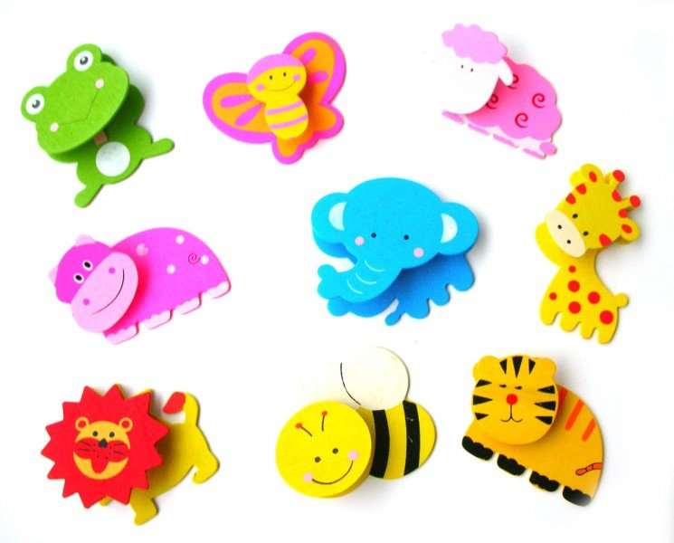
Teaching PowerPoint

Slide 9
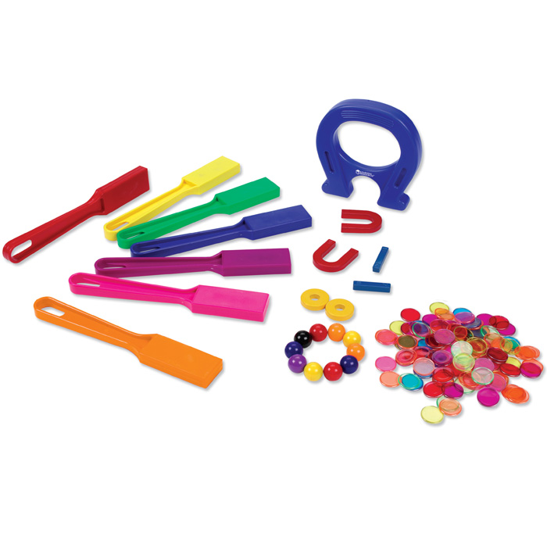
Magnets come in all sorts of colours, shapes and sizes

Slide 10
Can you think of anywhere you have seen magnets used in everyday life?

Slide 11
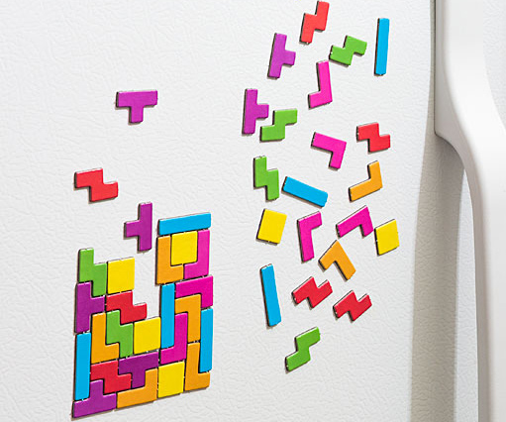
Here are some of them
Magnetic Puzzles
Magnets to decorate fridges

Slide 12
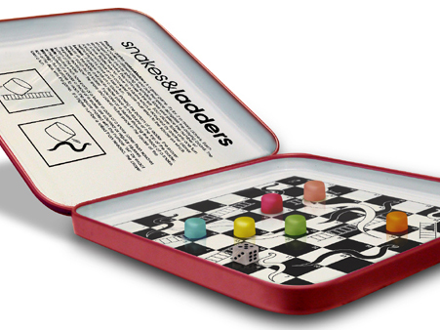
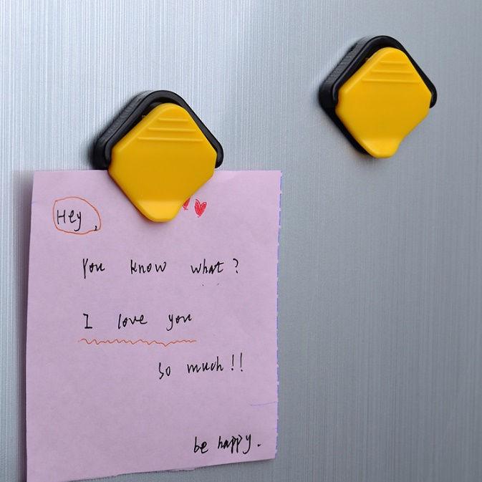
Magnetic clips hold messages
Magnetic travel games keep the pieces in place when you are on the move

Slide 13
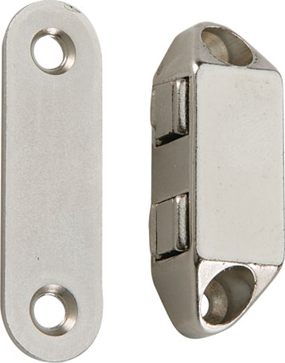
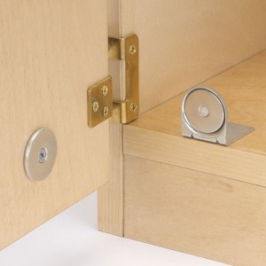
Magnetic catches can help keep cupboard doors closed

Slide 14
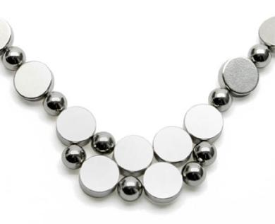
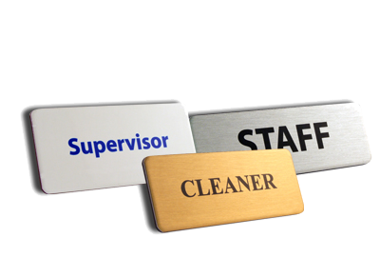
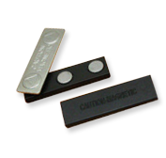
Magnetic Badges can be easier and safer to fasten than pin badges
Magnetic jewellery is fun to wear as you can change the design whenever you want

Slide 15
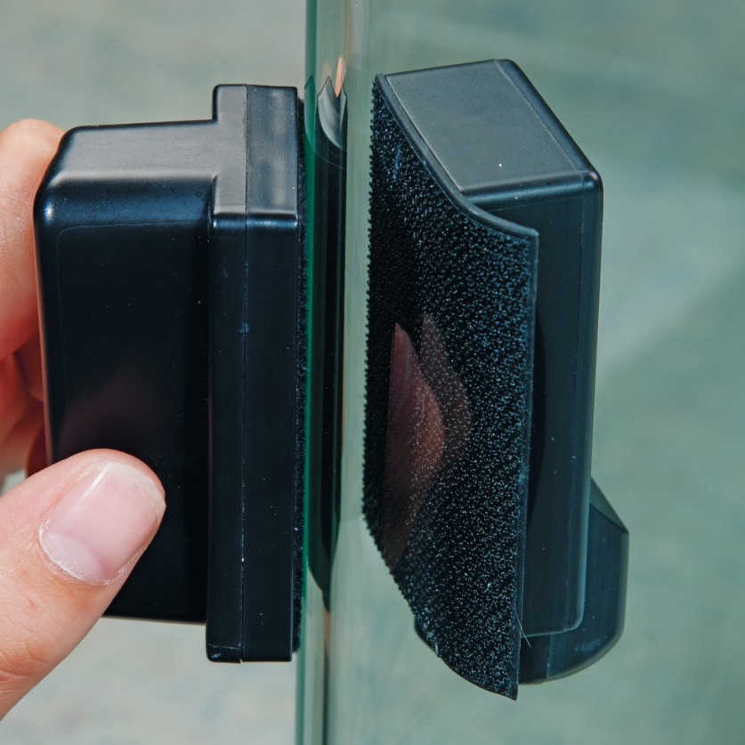
A pair of strong magnets can help you clean the inside of a fish tank without having to get your hands wet! The magnet on the inside has a rough cloth attached to it. You rub the magnet on the outside to clean the glass on the inside.

Slide 16
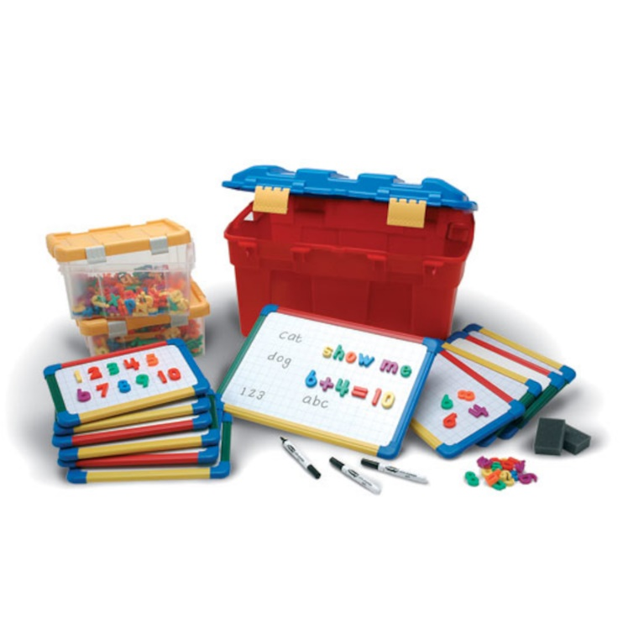
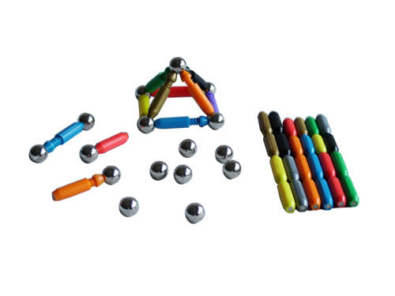
Magnetic construction toys are fun and easy to use
Magnetic boards can help with learning

Slide 17
What would you like to find out about magnets?
Make a class list of questions that you could investigate

Slide 18
Here are some questions you could have thought of
Are big magnets more powerful than small ones?
Which magnet is the strongest?
How many sheets of paper can a fridge magnet hold?
Are magnets just as powerful underwater as they are through the air?
You may have thought of some different ones of your own

Slide 19
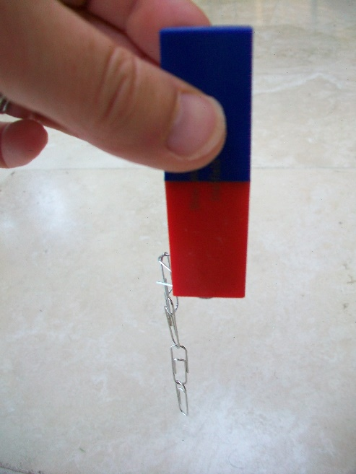
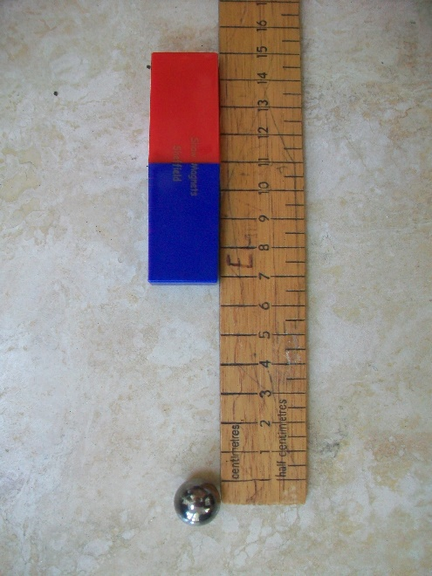
Can you think of a way to test how powerful a magnet is?
Discuss your ideas
Would your test be fair?
Here are a couple of ways you could test it
Count how many paper clips the magnet can hold
Measure how far away the magnet can be to pull an object towards it

Slide 20
Scientists try to answer their questions by doing an investigation (setting up a test)
Are big magnets more powerful than small ones?
Are magnets just as powerful underwater as they are through the air?
How many sheets of paper can a fridge magnet hold?
Which magnet is the strongest?
You could choose a magnet question of your own
Which question would you choose to investigate? How would you set up a fair test?

