Slide 1
The Role of Robots
Yr 3 Wk 4 Day 1

Slide 2
Lesson Objective
know how robot works know the digital devices easy to use know that different devices can connect to networks

Slide 3
Key Vocabulary
computer-controlled device: A machine that inputs data, and performs a specific task Internet of Things: Smart devices connected to the internet

Slide 4
Big Question
How are smart devices shaping the environment of our lives?

Slide 5
Hook Activity – Group Activity (10 mins)
Work in groups. Each group to brainstorm and list the work of robots in the A4 sheet.

Slide 6
Discussion Time

Slide 7
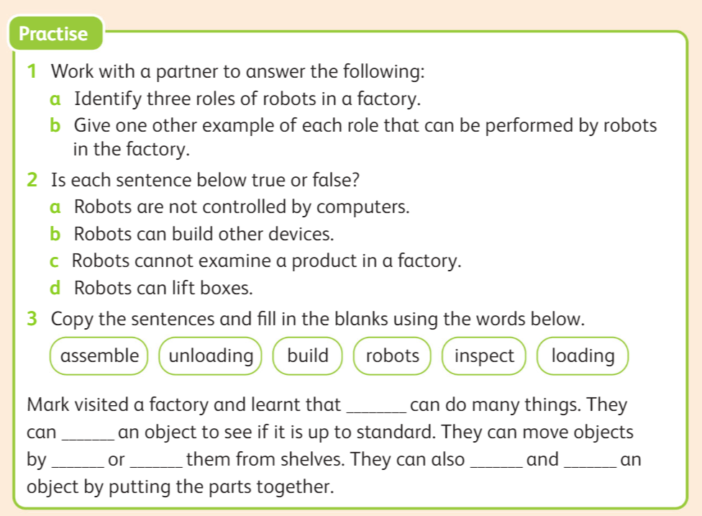
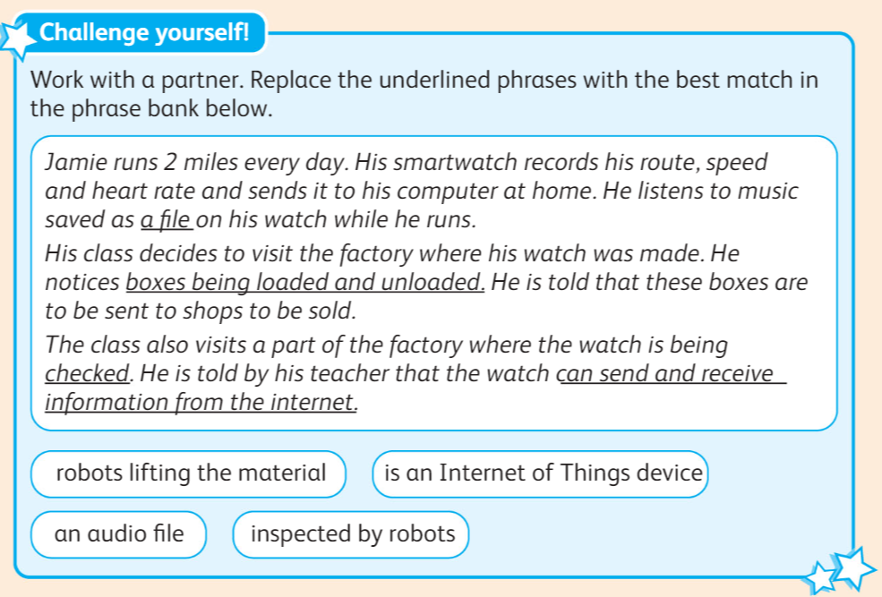
Main Activity– Pair Work (20 mins)
Identify three roles of robots in a factory.
Give one other example of each role that can be performed by robots in the factory.
Individual activity – 20 mins):
Do Practice question 1, 2 and 3 in the book pg 116.
Extension task:
Early finisher will do challenge task given on book pg 117.

Slide 8
Exit Ticket (10 mins)
www.plickers.com/shomaila/CS-Term-2-Unit-7--Computers-and-robots-30476

