Slide 1
Factors Affecting Rate of Reactions

Slide 2
What is reaction rate?
A measure of how fast a reaction takes place

Slide 3
Factors Affecting Rate of Reactions
The surface area of any solid reactants
The concentration of the reacting solutions
The pressure of reacting gases
The temperature at which the reaction is carried out
Presence of catalyst

Slide 4
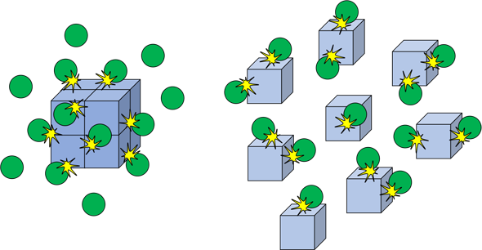
1) Influences of the surface area of any solid reactants
Sample A: Large Chips
decreased surface area, less effective collision
Sample B: Small Chips
Increased surface area, more effective collision

Slide 5
Conclusion: Influences of the surface area of any solid reactants
The rate of a reaction increases when the surface area of a solid reactant is increased.
BACK

Slide 6
What is concentration?
The measure of how much solute is dissolved in a solvent. Solutions can be dilute (with a high proportion of the solvent) or concentrated ( with a high proportion of the solute)

Slide 7
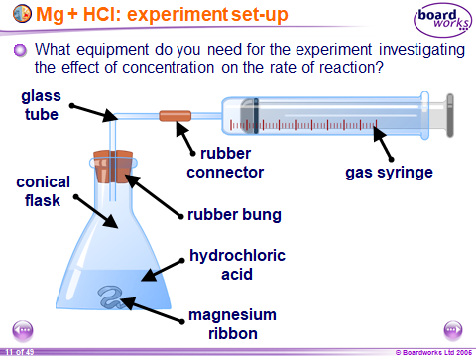
2) The concentration of the reactants
magnesium + hydrochloric acid magnesium chloride + hydrogen
Mg_{(s)} + 2HCl_{(aq)} MgCl_{2(aq)} + H_{2(g)}
The experiment is carried out twice.
Independent Variable:
- Concentration of the acid (0.5M and 1M)
Controlled Variable:
Same mass of magnesium
Same volume of HCl
Same temperature
Dependent Variable:
- Volume of hydrogen collected

Slide 8
Magnesium and hydrochloric acid
To run the experiment investigating the effect of concentration on the rate of reaction:
1. Measure out a fixed volume of hydrochloric acid into the conical flask.
2. Add a known mass of magnesium to the flask, immediately attach the gas syringe and start a stop-clock.
3. Measure the volume of hydrogen collected in the syringe at regular intervals until no more gas is produced.
4. Repeat the experiment using a different concentration of hydrochloric acid but using the same volume of acid and the same mass of magnesium. Compare the rate at which hydrogen is produced.

Slide 9
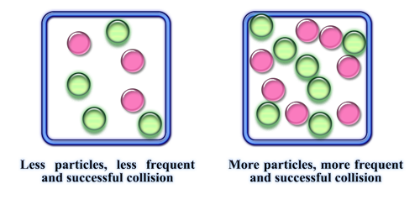
The concentration of the reactants
Experiment D
Experiment C

Slide 10
Interpret the Graph

Slide 11
Interpret the Graph
The curve for experiment C is steeper than for D. This shows clearly that reaction C, using more concentrated acid, is faster than reaction D.
The curve for experiment C starts off twice as steeply as for D. This means that the reaction in C is twice as fast as in experiment D initially. So doubling the concentration of the acid doubles the rate of reaction.
The total volume of hydrogen produced is the same in both experiments, although experiment C produces it faster.

Slide 12
Conclusion: The concentration of the reactants
The rate of a reaction increases when the concentration of a reactant in solution is increased.
BACK

Slide 13
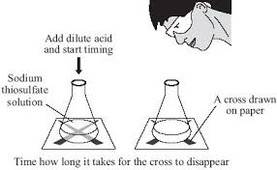
3) The temperature at which the reaction is carried out
sodium thiosulfate + hydrochloric acid sodium chloride + sulfur +
sulfur dioxide + water
Na₂S₂O_{3(aq)} + 2HCl_{(aq)} 2NaCl_{(aq)} + S_{(s)} + SO_{2(g)} + H₂O_{(l)}
Independent Variable:
Carried out several times with solutions pre-warmed to different temperatures
Controlled Variable:
Same volume of Na₂S₂O₃ solution
Same volume of HCl
Dependent Variable:
- Time taken for cross to disappear

Slide 14
Sodium thiosulfate and hydrochloric acid
To run the experiment investigating the effect of temperature on the rate of reaction:
1. Mark a cross on a piece of paper.
2. Add a known amount of sodium thiosulfate to a beaker, and place it on the piece of paper(marked X).
3. Add a known amount of hydrochloric acid to the beaker and immediately start a stop-clock. The solution will begin to turn cloudy.
4. As soon as the cross can no longer be seen, stop the clock and note the time.
5. Repeat the experiment at different temperatures using the same volume of reactants. Compare how long it takes the
cross to disappear.

Slide 15
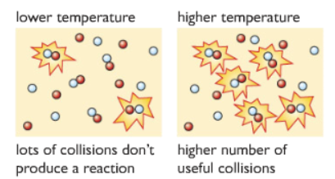
The temperature at which the reaction is carried out

Slide 16
Interpret the Graph

Slide 17
Conclusion: The temperature at which the reaction is carried out
The rate of a reaction increases when the temperature of the reaction mixture is increased.
BACK

Slide 18
Sources
Cambridge IGCSE Chemistry Coursebook 5th ed.
Edexcel IGCSE (9-1) Chemistry (Pearson)
Images from Google
Boardworks Ltd.

