Slide 1
Grammar Revision

Slide 2
L.O: To identify and use simple present, simple past, present progressive, present perfect and past perfect verb tenses in sentences.

Slide 3

LO: to identify and use present tense verbs
Recall
1)What is a verb?
2)How does a verb change a sentence?
Identify the tense:
4) Harry had eaten 2 boxes of chocolates yet still had room for dinner!
5)Ali participated in a chess tournament last week.
6)Our dog was chewing the sofa when we got home from school.

Slide 4
LO: to identify and use present tense verbs
Evaluation
1)What is a verb? An action or state of being.
2)How does a verb change a sentence? It changes the tense.
Identify the tense:
4) Harry had eaten 2 boxes of chocolates yet still had room for dinner! Past perfect.
5)Ali participated in a chess tournament last week. Past tense.
6)Our dog was chewing the sofa when we got home from school. Past progressive.

Slide 5

LO: to identify and use present tense verbs
What are tenses?
Verb tenses tell us when an action took place in the present, past or future.
For example:
I walked to the shops. (past)
I am walking to the shops. (present)
I will walk to the shops. (future)

Slide 6
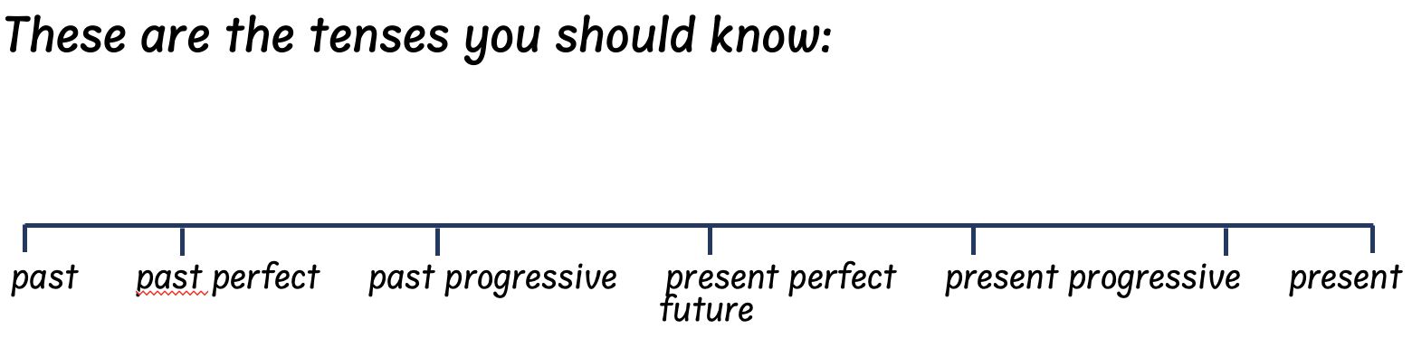
LO: to identify and use present tense verbs

Slide 7
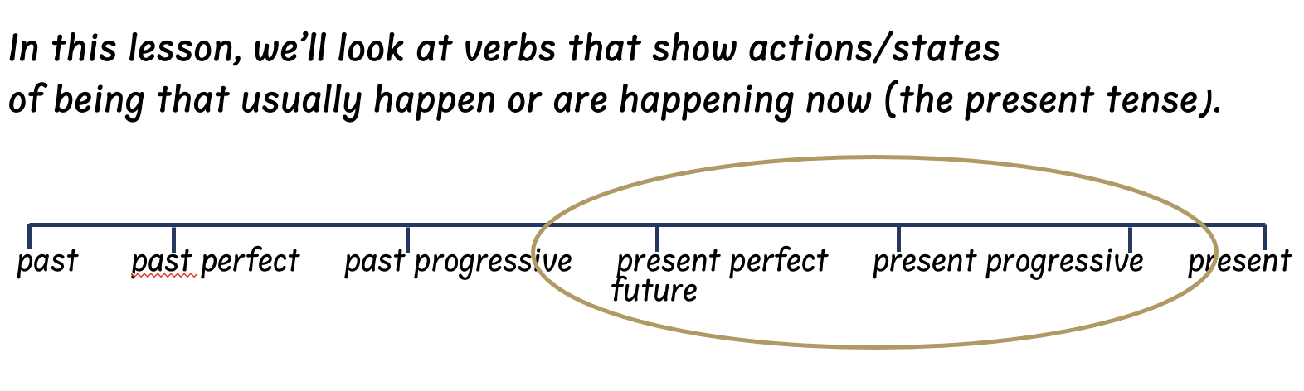
LO: to identify and use present tense verbs

Slide 8
LO: to identify and use present tense verbs

Slide 9
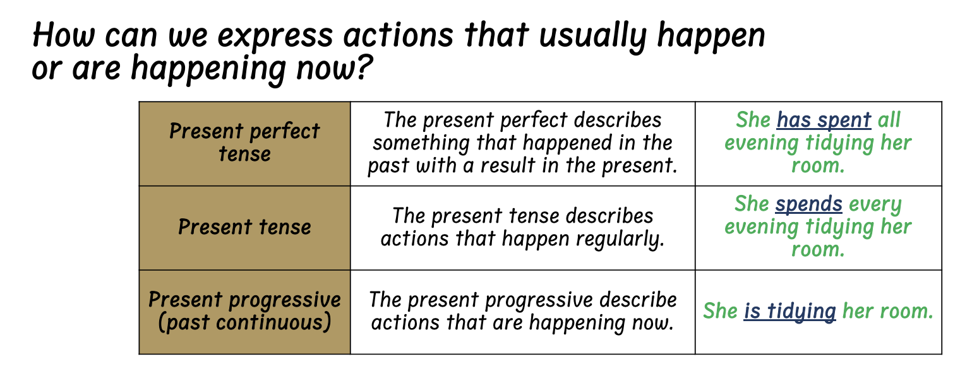
LO: to identify and use present tense verbs

Slide 10

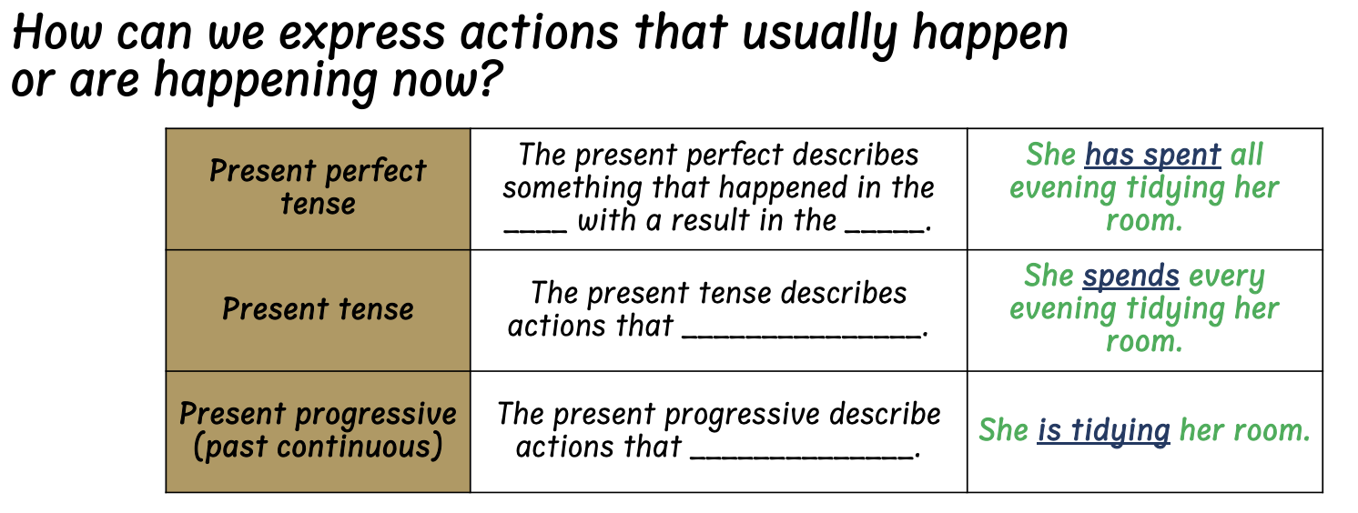
LO: to identify and use present tense verbs

Slide 11

LO: to identify and use present tense verbs
Independent Practice 1
Identify the tense used in each sentence.
e.g. I have been learning to play tennis for 6 weeks. Present perfect.
I catch the bus to school every morning.
2) I am cooking a homemade spaghetti Bolognese.
3) They go swimming every Sunday at the leisure centre.
4) We are drawing cartoons for our poster.
5) The lift has broken so we need to take the stairs.
6) I have caught a cold so my eyes keep watering

Slide 12
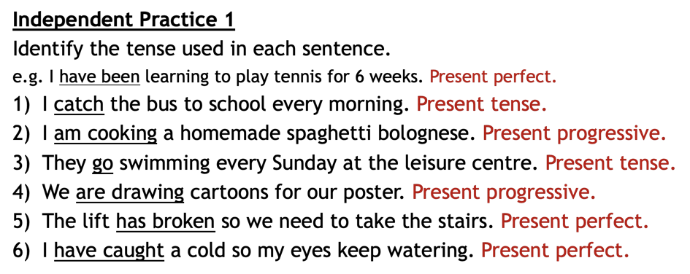
LO: to identify and use present tense verbs

Slide 13
LO: to identify and use present tense verbs
Independent Practice 1
Identify the tense used in each sentence.
e.g. I have been learning to play tennis for 6 weeks. Present perfect.
1)I catch the bus to school every morning. Present tense.
2)I am cooking a homemade spaghetti bolognese. Present progressive.
3)They go swimming every Sunday at the leisure centre. Present tense.
4)We are drawing cartoons for our poster. Present progressive.
5)The lift has broken so we need to take the stairs. Present perfect.
I have caught a cold so my eyes keep watering. Present perfect

Slide 14
LO: to identify and use present tense verbs
Independent Practice 2
1)Explain how you know ‘Julia makes all her friends laugh.’ is
in the present tense.
2) Explain how you know ‘Chen is practising his times tables.’ is in the present progressive tense.
3) Explain how you know ‘Amy has shown her whole family her gold medal.’ is in the present perfect tense.

Slide 15
LO: to identify and use present tense verbs
Independent Practice 2
1)Explain how you know ‘Julia makes all her friends laugh.’ is
in the present tense.
2) Explain how you know ‘Chen is practising his times tables.’ is in the present progressive tense.
3) Explain how you know ‘Amy has shown her whole family her gold medal.’ is in the present perfect tense.

Slide 16
LO: to identify and use present tense verbs
Independent Practice 2
1)Explain how you know ‘Julia makes all her friends laugh.’ is
in the present tense. In general/regularly, Julia makes her friends
laugh. No specific time is given.
2) Explain how you know ‘Chen is practising his times tables.’ is in the present progressive tense. The act of ‘practising’ is happening now.
3) Explain how you know ‘Amy has shown her whole family her gold medal.’ is in the present perfect tense. The act of Amy showing her gold medal took place in the past with a result in the present (note: the result isn’t stated in the sentence)

Slide 17
LO: to identify and use present tense verbs
Independent Practice 2
1)Explain how you know ‘Julia makes all her friends laugh.’ is
in the present tense. In general/regularly, Julia makes her friends
laugh. No specific time is given.
2) Explain how you know ‘Chen is practising his times tables.’ is in the present progressive tense. The act of ‘practising’ is happening now.
3) Explain how you know ‘Amy has shown her whole family her gold medal.’ is in the present perfect tense. The act of Amy showing her gold medal took place in the past with a result in the present (note: the result isn’t stated in the sentence)

Slide 18
LO: to identify and use present tense verbs
Independent Practice 2
1)Explain how you know ‘Julia makes all her friends laugh.’ is
in the present tense. In general/regularly, Julia makes her friends
laugh. No specific time is given.
2) Explain how you know ‘Chen is practising his times tables.’ is in the present progressive tense. The act of ‘practising’ is happening now.
3) Explain how you know ‘Amy has shown her whole family her gold medal.’ is in the present perfect tense. The act of Amy showing her gold medal took place in the past with a result in the present (note: the result isn’t stated in the sentence)

Slide 19
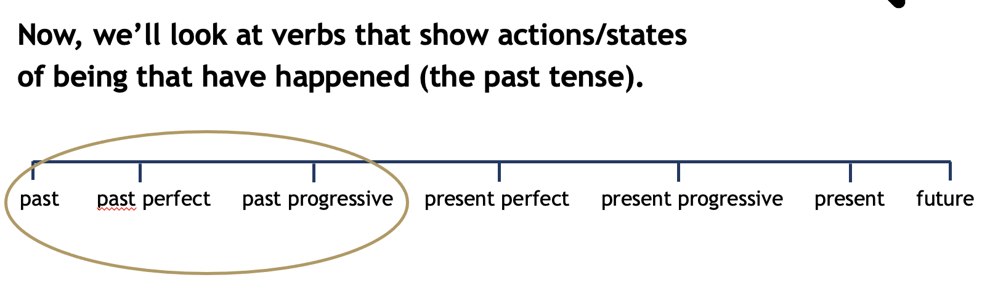
LO: to identify and use past tense verbs

Slide 20
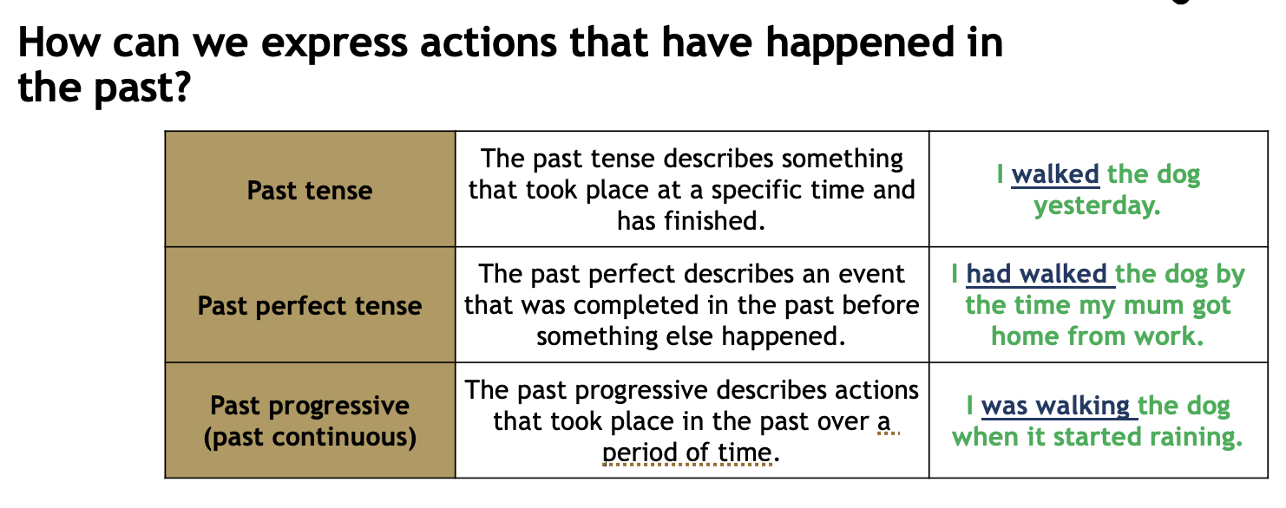
LO: to identify and use past tense verbs

Slide 21
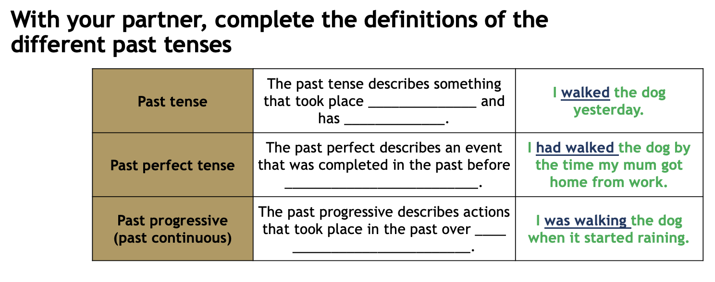
LO: to identify and use past tense verbs

Slide 22
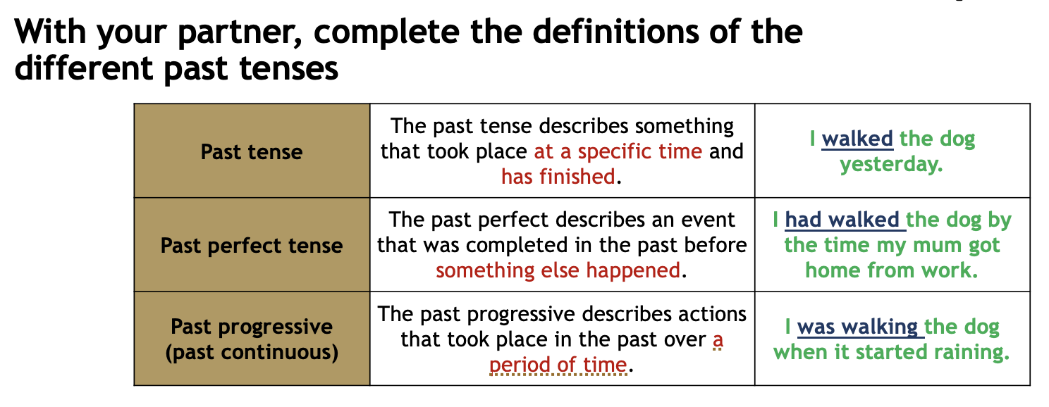
LO: to identify and use past tense verbs

Slide 23
LO: to identify and use past tense verbs
Independent Practice 1
Identify the tense used in each sentence.
e.g. I had been at home all day before going to the cinema. Past perfect.
1)Jenny played basketball on Saturday.
2)I was flying a kite when it started raining.
3)They went home after the match.
4)We were baking cookies for almost two hours on the weekend.
5)The shop had closed ten minutes early so we couldn’t buy any milk.
6)I had done two pages of my homework before my dog ate it!

Slide 24
LO: to identify and use past tense verbs
Independent Practice 1
Identify the tense used in each sentence.
e.g. I had been at home all day before going to the cinema. Past perfect.
1)Jenny played basketball on Saturday. Past tense.
2)I was flying a kite when it started raining. Past progressive.
3)They went home after the match. Past tense.
4)We were baking cookies for almost two hours on the weekend. Past progressive.
5)The shop had closed ten minutes early so we couldn’t buy any milk. Past perfect.
6)I had done two pages of my homework before my dog ate it! Past perfect.

Slide 25
LO: to identify and use past tense verbs
Independent Practice 2
1)Explain how you know ‘Jasmine washed her mum’s car.’
is in the past tense.
1)Explain how you know ‘Qamran was drawing a picture of his dog when it suddenly moved!’ is in the past progressive tense.
2)Explain how you know ‘Jason had run the fastest in his class but still didn’t beat the school record.’ is in the past perfect tense.

Slide 26
LO: to identify and use past tense verbs
Independent Practice 2
1)Explain how you know ‘Jasmine washed her mum’s car.’
is in the past tense. The action ‘washed’ took place in the past and
has finished.
1)Explain how you know ‘Qamran was drawing a picture of his dog when it suddenly moved!’ is in the past progressive tense. The act of drawing took place over a period of time.
2)Explain how you know ‘Jason had run the fastest in his class so he was awarded a medal.’ is in the past perfect tense. The act of Jason running took place in the past before something else happened (he was awarded a medal).

Slide 27
LO: to identify and use past tense verbs
Independent Practice 2
1)Explain how you know ‘Jasmine washed her mum’s car.’
is in the past tense. The action ‘washed’ took place in the past and
has finished.
1)Explain how you know ‘Qamran was drawing a picture of his dog when it suddenly moved!’ is in the past progressive tense. The act of drawing took place over a period of time.
2)Explain how you know ‘Jason had run the fastest in his class so he was awarded a medal.’ is in the past perfect tense. The act of Jason running took place in the past before something else happened (he was awarded a medal).

Slide 28
LO: to identify and use past tense verbs
Evaluation
1)What is a verb?
2)How does a verb change a sentence?
Identify the tense:
4) Sally had made 12 boxes of cookies for the fair but she dropped one as she left the house.
5)Naomi sprinted to win the race.
6)My dad was driving when his car ran out of petrol!

