Slide 1
www.igcsebusiness.co.uk

Slide 2
An aim or a target to work ^{towards.}
Businesses are started by
either People…
or Governments
for different reasons and purposes.
What do you think are possible reasons for starting a
business?

Slide 3
The most common objectives are:
To make a profit
To share the market
To expand the business
To achieve business survival
To provide a service to the community

Slide 4
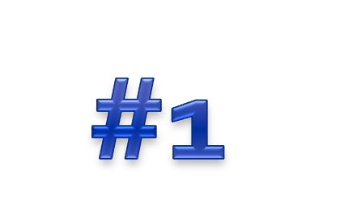
rather than the government are run to
Businesses owned by private individuals
make profits.
The owners will each take a share of the profits.
Owners of a business will aim for a satisfactory level of profits.
Profits are needed to return to the owners… without
profits, they are likely to close the business.

Slide 5
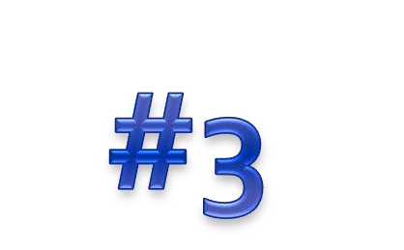
Owners and managers of a business may aim for growth in the size for a number of reasons:
Employees Managers
Owners
Enterprise
Cost advantages from the economies of scale

Slide 6
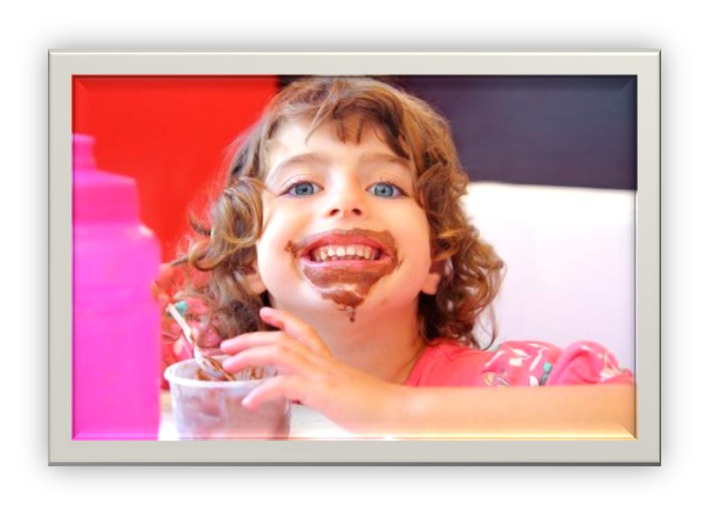
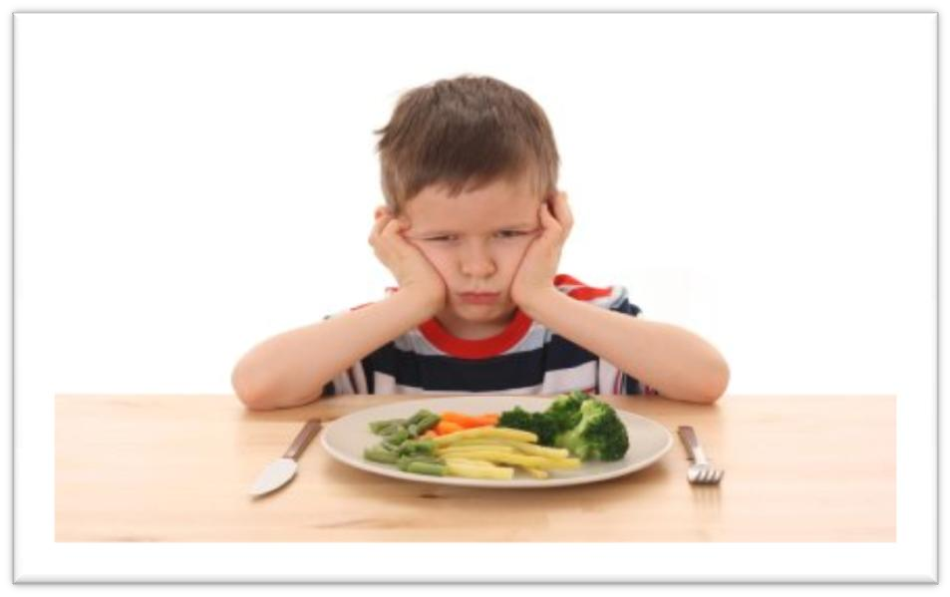
Growth will only be achieved if the business’s consumers are satisfied with the products or services being provided.

Slide 7
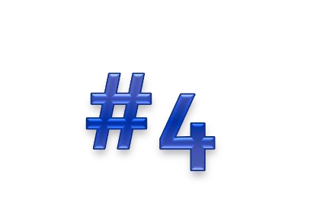
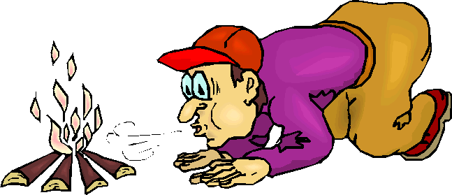
A firm is always trying to survive
Possible threats to the business:
A firm recently launching in the business
Economy is in financial trouble (recession)
New competition in the market

Slide 8
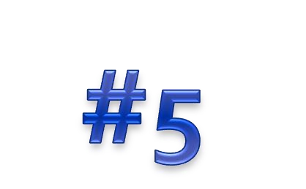
In some countries, important businesses are owned by the government.
The main aim of these businesses is focused
towards providing a service rather than making profit.
For example, water or electricity supply, transportation, educational institutions, public hospitals.

