Slide 1
Shape and Data
Understand left, right, clockwise and anti-clockwise as turns
Objectives
Day 1
Identify left and right; give accurate directions.
Day 2
Recognise clockwise and anticlockwise turns and right angles as quarter turns.
Notes:
Before teaching, be aware that:
On Day 1 instruction for the whole class practical activity is in the notes for Slide 7.
On Day 2 you will need number cards for 3, 6, 9 and 12. Instruction for the whole class practical activity is in the notes for Slide 12.

Slide 2
Shape and Data
Understand left, right, clockwise and anti-clockwise as turns
Starters
Day 1
Left and right (pre-requisite skills)
Day 2
Follow directions (pre-requisite skills)
Notes:
Choose starters that suit your class by dragging and dropping the relevant slide or slides below to the start of the teaching for each day.

Slide 3
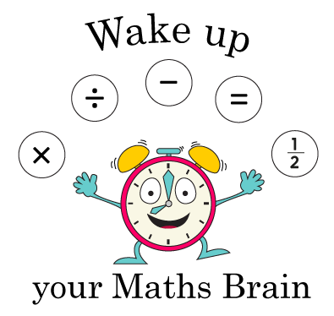
Shape and Data
Understand left, right, clockwise and anti-clockwise as turns
Starter
Left and right
Notes:
Pre-requisite skills – to use this starter, drag this slide to the start of Day 1
Remind children how they can make an ‘L’-shape using their left hands by holding their hand, palm facing away, fingers together, thumbs ‘stuck out’. Remember, L is for left! Play ‘Simon says…’ Wave your left arm. Simon says wave your left arm. Simon says look to the right. Remember that children should look to their right, not yours! Raise your right hand. Simon says touch your left shoulder. Repeat with similar instructions.

Slide 4
Shape and Data
Understand left, right, clockwise and anti-clockwise as turns
Starter
Follow directions
Notes:
Pre-requisite skills – to use this starter, drag this slide to the start of Day 2
Give each pair a copy of the robot’s maze from previous day’s ‘Directional instructions’ practice sheet. Secretly choose a white square on the grid and give children instructions to reach it from the start. They draw the journey the robot takes. Did they all end up in the same place?

Slide 5
Shape and Data
Understand left, right, clockwise and anti-clockwise as turns
Objectives
Day 2
Recognise clockwise and anticlockwise turns and right angles as quarter turns.

Slide 6
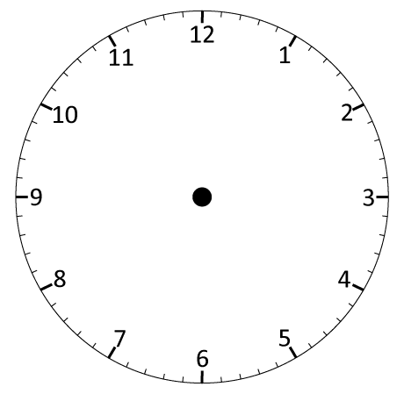
Day 2: Recognise clockwise and anticlockwise turns and right angles as quarter turns.
WATCH THE HAND CAREFULLY!
WATCH THE HAND CAREFULLY!
The hand has moved clockwise from 12 to 3.
How far has it turned? Did it turn anticlockwise or clockwise?
It has made a quarter turn. This is also called a right angle turn.

Slide 7
Day 2: Recognise clockwise and anticlockwise turns and right angles as quarter turns.
WATCH THE HAND CAREFULLY!
WATCH THE HAND CAREFULLY!
The hand has moved clockwise from 12 to 6.
How far has it turned? Did it turn anticlockwise or clockwise?
It has made a half turn.

Slide 8
Day 2: Recognise clockwise and anticlockwise turns and right angles as quarter turns.
WATCH THE HAND CAREFULLY!
WATCH THE HAND CAREFULLY!
The hand has moved anticlockwise from 12 to 9.
How far has it turned? Did it turn anticlockwise or clockwise?
It has made a quarter turn anticlockwise.

Slide 9
Day 2: Recognise clockwise and anticlockwise turns and right angles as quarter turns.
12
Place numbers 12, 3, 6 and 9 on opposite walls to represent the quarter hours.
9
3
Stand and face 12 and follow the instructions…
6
Notes:
Ask children to stand and face the number 12 on the clock.
Ask: Which way will you turn to face the 3? We call this direction clockwise because it is the same direction as the hands move on the clock.
Children turn clockwise to face number 3. Ask: How far have you turned? Discuss, then agree that children have made a quarter of a turn clockwise. Explain that we also call this quarter turn a right angle turn.
Tell children to turn to face 12 again and point out that they are turning anti-clockwise.
Say: Now turn to face the number 6. How far have you turned? Did you turn anticlockwise or clockwise?
Then ask children to turn to face number 3.
Repeat asking children to face 12, 3, 6 or 9, making ¼, ½ and whole turns either anti-clockwise or clockwise.
Then ask children to walk 2 steps forward and then make a quarter turn clockwise. Repeat 2-part instructions for other turns.

Slide 10
Day 2: Recognise clockwise and anticlockwise turns and right angles as quarter turns.
Now we know our turns and directions let’s try some 2-part instructions…
For example, walk 2 steps forward and then make a quarter turn clockwise.
Notes:
Today would be a great day to use a problem-solving investigation – Cover the Camel – as the group activity, which you can find in this unit’s IN-DEPTH INVESTIGATION box on Hamilton’s website.
Alternatively, children can now go on to do differentiated GROUP ACTIVITIES. You can find Hamilton’s group activities in this unit’s TEACHING AND GROUP ACTIVITIES download.
WT: Make and describe whole, half and quarter turns and their directions, using a floor robot or Describe the number and direction of quarter turns on a journey through a maze.
ARE: Count the number of clockwise and anticlockwise ¼ turns in a route through a maze.
GD: Count the number of clockwise and anticlockwise ¼ turns in a route through a maze.

Slide 11
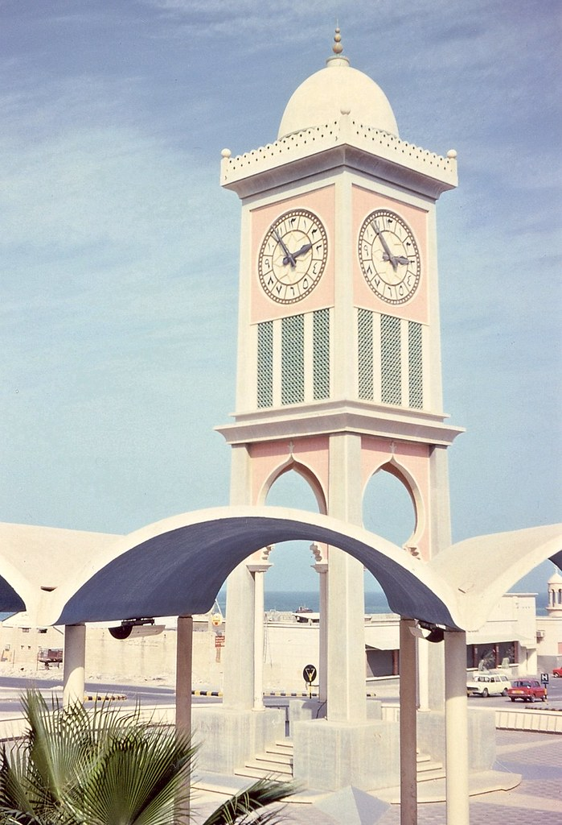
QNID
The 1960s Clock Tower outside the Emiri Diwan palace in central Doha, Qatar. The old tower, dating from the early days of Qatari independence, was one of the city's first landmarks.
Question: Aizah did errands from 12:00 o’clock to 3 o’clock. How did the clock hands of the Clock Tower move?
Answer: They moved clockwise from 12 to 3. They made a quarter turn.
.

Slide 12
Task 1 – Pair/Group Work
· Count how many ¼ turns (clockwise and anticlockwise) are needed to move through the maze.
· Use "right angle" and "¼ turn" to describe the turns.
· Make a new route through the maze and count the turns again.
· If you have time, write directions to help the robot get home.
· Walk through the big block maze and say how many quarter turns (or right-angle turns) you make and in which direction.
· Take turns helping each other move through the maze.
· Use Lego™ to build your own maze with a partner.
· Move a Lego™ person through your maze and count the quarter turns as they go.
Walk through the big block maze and say how many quarter turns (or right-angle turns) you make and in which direction.
· Take turns helping each other move through the maze.
· Use Lego™ to build your own maze with a partner.
· Move a Lego™ person through your maze and count the quarter turns as they go.
Record how many turns are clockwise and how many are anticlockwise.

Slide 13
Task 2 – Independent Work
Challenge
Notes:
The Practice Sheet on this slide is suitable for most children.
Differentiated PRACTICE WORKSHEETS are available on Hamilton’s website in this unit’s PROCEDURAL FLUENCY box.
WT: Mapping turns Sheet 1.
ARE: Mapping turns Sheet 2.
GD: Mapping turns Sheet 2.

Slide 14
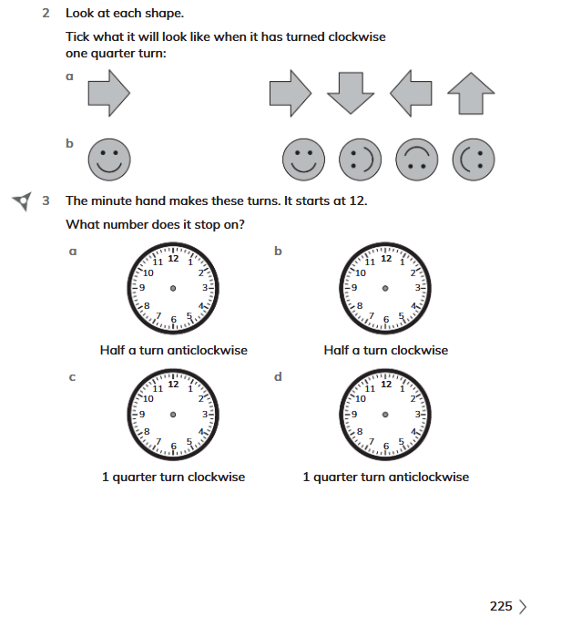
Plenary
Solve Workbook Exercise 15.1 nos. 2-3 on page 225

Slide 15
Homework
Play https://wordwall.net/resource/35885705/clockwise-anticlockwise-turns
Notes:
The Practice Sheet on this slide is suitable for most children.
Differentiated PRACTICE WORKSHEETS are available on Hamilton’s website in this unit’s PROCEDURAL FLUENCY box.
WT: Weight Sheet 1.
ARE/GD: Weight Sheet 2.

